Slide 1
Congo rainforest
By Theo and William

Slide 2
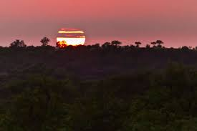
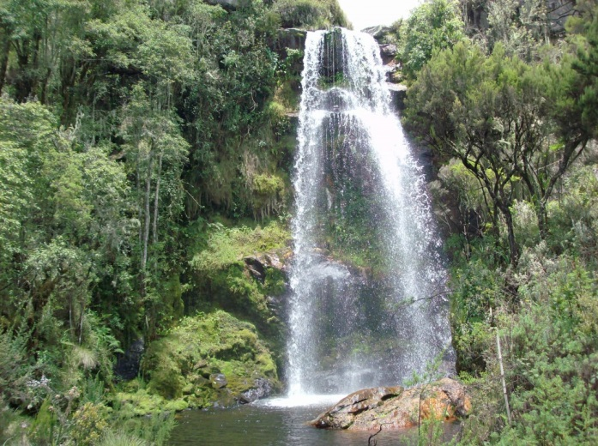
Here are some pictures of the congo rainforest

Slide 3
Plant facts
Only 1 % of the light reaches the ground which means that very few plants survive. The trees grow up to 40 metres forming a dense upper canopy.

Slide 4
ANIMAL FACTS
Endangered wildlife , forest elephants ,chimpanzees ,bonobos and mountain gorillas are all found in the congo basin. There are 400 species of mammals ,1000 species of birds and 100 species of fish.

Slide 6
Wow facts
The Congo is the second largest rainforest next to the Amazon.
The rainforest has an enormous biodiversity significance and is also important for the livelhoods of millions of people.

