Slide 1
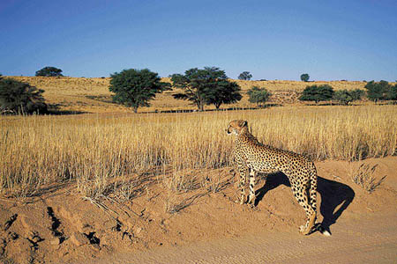
Kalahari DESERT
By lily- Ann and Skye

Slide 2

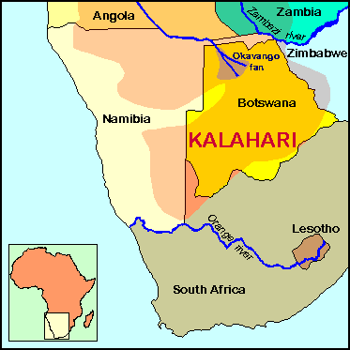
THE FLAG AND MAP

Slide 3
FACTS
The only permanent river that flows through the desert is the Okavango River.
The Kalahari desert is home to many big cats including lions, cheetahs or leopards.
The Kalahari is the southernmost desert in Africa.
It is the 6th biggest desert by area on Earth and the second biggest in Africa after the Sahara.
The Taa language, spoken by less than 5,000 people in the Kalahari desert is the language with the most vowels and consonants.

Slide 4
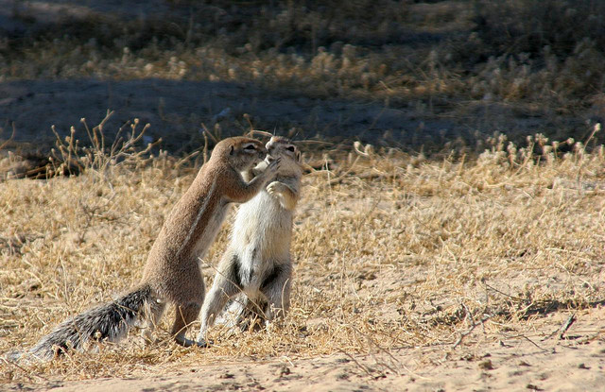
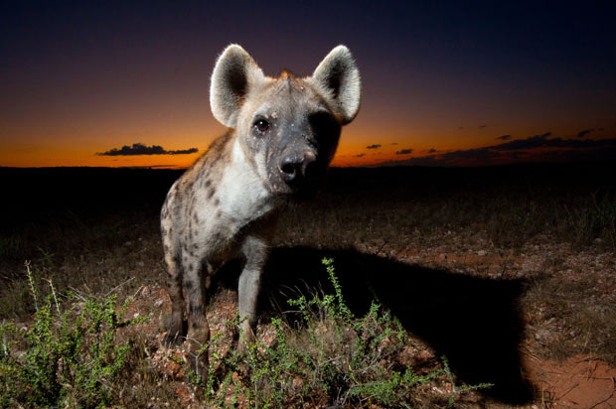
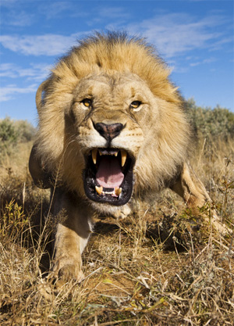
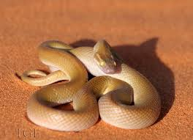
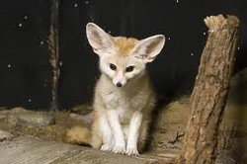
Animals in kalahari desert

Slide 5
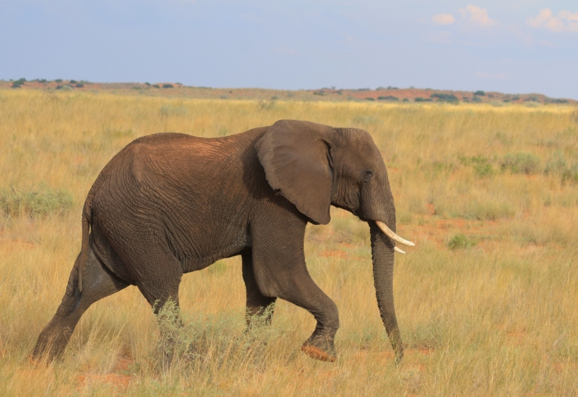
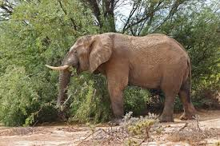
elephants
You would be forgiven for thinking that elephant are perpetually hungry when hearing the rumbling sounds coming from the herd you are watching.

Slide 6
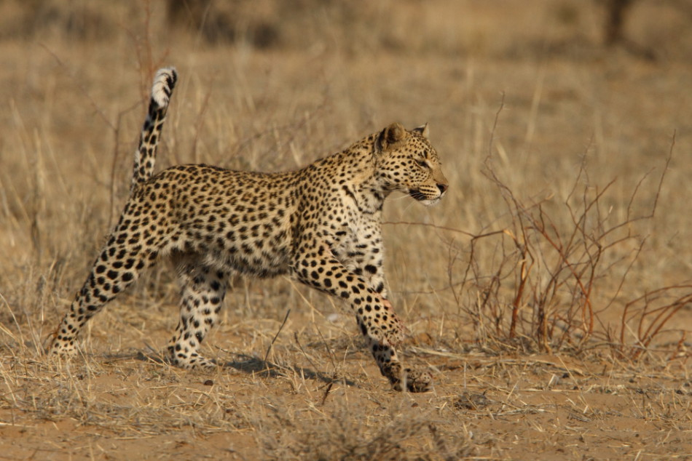
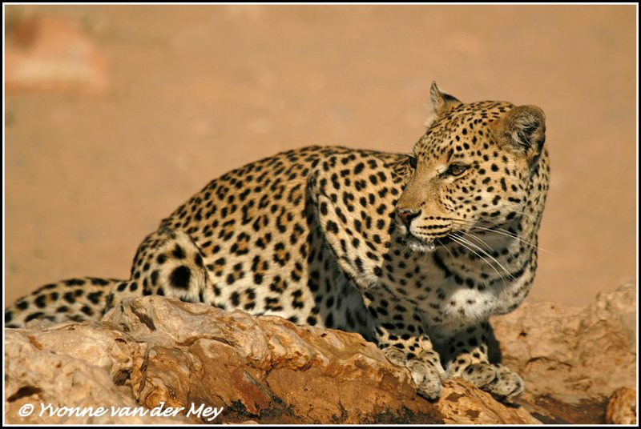
The leopard
Leopards show a great diversity in coat colour and rosettes patterns. In general, the coat colour varies from pale yellow to deep gold or tawny, and is patterned with black rosettes. The head, lower limbs and belly are spotted with solid black. Coat colour and patterning are broadly associated with habitat type. Their rosettes are circular in East Africa but tend to be squarer in southern Africa and larger in Asian populations. Their yellow coat tends to be more pale and cream coloured in desert populations, more gray in colder climates, and of a darker golden hue in rainforest habitats. Overall, the fur under the belly tends to be lighter coloured and of a softer, downy type. Solid black spots in place of open rosettes are generally seen along the face, limbs and underbelly.[4]

Slide 7
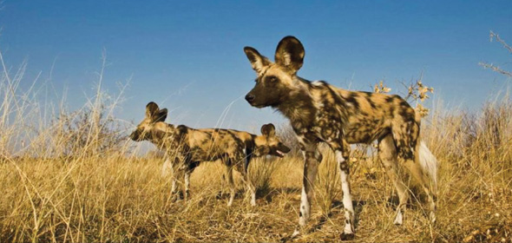
Painted dogs
Wild dogs are opportunistic carnivores
hunting in packs to chase down prey.
Killing of prey is mainly through disembowelment.
Wild dogs feed predominantly upon the most medium sized or large antelope available.

Slide 8
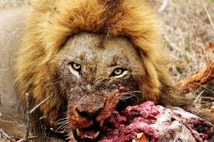
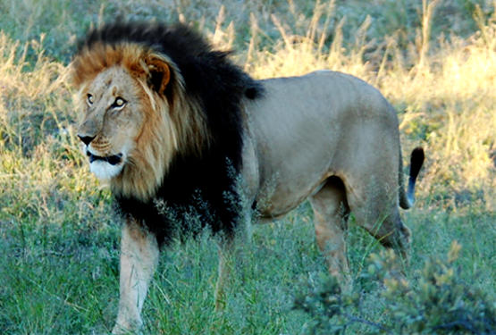
Lions
To survive, these lions can live without water for extended periods. The little moisture they do take in is obtained from the blood of their prey.
To find their prey, they need to travel very long distances in search of food. Hunger will drive them to take some risks when hunting larger prey. They will sometimes use the little energy they do have to settle for smaller prey like mice – prey that other lions will see as a waste of time.

Slide 9
facts
The popular game, Mario Kart features a track named Kalimari Desert. This track was inspired by the Kalahari Desert.
The Kalahari Desert actually has huge areas that are good for grazing and support more animals than are found in a true desert.

Slide 10
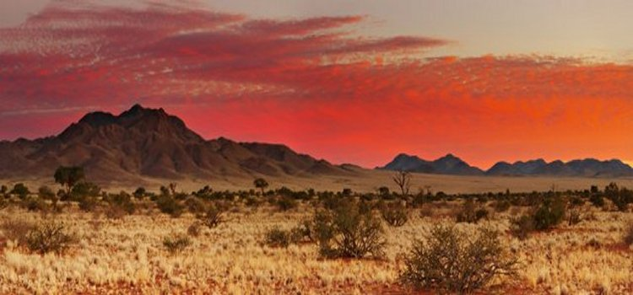
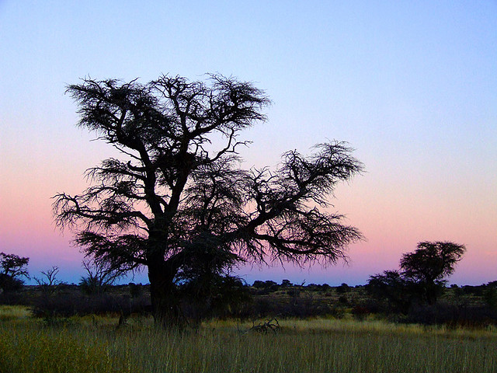
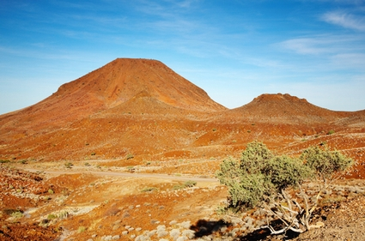
facts
The desert houses many different species involving birds, including the smaller weaver bird. The weaver bird creates huge nests from twigs and grass at the top of poles and trees.
The Kalahari is generally known as a semi-desert or savannah, as it receives some rainfall has more plants and animals than the usual dry desert.

Slide 11
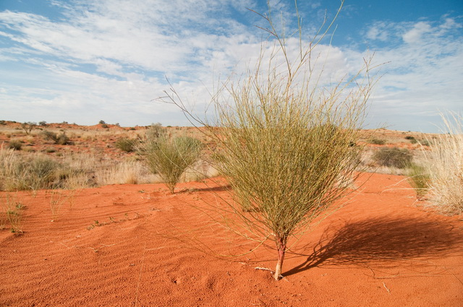
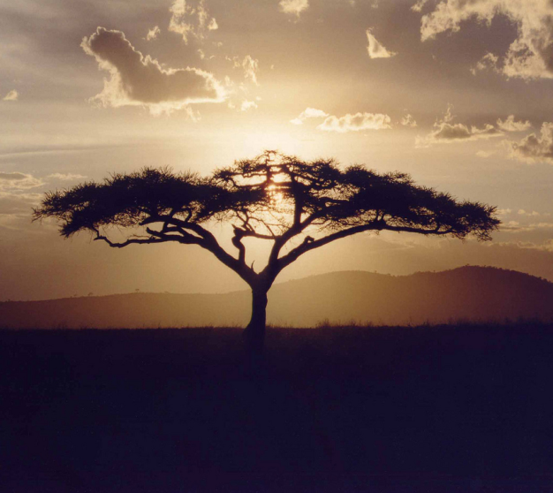
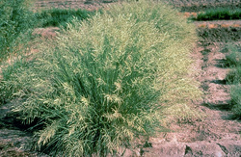
PLANTS AND RIVERS
The vegetation in the arid southern regions consist mostly of grasses including Eragrostis (lovegrass), Aristida, and Stipagrostis, as well as scattered trees and shrubs including Acacia, Colophospermum, Commiphora, and Terminalia.

Slide 12
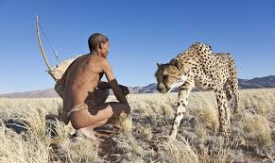
BUSHMEN
The Bushmen are one of the most studied aboriginal people and it has been stipulated that the Bushman is one of our last connections with a hunter gatherer existence some 20,000 years ago before man domesticated animals or grew crops.

