Slide 1
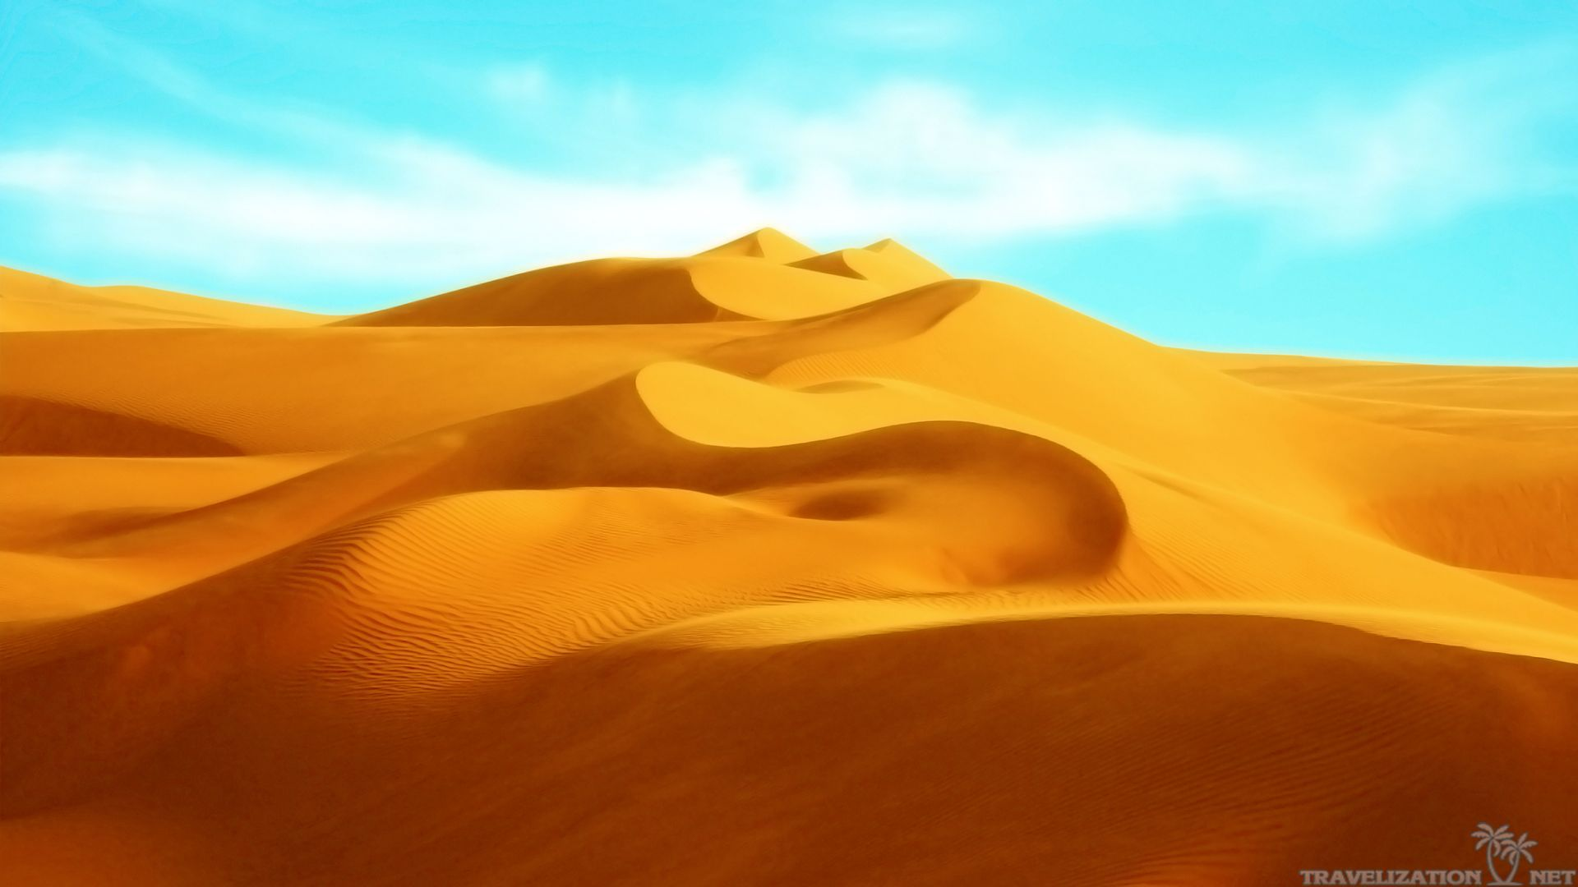
NMNM
Sahara Desert
By Jamie-lee Moss

Slide 2
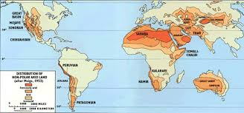
A map to show where the Sahara Desert is in Africa
(it also shows where

