Slide 1
Sahara desert
By Tejay and Maddie

Slide 2
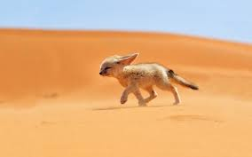
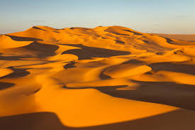
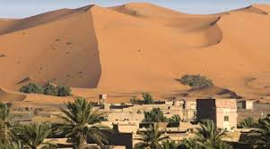
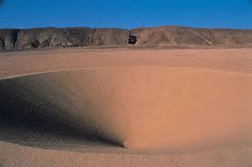
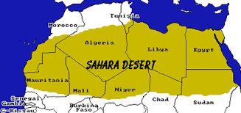
Sahara desert is the hotist desert in the WARLD.

Slide 3
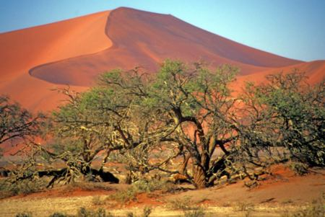
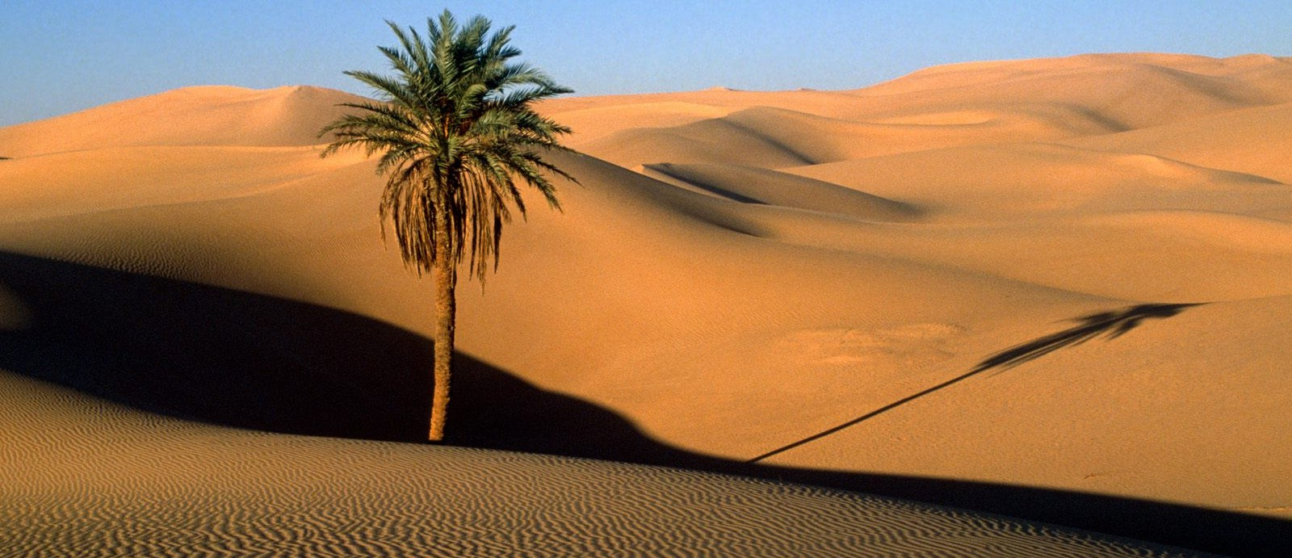
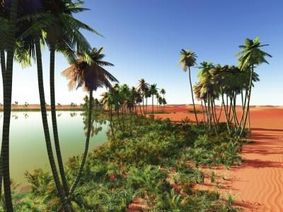
PLANTS
These are some plants

Slide 4
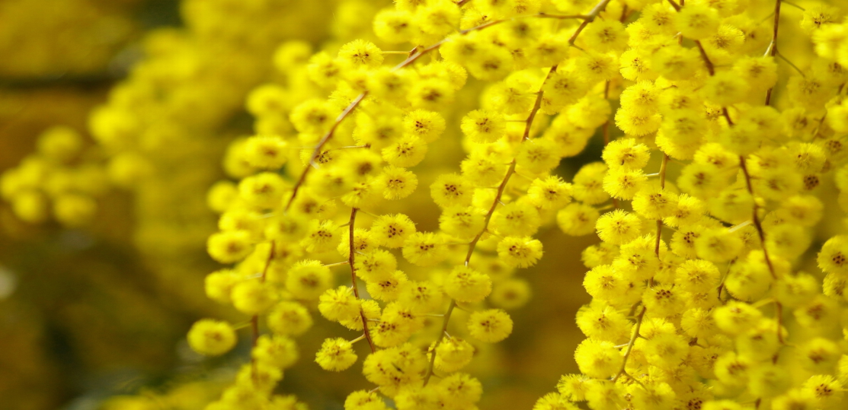
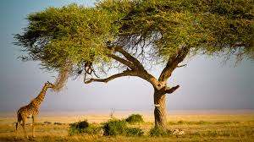
The Sahara has around 500 types of plants
Acacias are shrubs and trees found in warm and tropical regions. If their sharp spines aren't enough to keep the grazers away, their leaves are also loaded with some very nasty compounds.

Slide 5
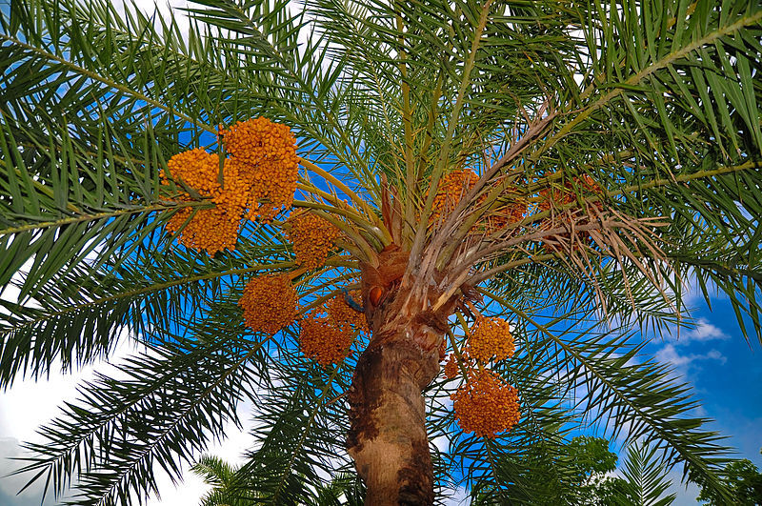

These are some Date plants

Slide 6
WOW FACTS
The date season really begins early in the year when we clean up the trees after the end of the dormant period.

Slide 7
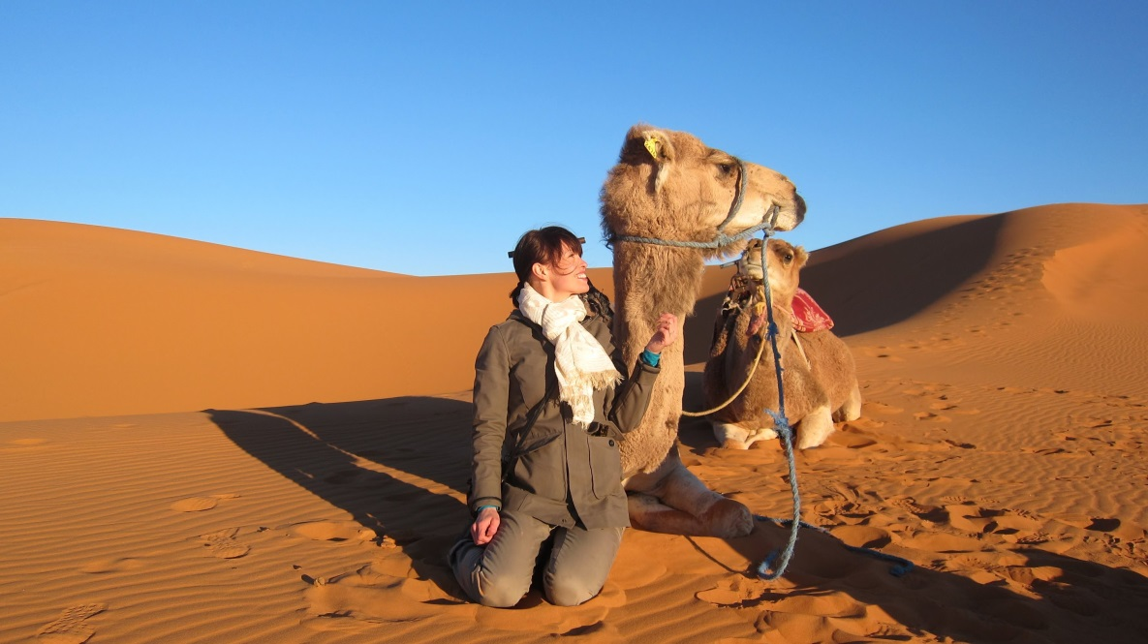
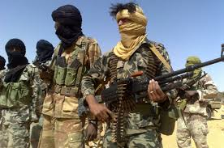
PEOPLE
Some of the people who live in the Sahara raise crops on irrigated land in an oasis. Others tend flocks of goats, sheep, and camels. These herders find grass for the stock along the desert's fringe or where sudden rains have fallen. They live in tents so they can move easily as soon as the grass is eaten in one place.

Slide 8
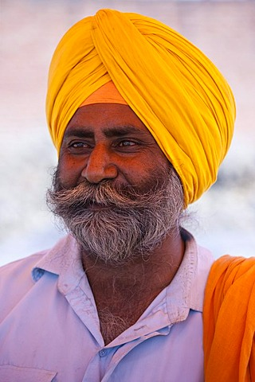
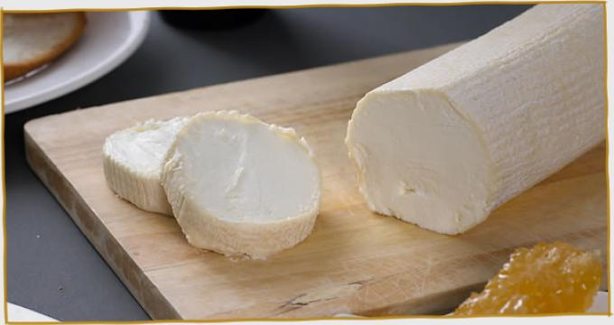
The nomads wear long woolen robes called barracans for protection against the hot sun and stinging sandstorms. They wear turbans wound around the head and neck and sandals to guard their feet on the hot ground. They eat dates from oasis palms and cheese made from the milk of goats and camels. Water is a scarce and precious resource. In the markets of the oasis villages people trade wool, hides, and some of their animals for dates, coffee, and manufactured articles.

