Slide 1
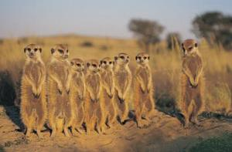
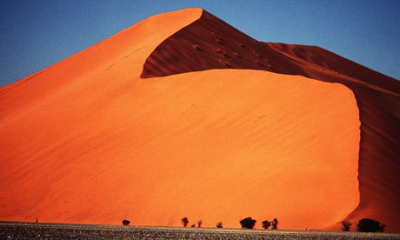
Kalahari desert
By Jass and Em

Slide 2
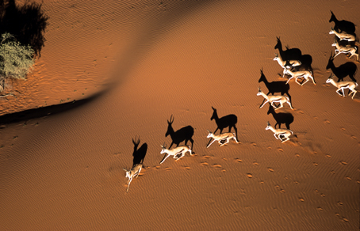
WHAT DOES KALAHARI MEAN?
Derived from the Tswana word Kgala, meaning "the great thirst", or Kgalagadi, meaning "a waterless place.

Slide 3
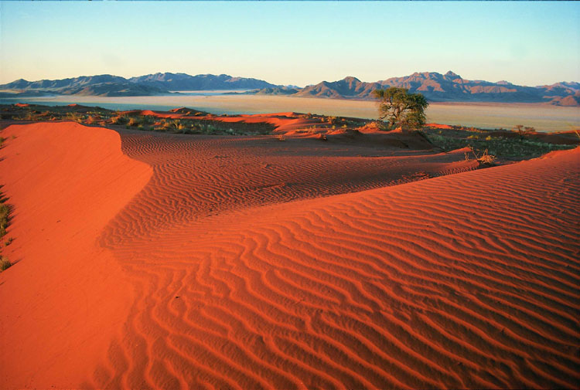
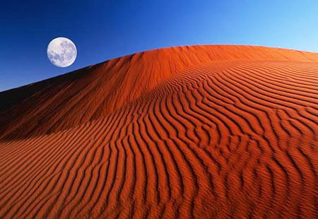
The Kalahari has vast areas covered by red sand without any permanent surface water.

Slide 4
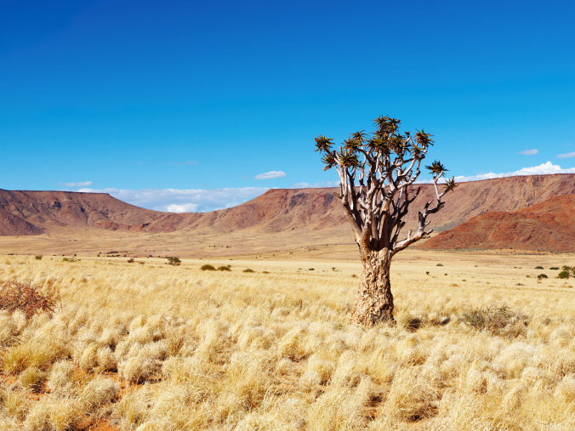
The only permanent river, the Okavango, flows into a delta in the northwest, forming marshes that are rich in wildlife. Ancient dry riverbeds—called omuramba—traverse the central northern reaches of the Kalahari and provide standing pools of water during the rainy season.

Slide 5
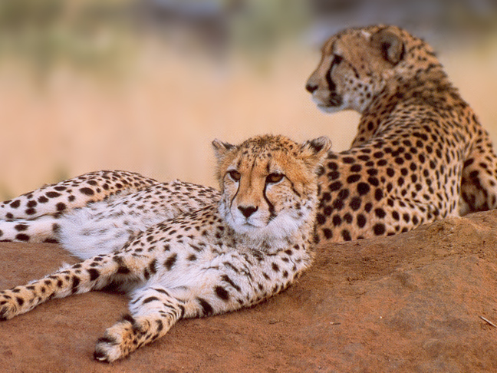
ANIMALS
Here travelers can find a number of Africa’s most famous large mammals, including Kalahari lions -- a subspecies of the African lion, adapted specifically for the challenges of the arid Kalahari -- cheetahs, leopards, hyenas, giraffes, wild dogs, zebras, impalas, baboons, elephants, desert black rhinos and buffalo.

Slide 6
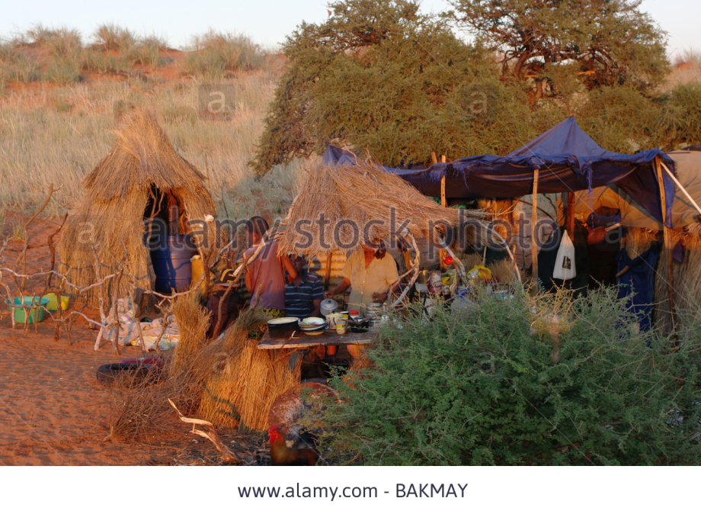
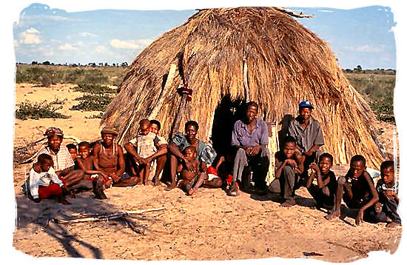
PEOPLE
. Even though survival in the Kalahari desert can be challanging there are several tribes that make it their home.

Slide 7
plants
.over four hundred species of plants have been identified in the Kalahari deserts
.The Kalahari’s sand is better than most deserts.

