Slide 1
Zambezi River and Victoria Falls
BY CHRISTOPHER AND LUKE

Slide 2
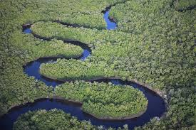
This is the beautiful Zambezi River!

Slide 3
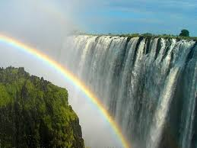
This is the amazing Victoria Falls!

Slide 4
AMAZING FACTS! 1
Victoria Falls is one of the Seven Natural Wonders of the World and the major waterfall on the Zambezi River in Africa. It is famous for being the largest waterfall in the world, in the wet season. The African people who live around the falls call it Mosi-oa-Tunya which means "smoke that thunders". The water makes a roaring noise as it falls over the cliff and down into the Zambezi River below. A cloud of water vapor is always seen around the falls.

Slide 5
AMAZING FACTS! 2
Victoria Falls on the Zambezi River is located on the border between the countries of Zambia and Zimbabwe in the continent of Africa.
The Zambezi River is the largest river in Africa and one of the longest. It flows
1,687 miles across Zambia, Angola, Namibia, Botswana, Zimbabwe and Mozambique until it reaches the Indian Ocean.

Slide 6
AMAZING FACTS!3
550 million litres of water drops 305 feet (93 m) every minute over the cliff at Victoria Falls and continues flowing downstream as the lower Zambezi River.
The width of Victoria Falls in the wet season is a bit over a 1 mile wide (1,609 meters).
The water depth at the base of the falls is 229 feet (70m).

Slide 7
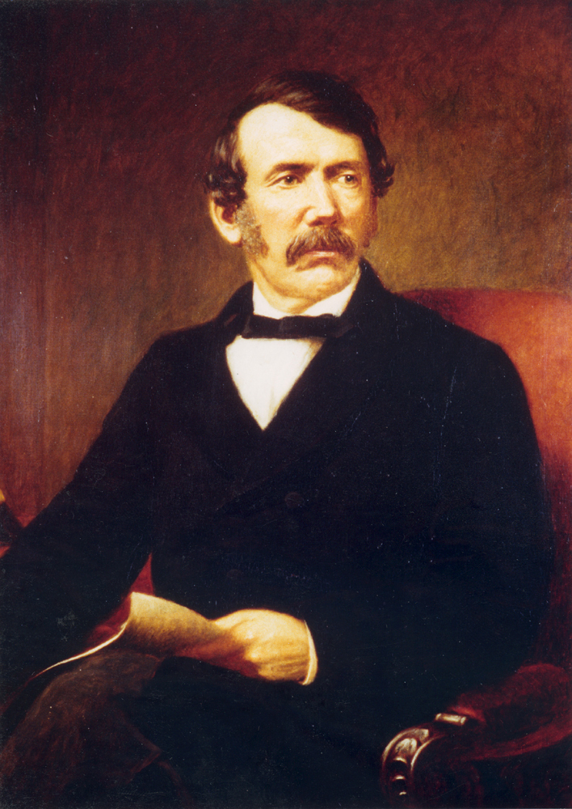
The European explorer, Doctor David Livingstone called the falls after Queen Victoria in England when he visited there in 1855.

Slide 8
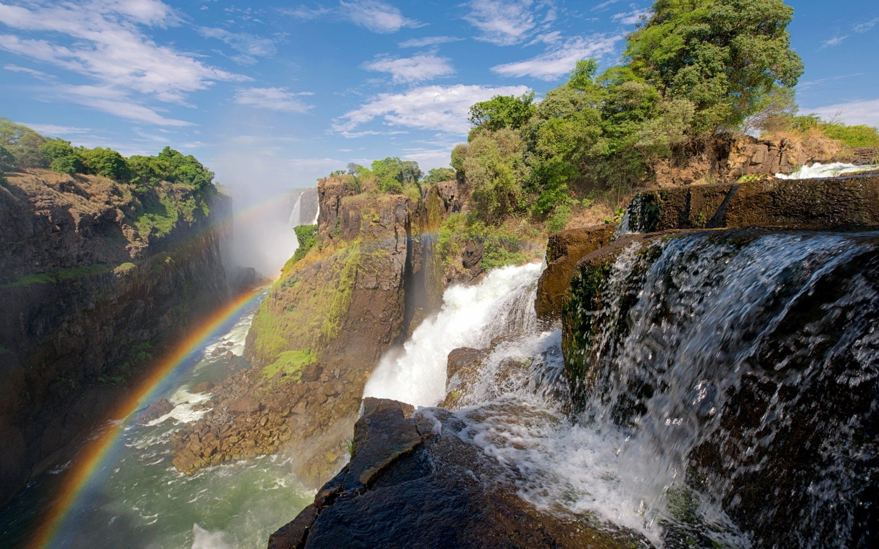
CLIMATE!
The average temperature is 20 degree .
The rain falls in a 4-6 month each year.

Slide 9
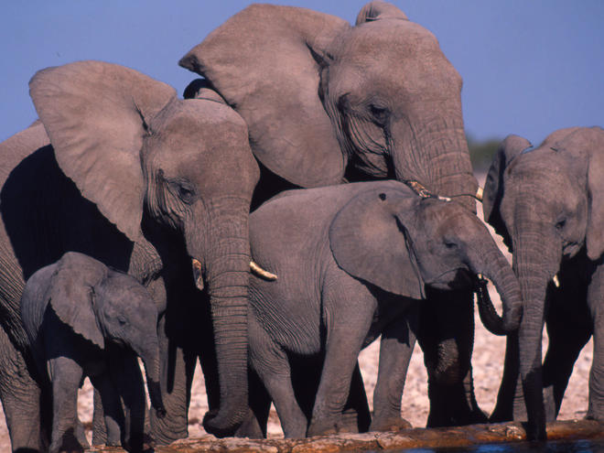
Animals!
The animals that live there are hippos,crocodiles,lizards,herons,pelicans ,egret,African fish eagles,buffalo,zebra,giraffes and elephants.
96 elephants die each day so in 15 years African elephants will be extinct!

Slide 10
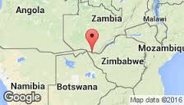
WOW fact!
The Zambezi River is the largest river in the world!550 million litres of water drops every minute from Victoria Falls!

Slide 11
WOW facts continued!
The river is 100m deep!

