Slide 1
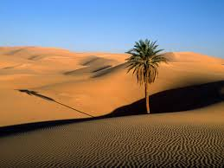
Sahara desert
By Lily and Carly

Slide 2
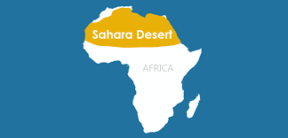
This is to show how much room the Sahara Desert takes up in Africa

Slide 3
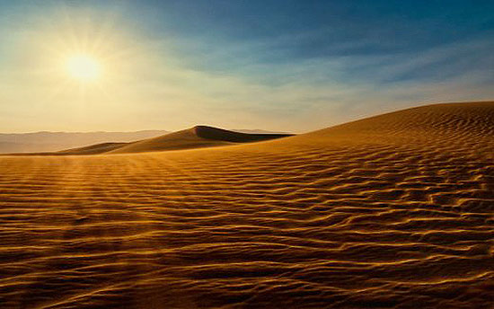
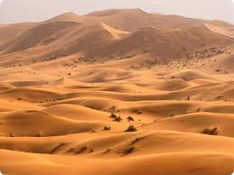
Facts you need to know
The Sahara Desert covers the majority of Northern Africa. It is the third largest desert in the world and also the hottest.
The shifts in climate in the Sahara Desert are due to a 41000 year cycle. During this cycle, the earth changes its tilt between 22 and 24.5 degrees.

Slide 4
Animals

Slide 5
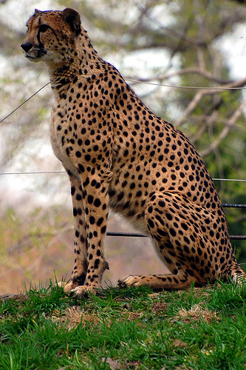
Saharan cheetah
Less than 250 adults survive today ,mostly in Central and Western Sahara , and the Sudanian Savannah . In contrast to other cheetahs this subspecies is a bit smaller , and has very faintly-colored coats .

Slide 6
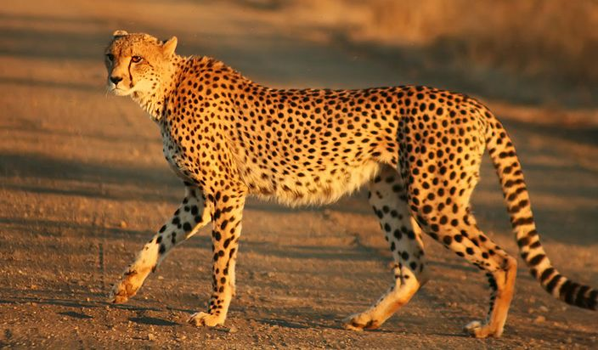
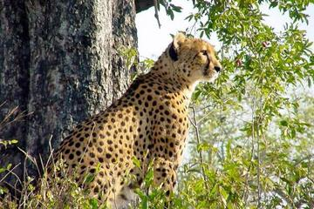
Where do cheetahs live?
Cheetahs are mostly found in sub-Saharan Africa and in eastern and southern African parks. Some of the animals can still be found in southern Algeria, northern Niger and Iran. They like dry, open grasslands where they can pick up speed to kill prey.
Saharan Cheetah facts
Cheetahs are found in grassland and semi-desert regions of eastern, central, and southwestern
Africa with small, isolated
numbers in southwest Asia. In the past they were widespread in Asia and the Middle East.
Historically, cheetahs were once found throughout all of the African and Asian continents from the far reaches of South Africa all the way to India. However, the species is now confined to parts of eastern, central, and southwestern Africa with small isolated populations found in southwestern Asia

Slide 7
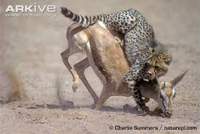
What does a Saharan cheetah eat ?
As a truly carnivorous animal that depends on meat for survival, the cheetah utilizing its speed to hunt various prey that inhabit the open or partially open savannah. In general, the diet of the cheetah consists of gazelles, wildebeest calves, impalas, and smaller hoofed animals in its habitat
Camouflaged against the tall grasses, cheetahs quietly sneak up on their prey until they are confident about the attack, burst out using their tail as a rudder, trip the animal with their paw, and then suffocate it with a bite to the neck. After making the kill, cheetahs must eat quickly or drag the food to a hiding spot before any lions, leopards, or hyenas steal it

Slide 8
Climate

Slide 9
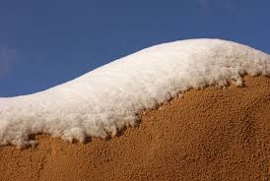
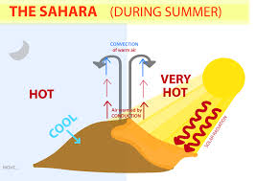
Sometimes no rain falls for years on end , followed by a heavy storm of torrential rain.
The Sahara has one of the harshest climates in the world.

