Slide 1
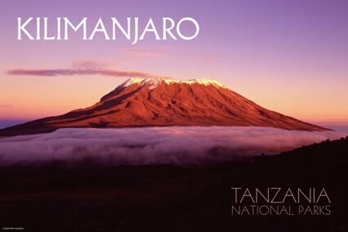
Mount kilimanjaro
Mount Kilimanjaro is the highest mountain in Africa.
By Ed and Joseph

Slide 2
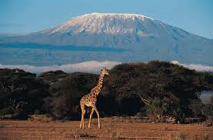
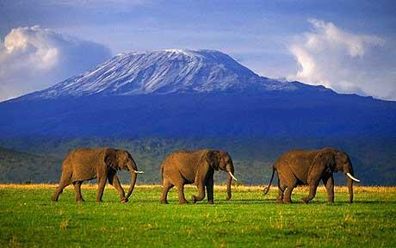
Located in northeastern Tanzania, Mount Kilimanjaro is the highest point in Africa. Though it lies in the tropics, its peak is covered with ice and snow year-round

Slide 3
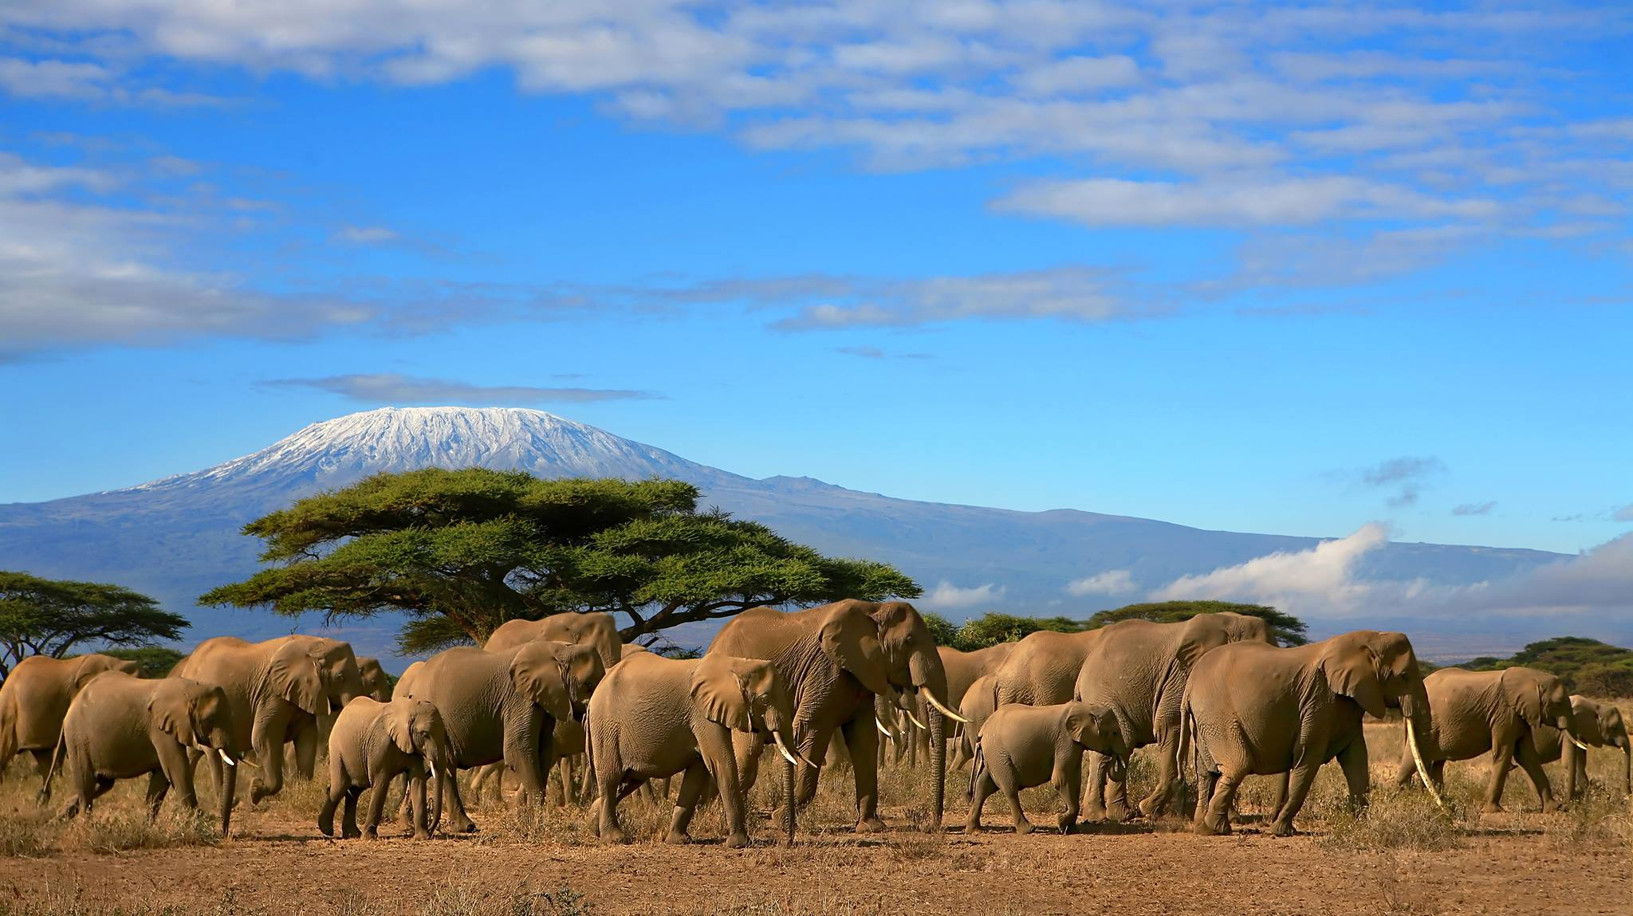
Parts of the lower slopes are densely forested. Elephants, buffalo, monkeys, and oxlike antelope called eland live in the forests.

Slide 4
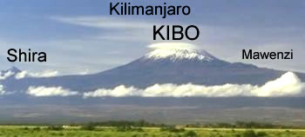
VOLCANOS OF KILIMANJARO
Mount Kilimanjaro is made up of 3 volcanoes called Kibo, Mawenzi and Shira.

Slide 5
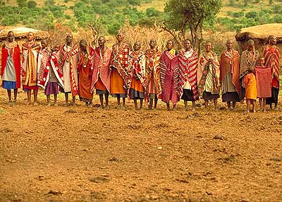
PEOPLE OF KILIMANJARO
People only live on the lower slopes . They grow bananas, millet and coffee and raise cattle. On the southern and eastern slopes the Chaga people have developed an irrigation system.

Slide 6
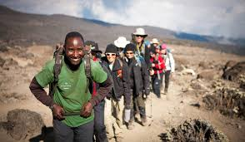

Slide 7
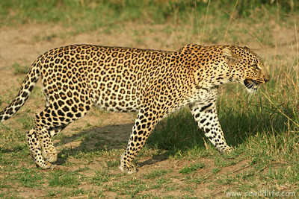
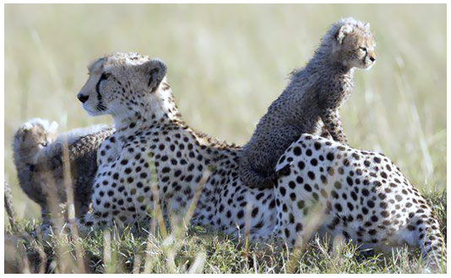
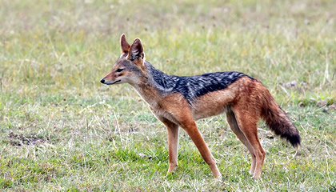
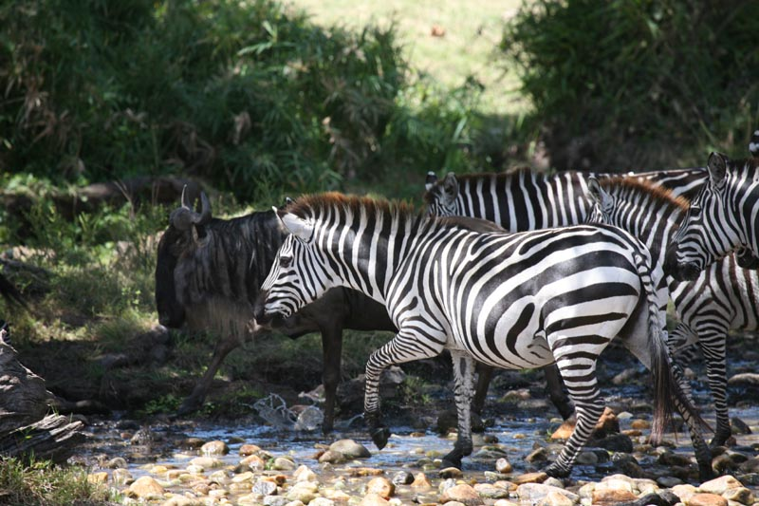
leopard
Zebra

Slide 8
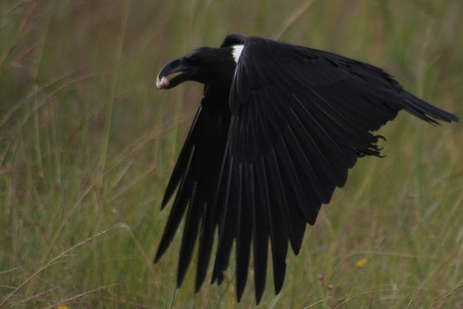
Animal facts
Kilimanjaro is great for birdlife. The cultivated fields on the lower slopes provide plenty of food, the forest zone provides shelter and plenty of nesting sites, while the barren upper slopes are ideal hunting grounds for raptors.

Slide 9
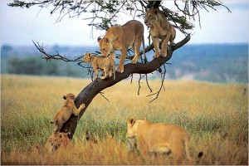
The average male lion weighs around 180 kg (400 lbs), while the average female lion weighs around 130 kg (290 lbs). Lions can reach speeds of up to 81 kmph (50 mph) and leap as far as 11 metres (36 feet) but only in short bursts because of a lack of stamina. The roar of a lion can be heard from approximately 8 kilometers (5.0 miles) away. Average age expectancy is 12 years for a male lion and 15 years for a female.

