Slide 1
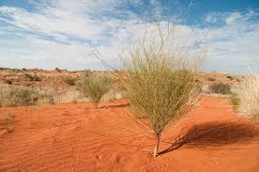
Kalahari desert
BY DANIKA , CHLOE

Slide 2
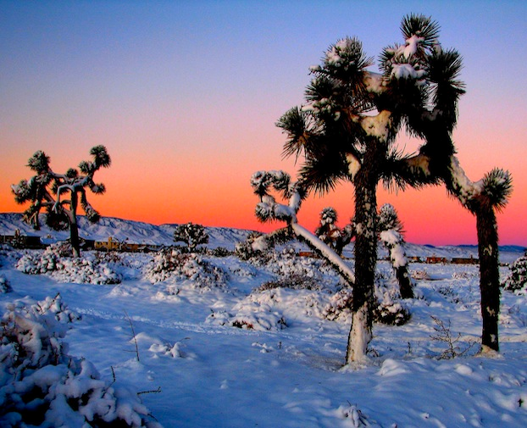
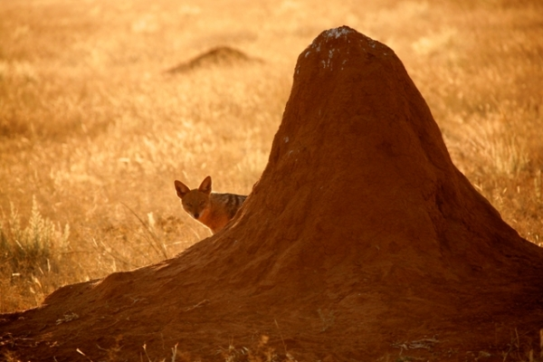
In summer the temperates can reach up to 100
degrees and in winter below freezing .
In winter
In summer

Slide 3
Wow facts
It is the 6th biggest desert by area on Earth and the second biggest in Africa after the Sahara.
Unlike other deserts, the dunes in the Kalahari are not wandering.
Thousands of years ago, the Kalahari Desert was thriving with life and there were many lakes there.
Today, in the place of these lakes, large salt pans remain, as is the case of Makgadikgadi Pan, the remains of the once huge Lake Makgadikgadi.

Slide 4
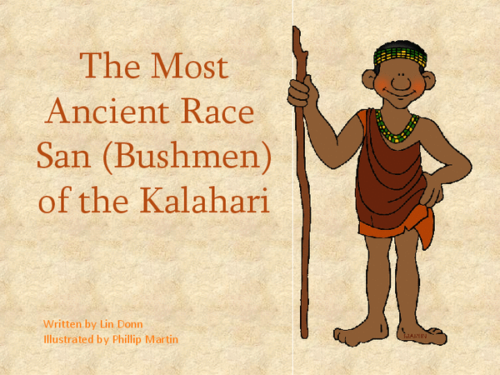
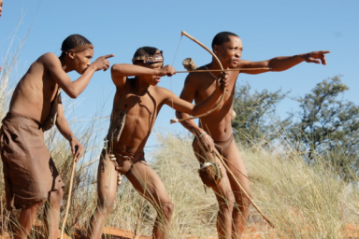
There is a population of Bushmen in the desert. They are mostly hunters-gatherers

Slide 5
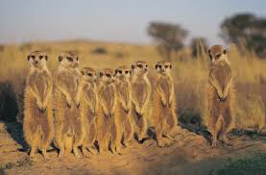
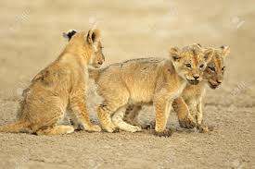
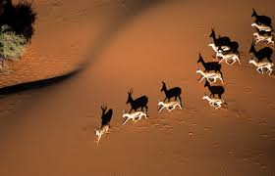
Here are some animals in the kalahari desert.

Slide 6
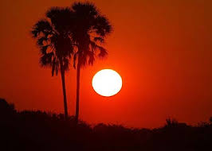
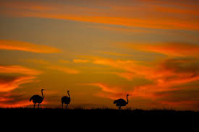

Slide 7
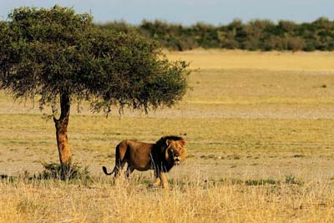
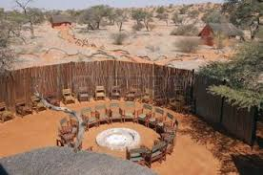
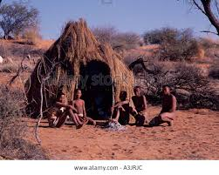
Here are some Tibes .

