Slide 1
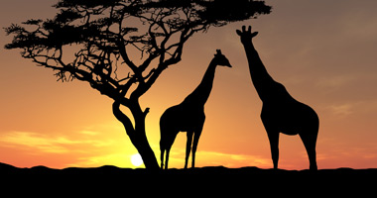
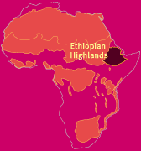
Ethiopian highlands
By Nancy and Philippa

Slide 2
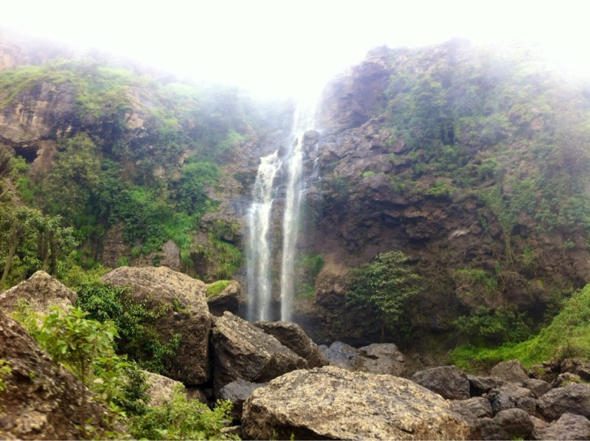
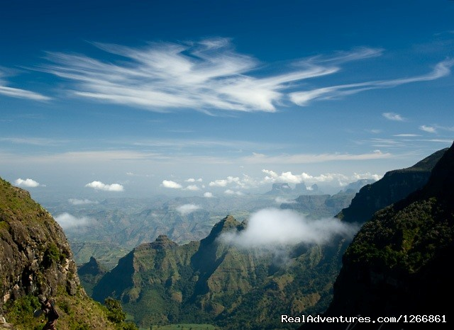
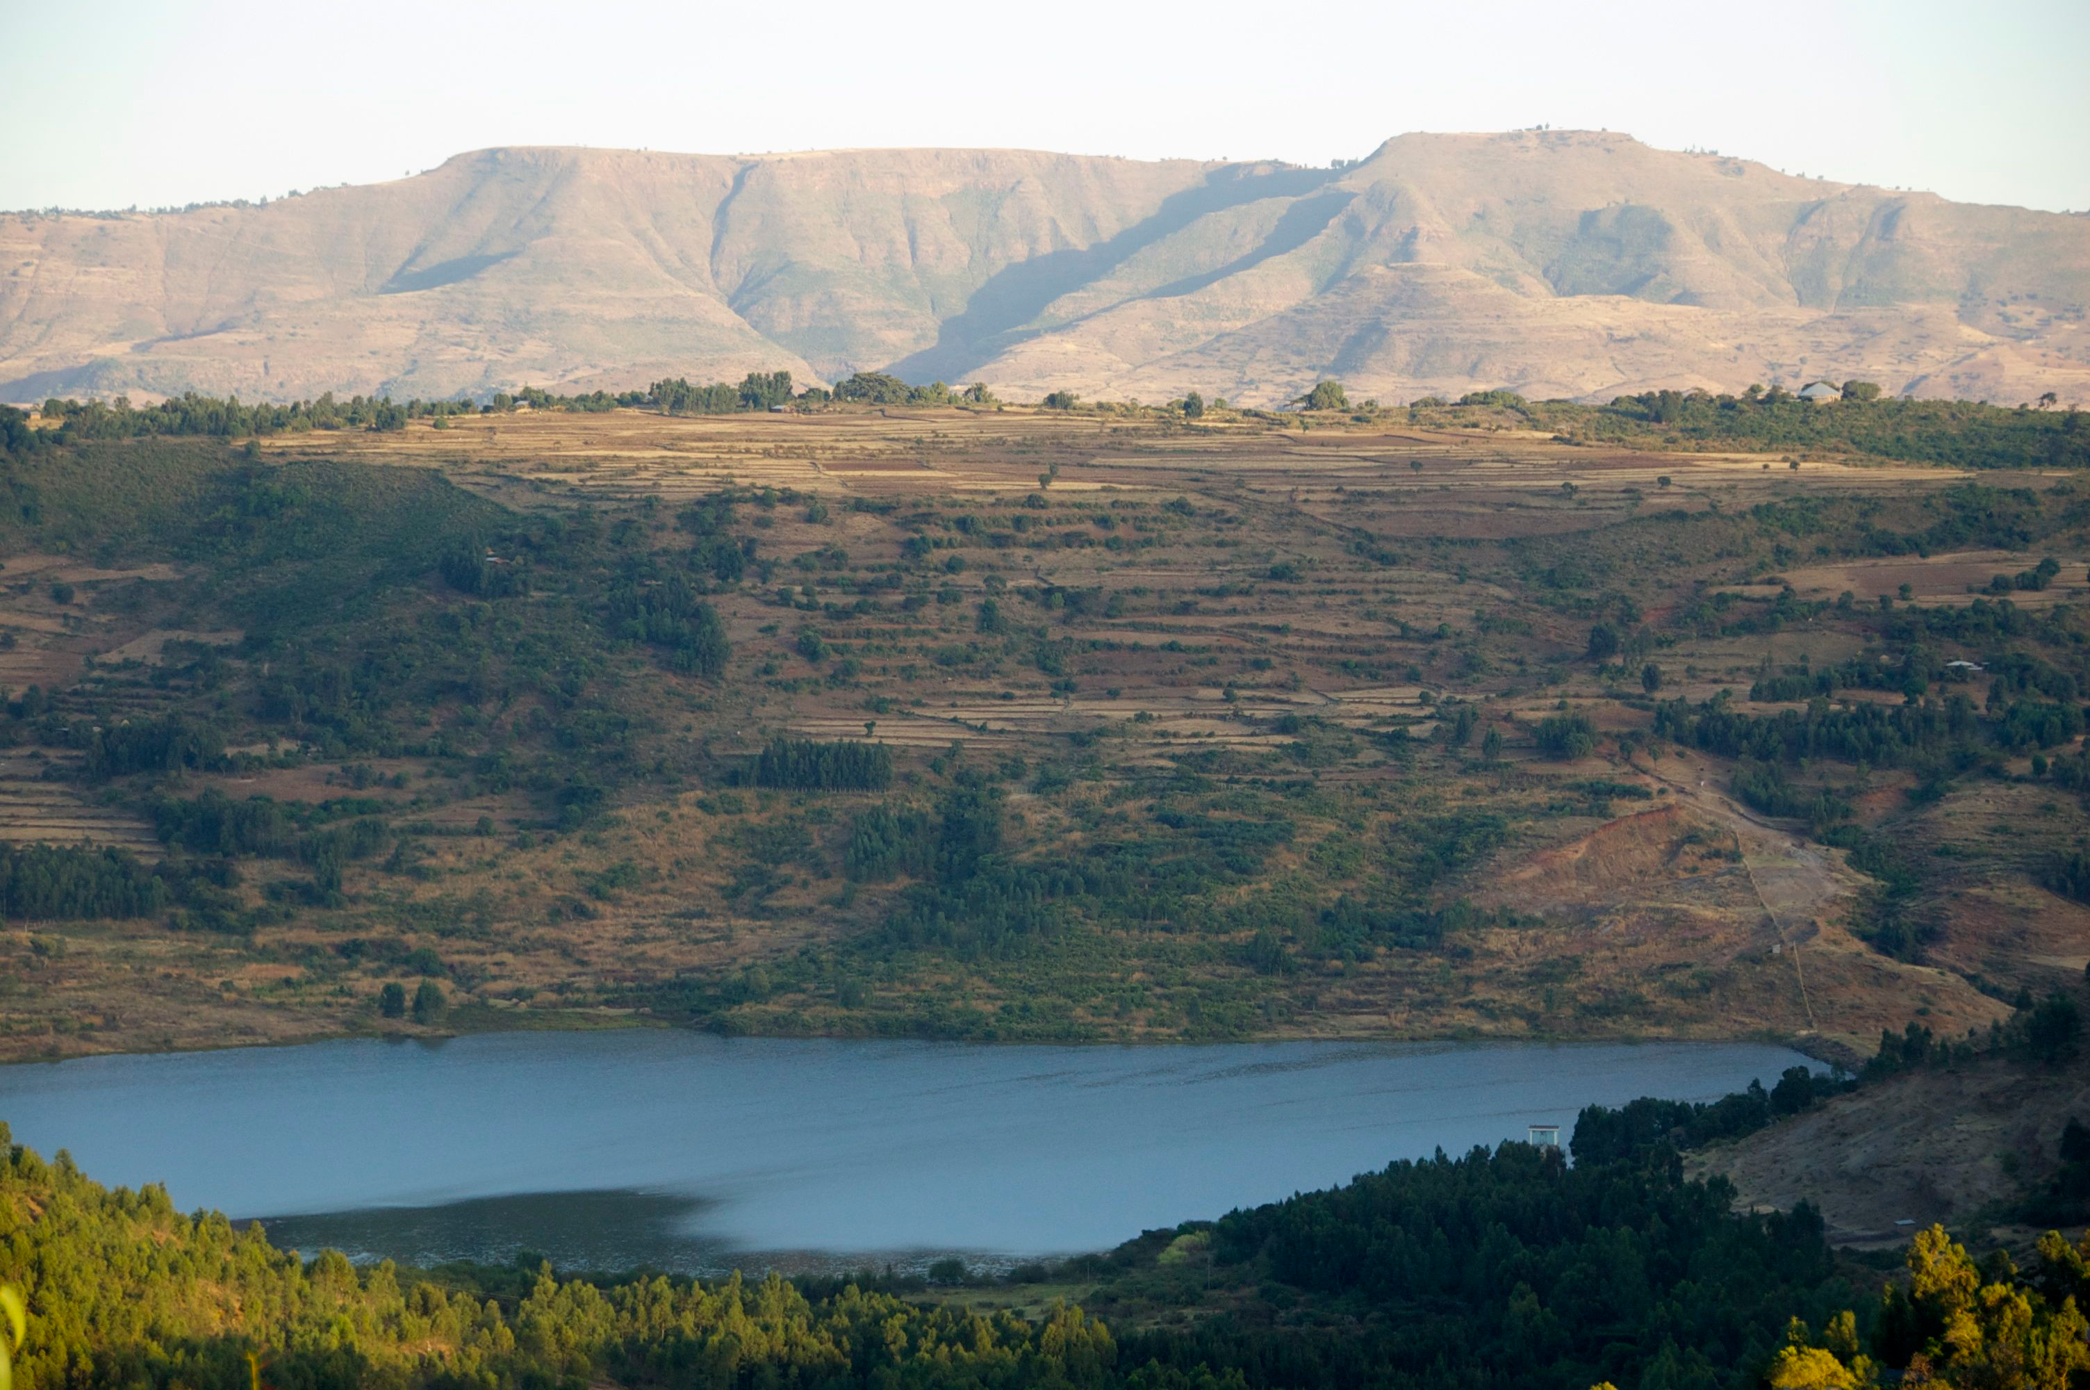

Hailed as the "cradle of humanity," . At its heart lie the Ethiopian Highlands.

Slide 3
Animals

Slide 4
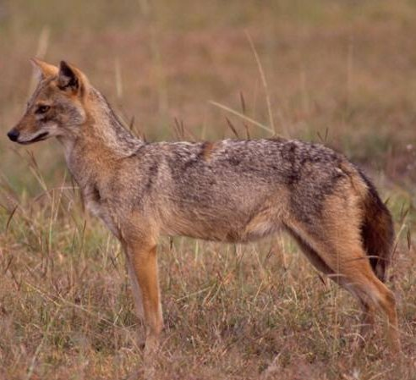
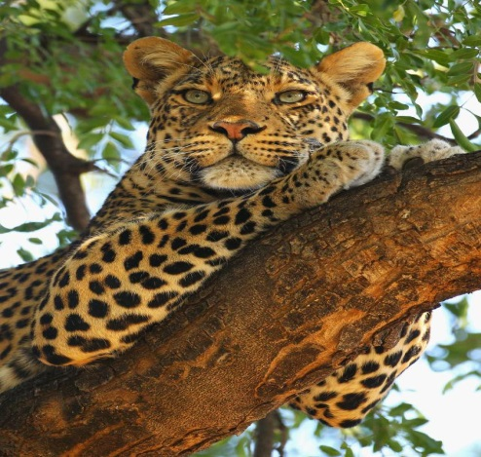
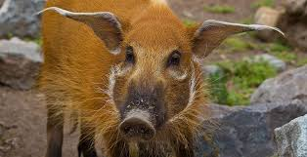
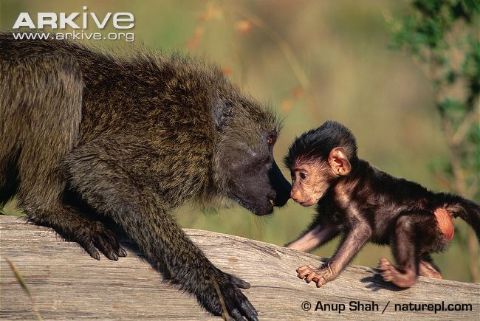
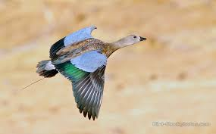
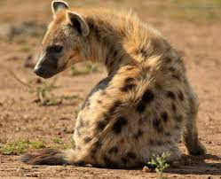
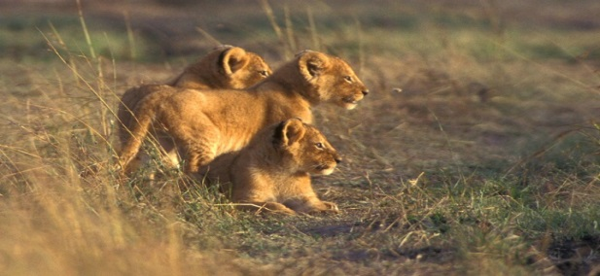
Egyptian wolf
Red river hog
African leopard
Blue winged goose
Olive baboon
Spotted hyena
Masai lion

Slide 5
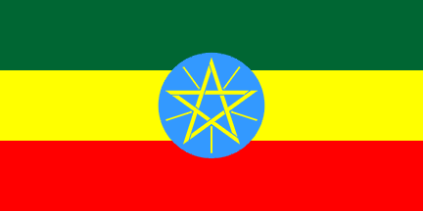
Ethiopia
Ethiopia is land locked
Boarding countries
sudan
Lake tanya is the biggest lake in ethiopia. It is located at the end of the blue nile. Lake tanya is the sorce of the blue nile.
South sudan
kenya
somalia

Slide 6
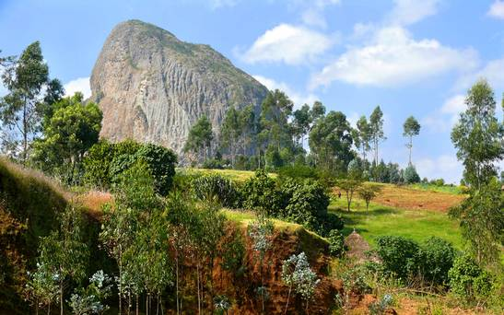
Facts
The ethiopian highlands is a rugged mass of mountains and peaks

Slide 7
More facts!
The highest mountain in the ehiopian highlands is mount abuna yosef
The other mountains are amba algi,mount welel
Formed with the remains of volcanoes in northeastern Africa, these highlands comprise of tall peaks, rich valleys, and hot deserts. This diverse environment houses an impressive array of plant and animal species that are specially adapted to life in a very sunny, relatively dry climate.

Slide 8
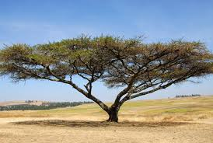
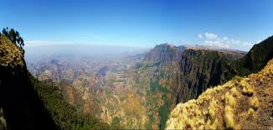
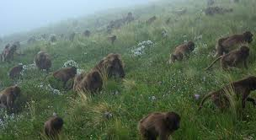
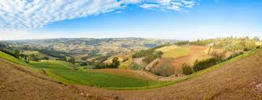
pictures

