Slide 1
ATLAS MOUNTAINS
https://youtu.be/IKoVI0vnAmg

Slide 2
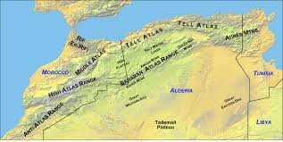
A map to show where the mountain range is.

Slide 3
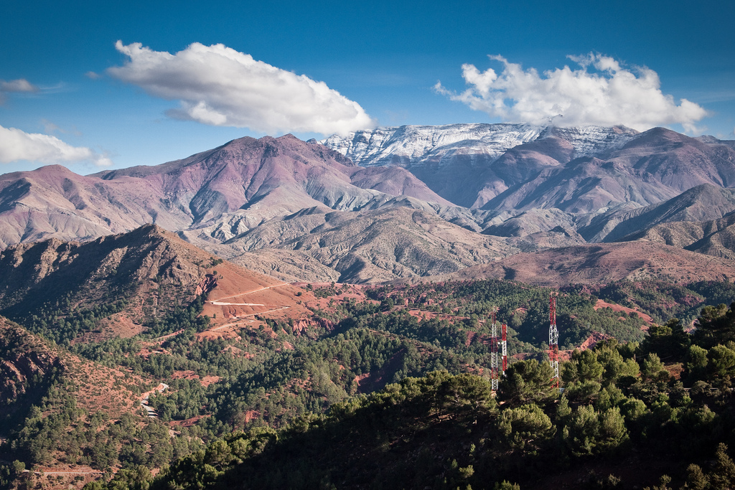
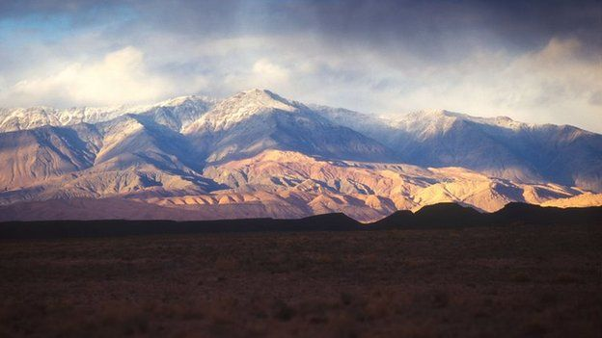

Slide 4
Facts
The mountain range stretches approximately 1,600 miles (2,500 kilometers) across Morocco, Algeria, and Tunisia.

Slide 5
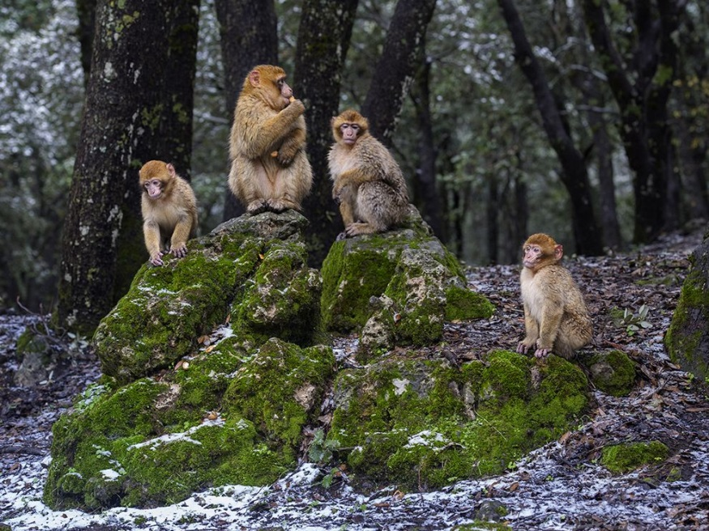
Animals
Animal life in the Atlas Mountains is decreasing. Only a few bands jackals , some monkey tribes , and herds of wild boar remain in the woods.

Slide 6
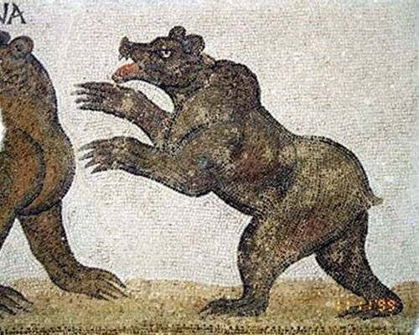
The mountains were home to the Atlas Bear which is now extinct. It was the only bear native to Africa. It was hunted extensively. It is believed the last one was killed or died in the late 1800's.

Slide 7
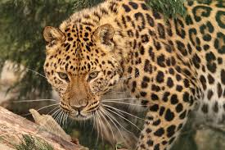
The endangered Barbary leopard lives in the Atlas mountains of Morocco and Algeria.
<

Slide 8
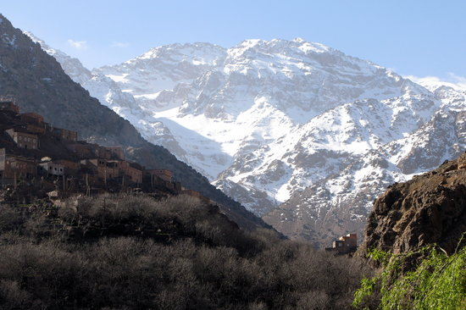
FACTS
The mountain range has several passes that provide routes between the coast and the Sahara desert.

Slide 9
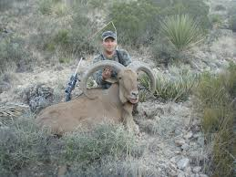
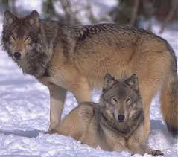
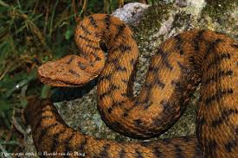
Images of animals from Atlas mountains
ATLAS MOUNTAIN WOLF
ATLAS MOUNTAIN GOAT
ATLAS MOUNTAIN SNAKE

Slide 10
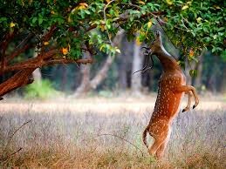
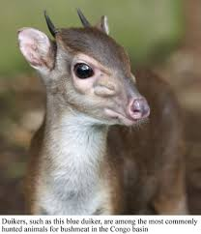
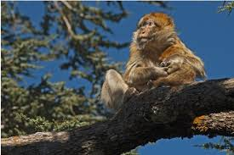
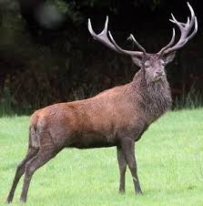
Guess what animals are from the Atlas mountain!
(2)

Slide 11


These are from the Atlas mountain

