Slide 1

Welcome to Year 1

Slide 2
EYFS/KS1
8.50 – 9am | Register
9 - 10am | Maths
10 - 10.15am | Break
10.15 - 10.50am | Phonics, Reading, handwriting
10.50 - 12pm | English
12 - 1pm | Lunch
1-3pm | Foundation Subjects
3pm | Story
3.25pm | Home
Daily Timetable

Slide 3
Weekly Timetable
Year One is supported by Miss
Sadler every morning and most afternoons.
For Autumn 1 PE days are Mondays and Fridays.
Please wear a Highfields PE Kit.
Mrs Walker will be teaching RE and Art on Tuesday afternoons.

Slide 4
Trips and Visits
Autumn 1 | Autumn 2 | Spring 1 | Spring 2 | Summer 1 | Summer 2
17th September RSPCA Workshop | Local walk around the area (FREE) Civic Trip Pantomine (FREE) |  |  | Nantwich Museum Toys (Small Charge)

Slide 5
There will be a variety of homework set in Year 1, largely concentrating on Phonics and Maths.
Homework is set on a Friday and due in on Wednesday.
Children will have a copy of their homework with a brief explanation of the task in their book bags.
Children can bring their completed homework into school or upload a picture onto Tapestry with a brief description on how they found it.
Reading runs alongside homework.
Homework

Slide 6
Phonics is taught daily.
Some children will have phonics interventions during the school day.
3 reads a week with a member of the ‘Year One Reading Team’- Little Wandle book to be sent home after 3 reads.
Reading for pleasure books to be
swapped on a Tuesday and Friday.
Reading at home to be written in reading diaries.
Little Wandle

Slide 7
School staff to decide when a child changes levels. We take many things into account when changing their level.
Little Wandle promotes reading a book more than once to create fluent readers.
Children should be reading the Little Wandle books fluently at home.
Children will have access to Reading for Pleasure books.
Reading for Pleasure books are to be enjoyed at home together.
Reading Books

Slide 8
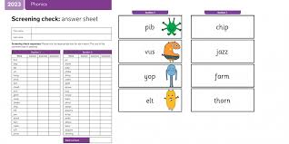
National Testing
Year ones complete the ‘Phonics Screening Check’. This will be in the week commencing the 8th June 2026.
In the check, children read 40 words in total. These words are a mixture of real and ‘alien’ words.
Children are to use their knowledge of phonics to decode and read the words.
A pass mark is set each year and is released after the test period has closed.
During the year, we do LOTS of practises.
The pass mark is usually 32.

Slide 9
Book via School Spider app
Before school care from
7.30am - 8.45am is £6.00.
After school care:
3:30pm -6:00pm is £13.00.
Before and After school care
Kidspace

Slide 10
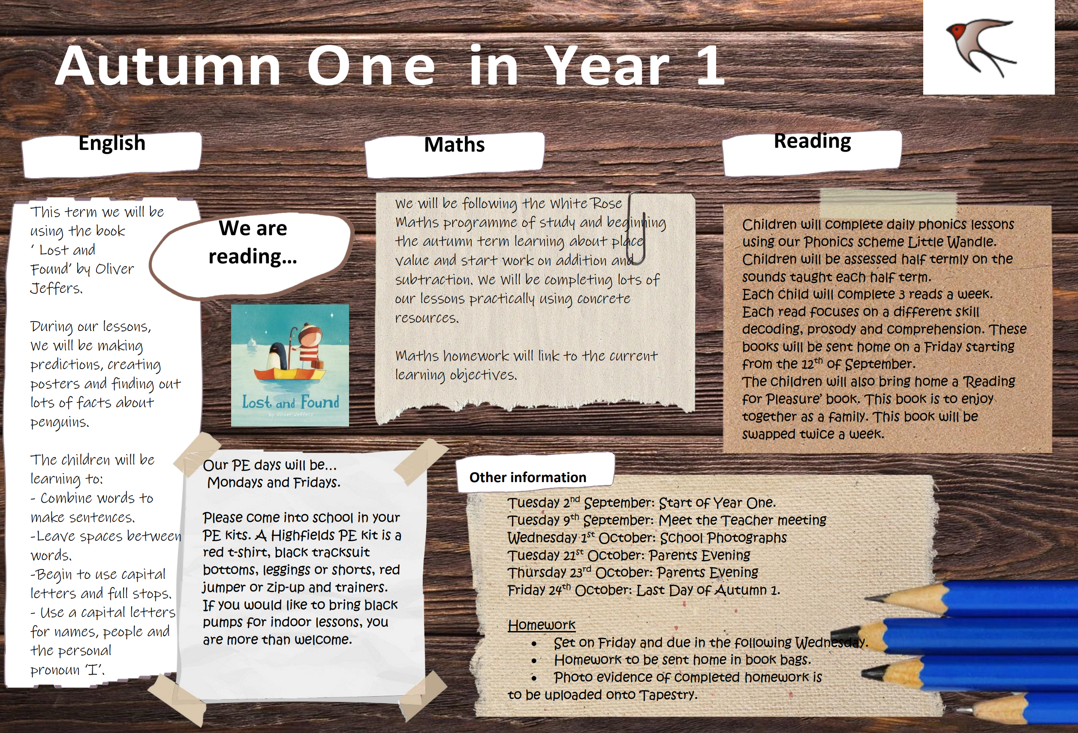
This half term’s learning…

Slide 11
Keeping in touch
​
I am more than happy to answer any questions or queries you may have or if you wish to discuss your child’s progress. To make an appointment please email me or catch me on the door afterschool and we can find a mutually convenient time.​
​
If you need to speak to me privately, I can see parents after school, you just need to call the school office to arrange this beforehand. ​
​
Alternatively, you can catch me once all the children have left at 3:25pm
Communication from myself will be via SchoolSpider.
Please follow us to see what we have been up to!
Twitter: @HighfieldsCPS
Facebook: Highfields Academy

Slide 12

Any questions

