Slide 1


Slide 2
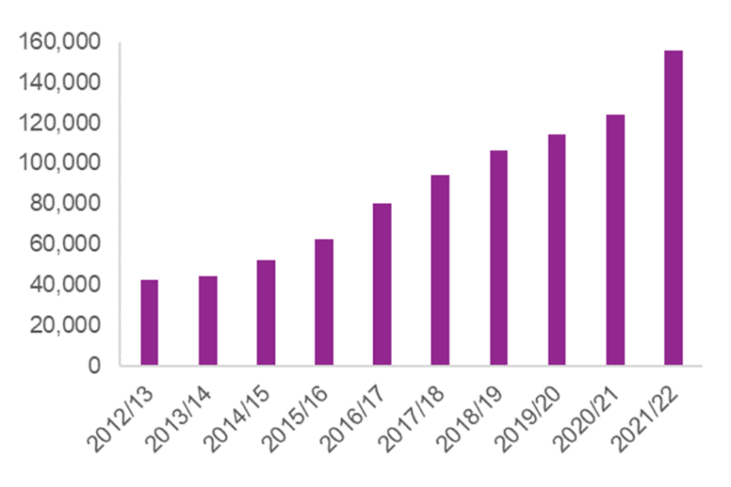
Why are we here?
Hate crime, England and Wales, 2021-2022
In year ending March 2022, there were 155,841 hate crimes recorded by the police in England and Wales, a 26 per cent increase compared with the previous year.
The majority of hate crimes were racially motivated, accounting for 70% of such offences;

Slide 3


Schools: an alternative narrative
“We have to be delivering a curriculum that enables children to understand the benefits that exist in a society where diversity and difference are celebrated. Furthermore we need our children to want to be part of that society, and we have to sell it to them; that desire may not come naturally by itself.”

Slide 4
The Equality Act 2010
Public bodies have to consider all individuals when carrying out their day to day work- in shaping policy, in delivering services and in relation to their own employees.
It also requires that public bodies
Have due regard to the need to eliminate discrimination
Advance equality of opportunity
Foster good relations between different people when carrying our their activities
(Government Equalities Office, 2013, p13)

Slide 5

What’s it like living in the UK today?
What messages are we giving our children about…..
Race
Religion
Sex
Gender reassignment
Age
Disability
Sexual orientation
Pregnancy or maternity
Marriage or civil partnership

Slide 6
KCSIE 2023 (p51)
Children who are lesbian, gay, bi, or trans (LGBT)
203. The fact that a child or a young person may be LGBT is not in itself an inherent risk factor for harm. However, children who are LGBT can be targeted by other children. In some cases, a child who is perceived by other children to be LGBT (whether they are or not) can be just as vulnerable as children who identify as LGBT.
204. Risks can be compounded where children who are LGBT lack a trusted adult with whom they can be open. It is therefore vital that staff endeavour to reduce the additional barriers faced and provide a safe space for them to speak out or share their concerns with members of staff.
205. LGBT inclusion is part of the statutory Relationships Education, Relationship and Sex Education and Health Education curriculum and there is a range of support available to help schools counter homophobic, biphobic and transphobic bullying and abuse.

Slide 7
Ofsted guidance 2023
(evaluating Personal Development)
Para 313
develops pupils to become responsible, respectful and active citizens who are able to play their part and become actively involved in public life as adults
through the curriculum, assemblies, wider opportunities, visits, discussions and literature, develops and deepens pupils’ understanding of the fundamental British values of democracy, individual liberty, the rule of law, and mutual respect and tolerance
promotes equality of opportunity so that all pupils can thrive together, understanding that difference is a positive, not a negative, and that individual characteristics make people unique. This includes, but is not limited to, pupils’ understanding of the protected characteristics and how equality and diversity are promoted
Ensures an inclusive environment that meets the needs of all pupils regardless of age, disability, gender reassignment, race, religion or belief, sex or sexual orientation and where no discrimination exists, fpr example in respect pf wider opportunities for pupils.

Slide 8
Ofsted: Inspecting teaching of the protected characteristics (2022)
Pupils’ understanding of the protected characteristics and how equality and diversity are promoted form part of the evidence that inspectors use to evaluate the school’s personal development of pupils.
All primary and secondary schools, whether state-funded or independent, should be able to demonstrate that no form of discrimination is tolerated and that pupils show respect for those who share the protected characteristics.
Schools will not be able to demonstrate this by pointing to a general policy of encouraging respect for all people.

Slide 9
RSE:
Equality
Para 31. Schools should be alive to issues such as everyday sexism, misogyny, homophobia and gender stereotypes and take positive action to build a culture where these are not tolerated, and any occurrences are identified and tackled. Staff have an important role to play in modelling positive behaviours. School pastoral and behaviour policies should support all pupils.

Slide 10
Ofsted: Parkfield Community School (May 2016)
The provision for pupils’ spiritual, moral, social and cultural development is a key strength of the school. Fundamental British values are actively promoted through the school’s work on ‘No outsiders in our school’, which develops pupils’ understanding of how the Equality Act relates to and affects them. As a result, pupils celebrate diversity and are respectful towards others, including those with different beliefs, sexuality, gender or culture. One pupil spoke for many when she told inspectors, ‘everyone is an insider in our school, there are no outsiders, whatever their beliefs, whatever their colour, gender or sexuality’.

Slide 11
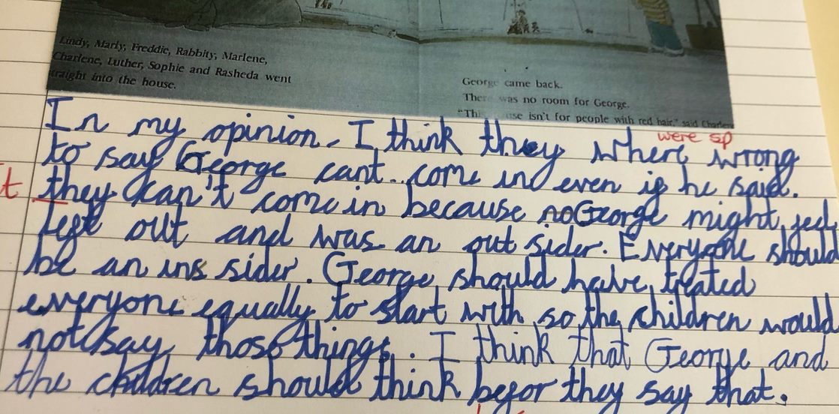
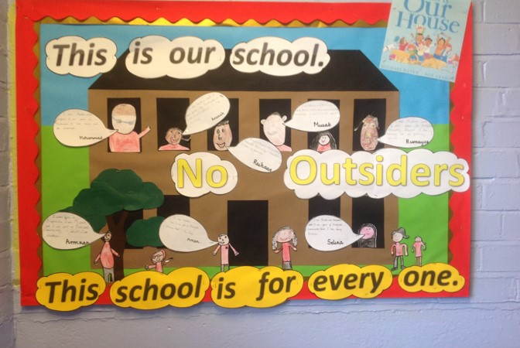
Year 3: what is discrimination?

Slide 12
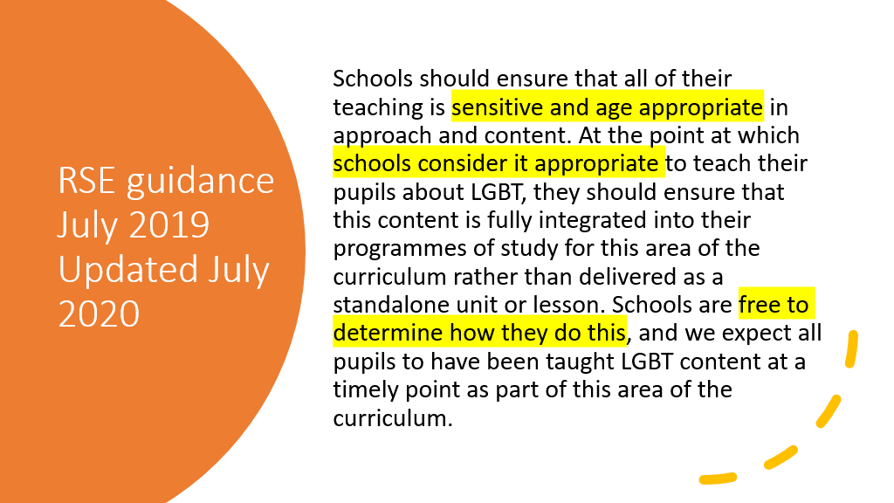

Slide 13
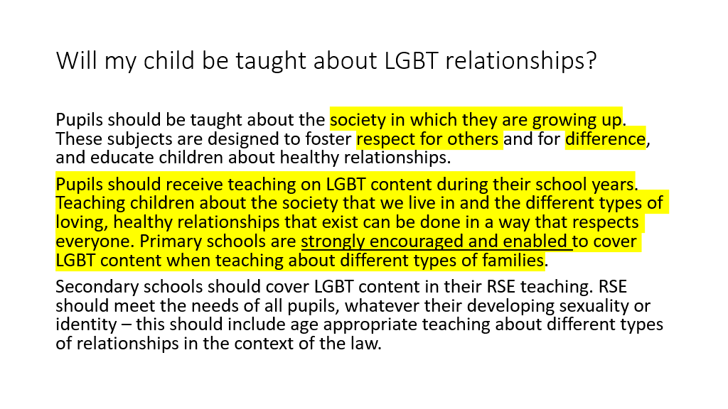

Slide 14
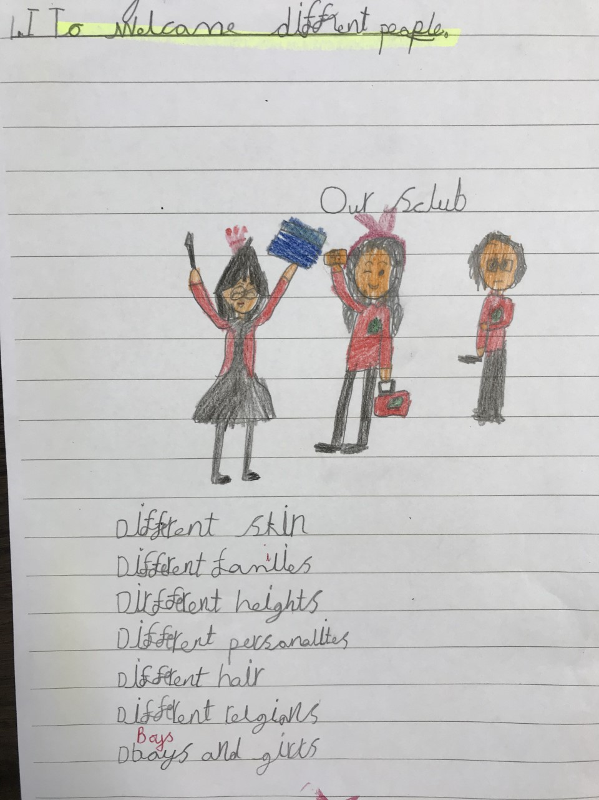


Slide 15
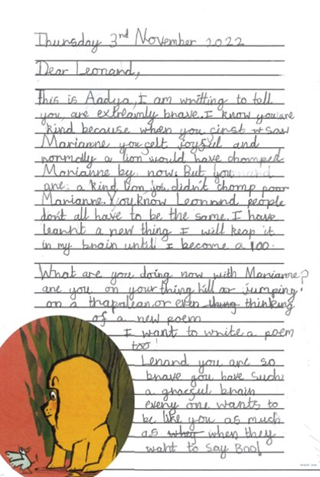

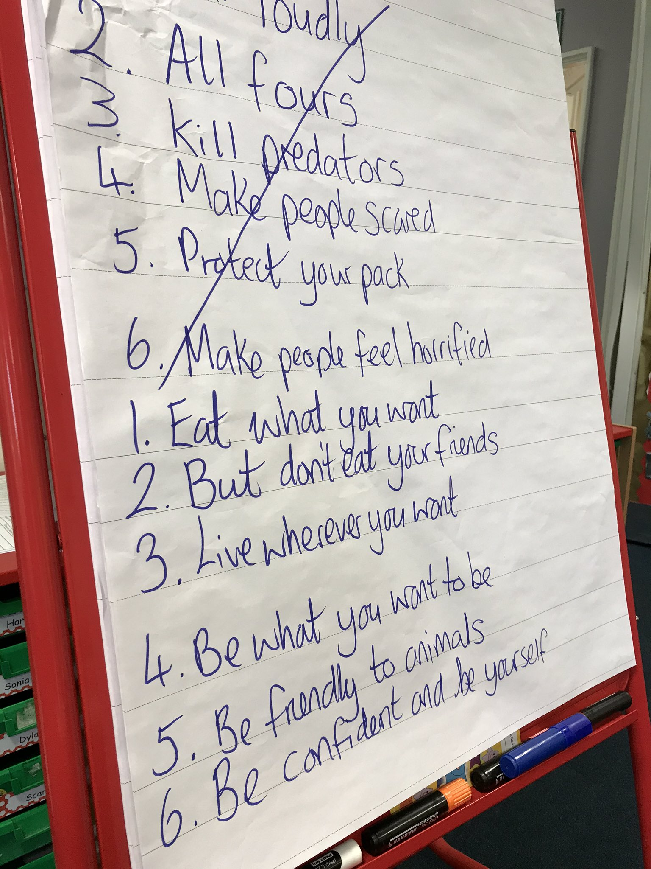

Slide 16
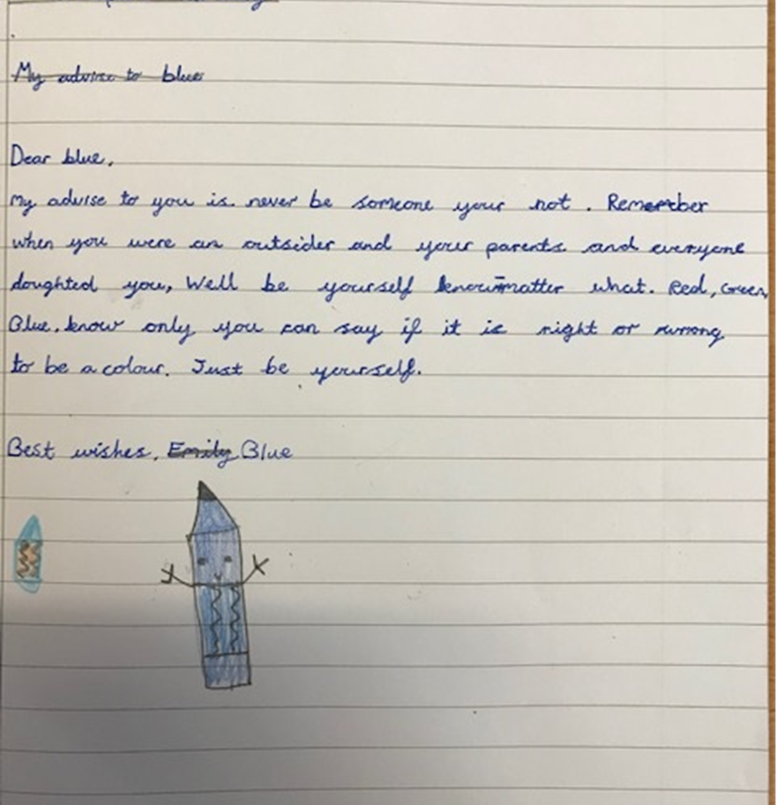


Slide 17
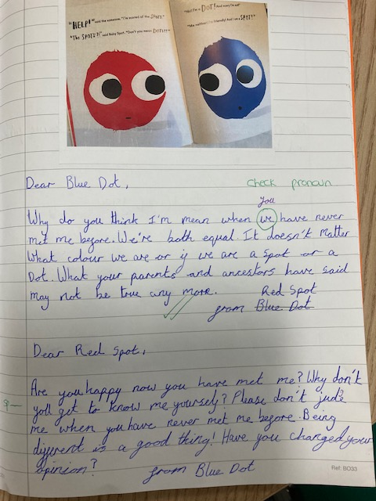


Slide 18

Year 5: not everyone agrees, what do you think?

Slide 19
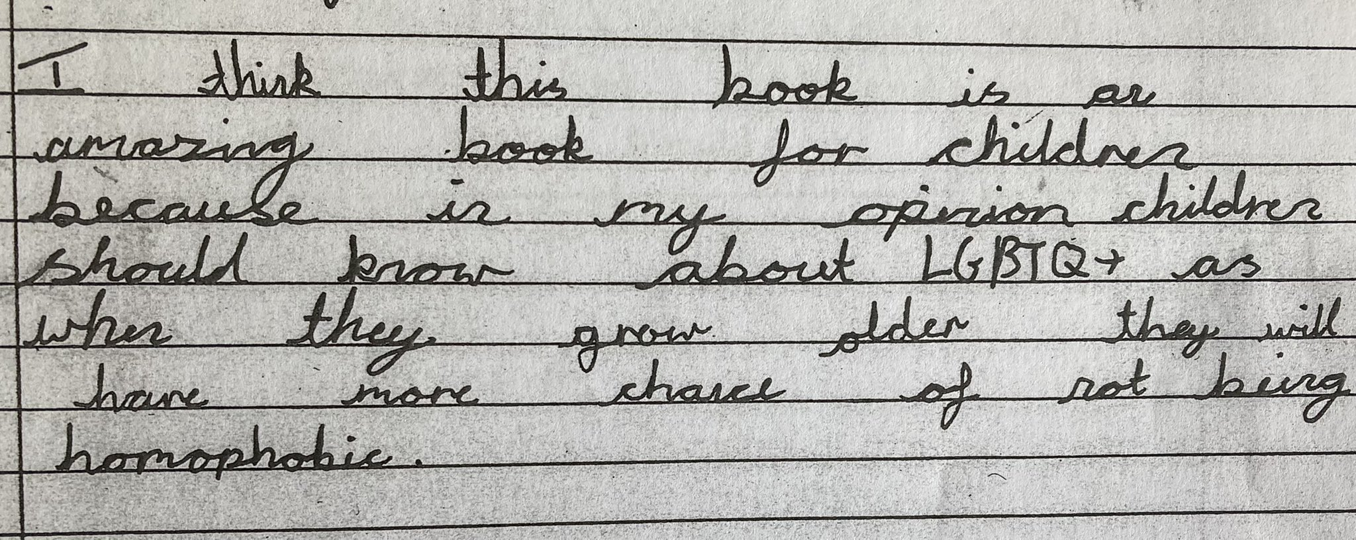
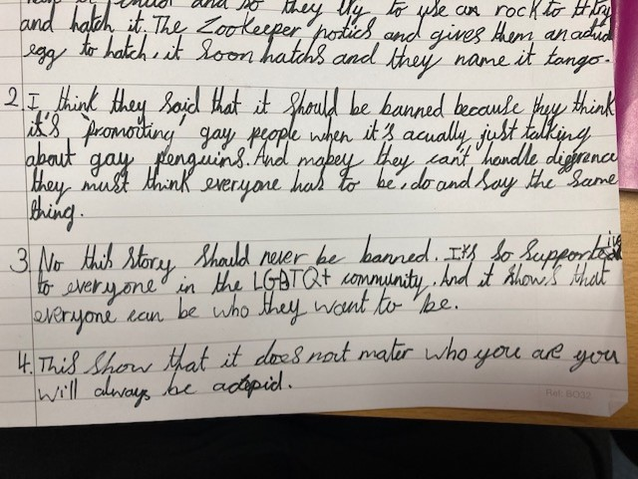
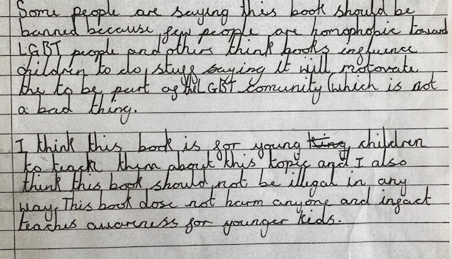
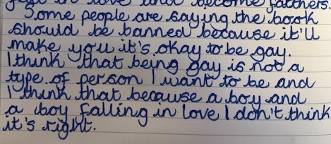

Slide 20
Ofsted: Inspecting teaching of the protected characteristics (2022)
Faith teachings on protected characteristics
Schools are at liberty to teach the tenets of any faith on the protected
characteristics. For example, they may explain that same-sex relationships and
gender reassignment are not permitted by a particular religion.
However, if they do so, they must also explain the legal rights LGBT people have under UK law,
and that this and LGBT people must be respected.

Slide 21
Trans: the current debate in schools
Teachers warn new gender guidance for English schools could put children at risk
The Observer, April 23 2023
Teachers in England are warning that young people could be put at risk of harm and homelessness if the government presses ahead with new guidance compelling schools to inform parents if their child is questioning their gender.
Children must not be allowed to switch identities in schools without telling their parents, Rishi Sunak says
Daily Mail, June 19th 2023
The Prime Minister told teachers that letting boys identify as girls was 'not a neutral act' and could have a 'significant impact' on children.
He also said school staff must alert parents if their children want to be referred to by different pronouns.
It was reported last night that the guidance will finally be published this week, banning schools from letting pupils 'socially transition' by changing their names, pronouns or uniform if their parents do not consent.

Slide 22

