Slide 1
Keeping Ourselves Safe Week
#Oakfieldfamily2022!

Slide 2

Mobile phone safety
https://www.childline.org.uk/info-advice/bullying-abuse-safety/online-mobile-safety/mobile-phone-safety/

Slide 3
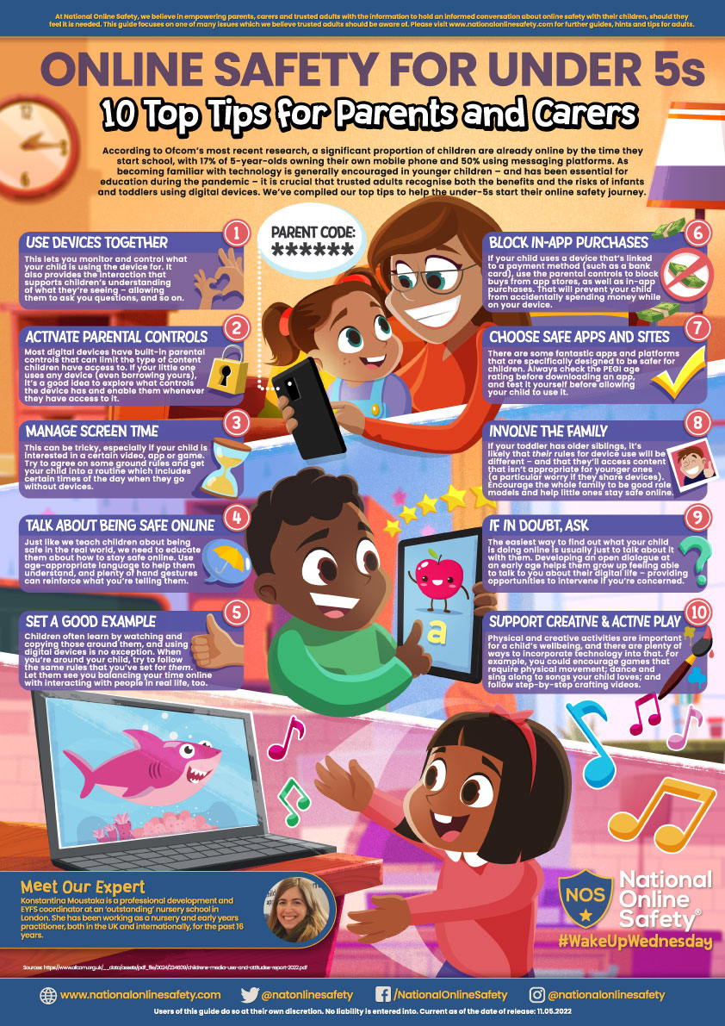
On - line safety
https://nationalonlinesafety.com/training/search?search=&cat=&type=resource&sort=latest

Slide 4


Road safety
https://www.nidirect.gov.uk/articles/road-safety-seven-11-year-olds

Slide 5


Healthy lifestyle
https://babyfoode.com/blog/30-healthy-lunch-box-ideas-for-kids/

Slide 6

Bullying
STOP
Several
Times
On
Purpose

Slide 7

Personal hygeine
Finny the Shark
NHS Washing hands

Slide 8
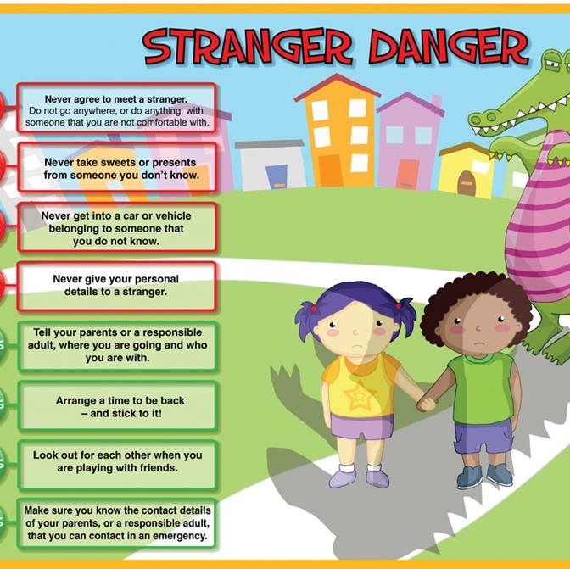
Stranger danger
https://www.safe4me.co.uk/portfolio/clever-never-goes/

Slide 9

Sexual abuse
https://www.nspcc.org.uk/keeping-children-safe/support-for-parents/pants-underwear-rule/

Slide 10

Mental Health
https://www.bbc.co.uk/bitesize/articles/zy3yf82?utm_source=google&utm_medium=cpc&utm_campaign=mental-health

Slide 11
Halton services
https://localoffer.haltonchildrenstrust.co.uk/help-support-advice-2/
There are 4 Halton's Children Centres in Widnes (Ditton Library, Kingsway, Upton and Ditton Children’s Centre) that have a range of 0-4 years groups .
They offer support, advice, clothes swop shops and now they have parent classes to help with Children’s Mental Health and Emotional Wellbeing, Fussy Eating and Snacks and Sleep and Screen Time.
There is a timetable for Autumn but there will be a new one by the end of November as they do a range of Christmas activities and even a Santa's Grotto and party for about £1 per child.

Slide 12
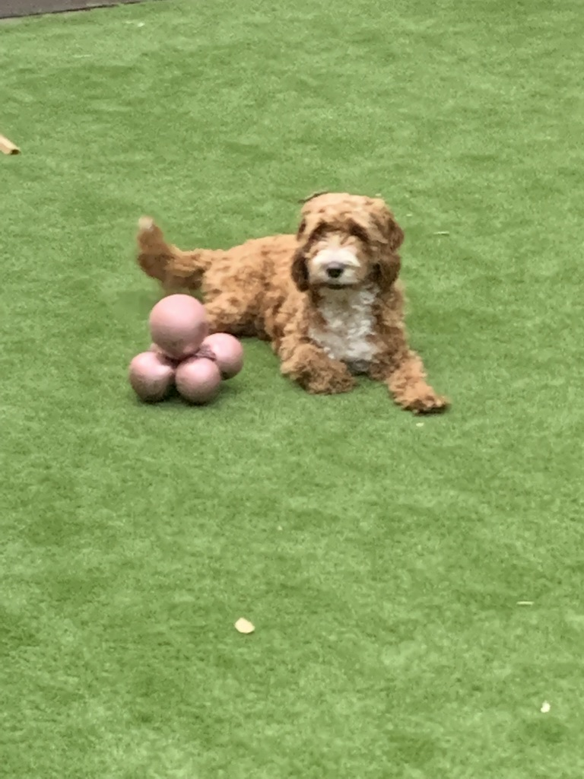
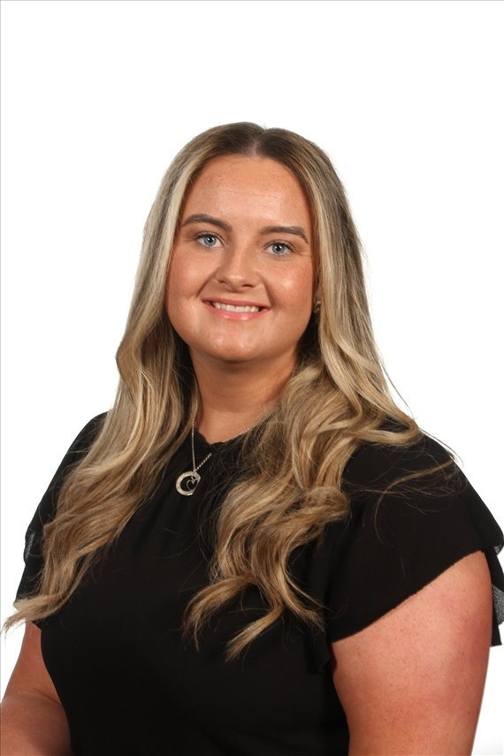
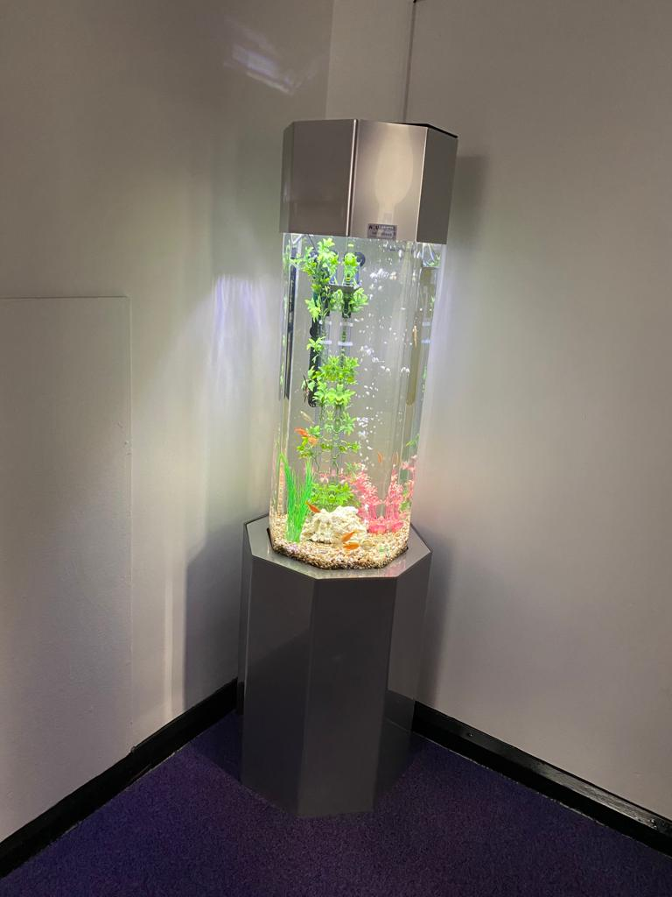
Whole School strategies

