Slide 1

WELCOME TO our first stay and learn session

Slide 2
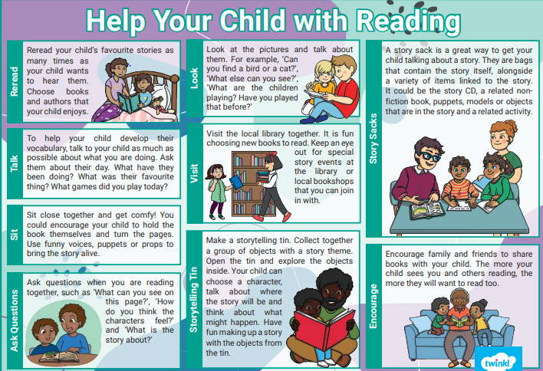

Slide 3

Looking at a book for the first time
Look at the front cover together – talk about the pictures and the title. What might the book be about?
Allow your child to ‘read through’ the pictures first. Use this time to talk about any unfamiliar words and link them to the pictures.
In the early days, read the book to your child before expecting them to read it to you.
When they begin to read, encourage them to point to the words and pick out any they remember.

Slide 4
Looking at a book for the first time
As your child becomes confident with their ‘letter sounds’, encourage them to ‘sound out’ simple words like ‘dog’ or ‘pen’.
Looking at the pictures is another strategy for working out new, longer words, but remind children to double-check by looking at the letters at the beginning of the word too.
Not all words can be sounded out e.g. ‘the’, ‘we’. Just explain these are ‘tricky words’ and tell your child what they say.

Slide 5

Looking at a book for the first time
Encourage your child to relate the book to their own experiences.
Talk about the characters in the story and what they might be thinking or feeling.
Ask questions to encourage your child to make sense of what they have read. How/Why?
Sometimes, practise retelling the story,

Slide 6

Phonics
We follow the ‘Little Wandle.’
Phonics is taught daily, and a new letter sound is learnt each day.
Phonics helps children to segment words and blend them together to read and spell, such as c-a-t- cat
The main method that we use to teach children to read and write is through phonic work
Segmenting consists of splitting whole words into individual sounds to spell
Blending is merging individual sounds into whole words to read
If the children cannot hear the sounds or blend them orally it could hinder them with reading and writing

Slide 7

High frequency words
We refer to some of these words as ‘tricky words’ in school.
They are mostly words that cannot be sounded out.
Once a week, during phonics teaching time children will learn to read some new tricky words.
Children learn to read the tricky words using the ‘Look and say’ method. Using flashcards, playing pairs, snap or bingo all help children to remember these words.
If a child attempts to sound out a tricky word you can say to them “This is a tricky word and we can’t sound it out.”

Slide 8
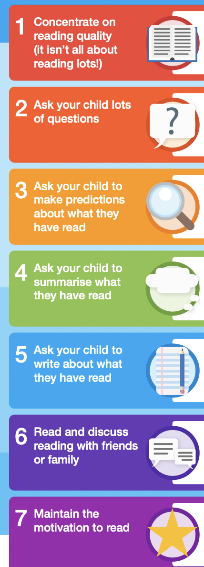

7 Top Tips to support reading aT HOME
READING IS A KEY SKILL THAT LAYS THE FOUNDATION FOR ALL FUTURE LEARNING. LITTLE AND OFTEN IS ESSENTIAL TO REINFORCE READING SKILLS AND DEVELOP A LOVE AND ENJOYMENT FOR BOOKS!
A family for learning. A family for ALL.

Slide 9
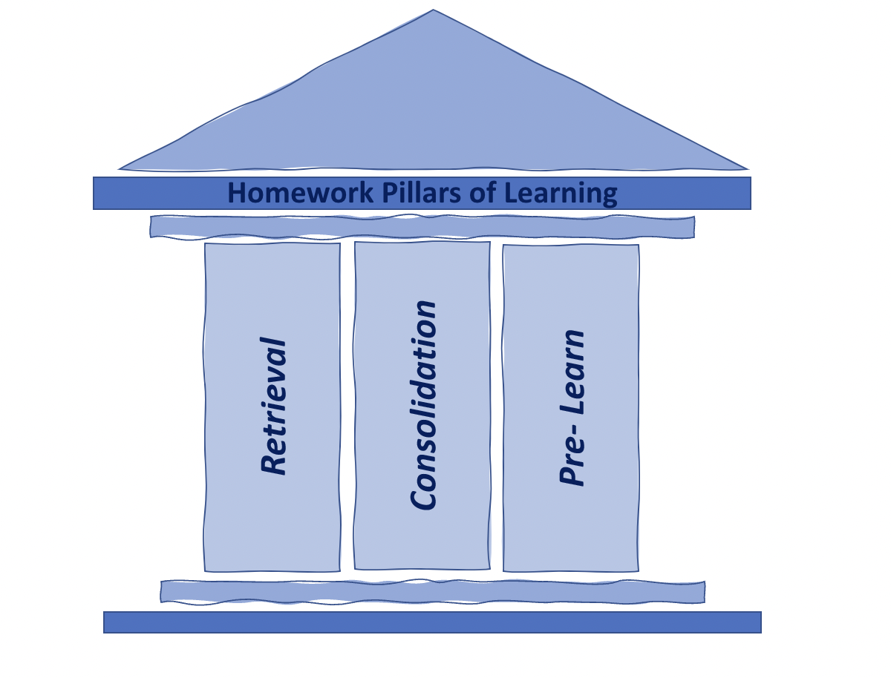
OUR NEW HOMEWORK POLICY REFLECTS ON RESEARCH EVIDENCE THAT SUGGESTS SHORT, FOCUSED TASKS OR ACTIVITIES WHICH RELATE DIRECTLY TO WHAT IS BEING TAUGHT, AND BUILT UPON IN SCHOOL, ARE LIKELY TO BE MORE EFFECTIVE THAN REGULAR DAILY HOMEWORK. OUR CORE PURPOSE FOR HOMEWORK WILL BE ALIGNED WITH 3 PILLARS OF LEARNING:
Retrieval- Retrieval practice brings information to mind, boosting long-term learning.
Consolidation- New material is reviewed and learning is reinforced, enabling the teacher to reflect on the learning objectives and give whole class or individual feedback.
Pre-Learn-presented with new material in preparation to discuss the following week in class, this in effect ‘flips’ the learning to introduce a new concept prior to the lesson. PRE- LEARNING WILL CONNECT NEW KNOWLEDGE WITH PRIOR KNOWLEDGE.
homework will be sent home on Classdojo and all children will be provided with a book in which they can complete these activities.
A family for learning. A family for ALL.

Slide 10


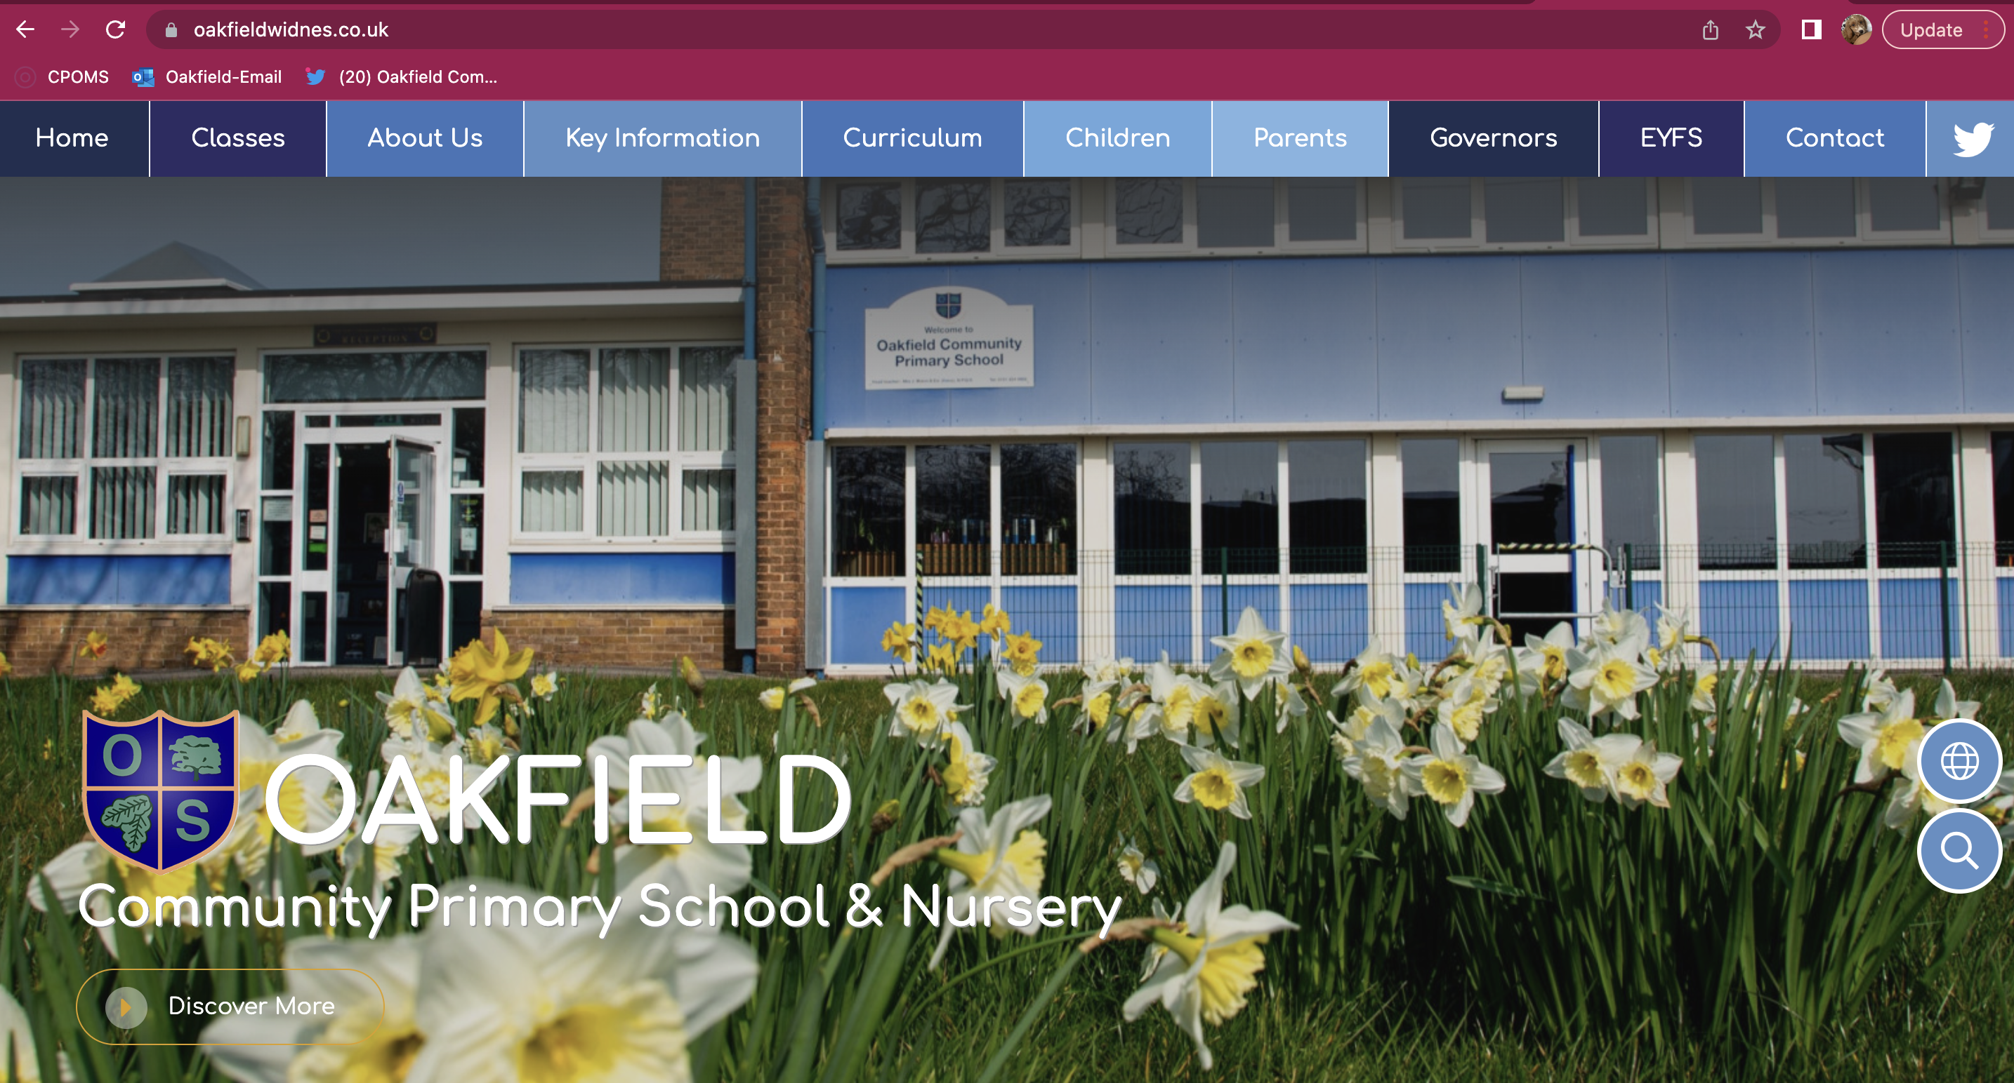
Are you connected?
https://www.oakfieldwidnes.co.uk/
A family for learning. A family for ALL.

Slide 11


Wrap around before & after school
Wrap
Around
Before
& After
Care
Breakfast : 8am / 8.30am
£2.00 / 50p
After school : 4.15 / 5.15
Starts Monday 3rd October
£3.50 / £7.00
Booking via School Spider App
A family for learning. A family for ALL.

Slide 12

Additional information

Slide 13

Questions

