Slide 1

WELCOME TO our first stay and learn session

Slide 2
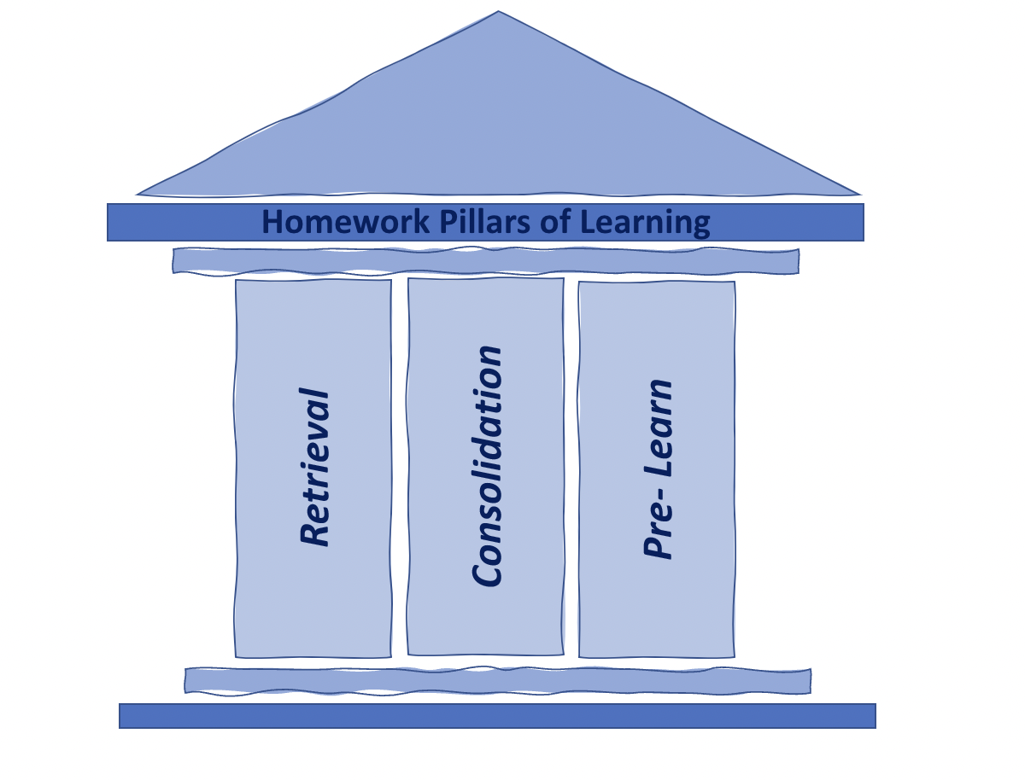
OUR NEW HOMEWORK POLICY REFLECTS ON RESEARCH EVIDENCE THAT SUGGESTS SHORT, FOCUSED TASKS OR ACTIVITIES WHICH RELATE DIRECTLY TO WHAT IS BEING TAUGHT, AND BUILT UPON IN SCHOOL, ARE LIKELY TO BE MORE EFFECTIVE THAN REGULAR DAILY HOMEWORK. OUR CORE PURPOSE FOR HOMEWORK WILL BE ALIGNED WITH 3 PILLARS OF LEARNING:
Retrieval- Retrieval practice brings information to mind, boosting long-term learning.
Consolidation- New material is reviewed and learning is reinforced, enabling the teacher to reflect on the learning objectives and give whole class or individual feedback.
Pre-Learn-presented with new material in preparation to discuss the following week in class, this in effect ‘flips’ the learning to introduce a new concept prior to the lesson. PRE- LEARNING WILL CONNECT NEW KNOWLEDGE WITH PRIOR KNOWLEDGE.
homework will be sent home on Classdojo and all children will be provided with a book in which they can complete these activities.
A family for learning. A family for ALL.

Slide 3

Homework expectations
Spellings / phonics to practice and learn
Key Vocabulary
Number work/ Times Tables (End of Year 4, pupils should know up to 12 x 12 tables)
Reading
Online learning / website links on school website
https://www.oakfieldwidnes.co.uk/page/english/123314
A family for learning. A family for ALL.

Slide 4
#Homework Tips
Set a routine at a good time of day
#1 Consistent Time
Quiet with limited distractions
#2 Keep it calm
Stay close and offer lots of praise
#3 Be involved
Play games on walks, in car/bath
#4 Keep it fun
Visual timer, little and often!
#5 Take breaks
We are always here to support
#6 Ask the teacher
A family for learning. A family for ALL.

Slide 5
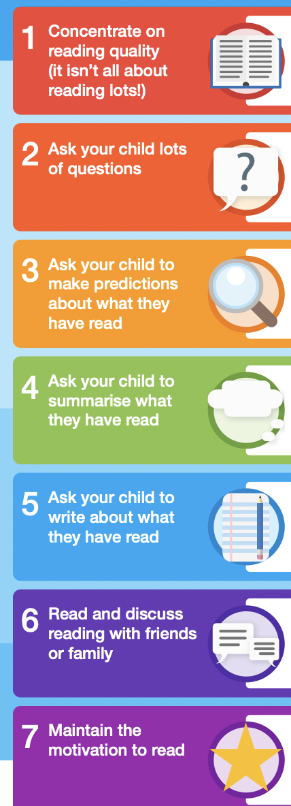

7 Top Tips to support reading aT HOME
READING IS A KEY SKILL THAT LAYS THE FOUNDATION FOR ALL FUTURE LEARNING. LITTLE AND OFTEN IS ESSENTIAL TO REINFORCE READING SKILLS AND DEVELOP A LOVE AND ENJOYMENT FOR BOOKS!
A family for learning. A family for ALL.

Slide 6
ITS NEVER TOO YOUNG TO START!
It’s never too early to start sharing books with them – they might not understand the words, but they will love cuddling up, hearing your voice, and looking at the pictures.
Join DITTON library, which has great advice and recommendations, with a new supply of books to enjoy. This library hosts Rhymetimes, weekly clubs and other Saturday story sessions.
Ask questions and talk about books. Picture books can be a great way to talk through fears and worries, or help to deal with emotions. Give them space to talk, and ask how they feel about the situations in the story.
As children get older, with lots of other activities competing for their time, how can we encourage them to make time for reading?- Read yourself ( anything!), give books as presents, keep reading together!
A Family for learning. A family for ALL.

Slide 7


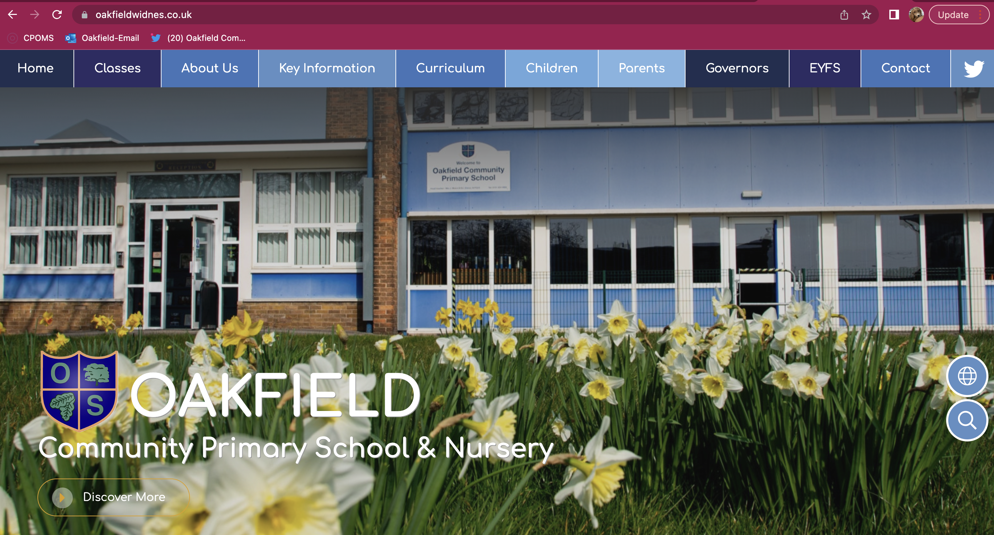
Are you connected?
https://www.oakfieldwidnes.co.uk/
A family for learning. A family for ALL.

Slide 8


Wrap around before & after school
Wrap
Around
Before
& After
Care
Breakfast : 8am / 8.30am
£2.00 / 50p
After school : 4.15 / 5.15
Starts Monday 3rd October
£3.50 / £7.00
Booking via School Spider App
A family for learning. A family for ALL.

Slide 9

Questions

