Slide 1

Wonder

Slide 2
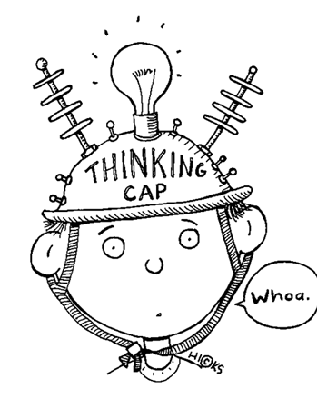
Learning Objectives
By the end of the lesson you will…
Understand the character of Jack
Be able to use PEE to display your knowledge of the character

Slide 3

Listen Along… pg. 175-185.
You may have your own copy of the book, feel free to read along.
N.B. I have paid for the audio version of Wonder by R.J. Palacio. I do not have the recording rights for it to be distributed any further than our learning platform.

Slide 4
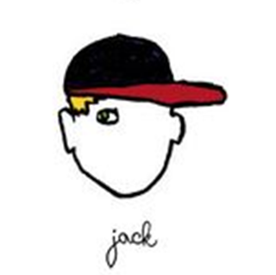
Thinking about Jack
Draw a picture of how you imagine Jack to look on a full page in your exercise book.
Label the picture with as many ideas about his character as you can from the chapters we are about to read.
Add a quotation from the text to support each idea you have about her. Remember to use “quotation marks”.

Slide 5
Using PEE
Can you spot the…
Point
Evidence
Explanation
Jack is a kind person, but he suffers under the stress of being August’s friend. I know this as he says “I guess I was just kind of wanting a little normal time to chill out with other kids.” The sentence begins with “I guess” as if Jack is struggling with his feelings; he wants to leave August but he feels guilty about it. “Normal time” suggests when he is with August he must carry his burden, which he finds difficult. “Chill out” tells the reader that he feels uncomfortable and wants to avoid the unpleasant attention that being with August brings. This links to his later feelings of “having ‘snapped’ under the pressure of being August’s friend”. He hides this from his friends as he feels ashamed.
Which part of the PEE is longest? Why?
Do you agree or disagree with the comments? Why?
Why do we use PEE?

Slide 6

Jack
If you are having trouble creating a PEE chain, use these prompts:
Point (one sentence only)
The writer suggests …
Jack seems like …
Palacio uses …
Evidence (remember “quotation marks”)
I know this because …
When he writes …
With the words …
Explanation (your own ideas go here)
This suggests that …
This makes me think that …
I believe that …
Use PEE to answer the following question:
What do we learn about Jack
as a character in pages 175-185?

