Slide 1

Wonder

Slide 2
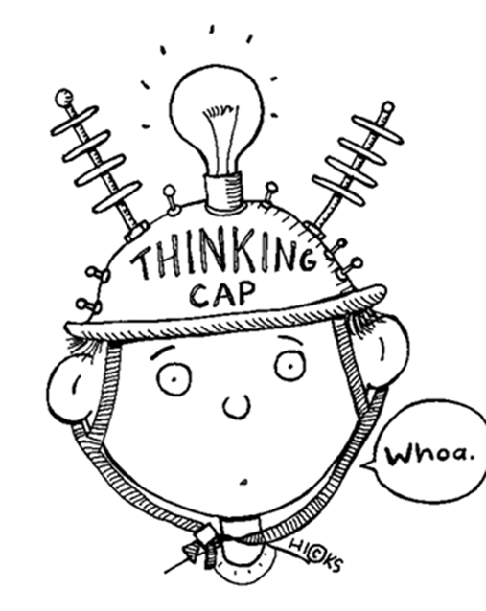
Learning Objectives
By the end of the lesson you will…
Be able to understand the hidden meaning behind words
Be able to explore formal & informal language choices

Slide 3

Listen Along… pg. 155-174.
You may have your own copy of the book, feel free to read along.
N.B. I have paid for the audio version of Wonder by R.J. Palacio. I do not have the recording rights for it to be distributed any further than our learning platform.

Slide 4
Who is talking? What does their language suggest about them?
And this is the way it’s always been for me, for the little universe of us. But this year there seems to be a shift in the cosmos.
right, right, right, i say, shaking my head. i sigh. i’m wiped, olivia. how the heck am i going to remember all these lines?
When Julian mentioned he was having a hard time befriending the boy, we told him he was ‘off the hook’ in that regard.
I hate science the most out of all my classes. We get so much work it’s not even funny!

Slide 5
Language Choices
We never hear directly from the adults in Wonder. Why do you think this might be? Do you think it would add to the impact of the story or detract from it?
Look at page160: who uses formal language? Why it is used? What do they want?
Look at page 164: who uses informal language? Why it is used? What do they want?

Slide 6
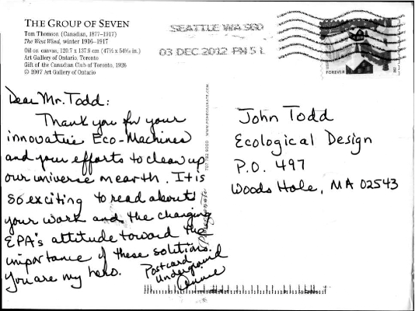
Additional home learning:
Postcard Precept
Mr Browne has his pupils send him their own precept. You could do the same thing.
Complete the postcard by writing down an address, precept and explain your choice.
Precept Hint: choose a famous quotation, musical lyric or famous saying that expresses something you feel is important.

