Slide 1

Wonder

Slide 2
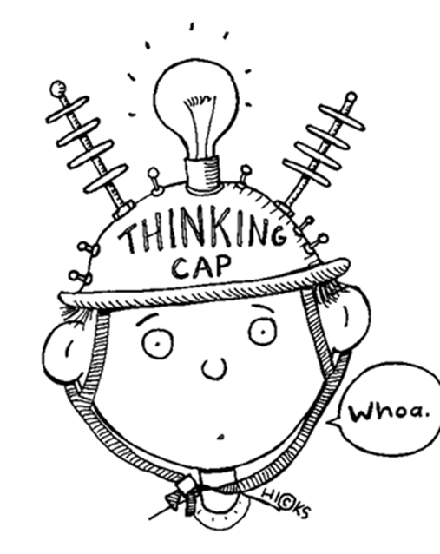
Learning Objectives
By the end of the lesson you will…
Be able to write from a character’s point of view

Slide 3

Listen Along… pg. 133-154.
You may have your own copy of the book, feel free to read along.
N.B. I have paid for the audio version of Wonder by R.J. Palacio. I do not have the recording rights for it to be distributed any further than our learning platform.

Slide 4

Julian’s Story
Although we see many sides of the story in Wonder, we never get to see Julian’s point of view.
Your task is to rewrite a scene from the novel from his point of view. Consider his thoughts, feelings, behaviour and attitudes.
It would be easy to paint him as a stereotypical villain, but as we’ve seen from exploring other characters, this is not real. Try to create a real, flawed human being.

