Slide 1

Wonder

Slide 2

Learning Objectives
By the end of the lesson you will…
Explore characters through creative writing

Slide 3

Listen Along… pg. 118-132.
You may have your own copy of the book, feel free to read along.
N.B. I have paid for the audio version of Wonder by R.J. Palacio. I do not have the recording rights for it to be distributed any further than our learning platform.

Slide 4

Character Playlist
Imagine you find one of the main character’s iPod on the floor.
What music do you think you would find on it?
Create a playlist of 10 songs for one of the characters. Explain why you have chosen each song.

Slide 5
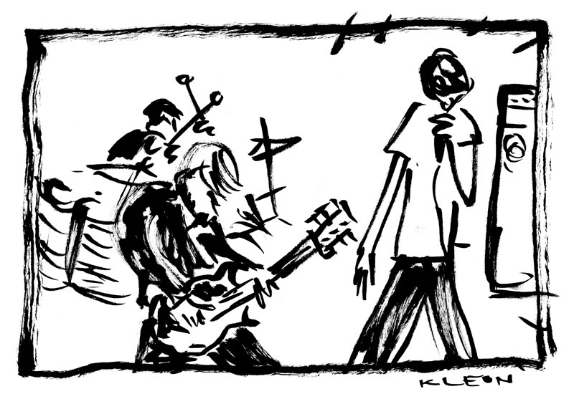
Additional home learning
Choose one of the songs from the playlist, write out or print the lyrics and explain how it relates to the novel (just like we did as a class with Space Oddity).

