Slide 1

Wonder

Slide 2
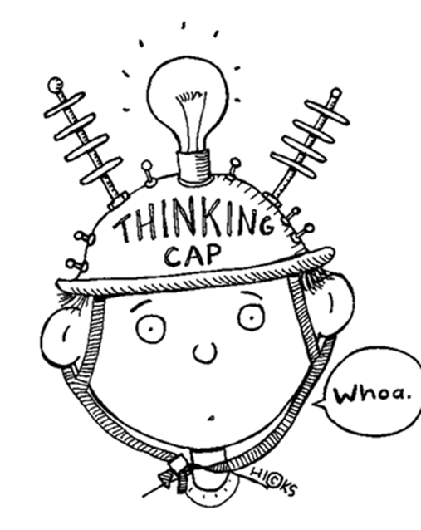
Learning Objectives
By the end of the lesson you will…
Explore characters through creative writing and drawing

Slide 3

Listen Along… pg. 103-117.
You may have your own copy of the book, feel free to read along.
N.B. I have paid for the audio version of Wonder by R.J. Palacio. I do not have the recording rights for it to be distributed any further than our learning platform.

Slide 4
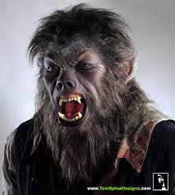
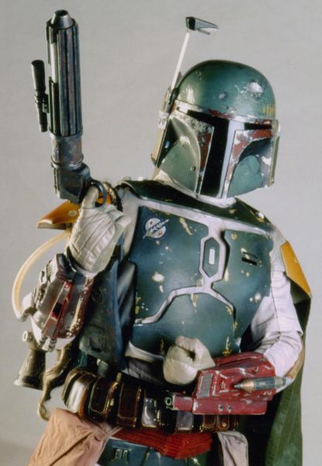
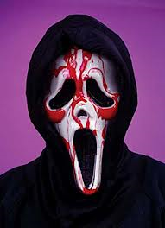
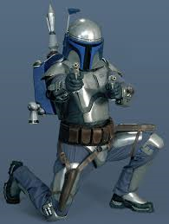
Halloween
Costumes
Auggie was going to be Boba Fett.
At the last minute, he changed to a bleeding Scream costume.
Jack said he was going to be a wolfman.
Julian is going to be Jango Fett.

Slide 5
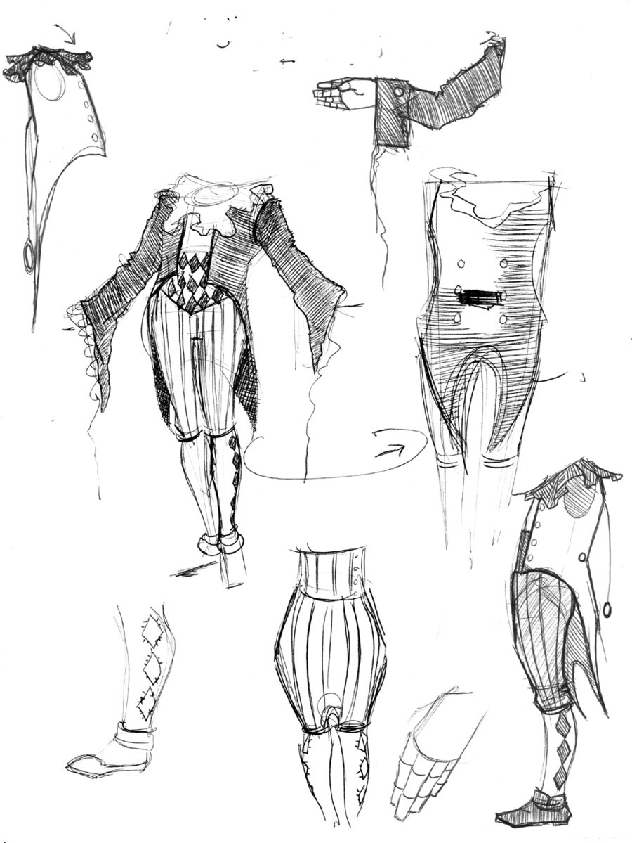
Designing a Halloween Costume
Create a Halloween costume for one of the major characters. Take a full page of your exercise book for the drawing – add labels and colour when completed.
Then, on the following page, explain why you chose the costume: how does it relate to the character? What are you trying to reflect about their personality & behaviour?
Extension Task: write a diary entry for your character’s Halloween night.

