Slide 1

Wonder

Slide 2

Learning Objectives
By the end of the lesson you will…
Explore the author’s craft and understanding the importance of point of view in writing
Compare and contrast the lyrics from Space Oddity to the novel

Slide 3

Listen Along… pg. 81- 102.
You may have your own copy of the book, feel free to read along.
N.B. I have paid for the audio version of Wonder by R.J. Palacio. I do not have the recording rights for it to be distributed any further than our learning platform.

Slide 4

Part Two
Far above the world
Planet Earth is blue
And there’s nothing I can do
-David Bowie, Space Oddity
What could these lyrics be about?
What point of view is expressed?
What mood is created?
How can you relate the title to August?
Via

Slide 5
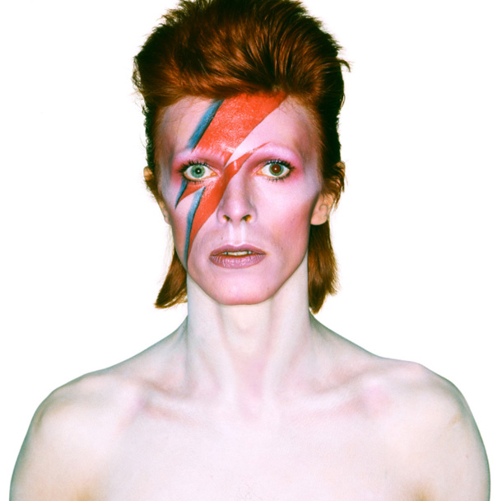
Space Oddity by David Bowie
As you listen to the song, think about the following:
The message of the song
How it relates to August
How it relates to Via
The point of view
The mood & atmosphere
https://www.youtube.com/watch?v=9_M3uw29U1U
Annotate the worksheet with links to the novel

