Slide 1

Wonder

Slide 2
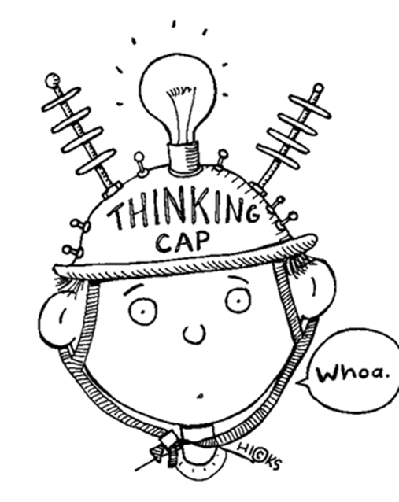
Learning Objectives
By the end of the lesson you will…
Explore the thoughts & feelings of August
Infer & deduce by using evidence from the text

Slide 3

Listen Along… pg. 68-80.
You may have your own copy of the book, feel free to read along.
N.B. I have paid for the audio version of Wonder by R.J. Palacio. I do not have the recording rights for it to be distributed any further than our learning platform.

Slide 4
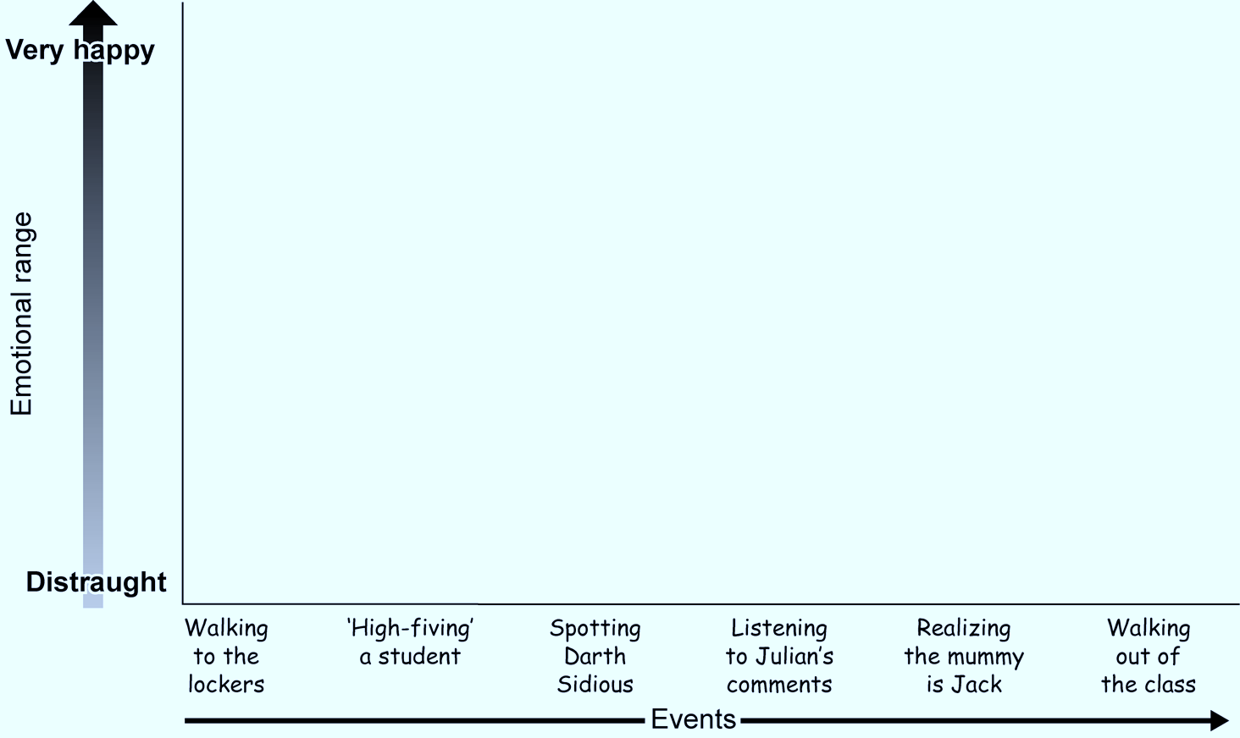
The Bleeding Scream

Slide 5
Emotion Graph
Using the emotion graph, plot Auggie’s feelings. You might even challenge yourself to include quotes from the text to support your reasoning.
The graph can be copied into your books and annotated or you are welcome to print it out, but as always, it’s not a requirement.

Slide 6

Additional home learning
Find out five facts about a Victorian man named John Merrick, more famously known as the Elephant Man.
Write a paragraph (or more) explaining how his situation could relate to that of Auggie.

