Slide 1

Wonder

Slide 2
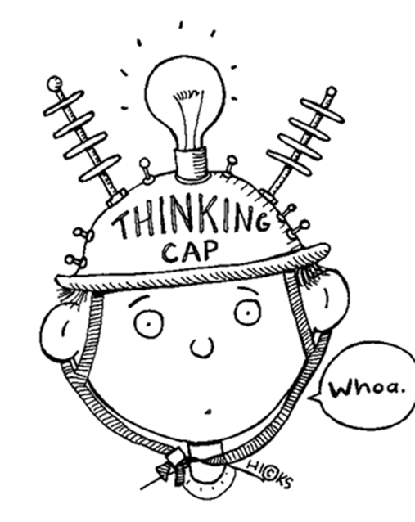
Learning Objectives
By the end of the lesson you will…
Explore the opinions and feelings of the characters in the novel
Create your own precept and explain its meaning to others

Slide 3

Listen Along… pg. 54-67.
You may have your own copy of the book, feel free to read along.
N.B. I have paid for the audio version of Wonder by R.J. Palacio. I do not have the recording rights for it to be distributed any further than our learning platform.

Slide 4
Precepts
A precept is a motto or a rule to live by.
Precepts shared by Mr Browne include:
“When given the choice between being right and being kind, choose kind.”
“Your deeds are your monuments”
What do you think they both mean? Do you agree with them?

Slide 5
No-one likes self-righteous people (big-headed)
You never know what someone has been through – you should be kind if you can.
“When given the choice between being right and being kind, choose kind.”
If someone is wrong and you are mean about it, they might be afraid to ask questions again.
Treat others the way you’d like to be treated.
If you act like you’re always right, you’ll never learn anything new.

Slide 6
Precepts: Rules To Live By
If you can’t say anything nice, don’t say anything at all.
Kind words do not cost much, yet they accomplish much.
Keep calm and carry on.
All you need is love.
Create your own precept with explanation in your exercise book. Make it your personal motto: it can be a song lyric, quotation from a novel, a famous saying or something personal between your friends and family.
WHY is your precept a good rule to live by?

Slide 7
“Your deeds are your monuments”
“Your Deeds are your Monuments” means that what you do is what you will be remembered for. You leave behind a deed instead of a statue.
Record what deeds you believe have created your monuments. I have provided a personal example for inspiration.

Slide 8




Buying my own house
Graduating from University
My Deeds
Being a teacher
Travelling around Australia

