Slide 1

Wonder

Slide 2
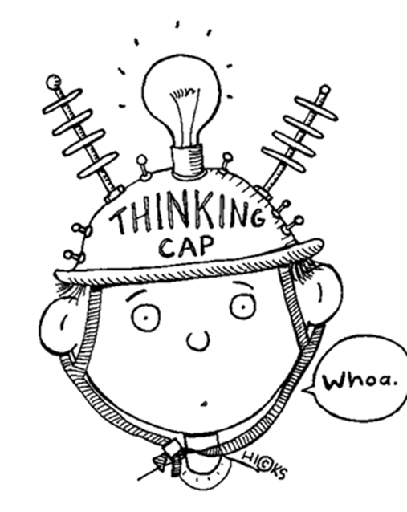
Learning Objectives
By the end of the lesson you will…
Select & retrieve information from the text
Relate events in the novel to our own lives

Slide 3

Listen Along… pg. 35-53.
You may have your own copy of the book, feel free to read along.
N.B. I have paid for the audio version of Wonder by R.J. Palacio. I do not have the recording rights for it to be distributed any further than our learning platform.
Notes:
Bob predictions; first impressions; likes and dislikes

Slide 4

Reflection
Note down how you felt on your first day at Primary School. If you can’t remember, consider how you’ll feel on your first day at High School.
Highlight or circle any feelings that you share/shared with Auggie.

Slide 5
Comprehension Questions
Answer the following questions in full sentences using evidence whenever possible:
How does August feel on his first day? (page 35)
Look at the chapter called ‘Locks’. Explain its literal meaning and then try to explain its metaphorical meaning. (page 37)
What do we learn about Charlotte from the way she introduces herself? (page 42)
Why is Darth Sidious discussed? (page 44)
How does Mr Browne’s precept relate to the novel so far? (page 48)
Try to create three more names that can be linked to summer. Explain your choices. (page 52)
* Use the screenshots to help retrieve the information required.

