Slide 1

Wonder

Slide 2
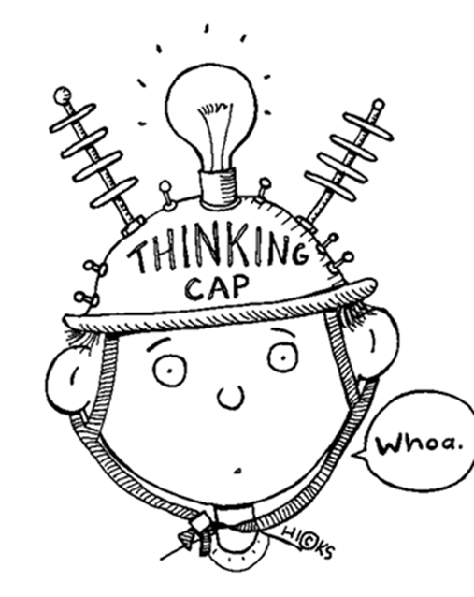
Learning Objectives
By the end of the lesson you will…
Use evidence from the text to make inferences about characters
Creative empathetic writing that explores thoughts & feelings

Slide 3

Listen Along… pg. 17-34.
You may have your own copy of the book, feel free to read along.
N.B. I have paid for the audio version of Wonder by R.J. Palacio. I do not have the recording rights for it to be distributed any further than our learning platform.
Notes:
Bob predictions; first impressions; likes and dislikes

Slide 4
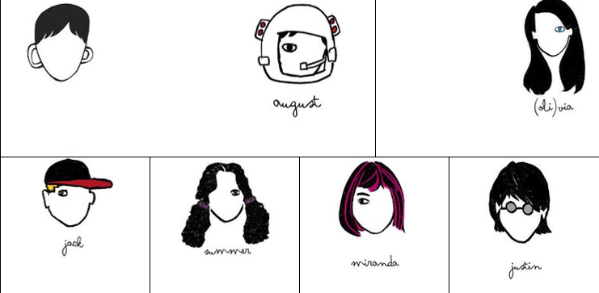
Character Log
Continue filling out the character log with information on the main characters as you listen/read along.

Slide 5
First Impressions
Jot down your first impressions of the characters using evidence from the text and providing an explanation.
Character | Quotation | What it tells us about the character
Julian | ‘forced a smile’ | He doesn’t want to be there and is pretending to be friendly.

Slide 6

Hot Seating
In your books, write three open questions you would like to ask any of August’s guides (Charlotte, Julian and Jack) about their first impressions of August.

Slide 7
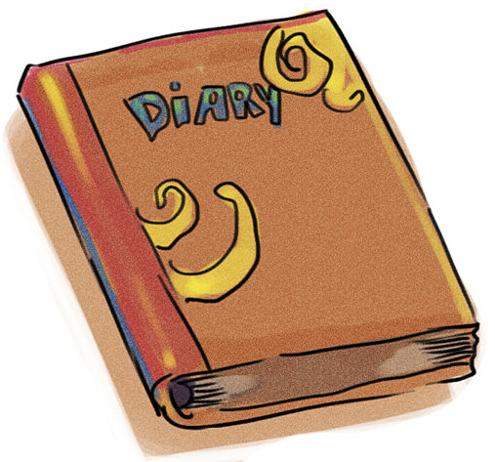
Diary Entry
Choose to be either Charlotte or Julian and write a diary entry of your day giving Auggie a tour of the school.
You should include:
Write in first person (‘I’)
Write in the past tense
Include information about the character’s feelings
Include details from the book
Use language suitable to their character

