Slide 1

Wonder

Slide 2
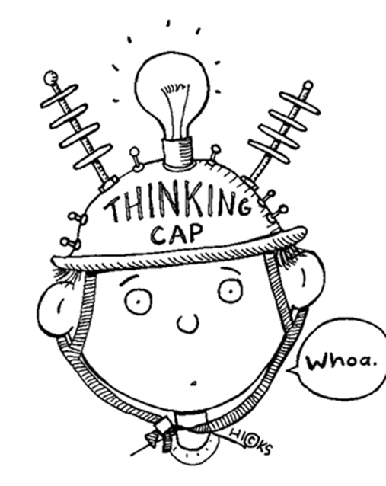
Learning Objectives
By the end of lesson 1 you will…
Explore the main characters and begin to understand August's point of view
Relate the novel to the song that inspired it

Slide 3



Study the Book- front and back cover

Slide 4


Slide 5
Blurb
My name is August.
I won’t describe what I look like.
Whatever you’re thinking, it’s probably worse.

Slide 6
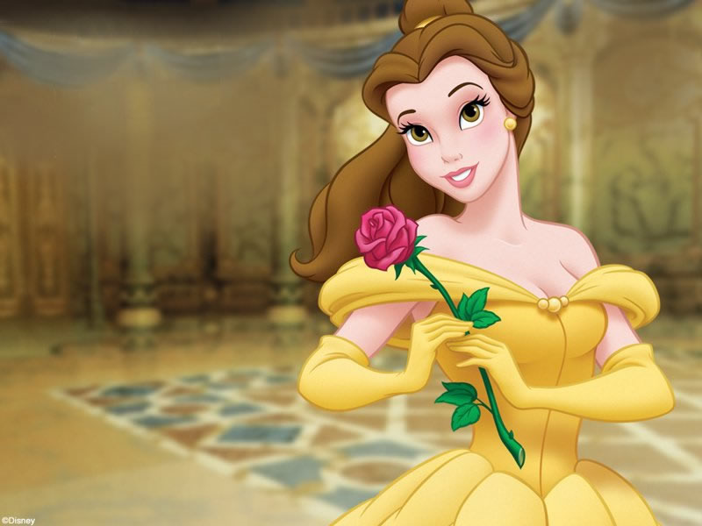
Discuss… either with an adult, peer or jot down your initial thoughts
What do you think beauty is? Try to be honest.
What do you do to feel attractive (look your best)?
How would you feel if you had a facial disfigurement that you couldn’t hide? Do you know anyone like this?

Slide 7

Listen Along… pg. 1-16.
You may have your own copy of the book, feel free to read along.
N.B. I have paid for the audio version of Wonder by R.J. Palacio. I do not have the recording rights for it to be distributed any further than our learning platform.
Notes:
Bob predictions; first impressions; likes and dislikes

Slide 8
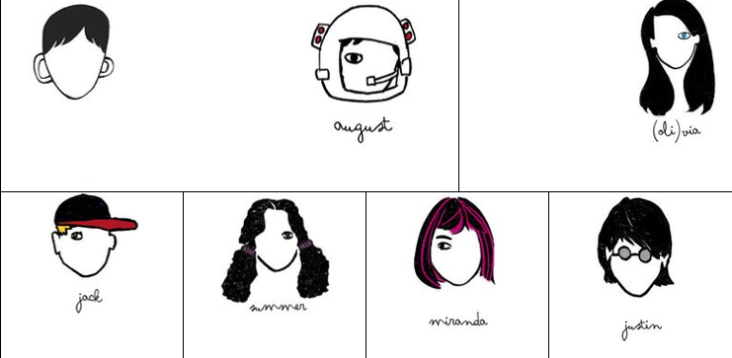
Character Log
Begin filling out the character log with information on the main characters as you listen/read along.

Slide 9

The Song
You are about to hear the song that inspired the author to write the book.
As you listen to the song, think about how the lyrics could relate to what we have read so far.
Has a song ever inspired you in the same way?
https://www.youtube.com/watch?v=6zpYFAzhAZY

Slide 10
Optional Home Learning Task
Research Treacher-Collins syndrome, which is the condition suffered by the main narrator of Wonder.
You need to collect five facts: how it affects people; how common it is; symptoms etc…

