Slide 1


Session 1
Being awesome

Slide 2
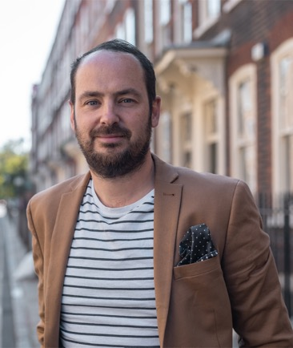
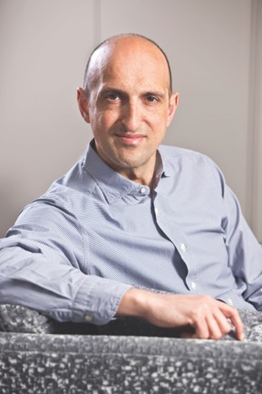
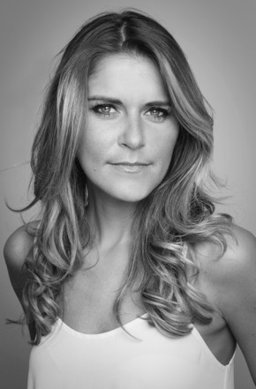
Hello Year 6, and welcome to ‘Be Awesome, Go Big’. We are going to help you get ready for secondary school over the next few weeks and learn how to be awesome. We have three people who are going to help you navigate this period of transition. They are:
Matthew Burton
Author of ‘Go Big’ and known for ‘Educating Yorkshire’ and ‘BBC Bitesize’
Matthew Syed
Author of ‘You Are Awesome’, as well as many other books. He is also a journalist and appears on a podcast called ‘Flintoff, Savage and the Ping Pong Guy’
Gemma Oaten
Actress, with roles in Emmerdale and Holby City as well as a number of other shows

Slide 3


Each session will take you through some big ideas that will help you on the way to secondary school.
If you have the books ‘You Are Awesome’ and ‘Go Big’, you can read them alongside these sessions; look for the instructions at the bottom of the slides. If you haven’t, the sessions will still make sense on their own.
Each session will have:
Two videos
Some key points
Some quotations from the books
Some questions for you to think about
A workbook which accompanies these sessions that you should complete as you go.

Slide 4
Our hope for you is that you will,
We know that you can BE AWESOME!
Good luck!
The PiXL Team, Hachette Publishers, Matthew, Matthew and Gemma

Slide 5
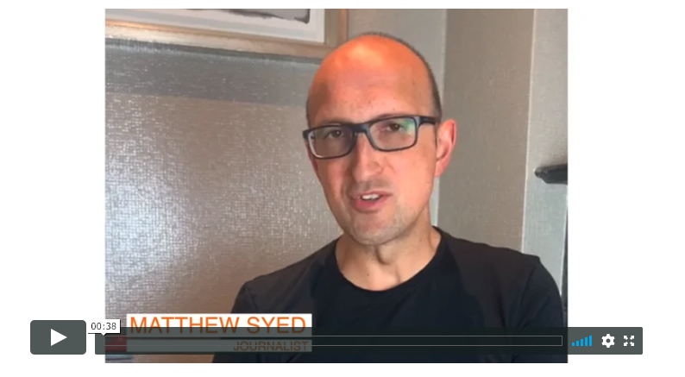

If you are reading ‘You Are Awesome’ alongside these sessions, then read up to page 45 and then complete this session.

Slide 6
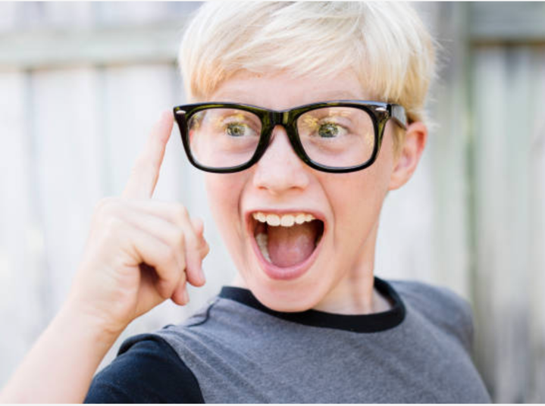
Have you ever thought about the fact that we get to choose our attitude?

Slide 7
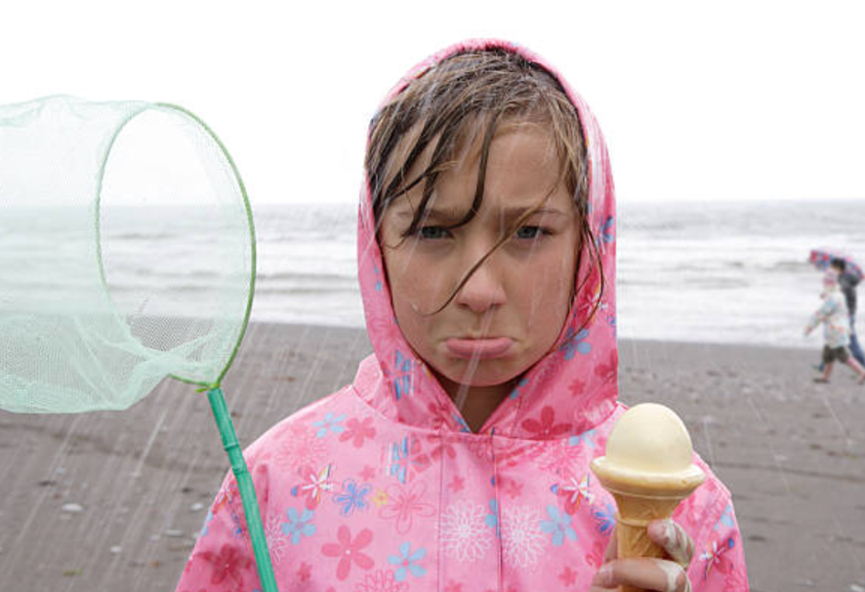
Even when we can’t choose SOME things…

Slide 8
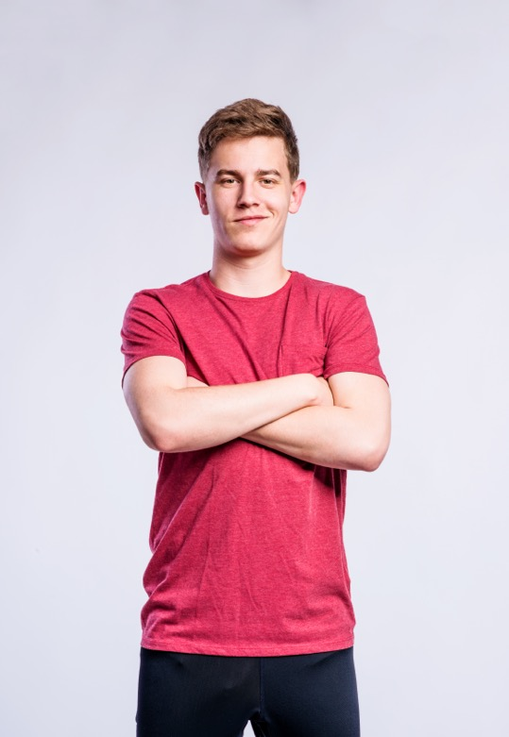
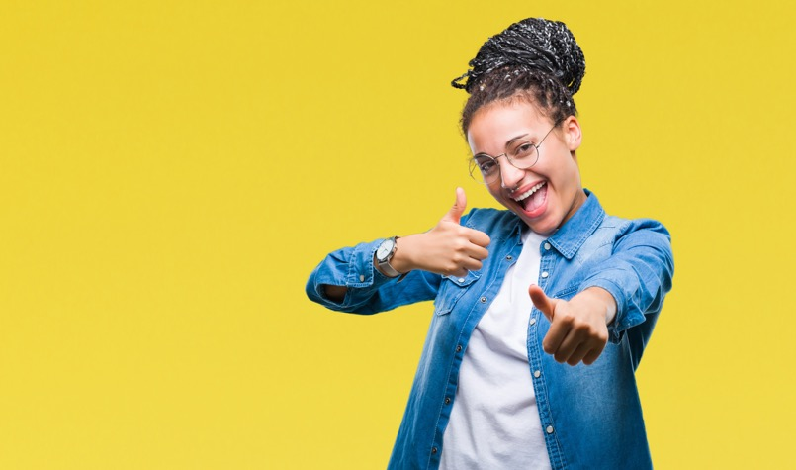
Sometimes we have attitudes about ourselves we didn’t even know we had.

Slide 9

Have you been 'kid average’ or ‘kid awesome’ at primary school?
What is the difference?

Slide 10
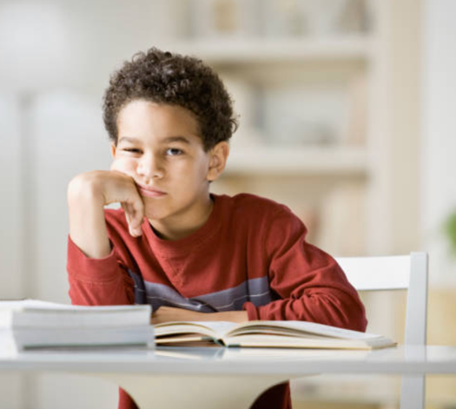
Kid average is someone who:
doesn’t try hard enough
thinks everyone else is talented
is lazy
is scared of taking risks
is worried about looking foolish
doesn’t put their hand up in class
thinks they will be okay, until it is too late.

Slide 11
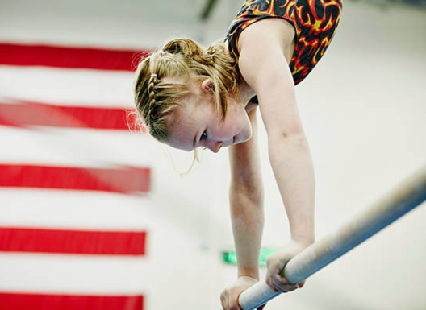
Kid awesome is someone who:
tries hard
puts time into learning things
is dedicated to what they want to achieve
is focused
doesn’t give up easily
stays positive during hard times
asks for help
overcomes fears
tries new things.
AWESOMENESS takes masses of practice to PERFECT.

Slide 12
Do you think you are ‘kid average’ or ‘kid awesome’?

Slide 13
You have a choice to make, so will you be ‘kid average’ or ‘kid awesome’?
“The world around us is changing so fast. It’s no wonder that we sometimes feel anxious about how we fit into it. We question whether we are smart enough. We get a bit scared to have a go in case we look stupid. And sometimes it’s tempting to quit before we’ve even tried having a go at something.” Matthew Syed, ‘You Are Awesome’ page 35
Now is the time to step up and make the change…

Slide 14
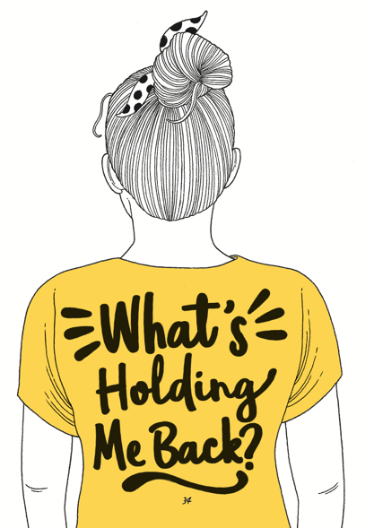
Sometimes we are worried about failing or messing it up. That is what stops us being ‘kid awesome’. Being awesome takes perseverance.

Slide 15
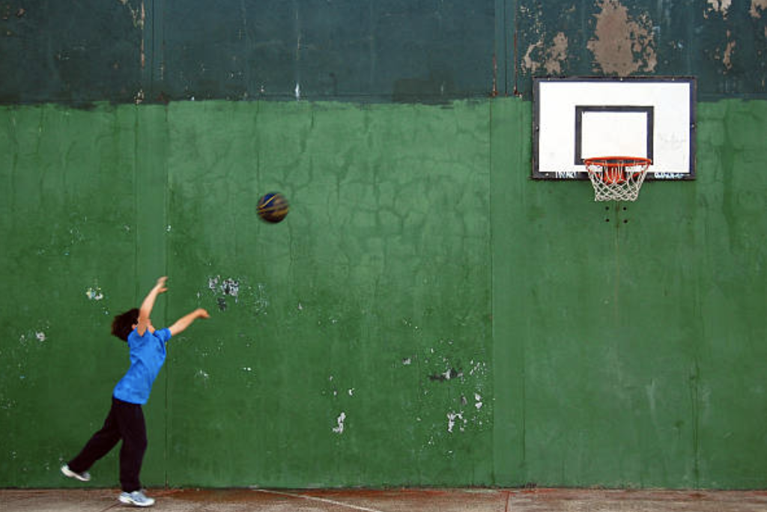
“I've missed more than 9,000 shots in my career. I've lost almost 300 games. 26 times, I've been trusted to take the game winning shot and missed.
I've failed over and over and over again in my life. And that is why I SUCCEED.”
Michael Jordan

Slide 16
TASK: Is there anything holding you back?
Worried you can’t do things
Find it hard to focus
Feeling embarrassed
Feeling stressed or anxious
Scared of hard work
Scared of taking risks
Fear of looking foolish

Slide 17

What is the secret of success?
Perseverance
Trying your hardest
Embrace challenges
Telling yourself that you CAN do it
Not being afraid of making mistakes
Doing something even though it is difficult

Slide 18
TASK: Write down what you can learn from your primary school experience, ahead of going to secondary school.
How did you handle things when they went wrong?
How did you react when you got stuck?
Think about a time when you showed a ‘kid awesome’ attitude. Write it down.
Write down the kind of person you want to be at secondary school.

Slide 19
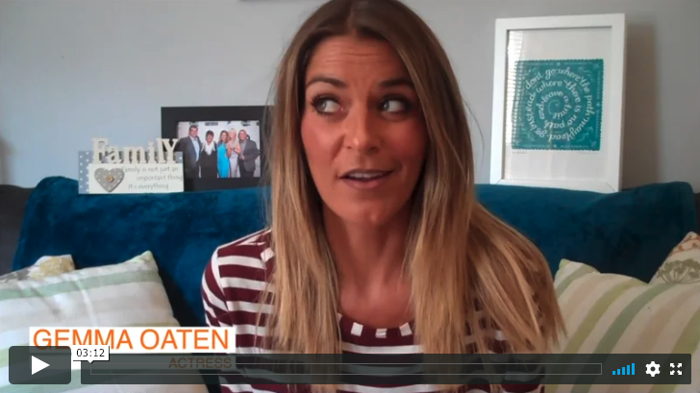
Here’s Gemma Oaten. She knows a thing or two about moving from ‘average’ to ‘awesome’. Listen to what she has to say…

Slide 20
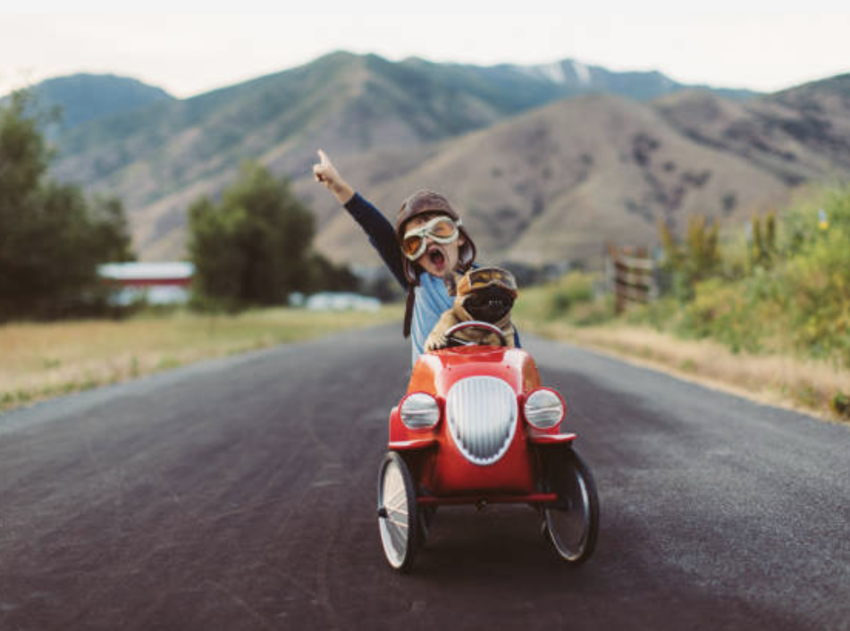
Remember: don’t give up – ever!
BE BRAVE
Make sure you have completed your Be Awesome, Go Big workbook.

Slide 21
© 2020 The PiXL Club Ltd and Hachette UK
This resource may be shared with any primary school Year 6 student in its current form, and parts thereof, to enhance your transition work with students. All opinions and contributions are those of the authors. The contents of this resource are not connected with, or endorsed by, any other company, organisation or institution.
If there are any inadvertent omissions or errors in the acknowledgements or usage, this is unintended and we will remedy these on written notification.
Hachette UK own 'You Are Awesome' by Matthew Syed and 'Go Big' by Matthew Burton, which may be purchased by individuals and schools, should they wish to do so to enhance these resources for students. 'You Are Awesome' illustrations copyright © Toby Triumph. 'Go Big' illustrations copyright © Chris Madden.

