Slide 1
QUIZ
NIGHT
THIS IS A GRAMMAR QUIZ
By Grace Davies

Slide 2
Find the missing punctuation!
1} john sat eating his tea at the table
2} i was sitting next to george
3} can i see the film

Slide 3
Which is which ?
Command, question or statement
Go and get your coat
Can you get your coat
Please go and get your coat

Slide 4
Which is right?
A, b or c
a} i can still see him.
b} I can still see him
c} I can still see him.

Slide 5
Watch these

Slide 6
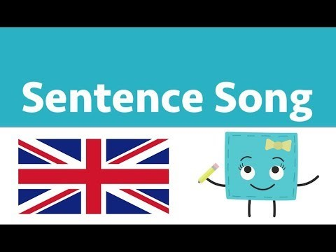
Punctuation

Slide 7
What is a preposition

Slide 8

Preposition

Slide 9
Which sentence has the preposition
1} I cant see you .
2} I'm in the garden .
3}can you here me ?

Slide 10
What is the passive and active voice
Be aware the next clip might scare you

Slide 11
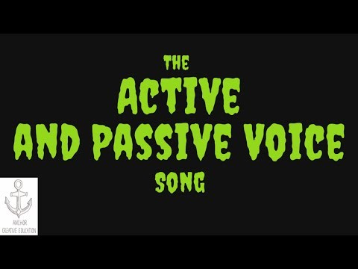
Active and Passive voice

Slide 12
Which is passive
The teacher teaches the students
OR
The song was sung by me

Slide 13
What is a noun phrase

Slide 14
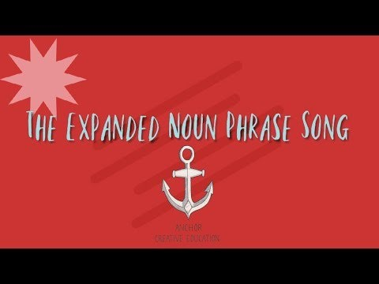
Noun Phrases

Slide 15
1.
Which of the following phrases serves as the noun phrase in the following sentence:
Playing trombone in the band has given Hunter more confidence.
Has given
More confidence
Playing trombone in the band
In the band

