Slide 1


Year 5 & 6 Residential:
Conway Centre

Slide 2

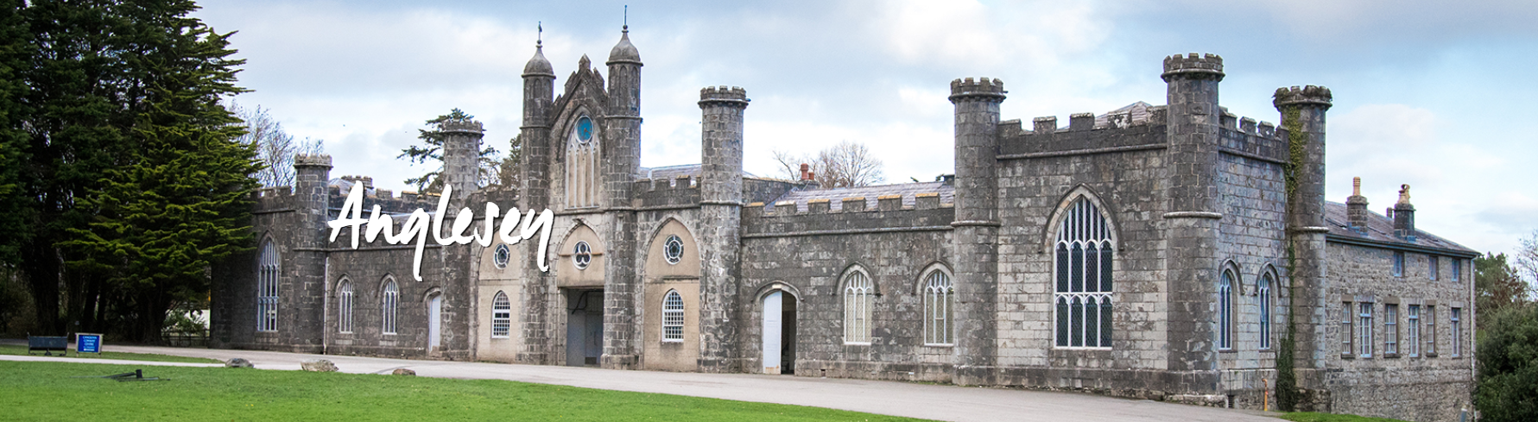
The Conway Centre
Year 5 & 6 are off on adventure to the Conway Centre in Anglesey from Monday 15th - Wednesday 17th June

Slide 3
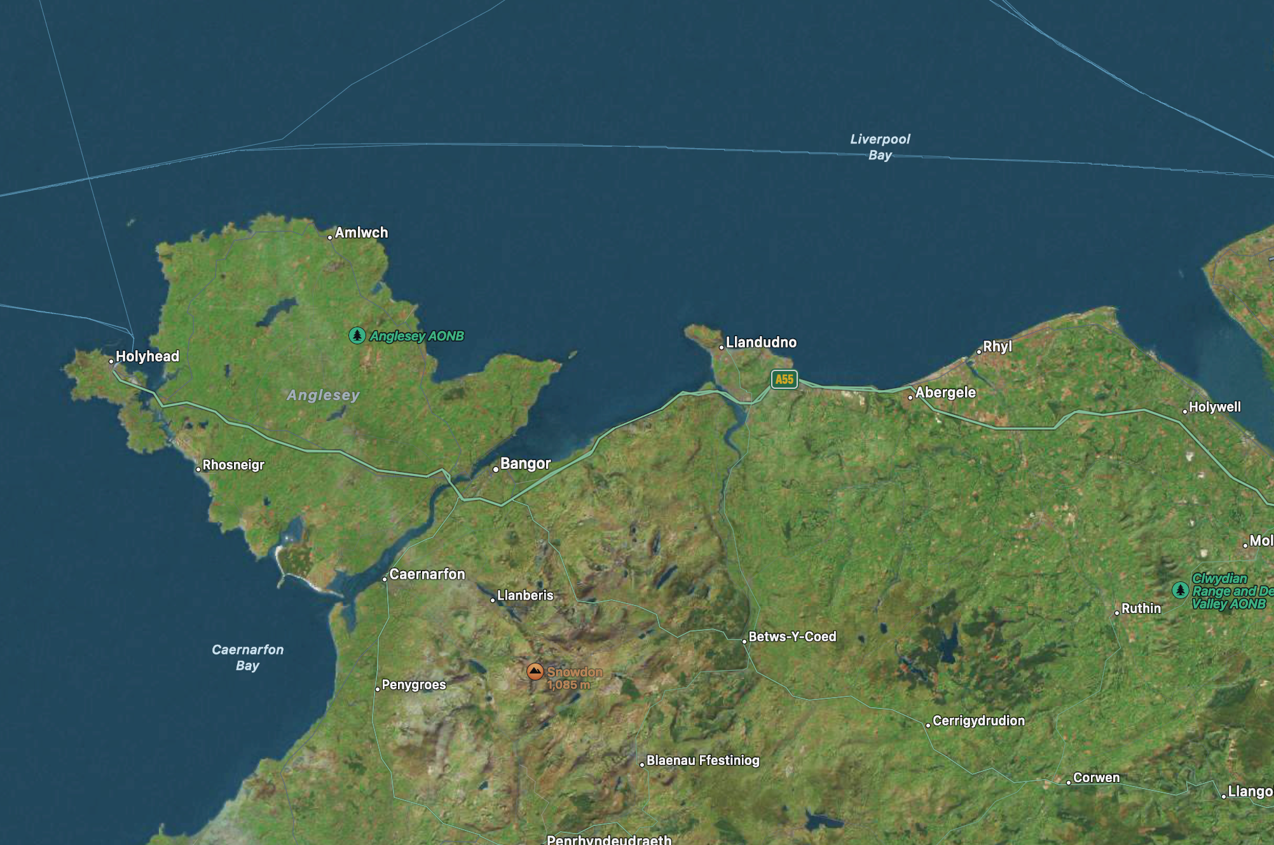
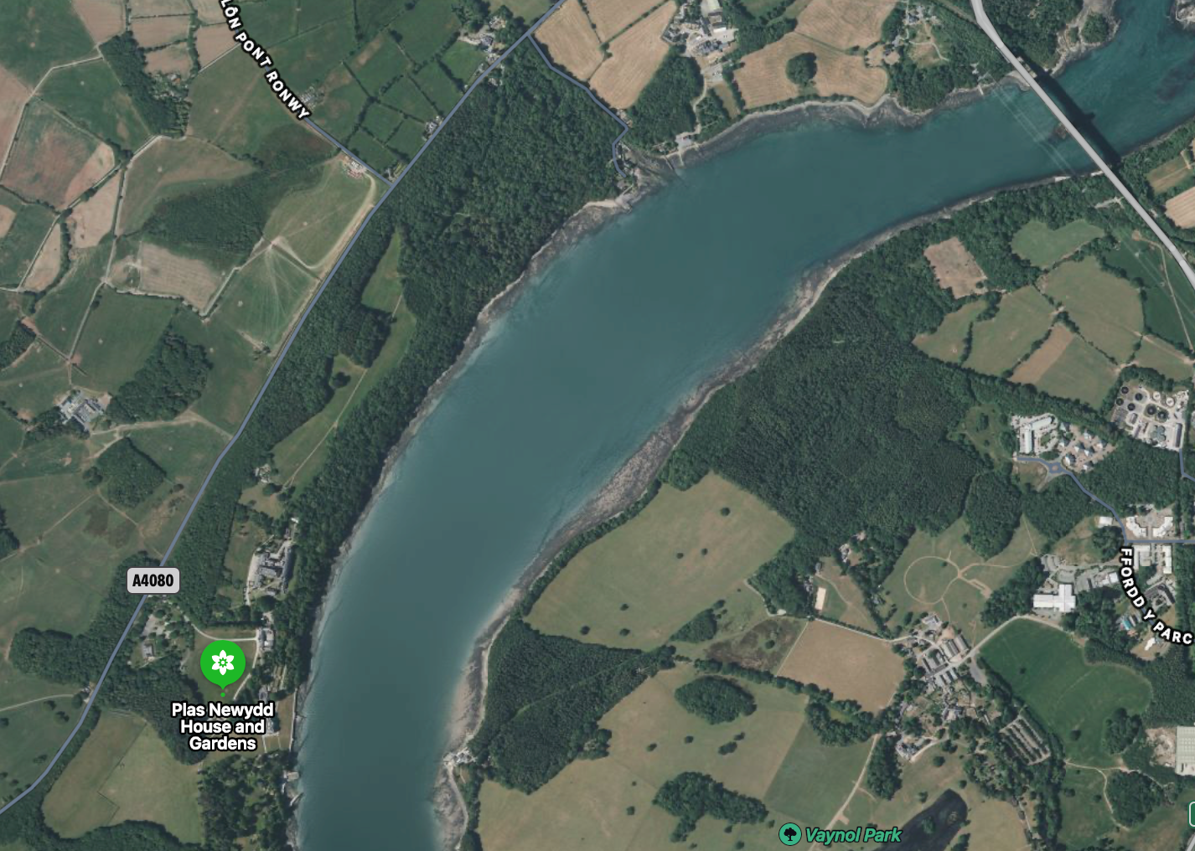
The Conway Centre
Llanfair pwllgwyngyll gogerywch wyrndrobwyll llandysilio gogo-goch

Slide 4
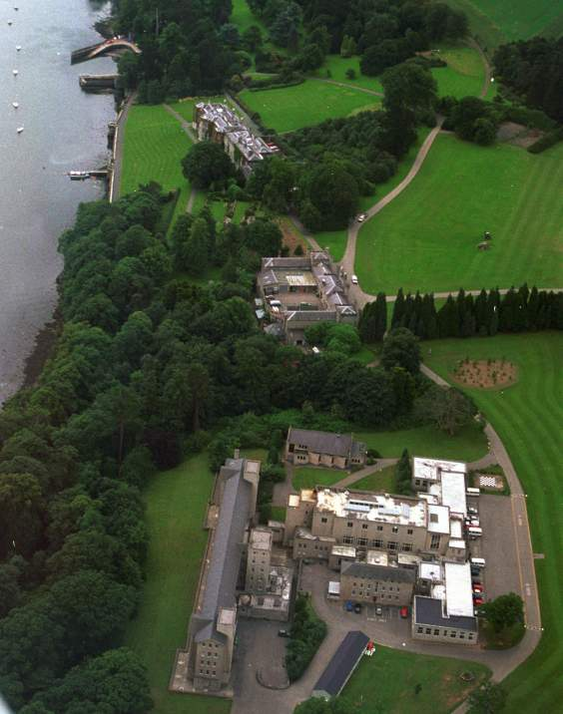
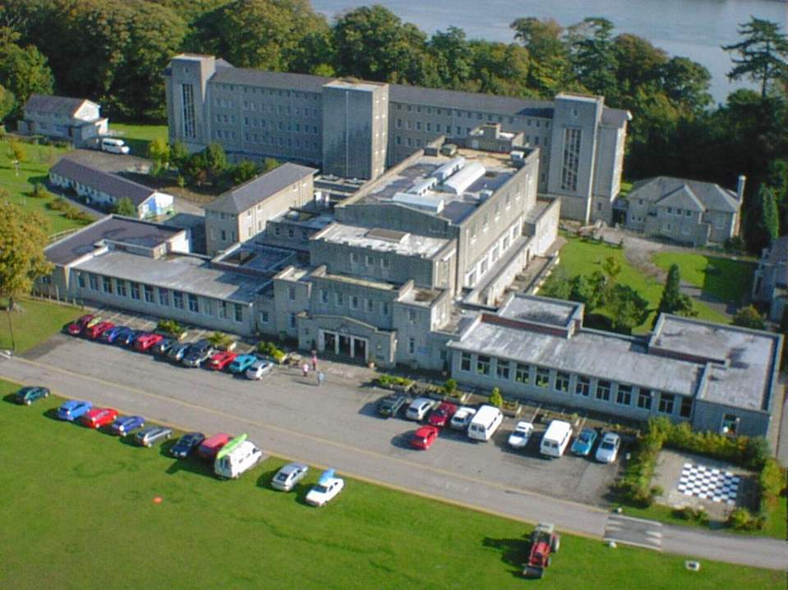

Slide 5

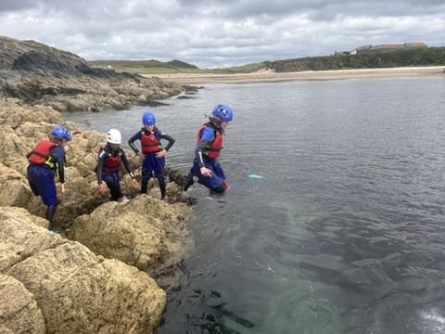
Our values and aims
Cooperation
Achievement
Respect
Enjoyment

Slide 6
Penmon
Hafod

Slide 7
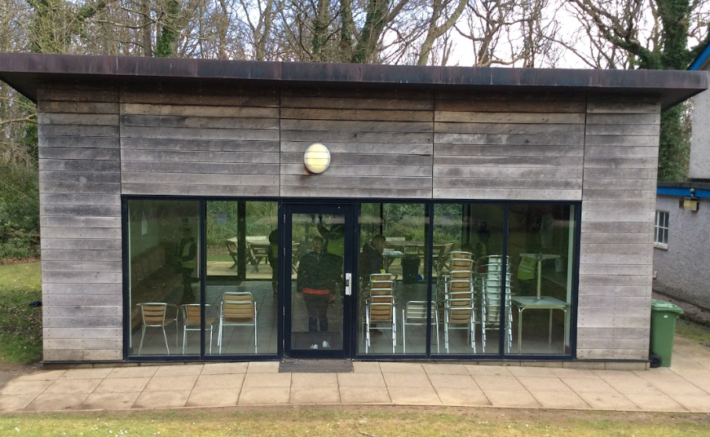
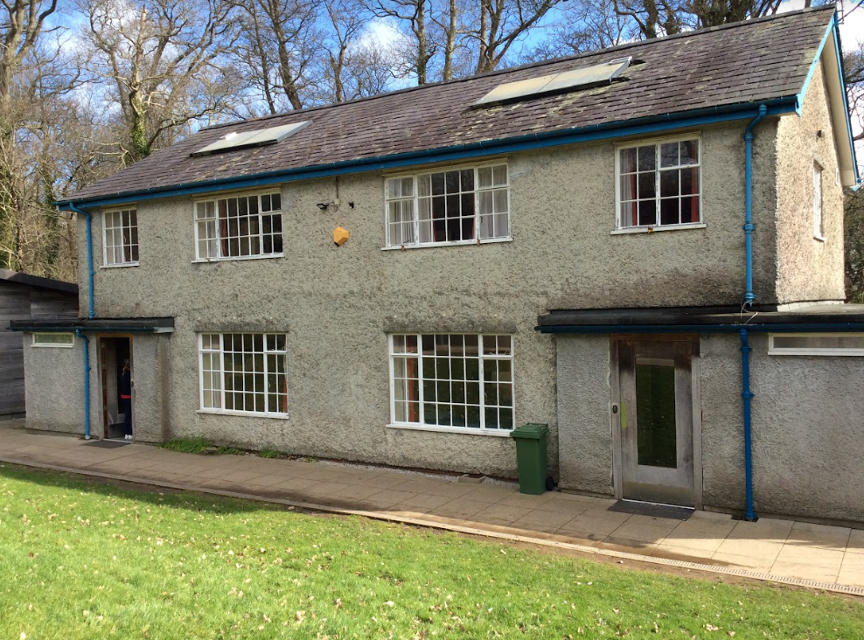
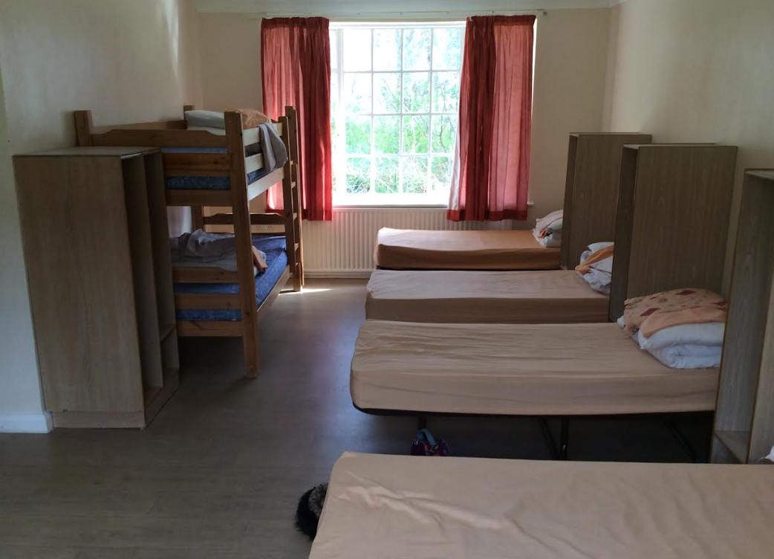
Accommodation
Year 5 will be staying in a house called Haford. Year 6 will be staying in a house called Penmon. The houses are split into two sides or floors, with separate dormitories, showers and toilets for girls and boys.
Both houses also have sole use of our very own common room, to chat, relax and chill after a busy day.

Slide 8
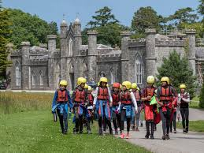
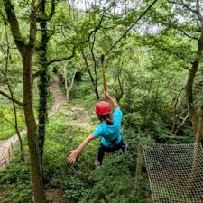
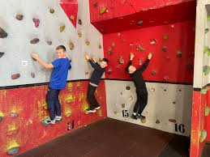
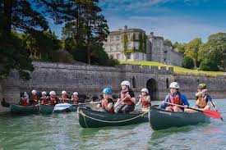
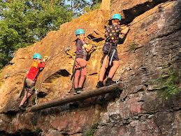
Y5 Activities
The class will be split into 4 groups. Each group will take part in the following activities.
Via Ferrata
Indoor climbing
Canoe
Low ropes and zipwire

Slide 9
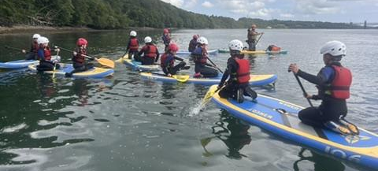
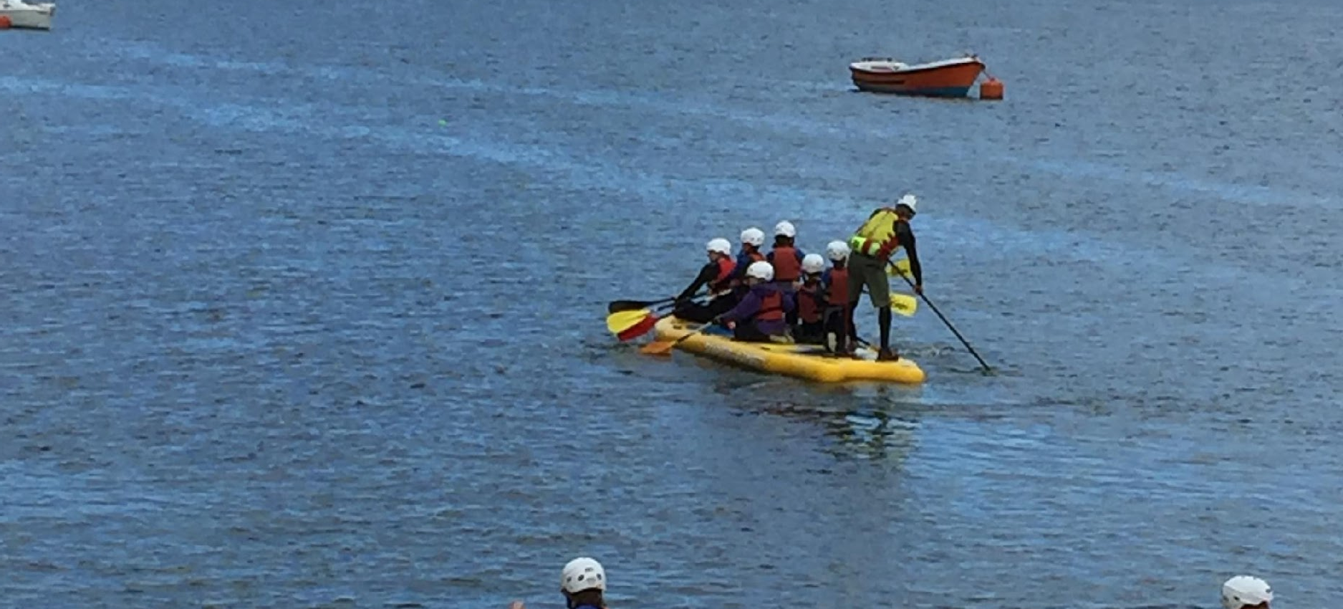
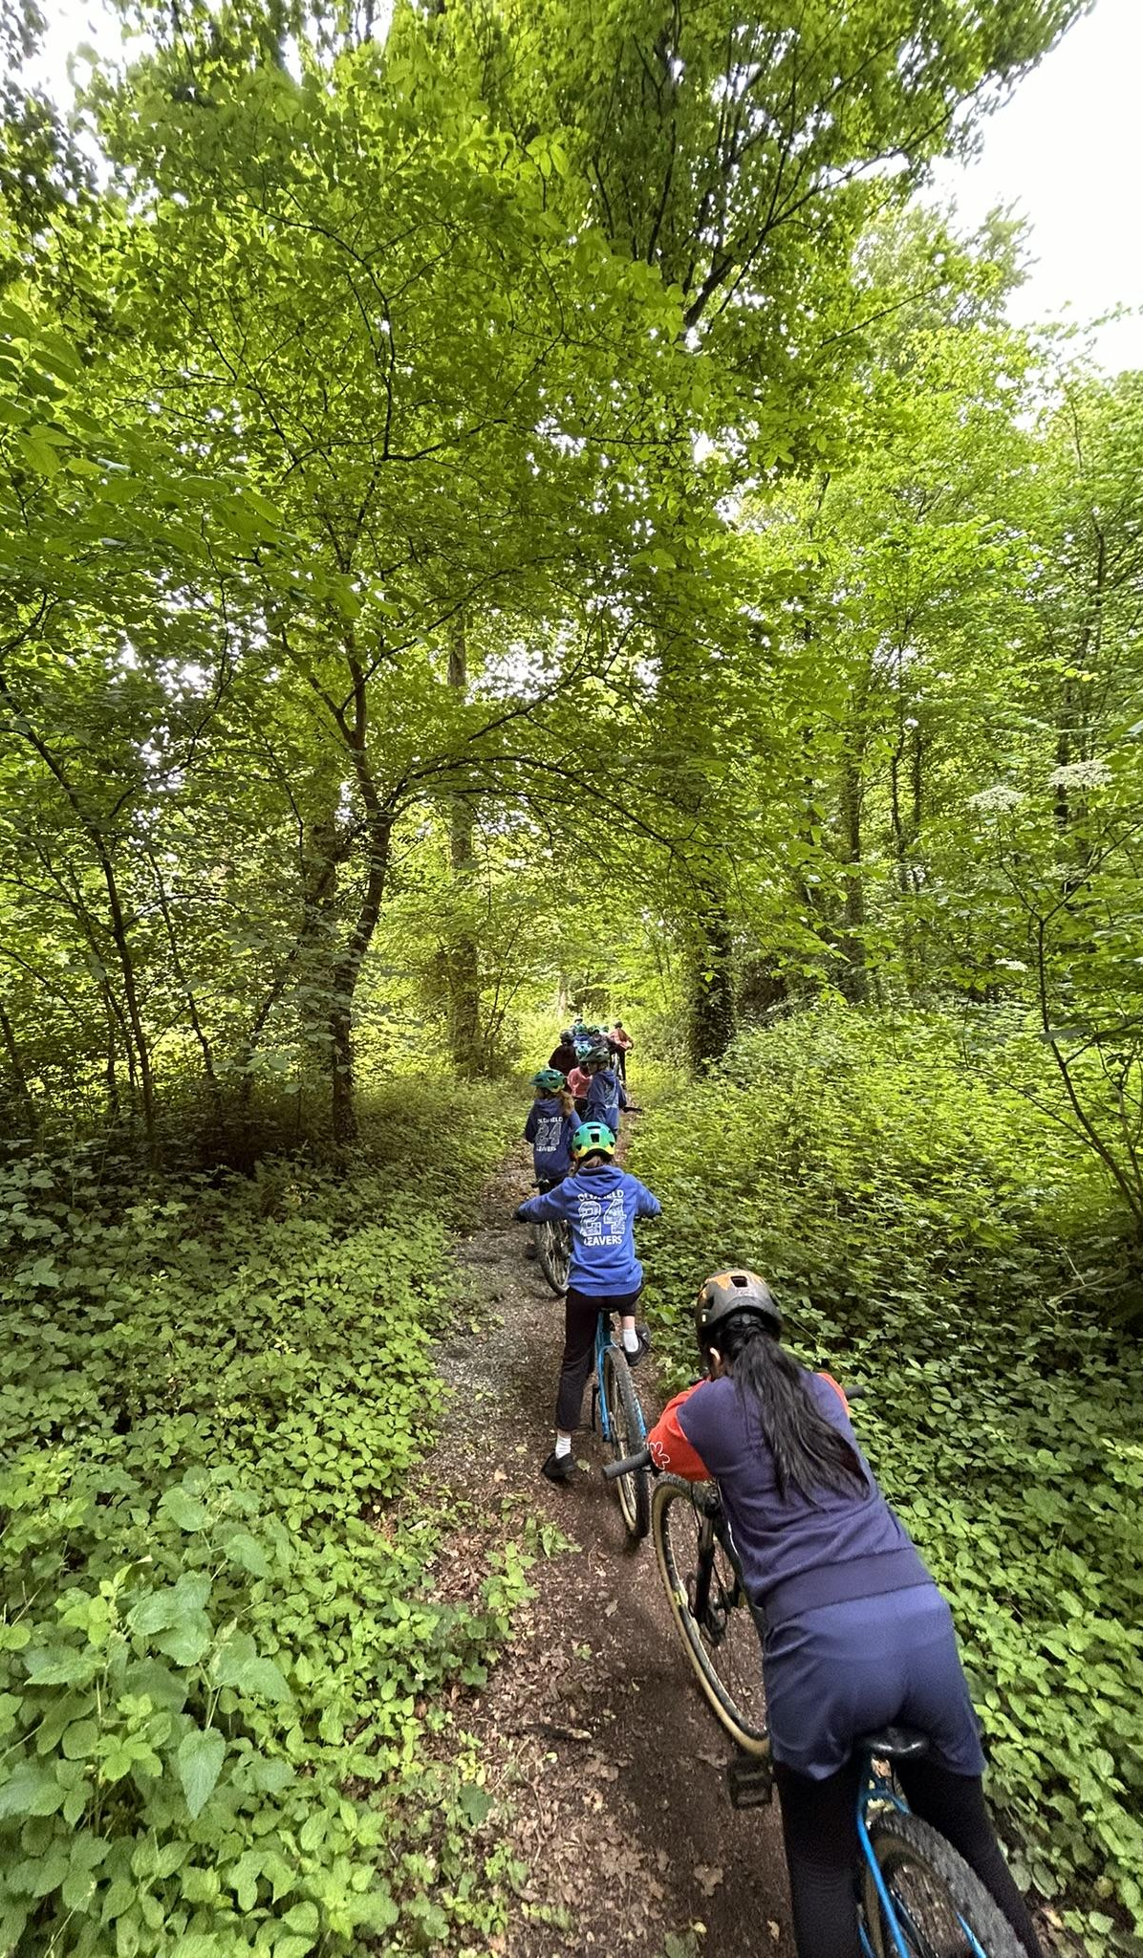
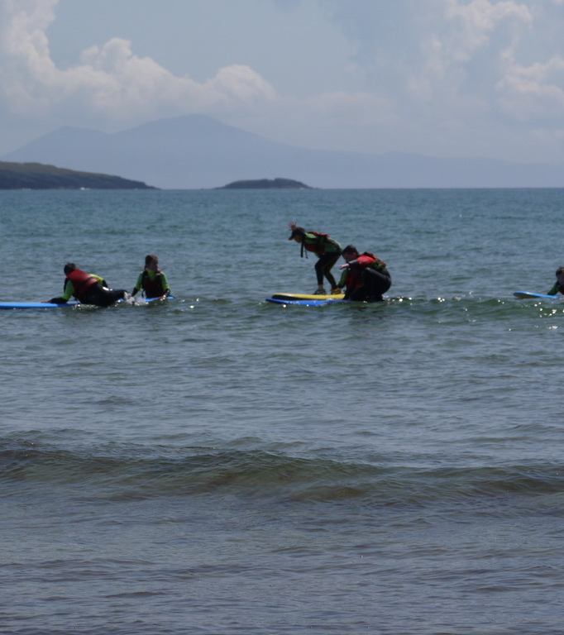
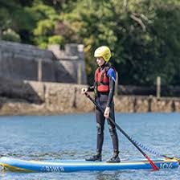
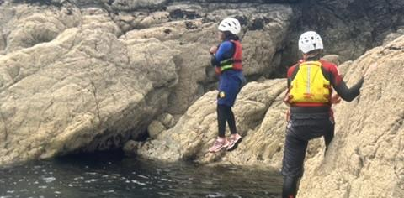
Y6 Activities
Stand Up Paddleboarding
Adventure Day - surfing or coasteering depending on the weather
Kayaking or mountain biking

Slide 10
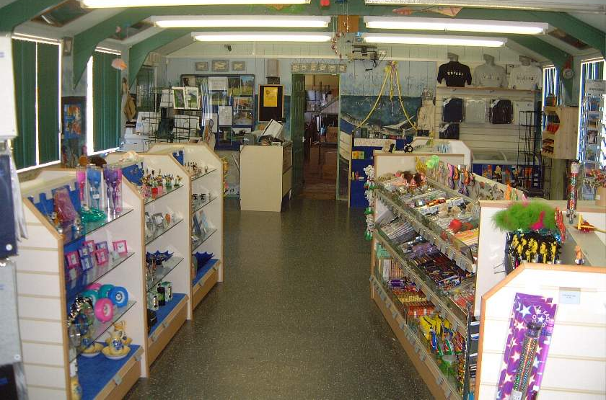
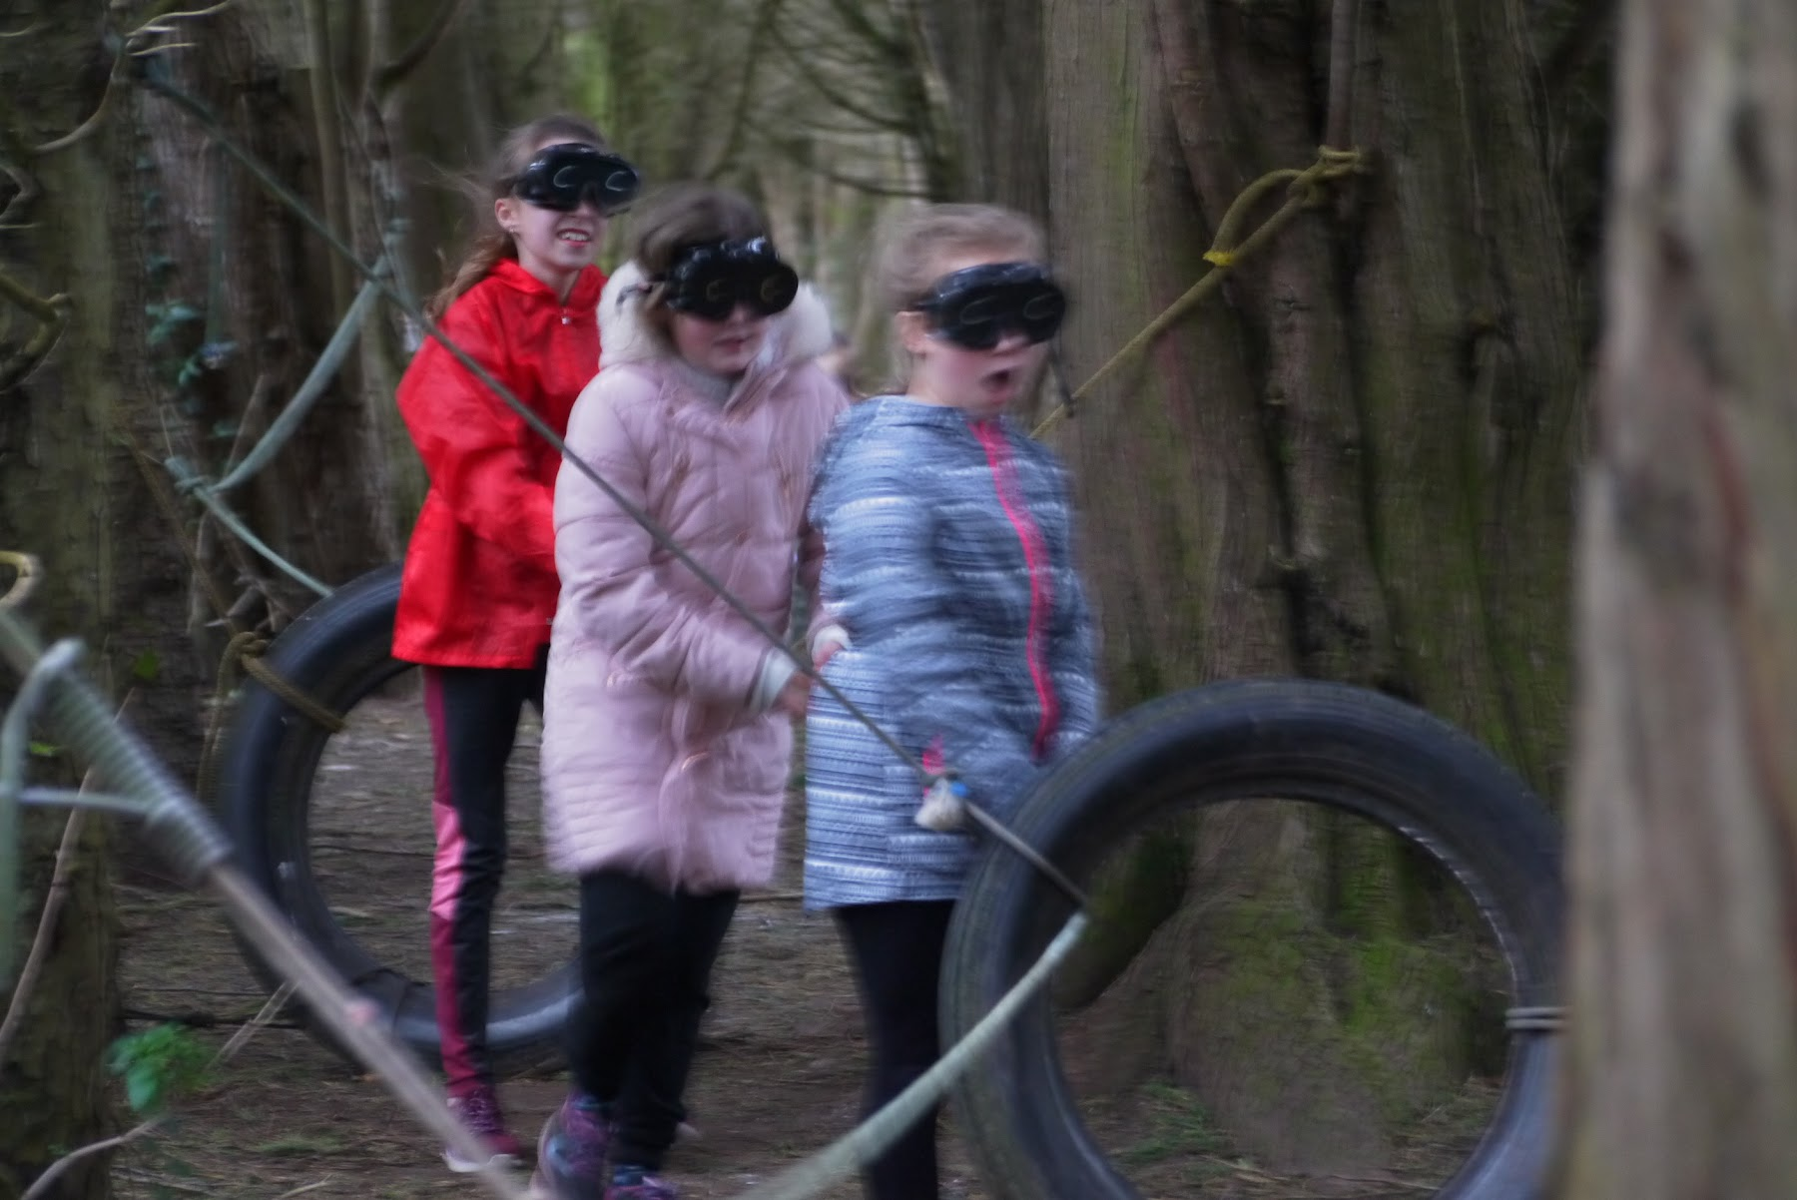

Evening Activities
During the evening of our first night we will be orienteering and the children will have some free time to enjoy games on the field.
On our second evening, we will visit the shop to spend their spending money (no more than £5 please) and enjoy an Oldfield disco.

Slide 11
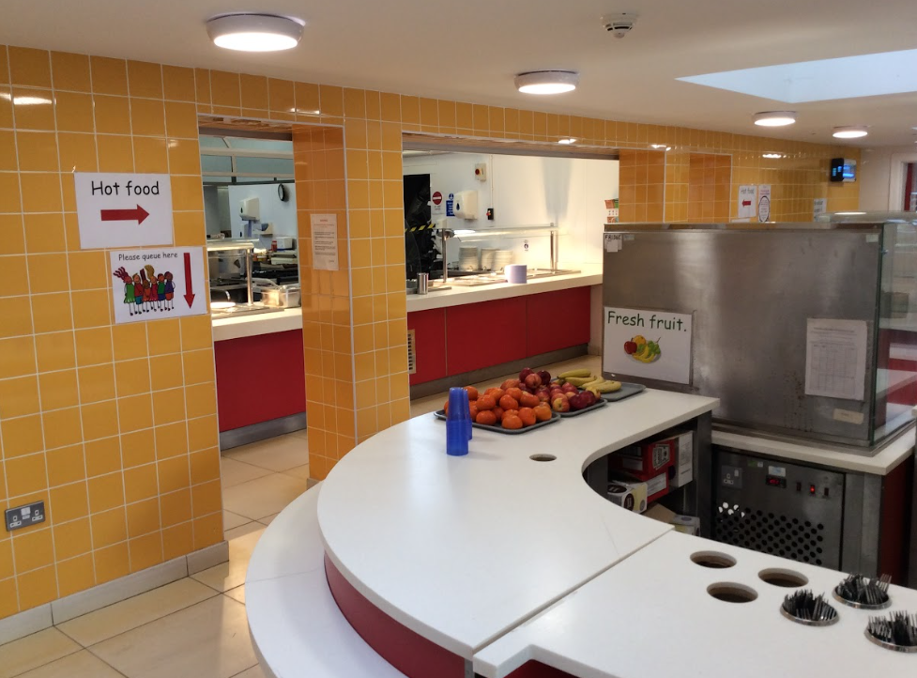
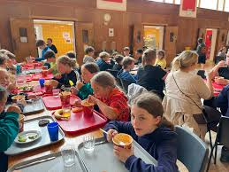
Food and Drink
Sample Menu
Apple/ Orange Fruit Juice 100ml Choice of Cereals (Cornflakes, Rice Krispies, Weetabix, Bran flakes) Sausage, Scrambled Egg, Baked Beans. OR Vegetarian/Vegan Breakfast Veg Sausage (x2), Tomato, Beans, Scrambled Egg OR Croissant (V) Fresh Fruit Toast with Butter & Jam (V)
Jacket Potato/Deli Bar Jacket Potato Hot /Cold Baguette served with a selection of fillings. Served with Mixed Salad & Coleslaw
Pasta Bolognese served with Garlic Bread Margarita Pizza Served with chips (V) Salmon & Sweet Potato Fishcakes served with chips Seasonal Vegetables /Mixed Side Salad A selection of desserts

Slide 12
Year 5 Kit List
Clothes to travel in
Packed lunch for Monday lunch and reusable water bottle
Night wear - cuddly toy
Toiletries - toothbrush and paste, soap, shampoo, brush/comb, flannel? (No aerosol)
2 Towels
5 changes of underwear and socks
4 T-shirts & 3 warm tops/fleece/hoody
4 pairs of trousers (Not Jeans) for activities (joggers/combats/leggings)
Swimming costume/shorts
Waterproof coat – not for activities
Gloves/Hat/Sun hat
Shoes - 1 for water activities (Wellies), 1 for getting dirty, 1 pair for good & Slippers
Book/Magazine
Medication – labelled and handed to staff member
Sun cream - labelled
£5 Max spends
Biscuits/Cake optional (nut free)
Carrier bags & Bin bag

Slide 13
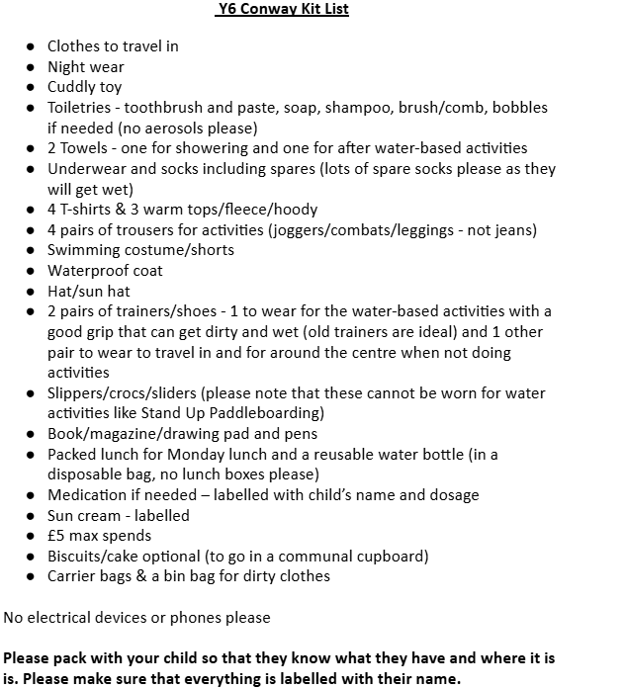
Year 6 Kit List

Slide 14
Spending Money
On our second night we will have the opportunity to visit the centre’s small shop.
Children can bring upto £5 spending money. The shop sells a small range of souvenirs, sweets, drinks and snacks.

Slide 15
Medication
If your children requires any medication whilst we are away, please complete the Form C.
On the morning of departure, please hand the medication (labelled in a sealed bag) to a staff member.

Slide 16
What to do next
Complete your Form C
Kit list
Check out the parent hub
Practise making the bed!

Slide 17
Questions?

