Slide 1



How to help your child in Year 1

Slide 2

Meet the Year 1 Team
Mrs Argent-Belcher
Class Teacher
(Monday- Wednesday)
Mrs Hopkins
Class Teacher
(Thursday- Friday)
Mrs Davis
Teaching Assistants

Slide 3
Additional Teachers
Mrs Chloe Vickers- House of Dance
Mr Hadfield - Forest School
Mrs Anders- PPA

Slide 4
Settling into Year 1
The curriculum builds upon and extends from the EYFS.
Learning in EYFS is play-based. Children have lots of freedom to choose their own activities and can move on to something else when they choose. In year 1, learning eventually becomes more formal, subject-based and adult-directed.
We will use a play-based / small focus group approach and gradually move to more formal learning when appropriate

Slide 5



What to bring each day…
One book bag with reading record & reading book: These are changed on a Monday and will be sent home on a Wednesday.
Labelled water bottle containing water only
Fruit snack

Slide 6
A typical morning in Year 1
Morning Challenge & Registration (8:50am)
Phonics lesson
Guided Reading lesson
Playtime & Snack - toast or a piece of fruit/vegetable from home (10:30am -15 mins)
English/Maths lesson
Lunchtime (12:10pm - 1hr)

Slide 7
A typical afternoon in Year 1
Lessons vary in the afternoon
Science; Art/D&T; Computing, PE;
My Happy Mind; PSHE; History
Break time 2:15pm
Whole School Assembly (2:45pm Monday & Friday)
Home time 3.20pm

Slide 8


Phonics and Reading
Phonics Screening Check
A short, statutory assessment to confirm whether children have learnt phonic decoding to an appropriate standard.The screening is due to take place in June. Date TBC
It is a list of 40 words - 20 real words and 20 nonsense words.
Phonics screening results will be reported to you in your child’s end of year report and results will be reported to the Local Education Authority by the end of the school year.
The assessment is age-appropriate. It is an enjoyable activity for children which takes no more than a few minutes.

Slide 9


Writing
We use high quality texts.
We focus on one text each half term.
We will be learning how to:
combine words to make sentences
use capital letters for names of people
and the personal pronoun ‘I’
leave spaces between words
begin to use capital letters and full stops
There will also be plenty of opportunities to read a story together, explore the meaning of new vocabulary and develop our comprehension skills.

Slide 10

Handwriting
We continue Year 1 by practising how to form letters correctly. It is important that the children are starting and ending individual letters in the correct place.
We will also do our best to support children with the correct pencil grip.

Slide 11
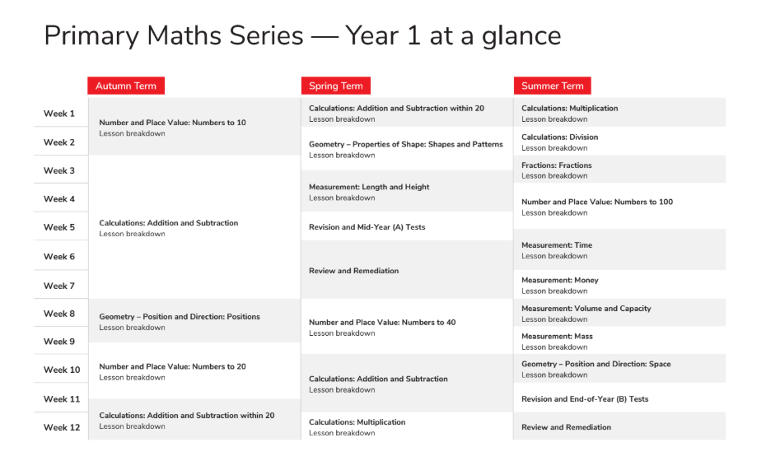
Maths
We teach a Mastery approach - depth not breadth.
Lesson Structure:
Explore problem - lots of discussion in pairs using Maths equipment & whiteboards.
Share our ideas & discuss as a class
Journal – together and independently
Read our textbooks together
Complete the workbook independently
Activities are then adapted to support or provide extra challenge.

Slide 12



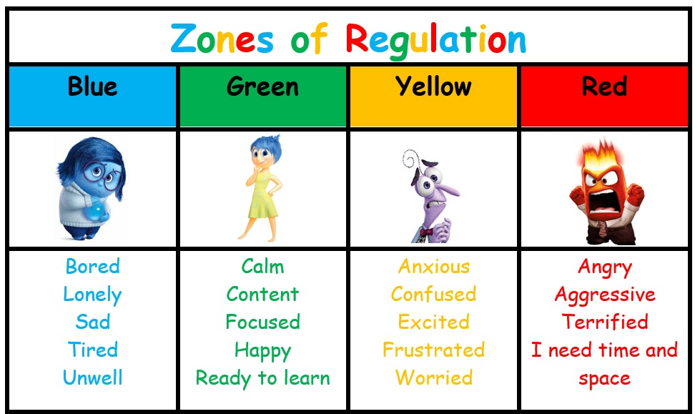

Science, RE &
the Wider Curriculum
Science; RE; Geography/History; Art/D&T; Computing; Music; PE & Forest School; My Happy Mind & The Zones of Regulation; No Outsiders
Each half term we will update the Year 1 Class Page on the Oldfield website.

Slide 13
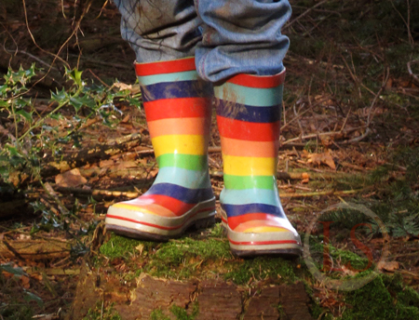
PE & Forest School
This half term, PE will be on Wednesday afternoon (House of Dance with Chloe) & Friday morning with Mrs Hopkins.
Children will need to come into school in their school PE kit.
Please try to remember to tie long hair back & take earrings out.
The children will be outdoors for PE as much as possible – they can wear tracksuit bottoms as part of their kit.

Slide 14
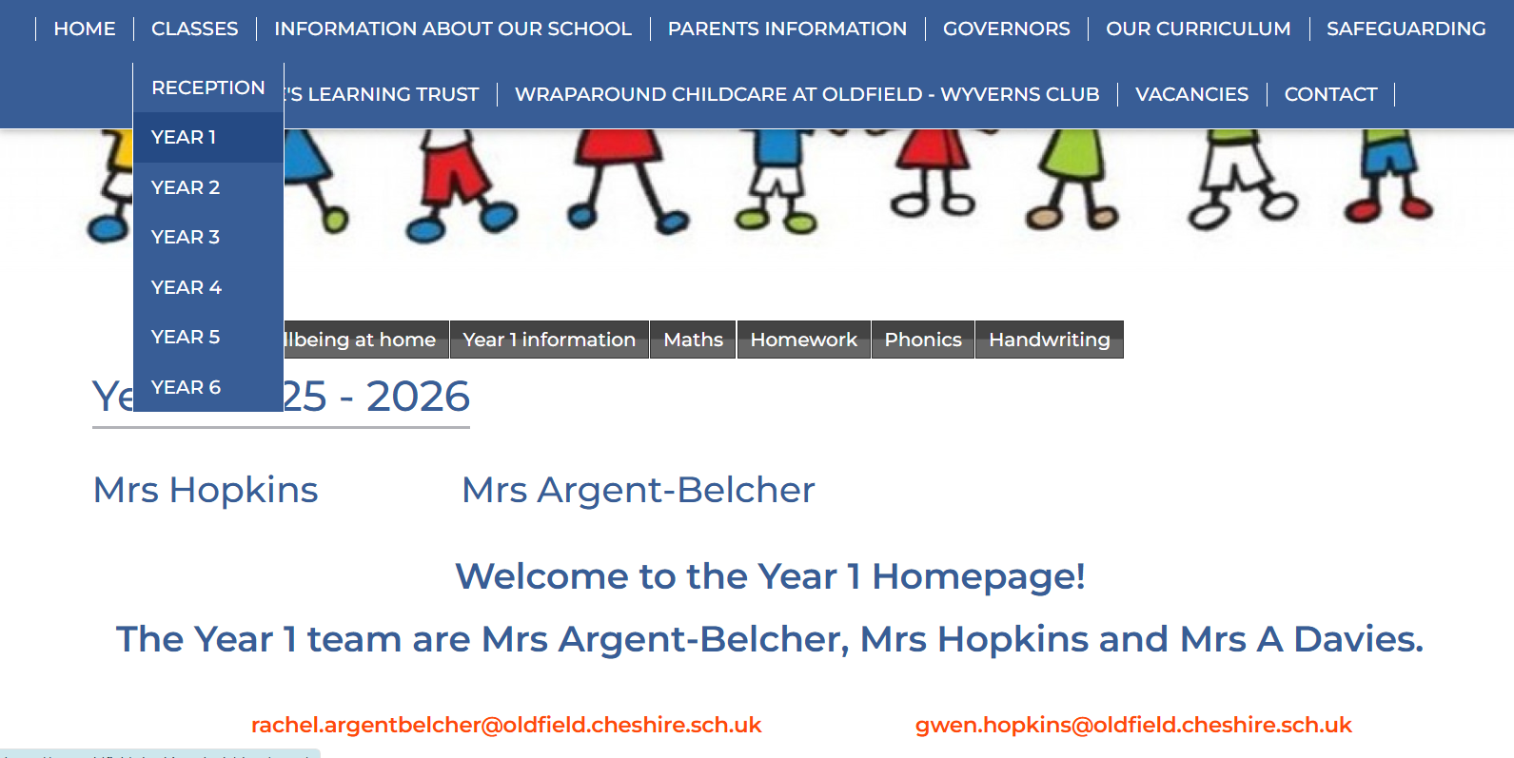
Where to find information
Class Page
Newsletter
Whole school/Y1 emails & text messages through School Spider

Slide 15


Reading
Keep in mind that reading or listening to the same book more than once is no bad thing – in fact, it is really important for children. Re-reading lets them see or hear words and phrases enough times to remember them, and also helps them to think again about the ideas in the book, perhaps noticing things they missed the first time.
Bear in mind that reading or listening to the same book more than once is no bad thing – in fact, it is really important for children. Re-reading lets them see or hear words and phrases enough times to remember them, and also helps them to think again about the ideas in the book, perhaps noticing things they missed the first time.
https://www.littlewandle.org.uk/resources/for-parents/
It is so important our children are confident readers by the time they leave Oldfield.
According to studies, the reading age required to understand many GCSE papers is now around 15 years and 7 months.

Slide 16


Reading
We also encourage all the children to choose books to read for pleasure. Click on the Reading tab on our Class Page for lots of book ideas or come and chat to us for some book recommendations. There is the Great Boughton Library on our doorstep and lots of books in our reading corner which the children are always welcome to take home.
Feel free to record these in their reading record too.
Each term, we order books for our reading corner from the Education Library which the children help to choose.

Slide 17
General Information
Please let the office or us know if there is any change as to who is picking your child/children up.
If your child needs to take medication during the school day, please complete a form at the school office. Please make a note of the expiry date.
Update permission for photographs to be used on our website/media if necessary.
Snack - Toast is 25p a day. Please book your snack on Parent Pay for the week ahead. You could also supply your child with a piece of fruit/vegetable.

Slide 18
School Uniform
Please support us by sending your children in the correct school uniform including PE kit. This is outlined on the school website.
Please label ALL uniform including PE kit and coats.
No jewellery other than stud earrings and a smart and sensible wrist watch.
Please make sure your child has a waterproof coat each day as we go outside during playtimes in most weather conditions.

Slide 19
Thank you for listening!
Don’t hesitate to pop in with any worries, concerns
or updates.
The Year 1 team are always available to speak with you before or after school or alternatively please email us. Sometimes we don’t pick up emails in the morning so if it is urgent, it is best to phone or email the office if you can’t speak to us directly.
Rachel.argentbelcher@oldfield.cheshire.sch.uk
Gwen.hopkins@oldfield.cheshire.sch.uk

