Slide 1


How to help your child in Year 6
2025 - 26

Slide 2

Meet the Year 6 Team
Mrs Oldman
Class Teacher
Mrs Ross
Support Staff

Slide 3
Our Values
We are proud to be at Oldfield Primary School and have 4 School Values:
Cooperate
Achieve
Respect
Enjoy
Children are rewarded for positive behaviour through:
Recognition Certificates
CARE Sticker Charts
Class Pebbles

Slide 4

Start & Finish Times
CLASS | START TIME | FINISH TIME
Year 6 | 8.40am (Gates Open) 8:50 (Registration) | 3.20pm

Slide 5
Morning Routine
There will be always be an adult close by to the door to greet the children and take any messages.
Each morning the children will complete a set Morning Challenge.
Children will be responsible for changing their own reading books.

Slide 6
A typical day in Year 6
Morning Session
Morning Challenge & Registration
Whole School Assembly (Monday)
Grammar, punctuation and spelling
Writing session
Snack & playtime (15 mins)
Maths session
Lunchtime (1hr)

Slide 7
A typical day in Year 6
Afternoon Session
Reading
Wider curriculum
PE: dance (Monday) and tag rugby (Tuesday)
Key Stage 2 singing assembly (Thursday)
Buddy time (Friday)
Whole School Achievement Assembly (Friday)
End of Day Story

Slide 8
PE
PE this half term will be on a Monday and a Friday.
Children will come into school on their PE days wearing their PE Kit.
Every child should have the correct kit for PE.
Children must wear separate trainers for PE rather than their normal school shoes.
Earrings are not permitted on PE days.
Please try to remember to tie long hair back.
The children will be outdoors for PE as much as possible – they can wear tracksuit bottoms as part of their kit.

Slide 9
Assessment
We assess children in lots of different ways:
Formative assessment from their work and contributions in lessons
Feedback & live marking in lessons
Marking written responses
Practice papers in the Spring term
KS2 assessments (SATs) in May
Working through past papers together

Slide 10

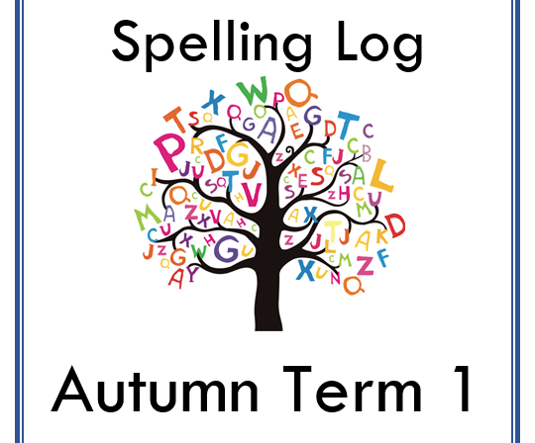

Home Learning
Reading for pleasure remains the priority
1 x 30 minute piece of homework (Maths/English/Wider Curriculum)
Set on a Friday and handed in by Thursday.
Spelling activity
TTRS & Rollama (later in the year)

Slide 11
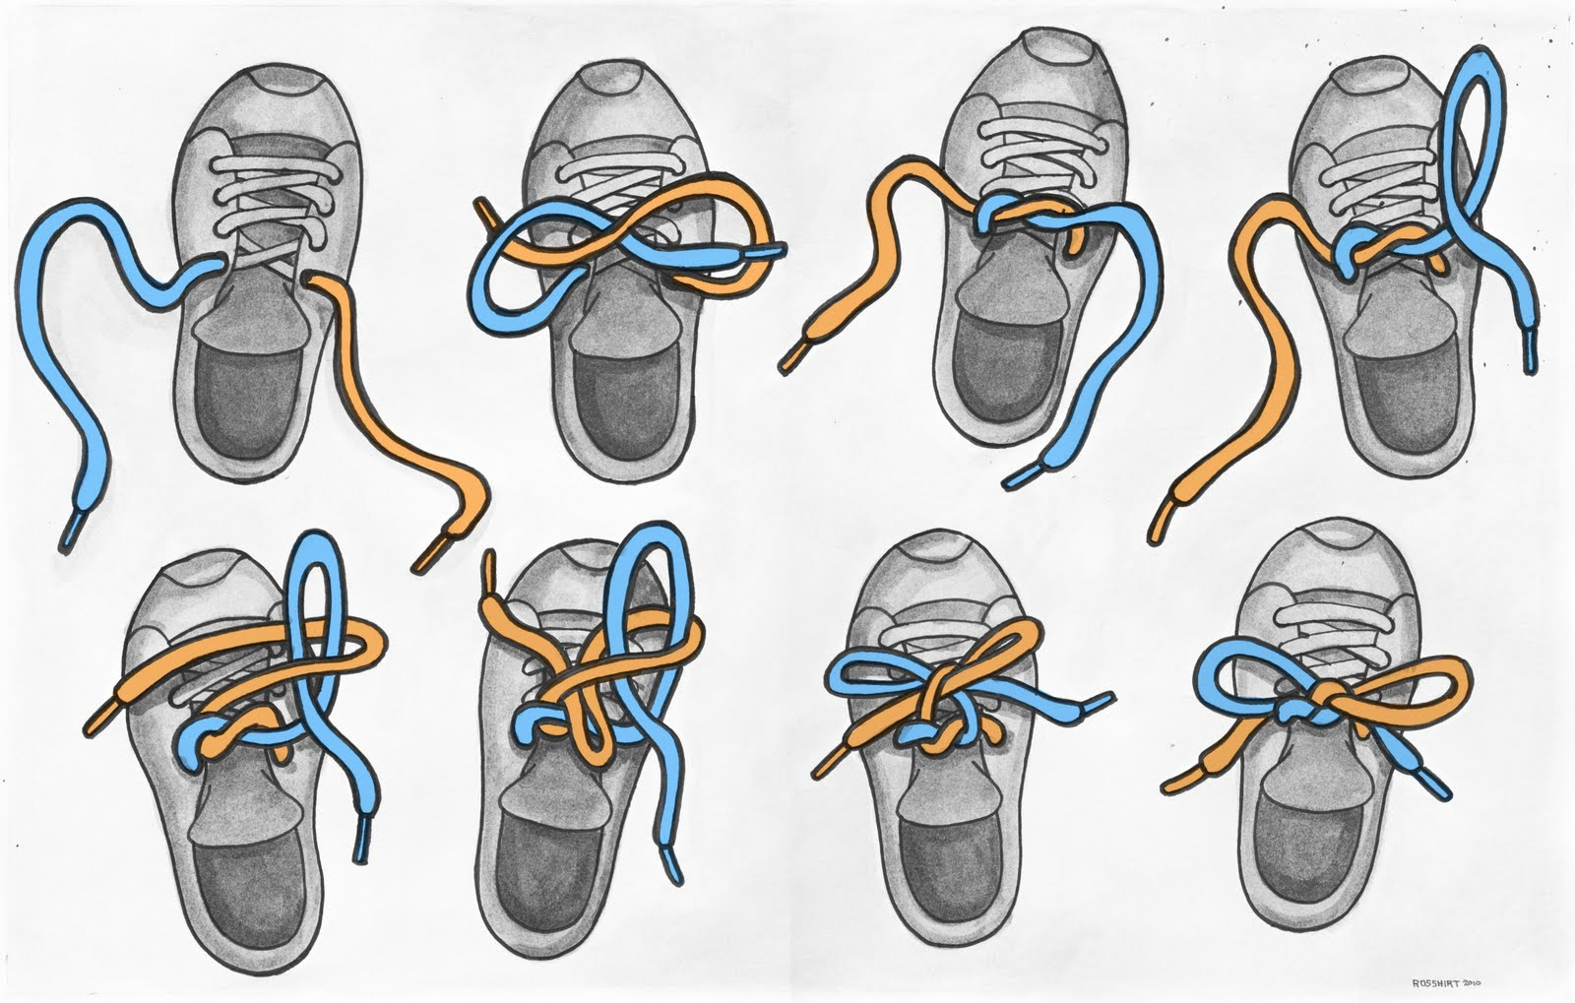

Skills to work on at home
In KS2 we actively promote independence.
It would be helpful for pupils to learn how to:
Tie their shoe laces.
Draw straight lines using a ruler.
Cut out neatly with scissors.
Tell the time on a digital and analogue clock.

Slide 12
Dates for your diary
Open days/evenings for local high schools
Apply for your chosen high school by:
31st Oct
KS2 Assessment week (SATs): Monday 11th May

Slide 13
A few reminders…
The Year 6 team are available to speak with you before or after school or alternatively please e-mail us.
Please check the website regularly as we try to update the class page as often as we can.
www.oldfield.cheshire.sch.uk
Don’t forget to ensure that you have downloaded School Spider App which allows messages to be sent easily.

Slide 14
Thank you for listening ☺
If you have a question, feel free to email.

