Slide 1



Welcome to Crigglestone St James CE Primary Academy
New Starter Information
September 2026-27

Slide 2

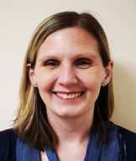
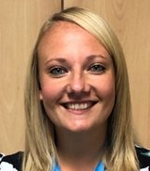
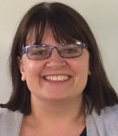
Senior leadership
Miss Minor - Headteacher
Mrs Dent – Deputy Headteacher
Mrs Butterworth - SENDCo

Slide 3
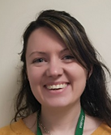
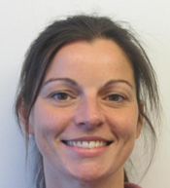
Our Reception Team
Class Teachers
Mrs Anderson – RA
Miss Ingham - RI

Slide 4

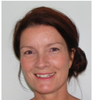
Our Reception Team
Mrs Drewell
Tuesday - Friday

Slide 5
Transition
We have been carrying out visits to the children’s nurseries and speaking to the staff that work with them, as well as saying hello to the children.
The children are then invited to spend the morning with us on Thursday, 2nd July and will stay for lunch. Please collect at 12.40pm.
We will ensure that your child has the best possible start to their journey at St James’ Academy.

Slide 6
What is the Early Years Foundation Stage?
The Early Years curriculum is based on the recognition that children learn best through play and active learning.
Pupils will learn through a mixture of adult-led activities (whole class, small groups and one to one) and independent self-initiated activities.
Throughout the year, pupils will build up a ‘Learning Journey’ of work, photographs and videos.

Slide 7
The Early Years Framework
We follow a framework called ‘Development Matters’, which is guidance that sets out the learning, development and assessment requirements for all children until the end of their reception year.
Activities are planned to support your child to meet the Early Learning goals in 7 areas and the needs of the children.
The 7 areas of learning: Communication and Language, Personal, Social and Emotional Development, Physical Development, Literacy, Mathematics, Understanding the World and Expressive Arts and Design.

Slide 8
The Early Years Framework
At the end of the academic year, the class teacher will complete an EYFS profile for all children. All information collated through previous assessments, observations and formal teaching will inform our final judgements against each of the 17 Early Learning Goals. We will only use the terms ‘emerging’ or ‘expected’ to describe our final judgements.

Slide 9
The Early Years Framework
The EYFS framework has never prescribed a particular teaching approach and the framework holds true to this value. Our philosophy of early year’s education remains the same with play and wellbeing at the heart of everything we do.

Slide 10
Tapestry
The children’s progress throughout Reception is regularly monitored via observations. ‘Remark on the remarkable.’
We use the online learning journal system Tapestry to collate assessment information.
Information will be fed back to parents and can be accessed on mobile devices and computers.
Parental observations can be logged using a secure login system.

Slide 11
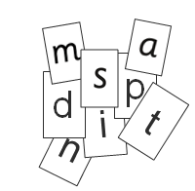
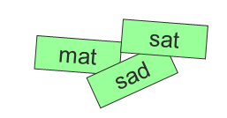
Phonics and Reading
At St James’, we aim to foster a love of reading, therefore, the development of reading skills is a priority.
A key focus of our teaching is the development of phonic skills.
We follow the Read Write Inc programme.
We teach the sounds first – in a specific order.
We then teach your children to blend those sounds together in order to read words.

Slide 12
Our Topics
Autumn Term – Marvellous Me (includes all about me and superhero adventures)
We spend the first half term getting to know the children and settling them into the new routines and structure of school life.
Photograph from home – We would like to create a ‘Family’ photo display. We ask for one photo per child that shows them with their immediate family or important people in their lives. We reference these photos throughout the year and it can provide comfort to many children. We ask that you to bring a photo to school by Friday, 17th July, 2026, so that we can have this ready for September.

Slide 13
Typical Day in Reception
8.40am: Doors Open– Mrs Anderson and Miss Ingham will be on the door ready to welcome the children.
8.50am: Morning task and morning routine
9.00am: Phonics
9.40am: Collective Worship
10.05am: Movement break, snack and a vocabulary lesson
10.30am Whole class English input
10.45:Children will work in provision areas (Indoor and outdoor) /focus group work
12.00pm: Lunchtime
1.00pm: Handwriting lesson
1.10pm: Whole class maths input
1.25pm: Children will work in provision areas (indoor and outdoor) / focus/group work
3.00pm: Story time
3.20pm: Hometime – Children will be released once a member of staff has seen the parent/carer

Slide 14
Useful Information
Please send in a water bottle that is clearly labelled with your child’s full name. The water bottle will be sent home daily.
Fruit is provided every day (free of charge). We also provide an alternative snack. To cover the cost of this and any cooking we may do throughout the term, we ask for a voluntary donation of £5 per term.
For water and mud play, children will need a waterproof jacket, a pair of waterproof trousers and a pair of wellies. These items need to be labelled with your child’s name and left in school.

Slide 15
Reminders
PE kit - come to school in kit on PE days
Waterproofs – leave in school
Wellies (a pair to stay in school for water/mud play)
Spare clothes
Sun hats in the summer
Hat, scarf & gloves in the winter
Books – everyday
Fruit (every day if preferred)
Water bottles (everyday)
ALL CLOTHES, SHOES AND BAGS must be clearly labelled with your child’s name.

Slide 16

Homework
Phonics homework will be set every week. The children will come home with sounds to learn each week.
Reading book
During Autumn term, children will be assessed to decide which reading book they bring home. We have a range of books that progress from picture books to books with words.
Tapestry can be used as a way of recording activities at home – photographs of practical activities, or special things you do at home.
Half termly information sheets will provide you with information to identify the topics and activities we will be carrying out in school. Information will also be shared on Tapestry.

Slide 17
Parents as Partners
We value any contribution that you would like to make to your child’s journey in Reception, through discussions with your child’s teacher and by inputting them onto your child’s Tapestry account.
Parents Evenings – twice a year (the first one is a settling in conversation).
Open events – parents can come in to see what their child has been doing at school

Slide 18
Finally…
Over the next two weeks, we will update our school website with any further information.
If you have any questions or you require further information, please email the following address: admin@stjamesacademy.co.uk
We all look forward to welcoming you and your family to St James’ Academy.

