Slide 1

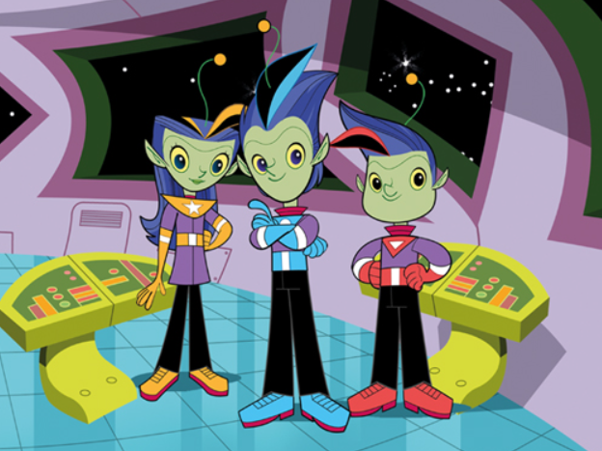
RWI Spellings
Updates and question opportunities

Slide 2
Overview of the programme
The RWI spelling programme is for fluent readers in years 2 – 6.
All year 2 children start at the same point and they begin by revisiting the sounds they were taught in RWI phonics.
It is taught 15-20 mins a daily and we teach spellings whole class.
The spelling programme teaches spelling concepts in a sequence that matches the National Curriculum.
Year 2 all start at the beginning of the programme.
Regardless of where children start, there are plenty of opportunities for children to complete all of the spelling units by the end of year 6.

Slide 3
What’s changed and why?
Through moderation, we have noticed that spellings is the area of writing that is holding children back.
RWI phonics works so well so we have refined the way we are delivering RWI spellings so that sessions are more inline with phonics based scheme.
The new writing framework has a big focus on transcription skills – spellings need to be the focus so children have more of a chance to be successful.
We have reassessed children in January to identify their gaps in their spelling knowledge and this has informed our teaching and where to start the spelling programme (Years 3-6)

Slide 4
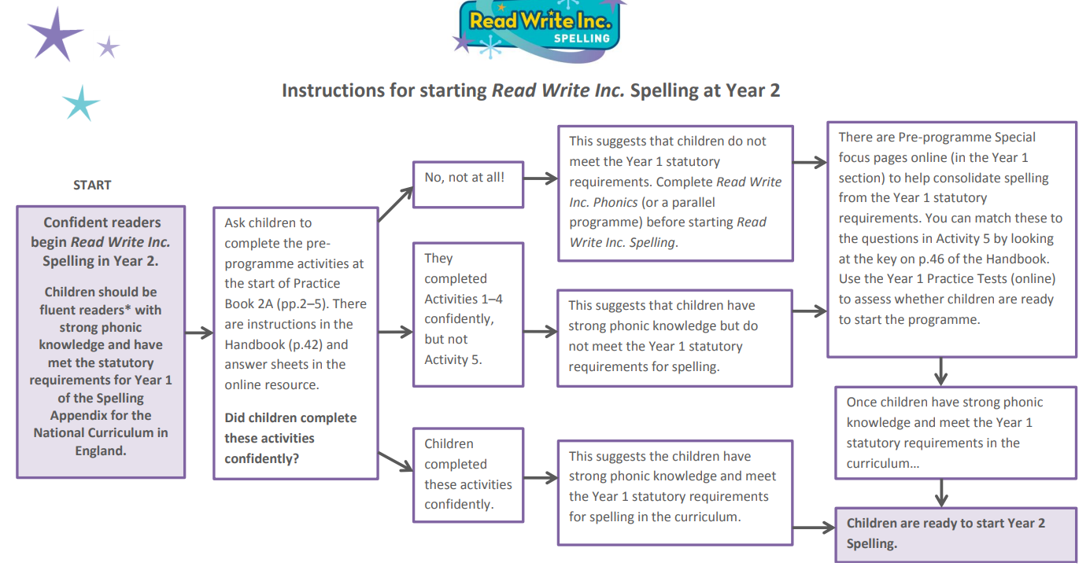

Slide 5
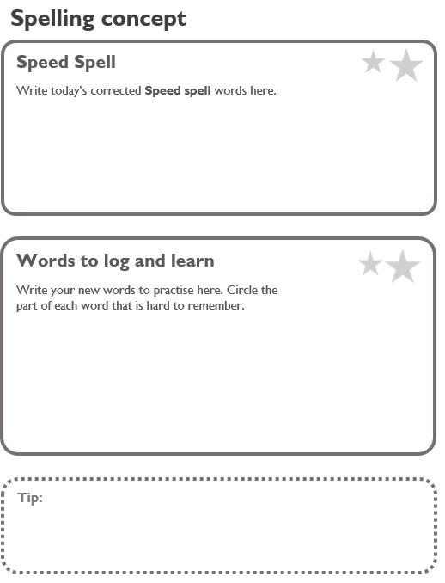
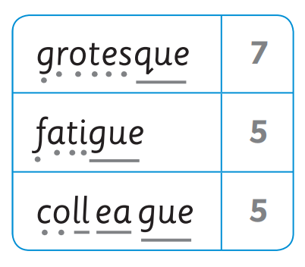
Teaching a spelling unit
Session 1
Speed Spell - children are given 6 words from the previous words which they found hard to test on. This may include RED OR ORANGE WORDS (these are the statutory spellings for the year group).
If they get any wrong, they write them in their personal log book (grey spelling books using the sheet template for that unit).
New spelling concept is introduced through RWI VIDEO
Spelling Zone activity that links with the video
Dots + Dashes – Helps children to sound out their words (phonics).

Slide 6
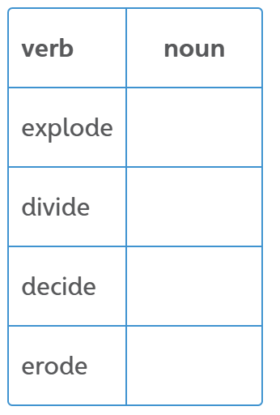
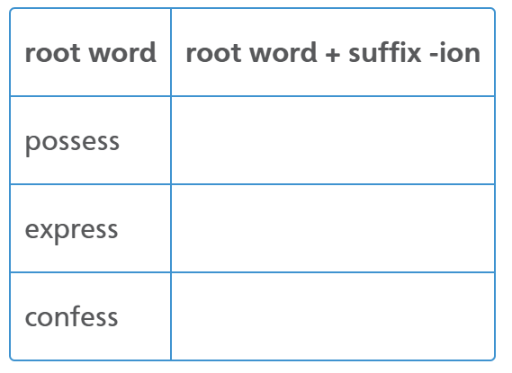
Session 2
Rapid Recall – go over the spelling concept
Word Changers – word building, adding suffixes and prefixes to root words, changing their class.
Red and Orange words which are taught by:
Mnemonics
Say as it looks
Word in a word
Sticky Letter
Rap it

Slide 7
Session 3
Word to log and learn – children to select x5 words from the week that they have found the hardest and write in their grey spelling book using the template for that unit. Children circle the hard part of the word and think about how they will remember the word – tell their partner.
Dictation - Practise focus spellings for the week in the context of a sentence.
Red and Orange words!
Mnemonics
Say as it looks
Word in a word
Sticky Letter
Rap it

Slide 8
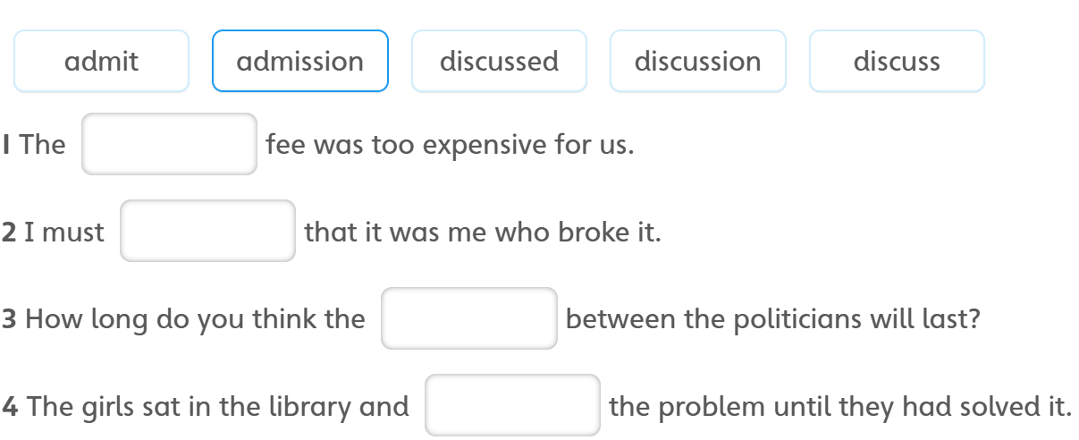
Session 4
Four -in-a-row – A chance for self assessment. Partners to spell the word in their activity book.
Teach word families in ‘Choose the right word’
Red and Orange words!
Mnemonics
Say as it looks
Word in a word
Sticky Letter
Rap it

Slide 9
Session 5
Team Teach – We order the words from hardest to easiest to spell.
Children to then do it in their teams.
Another chance for assessment. In groups, children test themselves with the words from easiest to hardest.
Jumping Red and Orange Words
Another assessment opportunity. The orange or red words that have been looked at are the ones children practise writing in their activity book. Give children clues e.g. “Think – word in a word.”
The words which they have got incorrect, they go back in the pile to keep practising.
Get new words so that there are always 6 for the next unit.

Slide 10
Y1 spellings – how does this fit in?
The spelling concepts from the National Curriculum, that need to be taught in Y1, have been mapped out to match the RWI phonics programme.
The spelling programme doesn’t start until year 2 but we are going to follow the same structure in Y1 so we are consistent.
Children in Y1 will bring home the grey spelling book with their log and learn sheet with the spellings that they need to practise.

Slide 11
Homework – how can I help?
For each unit, children will bring home a new log and learn sheet.
Their speed spell will be words from previous units that they are still working on. These need to be practiced and will be brought home after session 1.
The words to log and learn will be words from the current unit they are learning. These need to be practise and will be brought home after session 3.
Grey spelling books need to be brought back to school every day so children can practise their spellings at school and at home.
Units should typically take a week but to ensure we are not rushing through spelling concepts and moving children on if they are not ready, units may take longer than a week. Please check your child’s spelling book to see what spelling concept is being taught.
https://home.oxfordowl.co.uk/english/primary-spelling/

Slide 12
Next steps for us.
Looking at ways to enhance our spelling homework using online resources.
We will be moving to half termly assessments using the RWI spelling tests that link with the units that they have been taught. This is so we can identify gaps and go over any units that they are not confident with.
Decisions on how we can communicate the spelling progress of your child further.

Slide 13
Any questions?

