Slide 1

PSHE Curriculum
(Personal, Social, Health and Economic education)
Crigglestone St James CE Primary Academy
Parent consultation

Slide 2

Aims of the consultation
To introduce our One Life curriculum and the resources that we use to deliver lessons.
To explain what the statutory requirements are for schools
To inform you of the non-statutory lessons that we teach and why we deliver them

Slide 3
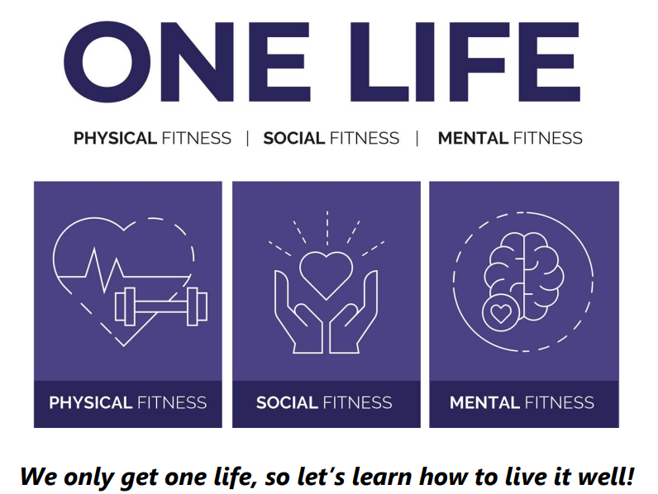
PSHE Curriculum: One Life
One Life, which is a universal offer for personal development, explicitly teaches all children how to live their ‘one life’ well.
The clear end goal of the programme is to ensure that all pupils know how to live a healthy, safe and happy life and know to manage their academic, personal and social lives in a positive way.
At the heart of One Life is building strong mental, physical and social fitness. Each statutory requirement has been broken down into age-appropriate content which has been sequenced and connected to ensure that learning is built upon and can be activated outside of the classroom.
This programme of work covers the statutory components of Relationships and Sex Education (RSE) and Health Education guidance and ensures that all content is taught and not told.

Slide 4
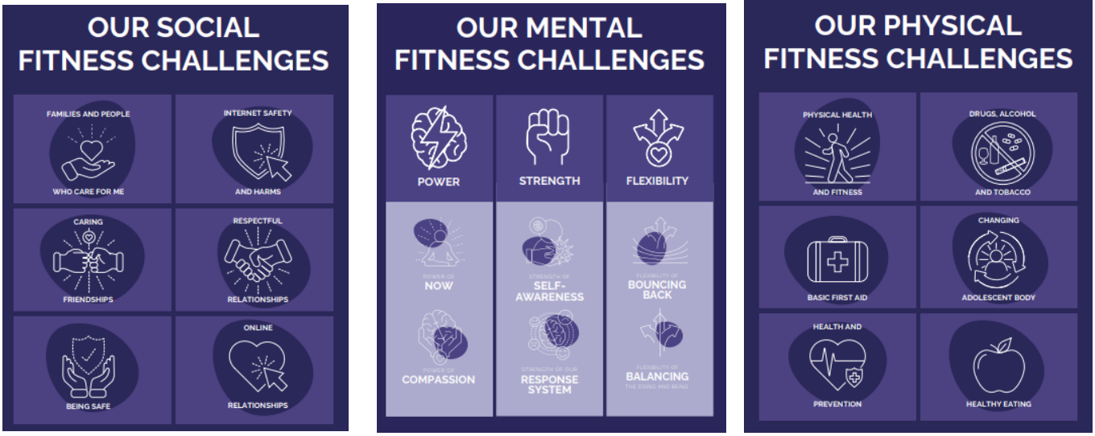
PSHE Curriculum: One Life
One Life is based on the following three components:

Slide 5
How we deliver PSHE at St James
To be effective, PSHE will:
Be age appropriate
Be based on the needs of the children
Be progressive, recapping and building on prior knowledge
Be inclusive
Be delivered by trained and knowledgeable staff in a safe environment
Prepare children adequately for puberty in a supportive and safe environment
Prepare children for adult life
Establish and agree basic ground rules that will be followed by children and the teacher
Promote positive relationships
Value all contributions

Slide 6
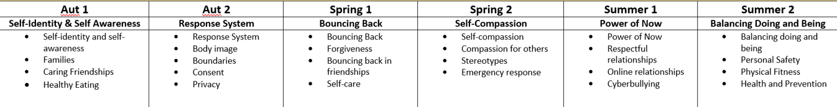


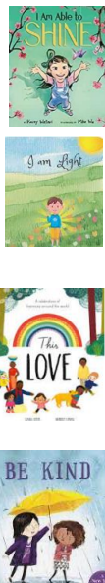

How we deliver PSHE at St James
The same theme is taught across school.
The learning is progressive across the different phases.
Learning is based upon books, with the books used being suitable for the phase that they are intended to be used in.

Slide 7
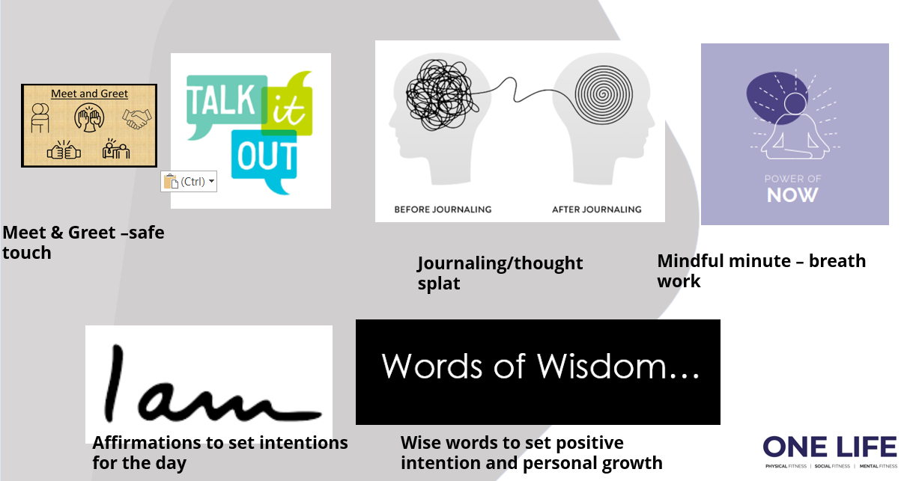
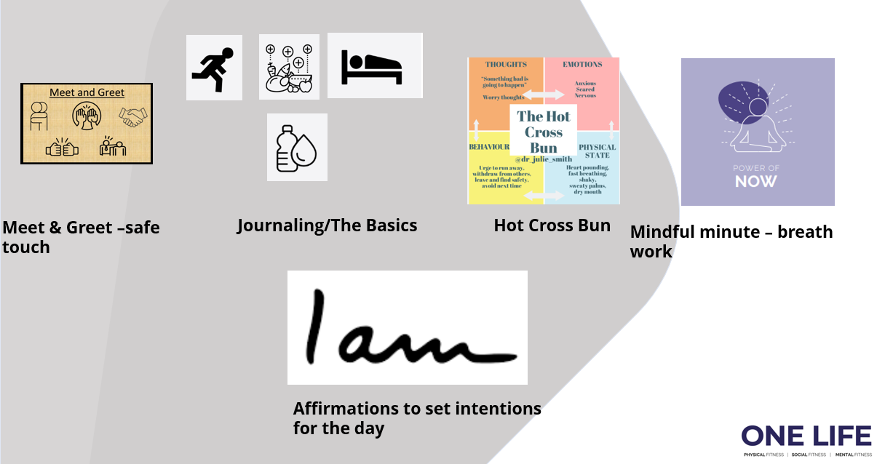
Morning Routine

Slide 8
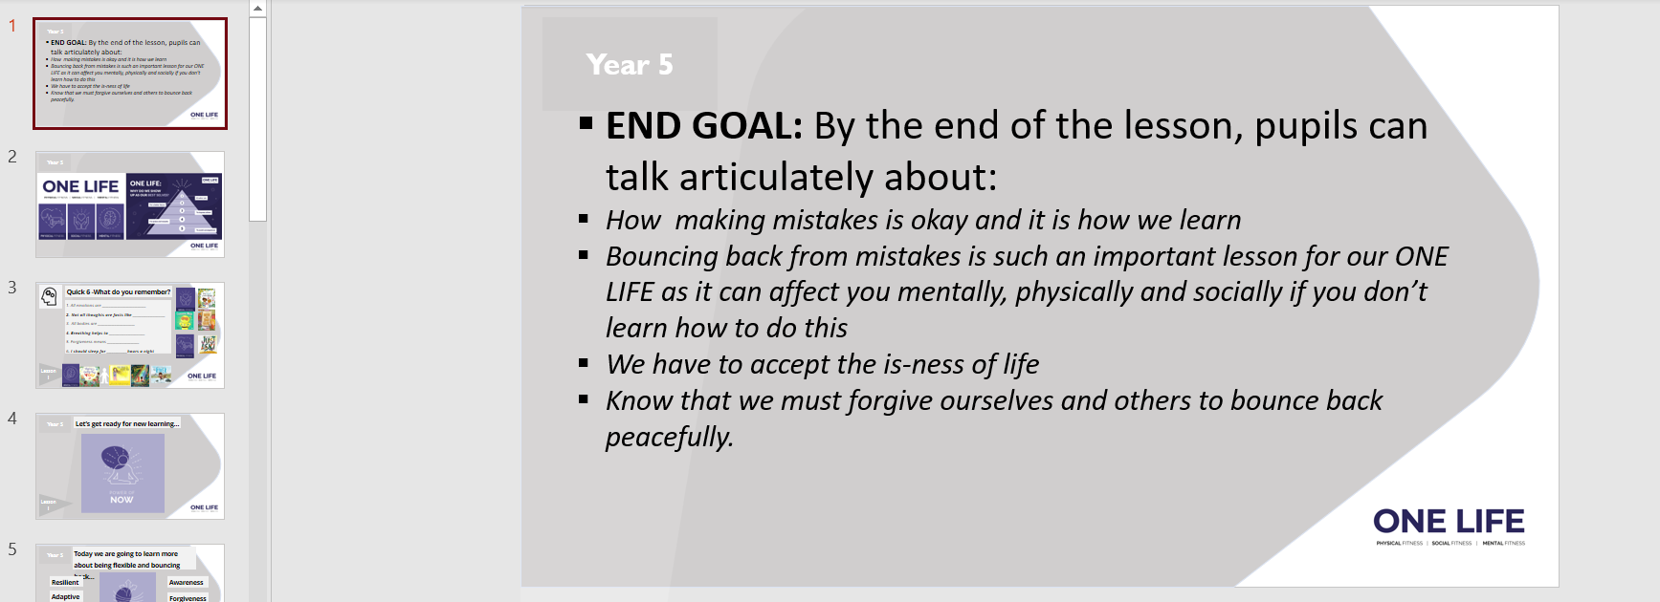
What does it look like in action?

Slide 9
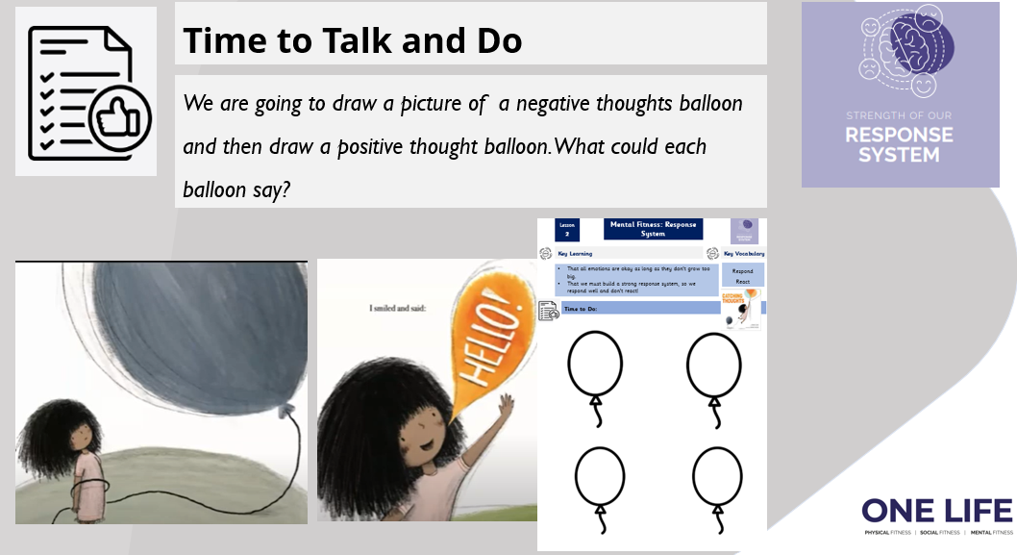
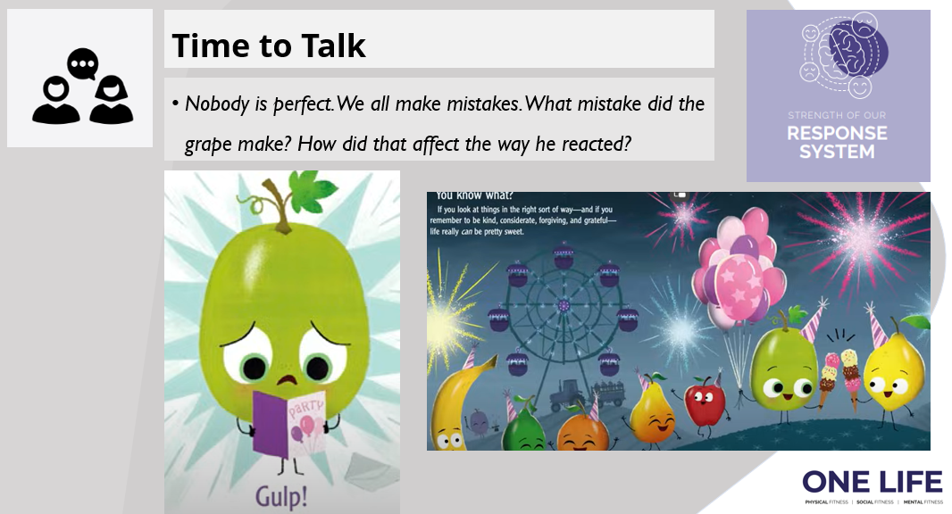
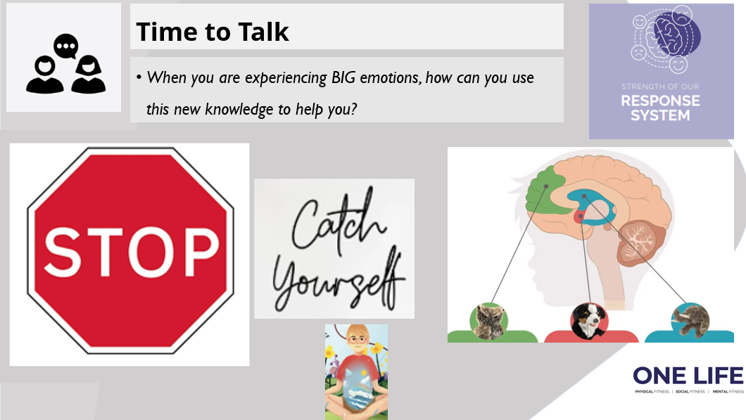
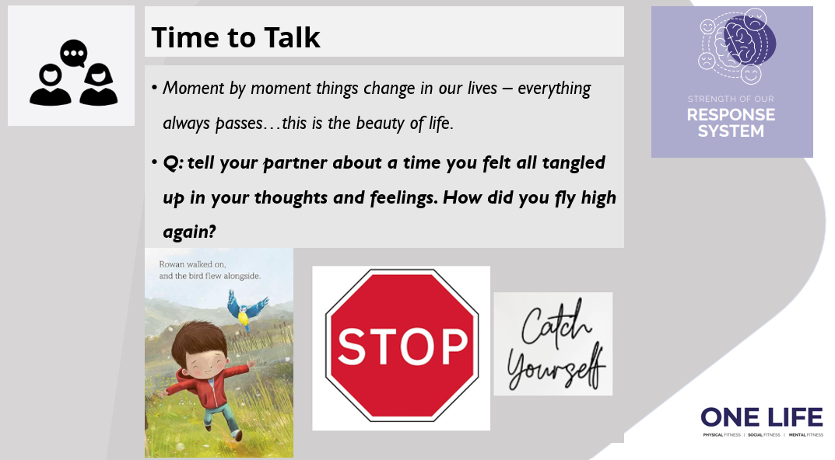
What does it look like in action?

Slide 10
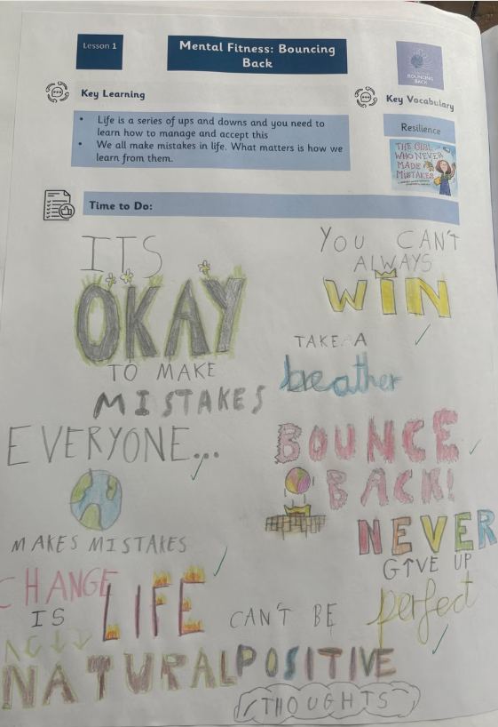
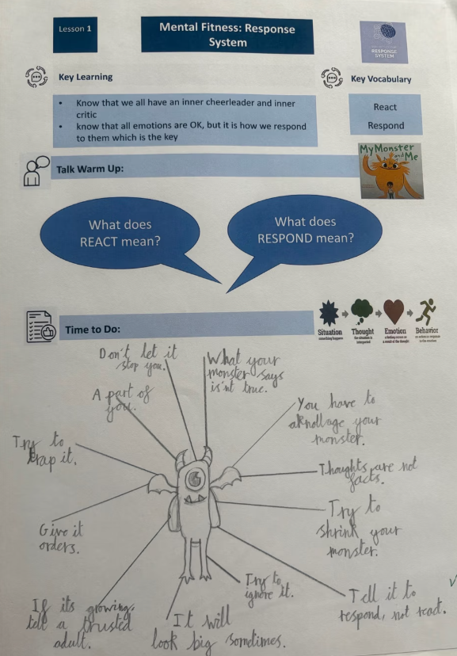
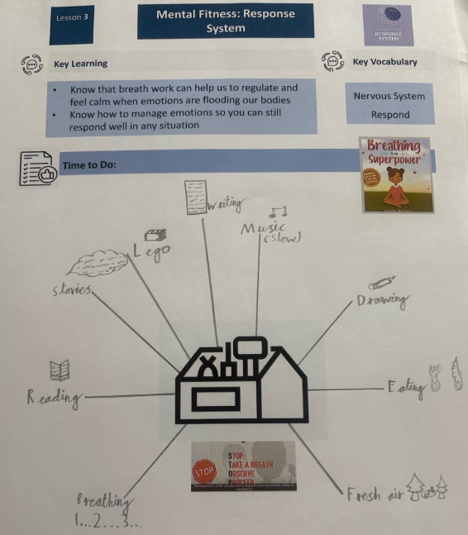
What does it look like in action?

Slide 11
Relationships education – A Statutory element of PSHE
RSE stands for: Relationships and Sex Education
Relationships Education has 5 core areas of learning:
  Families and people who care for me
  Caring friendships
  Respectful relationships
  Online relationships
  Being safe

Slide 12
EYFS – Where Relationships Education fits in
Building relationships:
  Work and play cooperatively and take turns with others.
  Form positive attachments to adults and friendships with peers.
  Show sensitivity to their own and to others’ needs.
Managing self:
  Be confident to try new activities and show independence, resilience, and perseverance in the face of challenge.
  Explain the reasons for rules, know right from wrong and try to behave accordingly.
  Manage their own basic hygiene and personal needs, including dressing, going to the toilet, and understanding the importance of healthy food choices.
Self regulation:
  Show an understanding of their own feelings and those of others and begin to regulate their behaviour accordingly.
  Set and work towards simple goals, being able to wait for what they want and control their immediate impulses when appropriate.
  Give focused attention to what the teacher says, responding appropriately even when engaged in activity, and show an ability to follow instructions involving several ideas or actions.

Slide 13
EYFS – Where Relationships Education fits in
The natural world
  Explore the natural world around them, making observations and drawing pictures of animals and plants.
  Know some similarities and differences between the natural world around them and contrasting environments, drawing on their experiences and what has been read in class.
  Understand some important processes and changes in the natural world around them, including the seasons and changing states of matter.

Slide 14
National Science Curriculum
Year 1 - Identify, name, draw and label the basic parts of the human body and say which part of the body is associated with each sense.
Year 2 - Notice that animals, including humans, have offspring which grow into adults.
Year 5 - describe the differences in the life cycles of a mammal, an amphibian, an insect and a bird.
Year 5 - describe the life process of reproduction in some plants and animals.
Year 5 - describe the changes as humans develop to old age. (They should learn about the changes experienced in puberty.)
Year 6 - recognise that living things produce offspring of the same kind, but normally offspring vary and are not identical to their parents.

Slide 15
Why we teach sex education
Children should know the correct terminology and vocabulary for their body parts. Children should know about their bodies and should be able to talk in confidence about what they are feeling / experiencing. This is especially crucial for safeguarding purposes.
As sex education is not compulsory, parents can choose to withdraw their child from sex education lessons.
The Science National Curriculum also teaches aspects of sex education – growing and changing, life cycles, reproduction. As this is part of the National Curriculum, this is compulsory. Parents cannot withdraw children from Science lessons.

Slide 16
Why is Relationships and sex education important?
Children should know that positive, caring and safe relationships are key
Puberty is starting earlier, for some children from the age of 8
For safeguarding purposes:
  Grooming
  Child sexual exploitation
  Abuse
  Sexting
  Online pornography

Slide 17
Which are the optional areas?
Year 6 only Year A and Year B | Making Babies – The statutory Relationships and Health content included in this lesson are covered elsewhere in the programme. This lesson is part of our optional content. The lesson will recap that the purpose of puberty is to prepare the body to reproduce. It explains conception through sexual intercourse. It explores the timeline of conception and pregnancy. It teaches legal facts about sexual intercourse. The lesson identifies other means of reproduction (including reference to same sex couples) including adoption, surrogacy and IVF. The lesson establishes that not every instance of sexual intercourse will result in a baby and talks briefly about contraception. It links to: Families and People who care for me, Being Safe (Relationships Education) and Changing adolescent body (Health Education)
Year 4 and Year 5 – periods – boys and girls separate

Slide 18
Summary
Parents have the right to withdraw children from Sex Education lessons that are not part of the statutory Science and statutory Relationships and Health Education (the optional parts that we will teach)
Schools have the right and obligation to teach PSHE topics to prepare children for life when they leave primary school.
You can view our PSHE policy on our website: Curriculum - PSHE

Slide 19

Any questions?

