Slide 1





I Can Help Maths
Tuesday, 8th October, 2024

Slide 2
Introduction
This powerpoint will be put on the school website
  I’ll send a message with where to find it once it is on
If you have any questions
  Please ask!
  If you want to ask afterwards that’s fine
  If you would like to email: assistanthead@stjamesacademy.co.uk
  If you’d like a chat at another time, please ring the school office and we can sort a time out: 01924 251048

Slide 3
Agenda
How we teach maths in school
  The journey from Reception to Year 6
  Concrete > Pictorial > Abstract
Key Instant Recall Facts (KIRFs)
Homework
  MyMaths, TT Rockstars, Numbots and 1 Minute White Rose Maths
The website
Questions
Feedback

Slide 4
Maths at St James
We are currently on the NCETM Mastery Programme.
This is a 4 year programme
  Preparatory Phase > Development Phase > Building Phase > Refinement Phase
  We are about to start our “Development Phase”
Our Curriculum
  We use White Rose Maths Hub to support our curriculum development
  We also use resources from the NCETM

Slide 5
How We Teach Maths
In Reception: Children will have 3 maths lessons per week
  They have continuous provision to support with the learning of maths
Year 1 to Year 6
  Children have 4 maths lessons a week
  Children have 1 arithmetic less a week
    In these arithmetic lessons children will revisit previous years arithmetic to ensure it is embedded and also secure their knowledge with their current years work.
  At the end of each unit of work children will undertake an assessment
  Children will also have an arithmetic and reasoning and problem solving assessment each term.

Slide 6
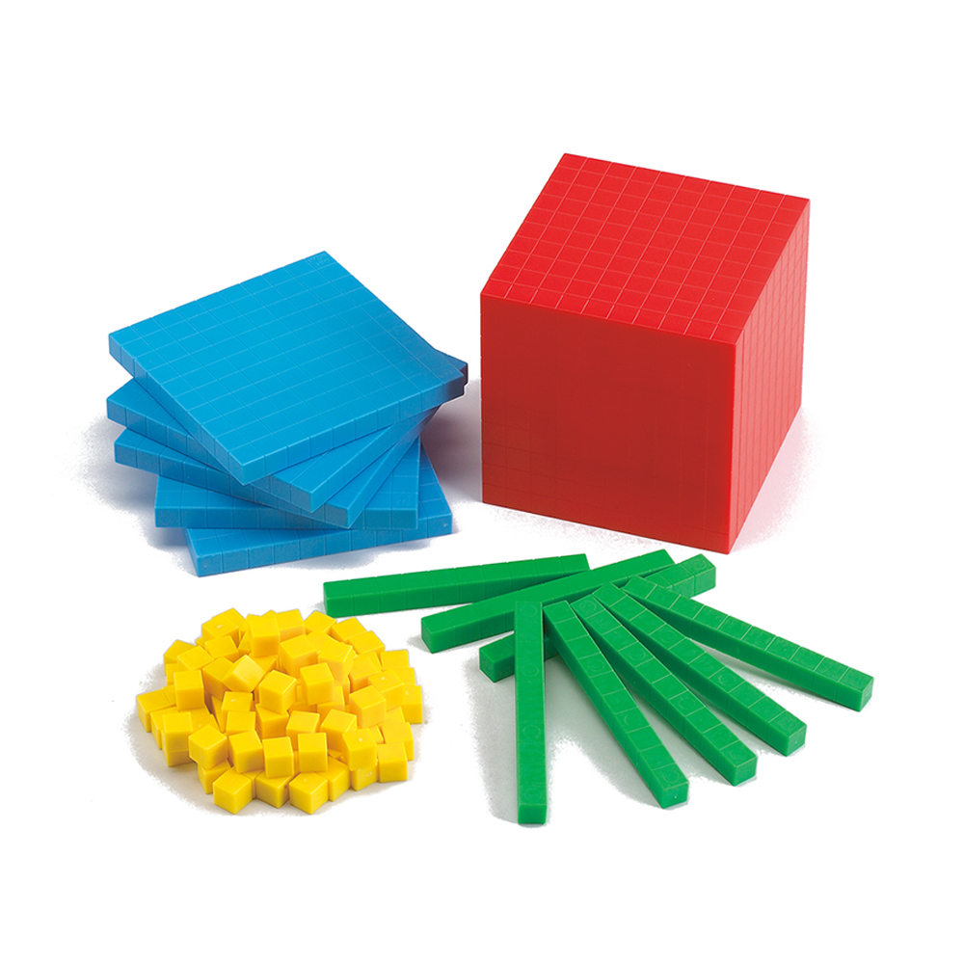
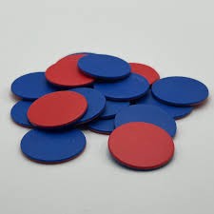
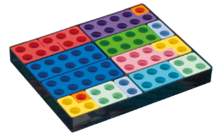
How We Teach Maths - Manipulatives
Numicon
Counters
Base 10

Slide 7
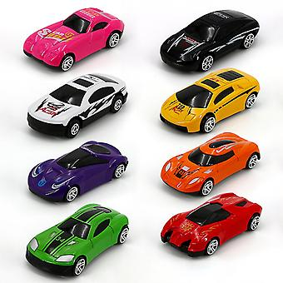
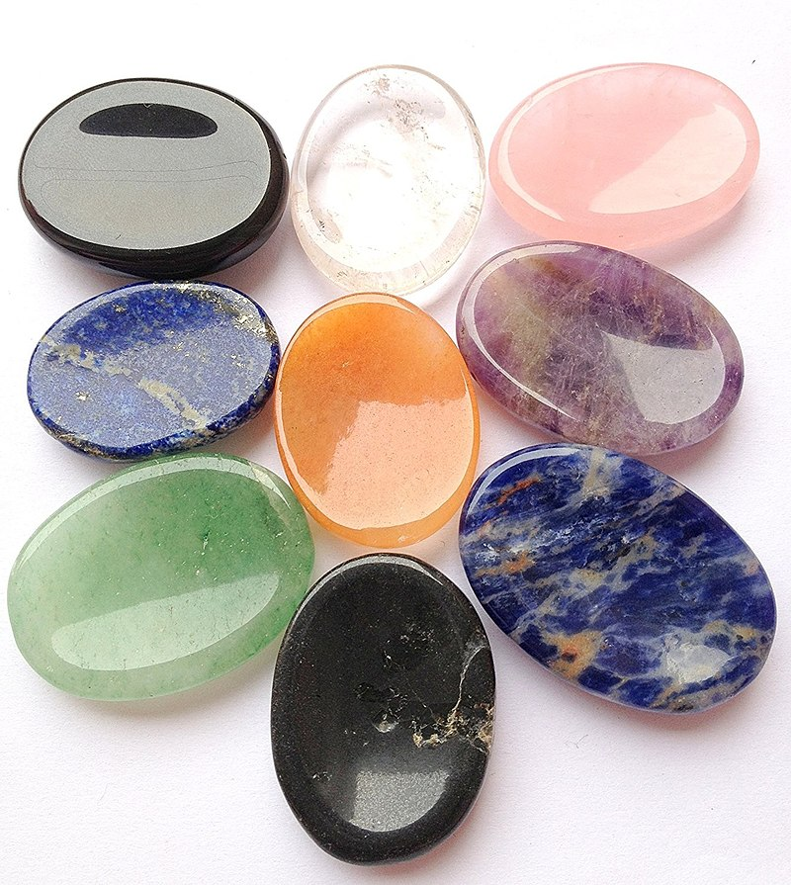
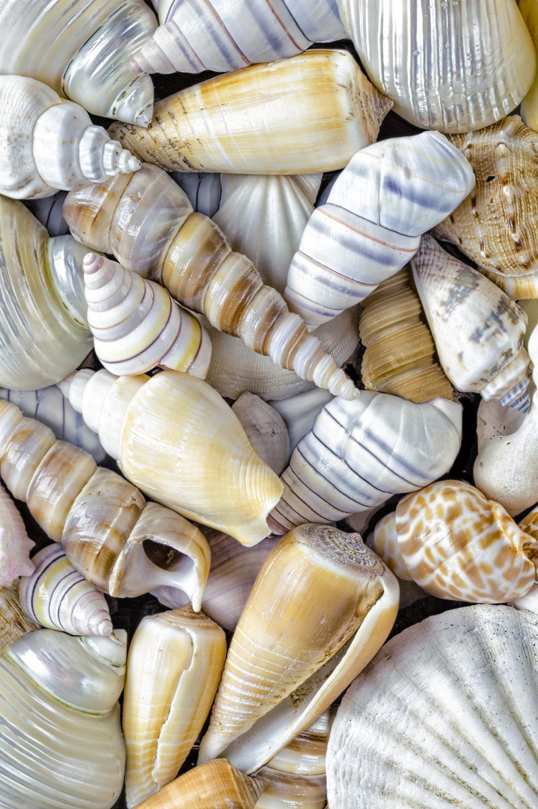

How We Teach Maths - Manipulatives
Toys
Stones
Shells
Wood

Slide 8
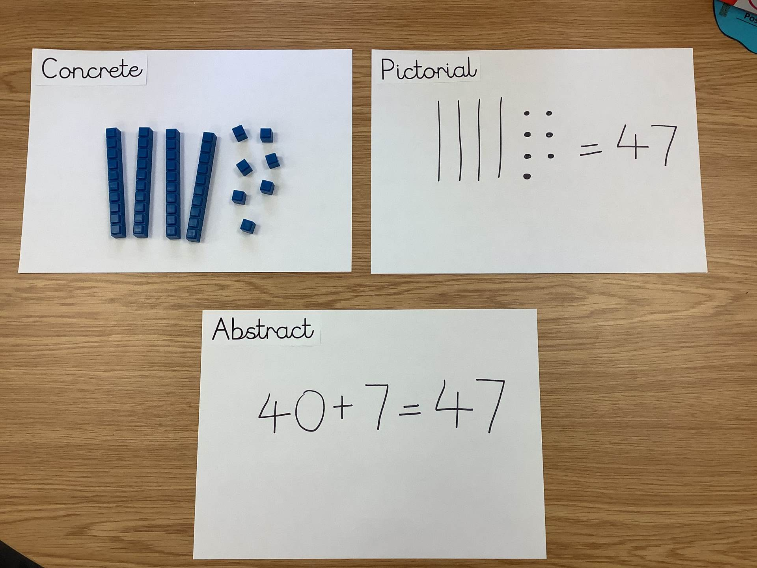
How We Teach Maths - Approach
Concrete > Pictorial > Abstract
This approach is what we are currently developing to ensure that it is embedded throughout school
Not all children will need the concrete or pictorial phase
We have invested in resources for each class so that children can access the learning
This approach will support children with their understanding of what they’re learning and also with strategies to answer questions

Slide 9
How We Teach Maths - Approach
Concrete > Pictorial > Abstract
When children are doing their maths homework
  It is ok for them to use concrete objects or to draw pictures to support them
This is what they do in class
This is what they do during assessments (SATs – marks for workings out)

Slide 10
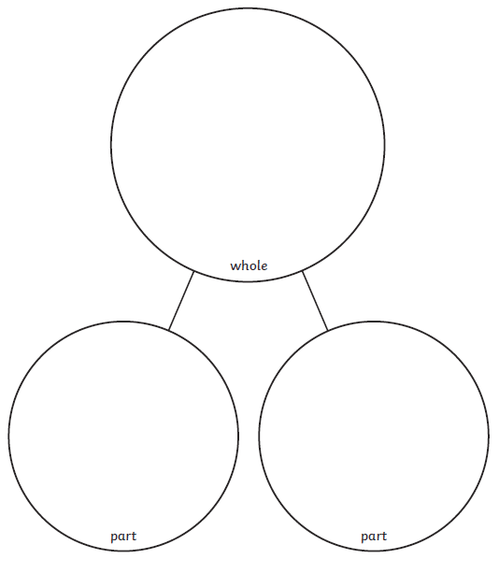
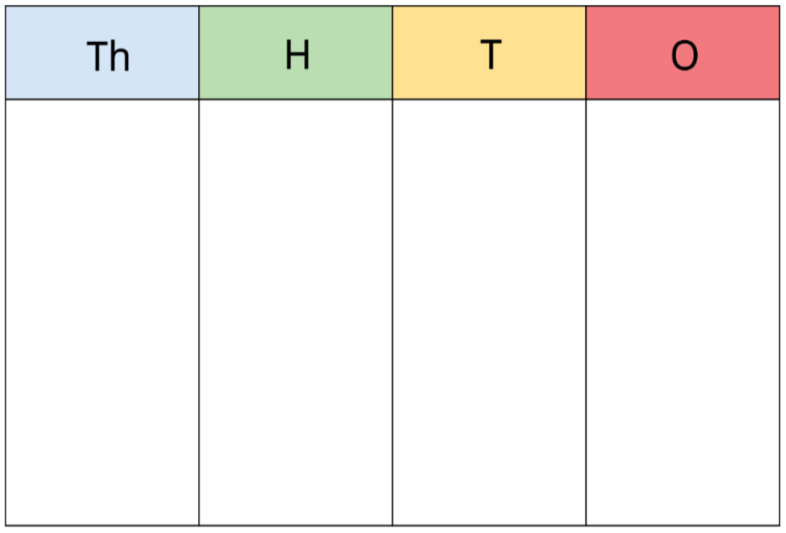

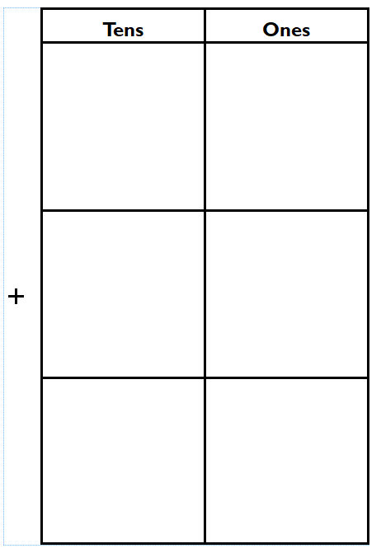
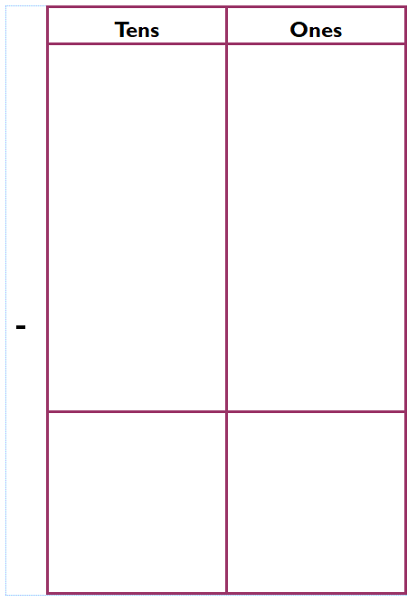
How We Teach Maths - Approach
Ten Frames
Place Value Charts
Part Whole Model
Addition and Subtraction Frames

Slide 11
How We Teach Maths - Process
Flashback
  This is a revisit of prior learning.
  This can be from the KIRFs, a previous year, arithmetic questions
I do
  This is where the teacher introduces the objective and how to answer questions
We do
  The children use the steps they learnt from the “I do” to support the teacher in answering questions
You do
  Children work with their partner to answer questions, explaining the process of getting to that answer

Slide 12
How We Teach Maths - Process
Guided Learning
  Children will answer 4 questions
  This is an opportunity to see if children can “fast track” to Reasoning and Problem Solving or if they need to go to fluency
Fluency
  This is a continuation of the guided learning questions
Reasoning and Problem Solving
  Children will able their knowledge to answer Reasoning and Problem Solving Questions, providing explanations for their answers
Whole Class Reasoning and Problem Solving
  To end a lesson, there will be a Reasoning/Problem Solving question for the whole class to answer

Slide 13
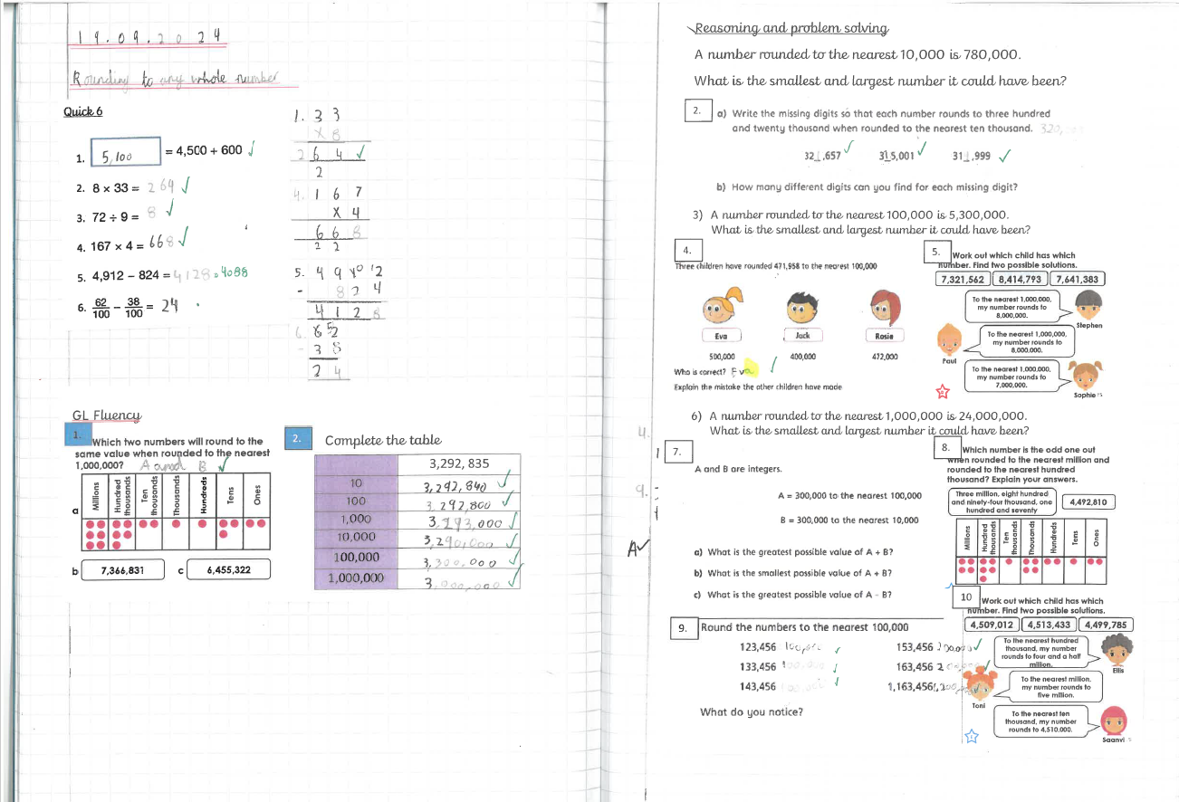
What it looks like in books

Slide 14
What it looks like in books

Slide 15

How you can help - KIRFs
Key Instant Recall Facts
  Working with the Maths Hub, the KIRFs have been created as facts children need to know at a specific part of the year
  We have designed this to make it more achievable for children and not overloading.
  Feedback on this would be useful as I am currently creating Autumn 2, Spring 1, Spring 2, Summer 1 and Summer 2 parent guides.
  Little and often!

Slide 16
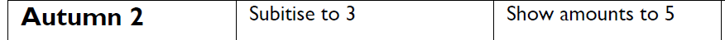
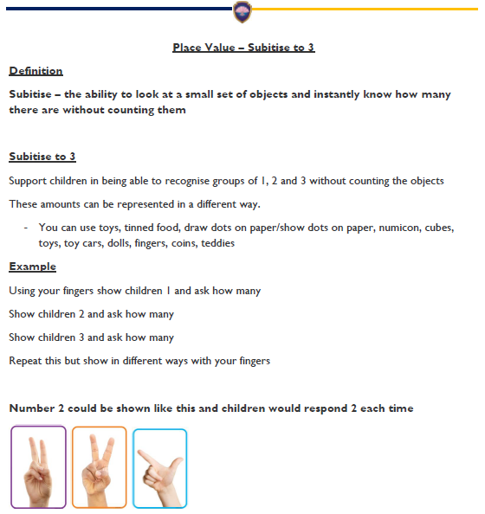
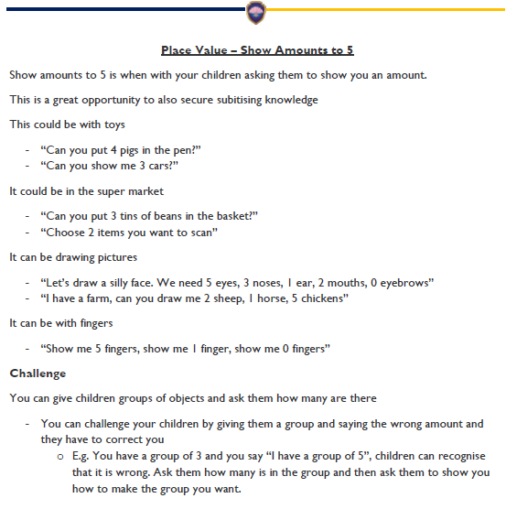
How you can help – KIRFs Example
Reception

Slide 17
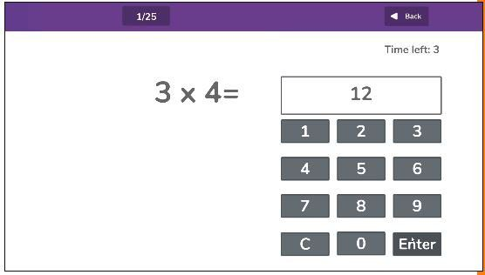
How you can help – Practise Times Tables
In Year 4 children undertake a Multiplication Check on all times tables
Children begin to learn their times tables in Year 1
  Counting in 2s, 5s and 10s
Then went they are in Year 2 they learn the multiplications
  Between Year 2 and Year 4 they learn the remainder of their times tables
MTC = WB 02/06/2025 (2 week window)

Slide 18
How you can help – Homework
Please do MyMaths homework with your child.
I have sent a guide out and it is also on the school website if you require it again.
We know this is done electronically
  Please allow children to do the Concrete > Pictorial approach at home to answer questions!
Ask “how do you know?”
Ask “Can you explain how you got that answer?”

Slide 19
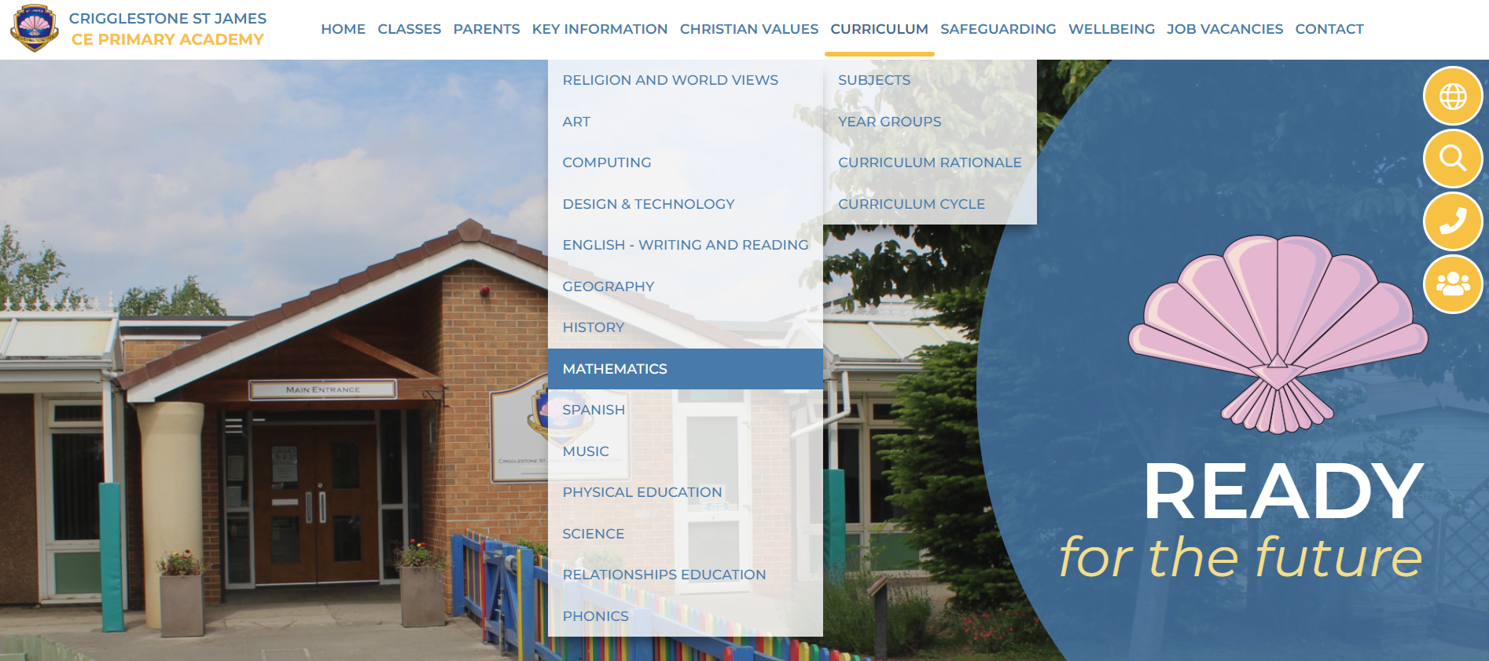
How you can help – School Website
https://www.stjamesacademy.co.uk/page/mathematics/123544

Slide 20
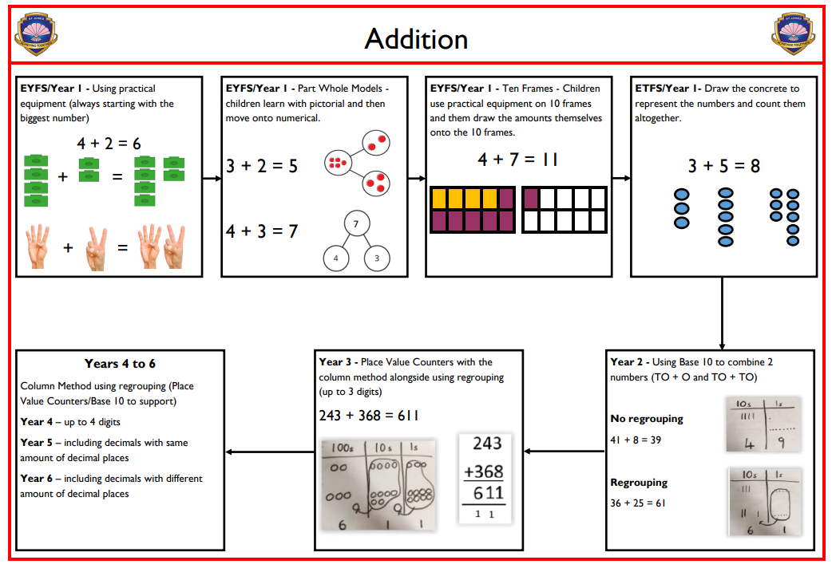
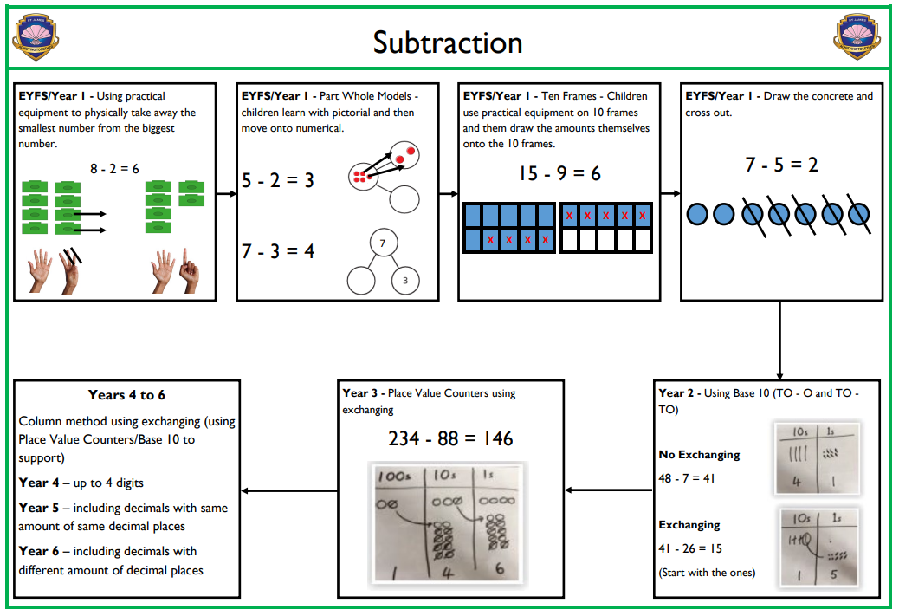
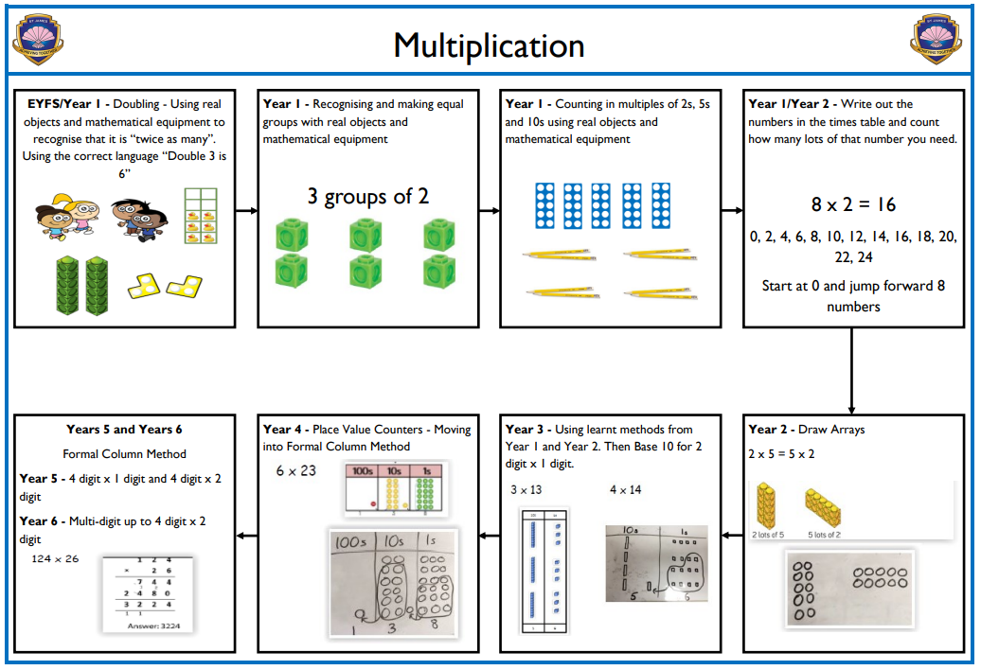
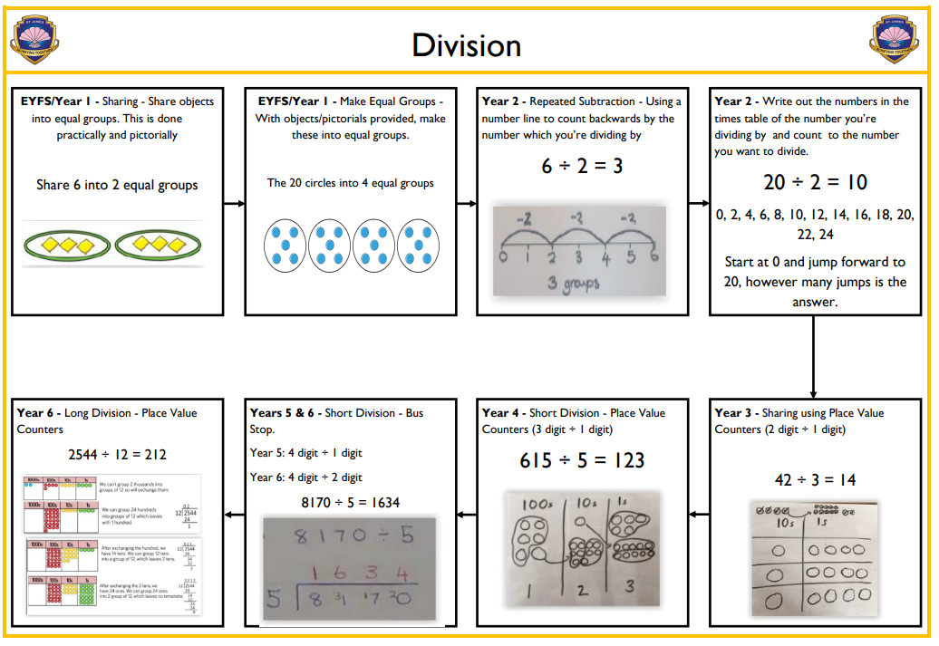
How you can help – Calculation Policy

Slide 21
Questions?
  Thank you for attending this session ☺

