Slide 1

I can help… writing from EYFS – Y6

Slide 2
What will we cover:
- Our writing culture (Linking to reading)
- Linking to research
- Early writing and what this looks like.
- How we teach writing in each phase of school
- End of KS2 expectations
- How you can support your child at home.
- Time for questions

Slide 3
Our writing culture – Writing for pleasure:

Slide 4
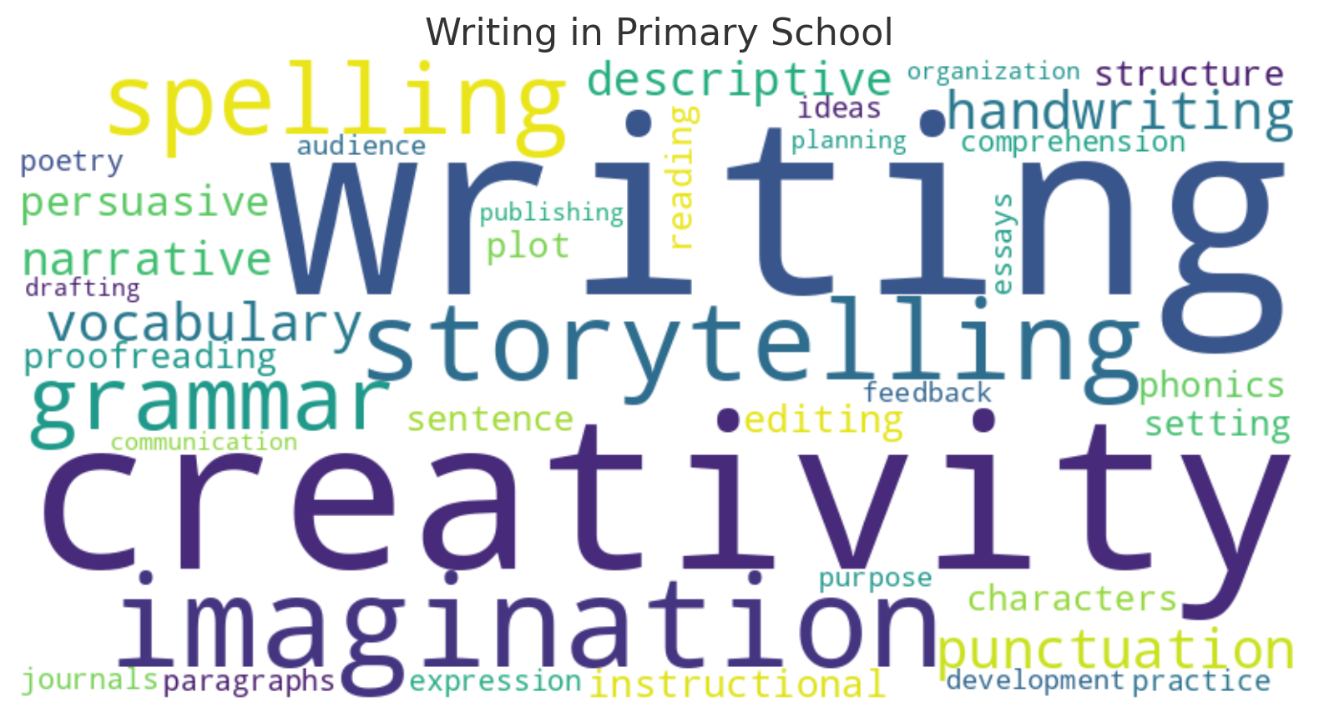
Our writing culture
We want children to enjoy writing!
We do this through:
- Using our enjoyment for reading book to hook the children into a writing unit
- Sharing our own examples of writing
- Different stimuli: pictures, videos, music
- Drama
- Opportunities to write freely (without judgement)

Slide 5
Why should we think about writing?
Developing literate pupils means developing their reading and their writing.
Learning to write can be considered the most challenging aspect of literacy (Quigley, 2022; Ofsted, 2022).
This complexity is a result of the multiple components that need to be managed simultaneously to achieve effective writing (Education Endowment Foundation [EEF], 2017).
Effective writing includes the ability to…
> Generate ideas.
> Form letters.
> Spell words.
> Construct sentences, paragraphs and whole texts.
All of this needs to be achieved with increasing sophistication, suitability for its audience and purpose. So, it is essential that leaders and teachers support all pupils to develop their writing because few pupils become good writers on their own.

Slide 6
The theory behind writing:

Slide 7
What components are needed to be a successful writer?
> Composition: the ability to draw on a set of knowledge and skills relating to texts, language and the world to express meaning.
> Transcription: the physical skills of handwriting, typing and spelling, which need to be developed to fluency to support composition.
> Executive function: the self-regulation to engage in planning, goal setting and management skills, which support writing. Self-regulation can be defined as pupils being able to ‘take control of their thoughts and actions’ (Rose and Didau, 2018, p.171).

Slide 8
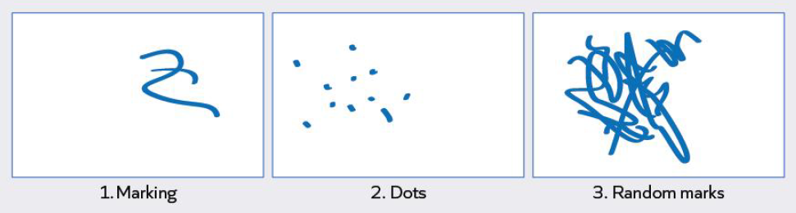
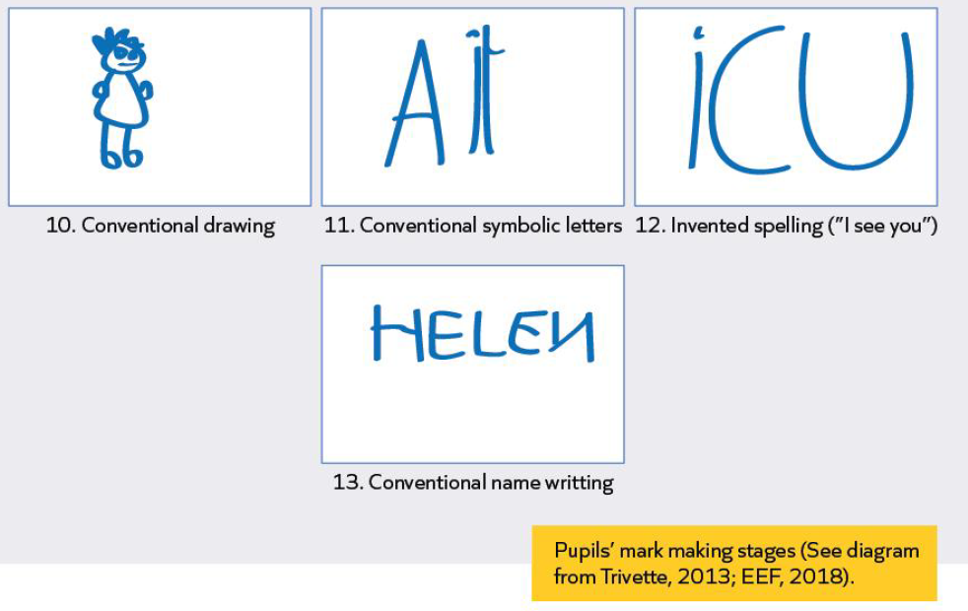
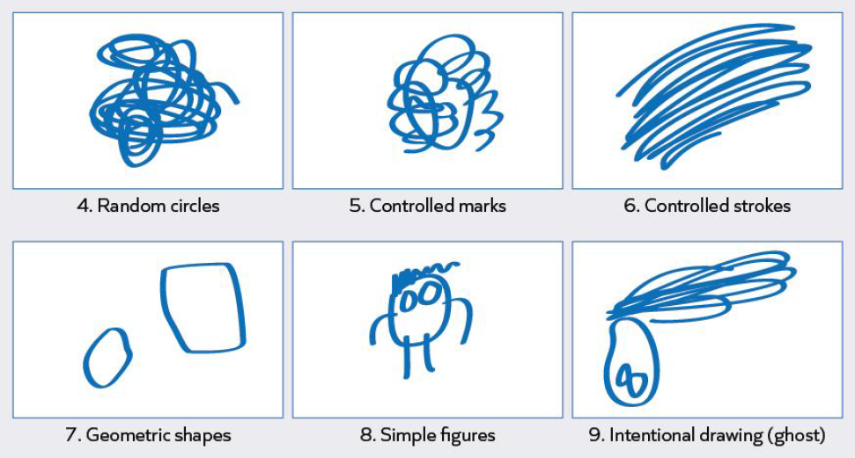
Early writing - transcription

Slide 9
Early writing – composition
Pupils in the early years might be provided with props to retell stories they are reading and talking about with their teachers.
Actions to go with the story
Story boards and maps for understanding of the structure of a story.
Retelling orally
Opportunities in provision to write words that link with their phonics

Slide 10
Changes to writing in KS1:

Slide 11
What has changed and why?
There is a huge focus on transcription in KS1, with opportunities to write independent sentences.
This follows a similar approach to RWI. The sentences are linked to the phonics they are learning. The focus is to develop accurate sentence structure.
During year 2, the children will have opportunities to write paragraphs, building on their previous learning in regards to dictated sentences and independent sentences where they have practised the skills.
> Using dictation and modelling as the main focus in lessons
> No third phase in Year 1.
> Introduction to the third phase in Year 2 around Spring term.

Slide 12
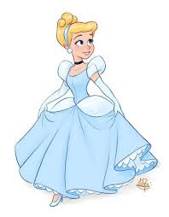
Dictation – what is it and why is effective?
Dictation can aid in the development of speaking, listening, reading, and writing skills – helping with listening and pronunciation to grammar and spelling.
At this point in the year, we'd be working on year 1s writing a simple sentence then going on to introducing the conjunction ‘and’ while the year 2s will be writing a sentence containing an expanded noun phrase.
She has a dress.
She wears a blue dress with puffy sleeves.

Slide 13
How we teach writing:

Slide 14
Our approach to writing:
From year 3 upwards, we give 3 weeks per unit and have 3 phases:
- Reading phase
- Toolkit phase
- Writing phase
* Year 1 – no writing phase as this is through dictation and learning the main skills to compose sentences
* Year 2 – writing phase is introduced in spring term once composition skills are full embedded

Slide 15
Reading Phase
Immersion into the text
hook, quality text, key features of the genre, prediction, sequencing, key vocabulary, drama, understanding the text type and what makes it effective for the reader, toolkit
Example: character description there will be lots of opportunities for drama and vocab.
This phase is really important for the children to understand what they are writing.

Slide 16
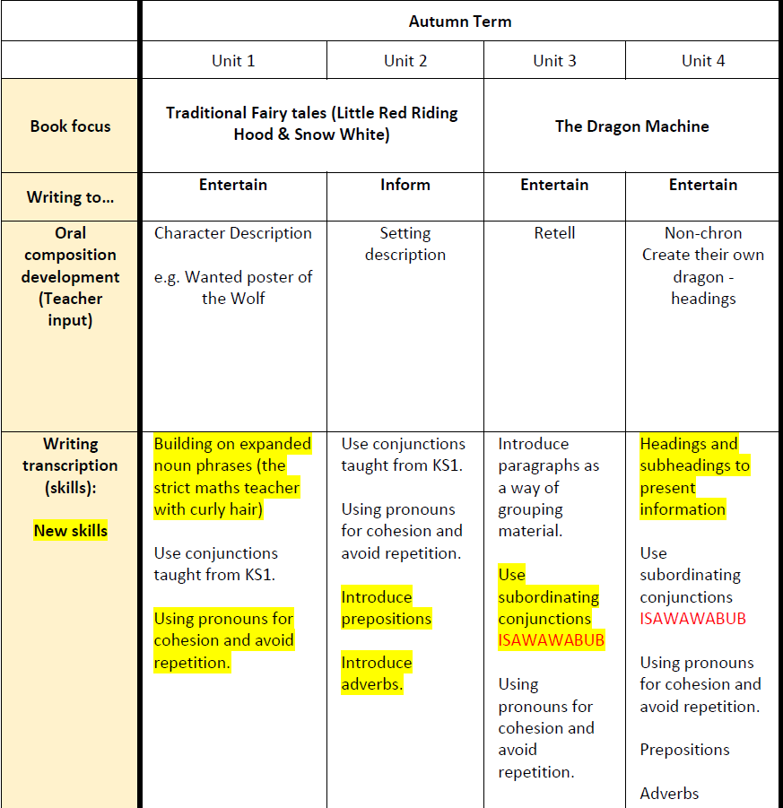
Toolkit Phase (teaching skills)
Explicitly teach year appropriate skills in context of the genre.
Sentence building/stacking
Teacher modelling and then children do independently in books.
guided writing, I do, we do, pairs, independent

Slide 17
Writing Phase
- Generating ideas
- Planning
- Modelled/shared writing (not all of it – short bursts)
- Edit
- Publish if appropriate

Slide 18
How we teach writing
Linked to the enjoyment for reading text
Use stimulus (pictures, videos, music)
Use talk 4 writing where appropriate to orally rehearse the text
Use story mapping to understand the structure

Slide 19
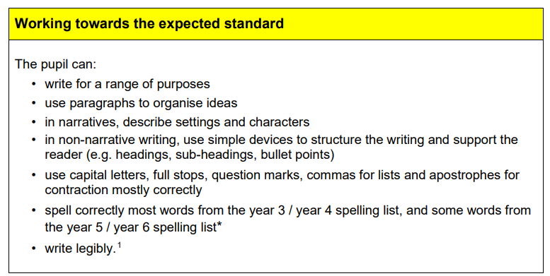
End of KS2 expectations

Slide 20
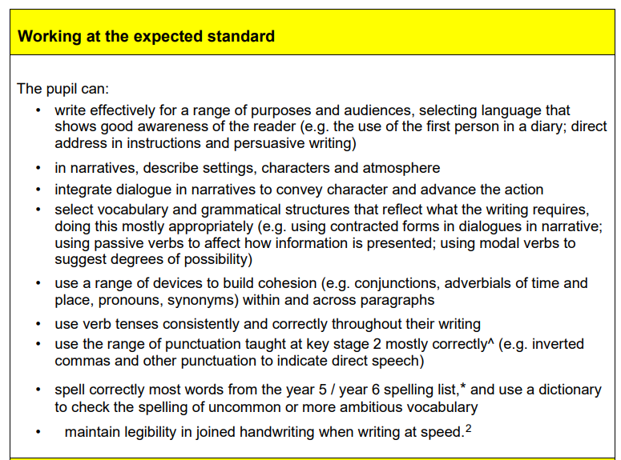

Slide 21
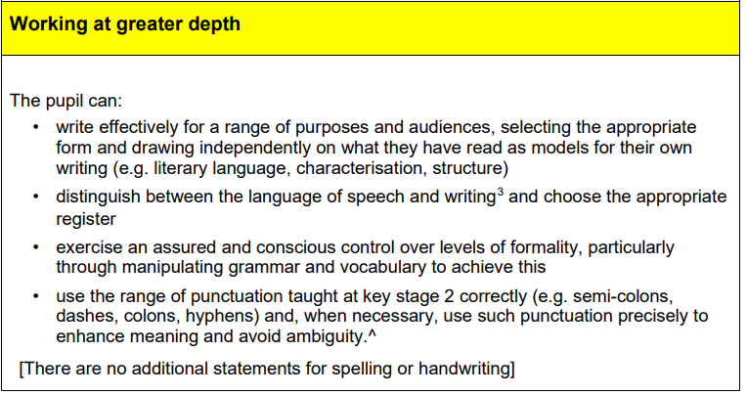

Slide 22

Handwriting
print, pre cursive and cursive (GD in Y2)
a b c d e
I like to read and write
For children to be expected at the end of Key Stage 2, children need to show that they can write legibly with cursive handwriting.

Slide 23
How can I help at home?

Slide 24
Q: What can I do at home to help?
> Value writing – Encourage your child to write
> Create story prompts
> Model writing to children
> Create a writing space
> Journaling
> Take writing materials places
> Ask family members to write letters
> Write a book or film review
> Expose them to different books and genres (reading and writing comes hand in hand to allow for imagination)
> Practise spellings (games)

Slide 25

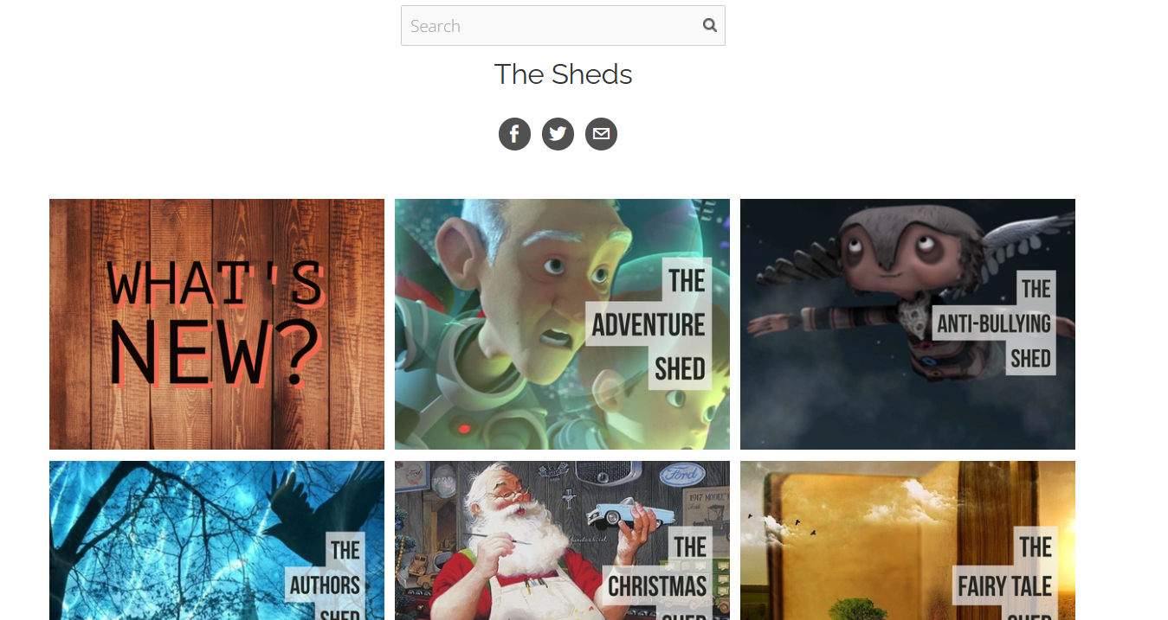
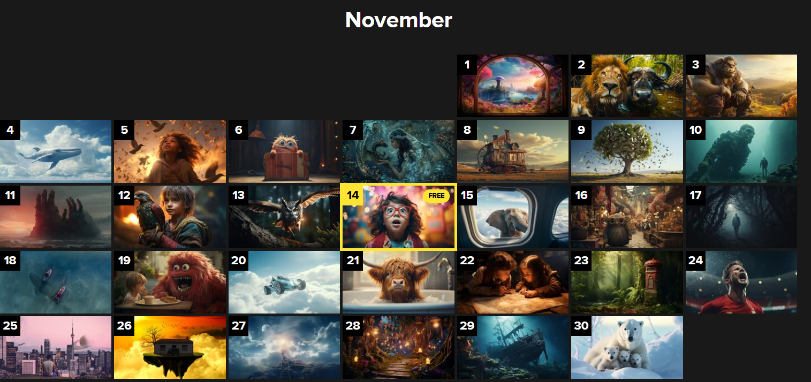
Good Websites to inspire writing:
https://www.onceuponapicture.co.uk/
https://app.pobble.com/lessons/prompt/calendar
https://www.literacyshed.com/

Slide 26

Any other questions?
Thank you for attending ☺

