Slide 1

Partnership with Families: Listening to your child read
Notes:
Approximately 20 minutes is needed for this session.
Notes are provided to help you lead the presentation.
Notes in italics are for your attention only.
Provide copies of ‘Reading at Home Booklet 1 or 2’ from Oxford Owl.
Booklet 1 is for Set 1 sound groups and Ditty/ Red Groups and Booklet 2 for Green – Grey Storybooks.
Children will make the best possible progress if they read as often as possible.
Today we are going to discuss how to listen to your child read their Read Write Inc. Phonics decodable storybook when they bring it home.

Slide 2
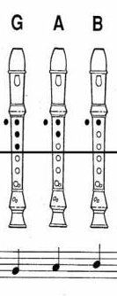
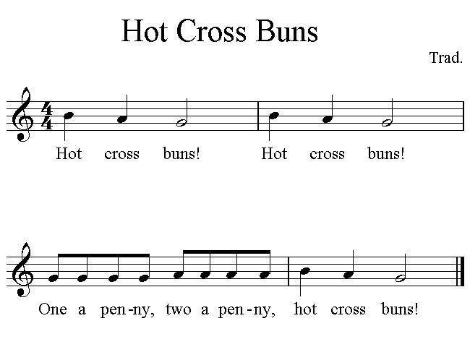
Learning to read music
Notes:
Think about a child learning to play the recorder for the first time. They are taught G-A-B (click). They can then play (click) ‘Hot Cross Buns’ containing just those notes.
They practise this simple tune over and over again. It’s always surprising how much joy they get from playing just these three notes!

Slide 3
Learning to read music
D
D
G
G
D
D
G
G
A
A
B
B
A
A
Notes:
And with just three more notes
(top D, lower D and C), they are ready to play (click) ‘London’s burning’. They practise this tune over and over again.
Beginner recorder players are only ever given music with the notes they can play.
Once children place their fingers on the holes accurately, they practise to gain fluency – over and over again. As their fingers move more quickly, they pay attention to playing expressively - even when playing a simple version of 'Hot Cross Buns'!
Learning to read music is like learning to read using phonics: it’s only once we can read the words, that we are able to focus on fluency and expression.

Slide 4
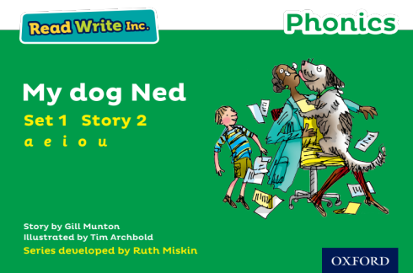
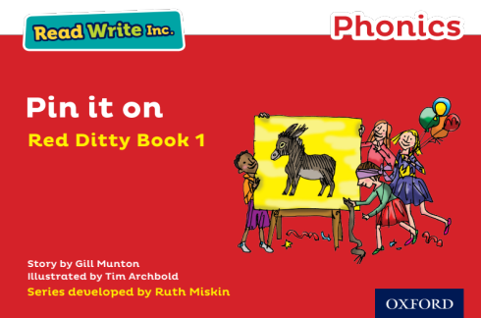
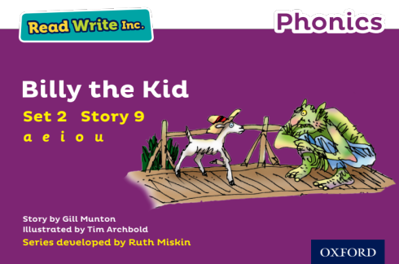
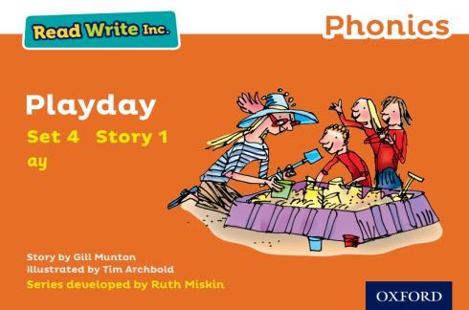
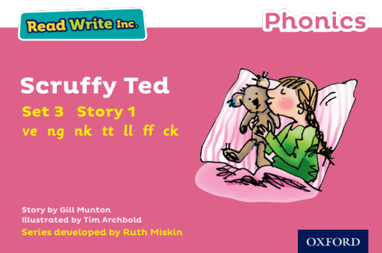
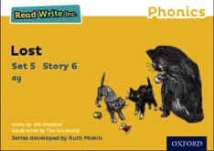
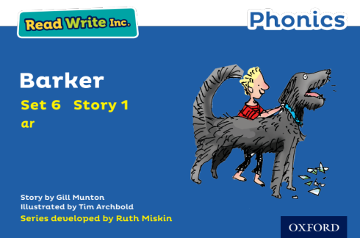
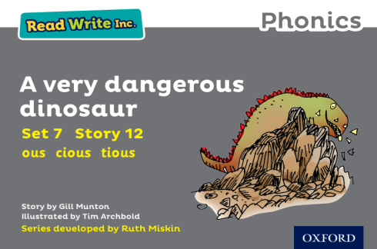
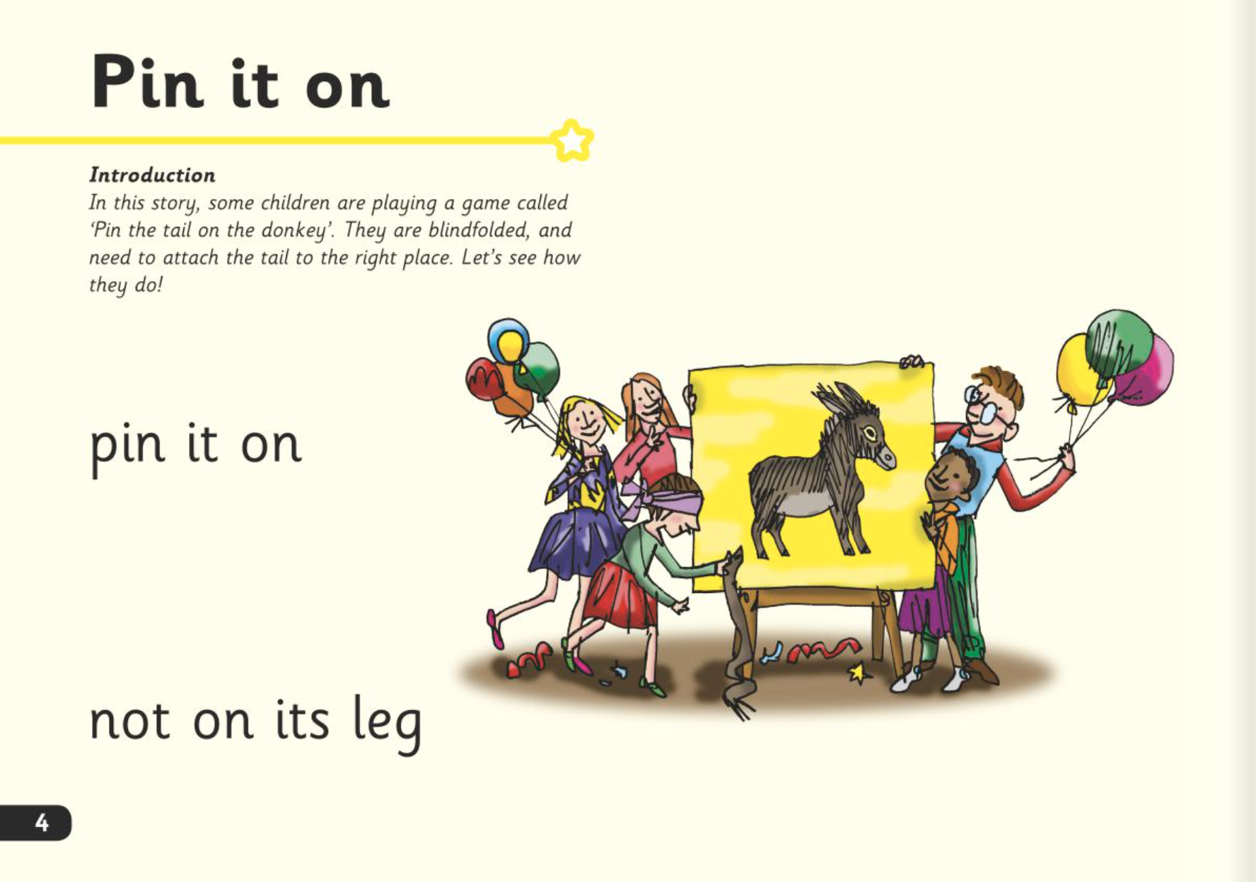
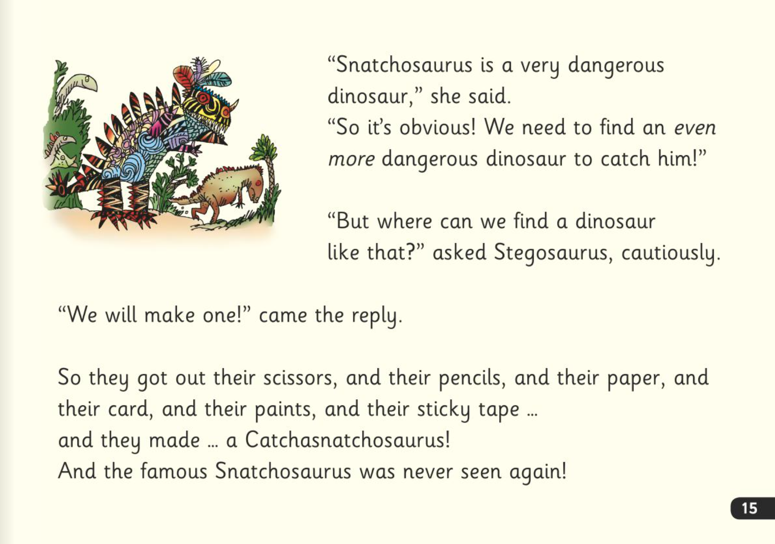
Read Write Inc. Storybooks
Notes:
In our school, children read Read Write Inc. Storybooks that match the sounds they can read.
They know that, with only a little help, they will be able to read every word in every story we give them and, by the time they take it home, they will be able to read the story confidently.
They know that we will never ask them to guess a word, either from a picture or the context - in the same way as we wouldn’t ask them to guess musical notes we hadn’t taught them.
The early texts are below children’s comprehension level because they cannot yet read all the words they can speak. If you read the story to them, they would be able to understand it easily - unless the child is new to English.
Although the story is easy, most children cannot focus on its meaning until they can read the words effortlessly - 'at a glance'. ‘At a glance’ means reading a word in a millisecond – without needing to blend the sounds into the word.

Slide 5

Three reads
Read every word accurately.
Read more words ‘at a glance’.
Read the whole story accurately, fluently and with a storyteller’s voice.
Notes:
They read each Read Write Inc. Storybook three times in class with their partner.
Re-reading the same book helps children to become confident readers. Each time they re-read, they build their fluency/speed and comprehension.
They love reading and want to read because they can read all of the words in the Storybook.
We set a focus for each re-read in school.
(Click) The first read focuses on reading every word accurately.
(Click) The second on reading the story more quickly.
(Click) The third read on comprehension - understanding what they read. Children can only do this once they can read all of the words accurately and read at a sufficient pace.

Slide 6

After the third read…
Notes:
So after the third read in class, children bring the same Storybook home to read and enjoy with you at home.
They love this book!
They can’t wait to read it to you, their grandparents or even their teddy bear.
With a little more practice at home, they will soon be able to show off their storyteller voice to the family!
Our school sends home books that match the sounds your child can read. We will never expect your child to read a book that contains sounds they cannot read.
We want them to be set up to succeed in their reading.
We want to make sure they enjoy reading so that they want to read.
The more they read, the faster progress they will make.
Please avoid saying, “This book is too easy for you!” but instead say “I love how well you can read this book!”

Slide 7
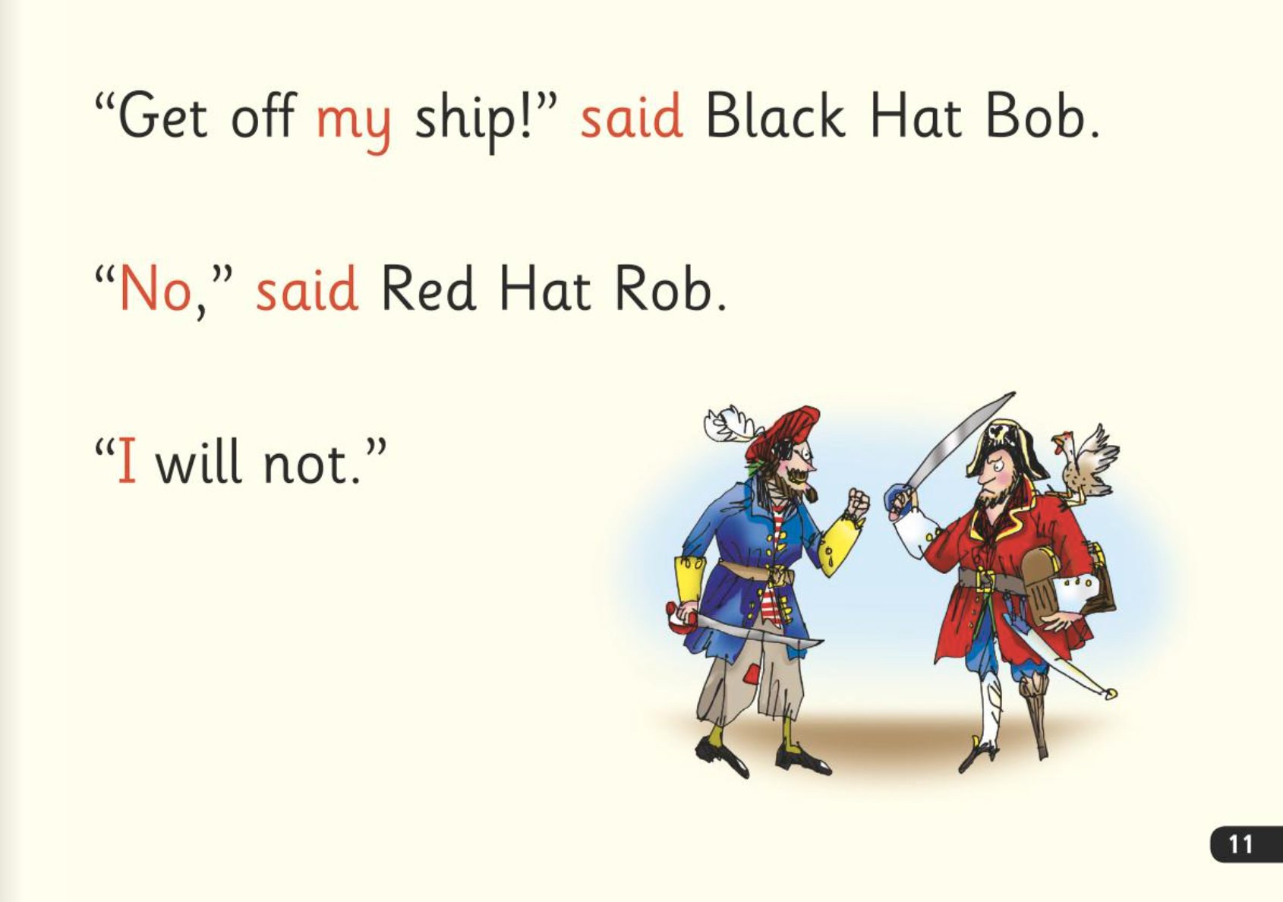

‘Special Friends’, ‘Fred Talk’
Notes:
Children will be able to read all of the words in the Storybook.
If they hesitate, remind them to read the word using ‘Special Friends, Fred Talk,’.
For example, this means they spot the ‘sh’, then Fred Talk and blend to read the word e.g. sh, sh-i-p, ship.

Slide 8

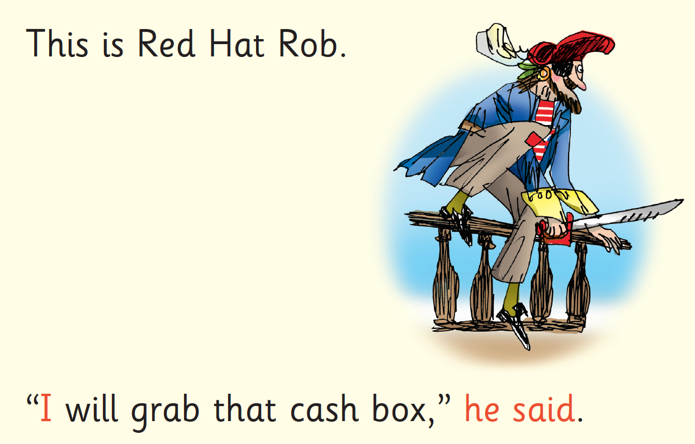
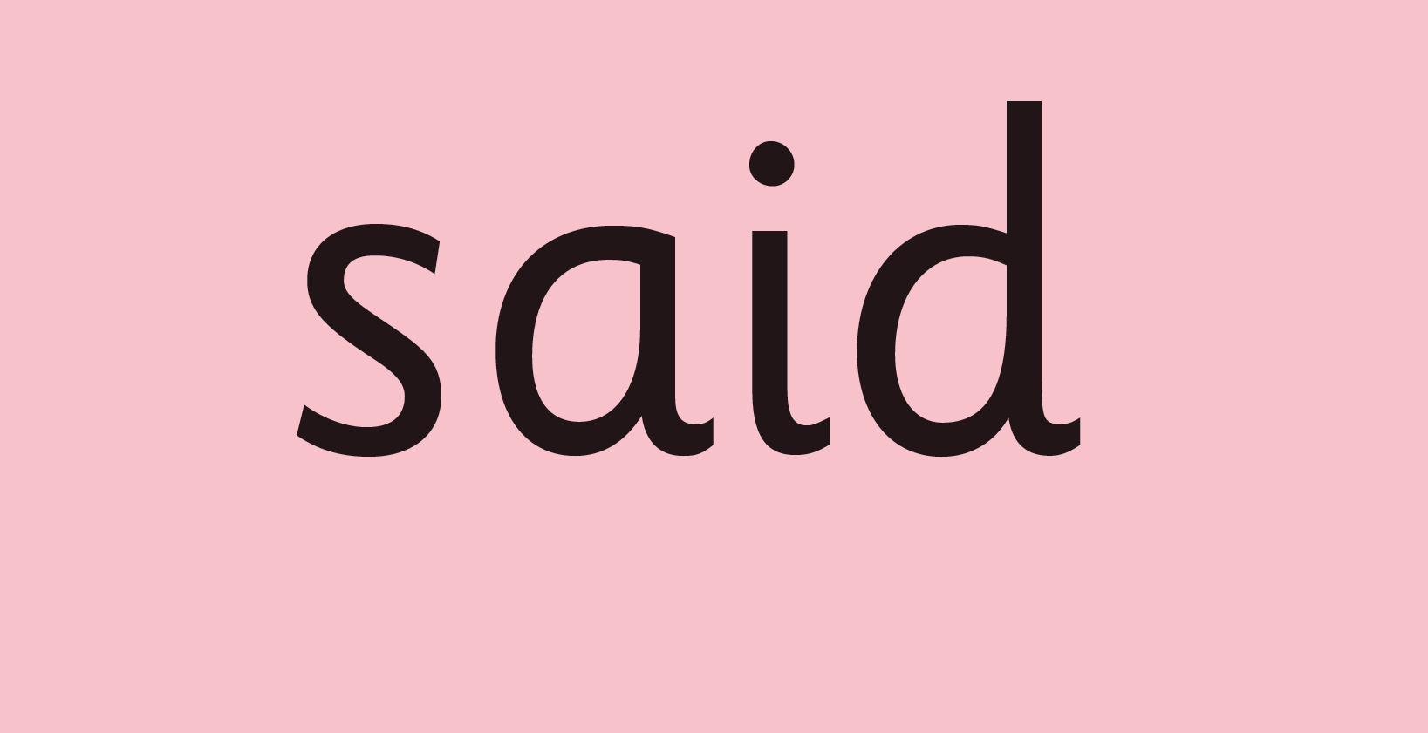
Red Words
Notes:
Some words are ‘tricky’ because they contain letters that don’t match the sounds the child has been taught.
For example, ‘said’ has ‘ai’ making an ‘e’ sound.
We teach these common exception words as Red words.
In the early Storybooks, these words are printed in red text.
Remind your child not to use Fred Talk to read Red words but instead to stop and think if they know the word. Tell them the word if needed.

Slide 9
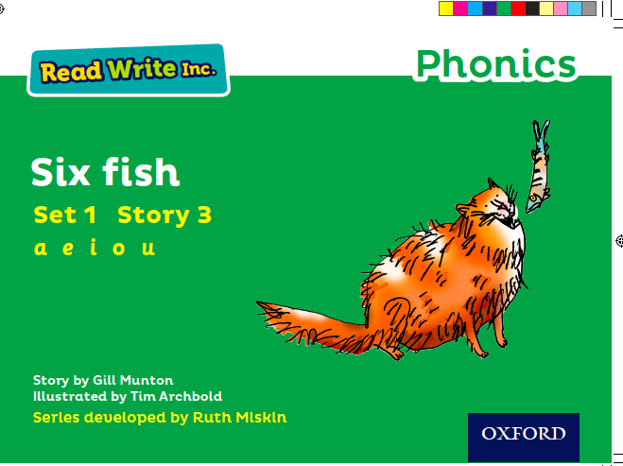
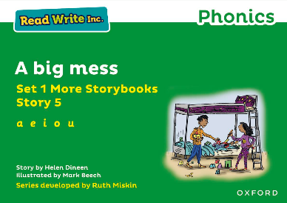

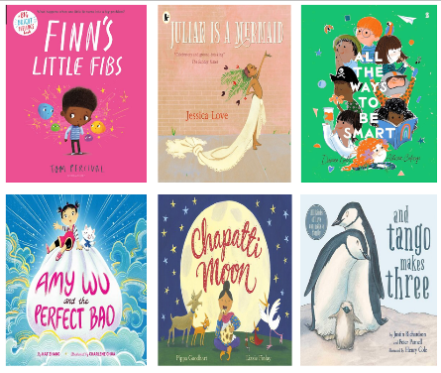
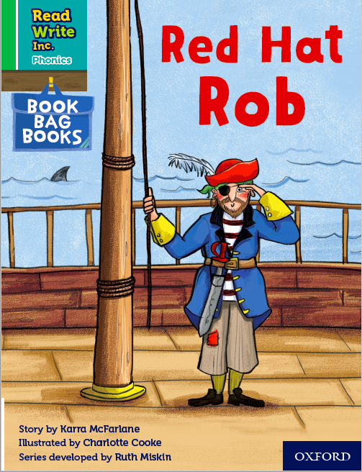
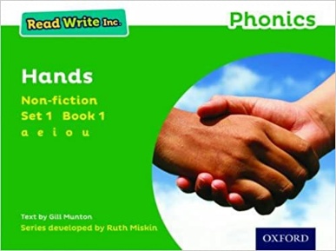
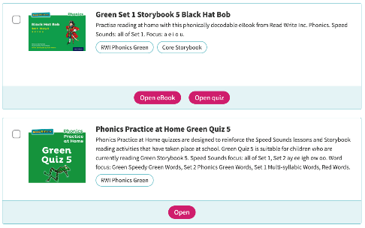
What books will children bring home?
Notes:
In your child’s book bag, they will bring home:
- the Storybook they have just read in class to practise reading what they can already read (they love this book and enjoy reading it in their storyteller voice).
- if applicable a past Storybook – a previously read RWI Storybooks for extra practice. The children enjoy re-reading stories they know well. Their fluency improves on every reading.
- if applicable a Book Bag Book that links to the story they have read in class or a non-fiction or ‘More’ Storybook.
A picture book to share with you which has already been read to them so they care about it. You can read the story to them or they can retell the story by looking at the pictures. They are not expected to read the story themselves.
We make sure that every book that goes into your child’s book bag is a well-loved book – one they know already and want to read again and again.
The more they read, the faster progress they will make.
Please avoid saying, “This book is too easy for you!” but instead say “I love how well you can read this book!”
If appliable:
We also use the Read Write Inc. Phonics eBook Library Subscription.
Each week, we will assign your child the book they have read during the week to read on a tablet or other device.
There are also phonics practice games to match each book.

Slide 10
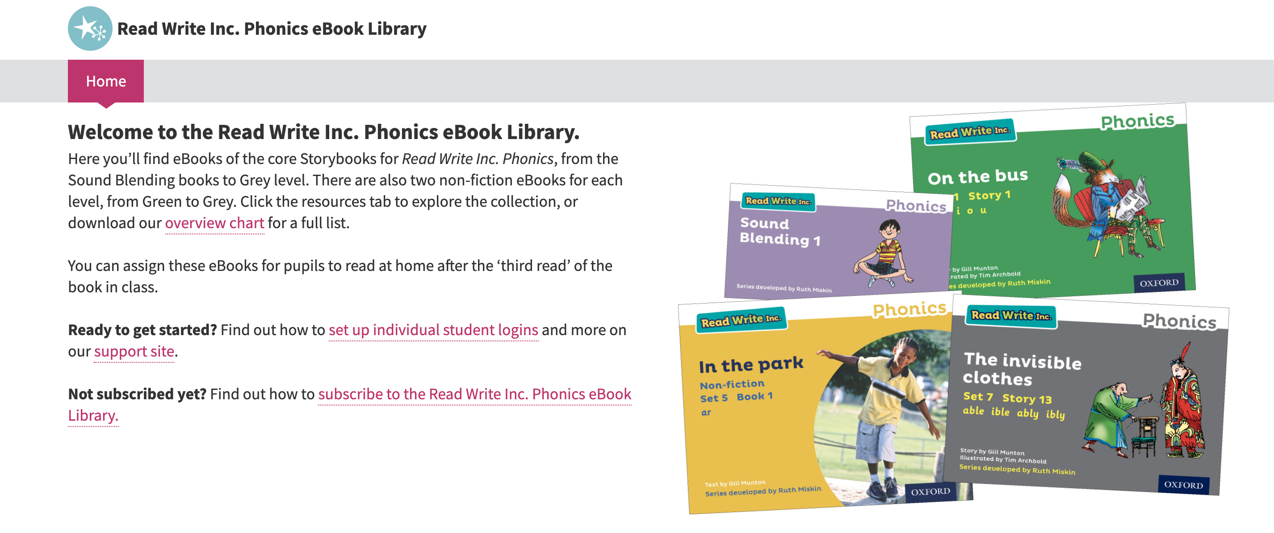
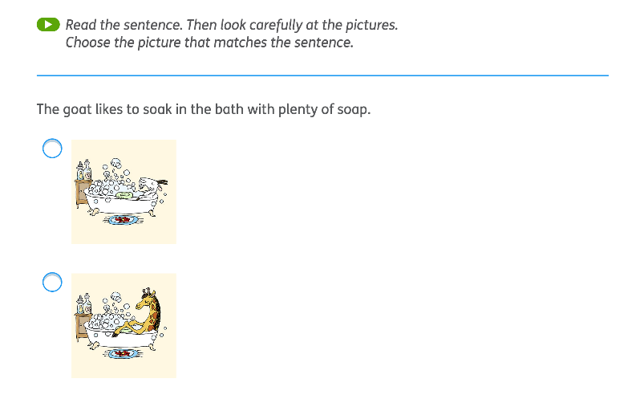
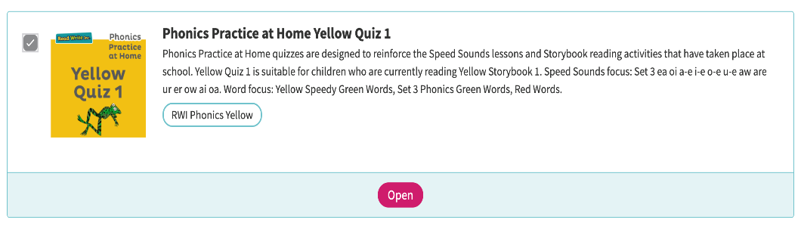
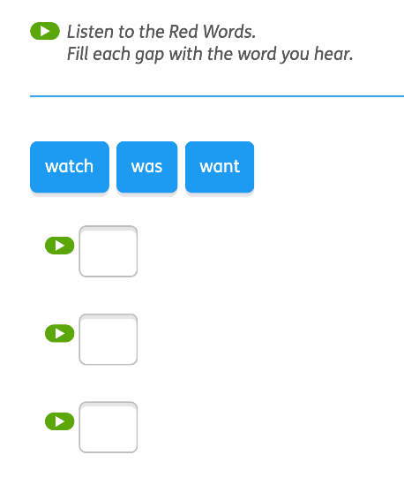
RWI Phonics e-Book subscription
Notes:
Use slide if appliable.
We also use the Read Write Inc. Phonics eBook Library Subscription.
Each week, we will assign your child the book they have read during the week to read on a tablet or other device.
There are also phonics practice games to match each book.

Slide 11


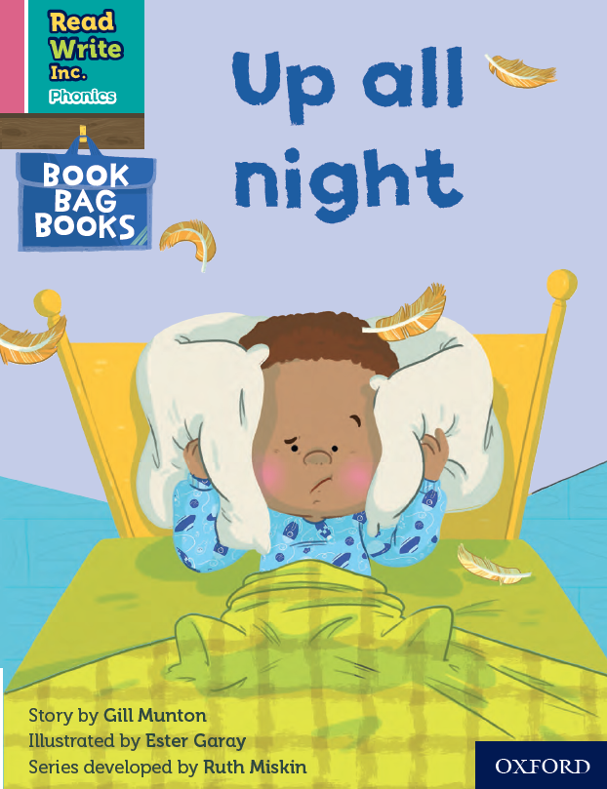
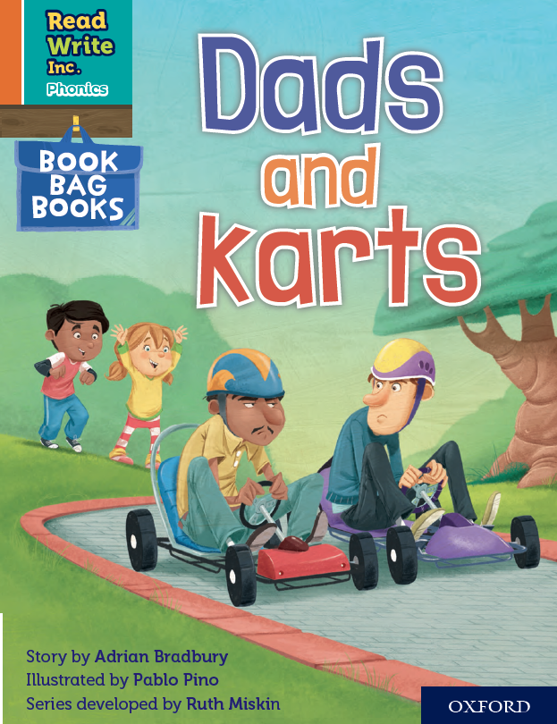

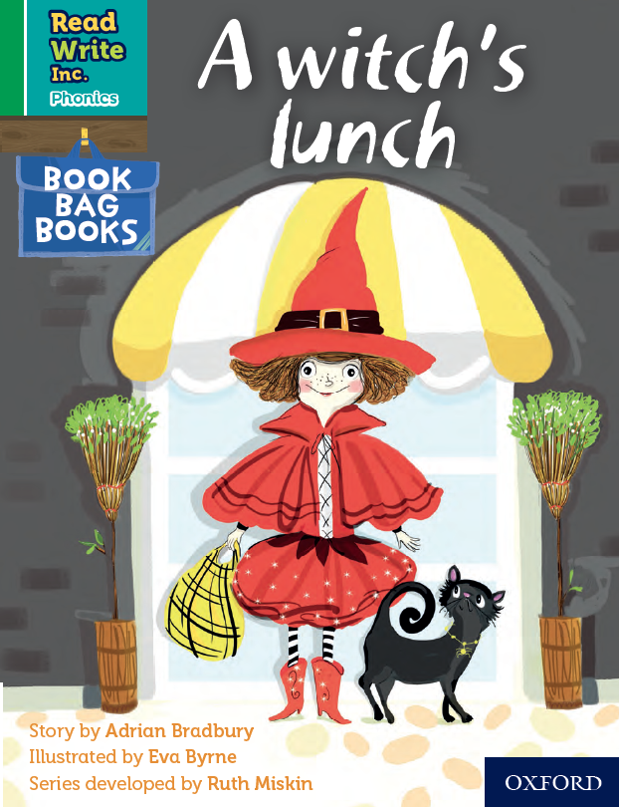
Book Bag Books
Extra reading practice at home.
Linked to the story they have read in class.
Matched to the sounds children know.
Notes:
Only use this slide if you use Book Bag Books in your school.
We use Book Bag Books especially for extra reading practice at home. They have guidance inside just for you, as parents.
These stories link to the story they have read in class.
They are matched to the books children read in school so provide practice of the same sounds. Your child will not have read this book before, but they know all the sounds and will be able to work out any new words.

Slide 12

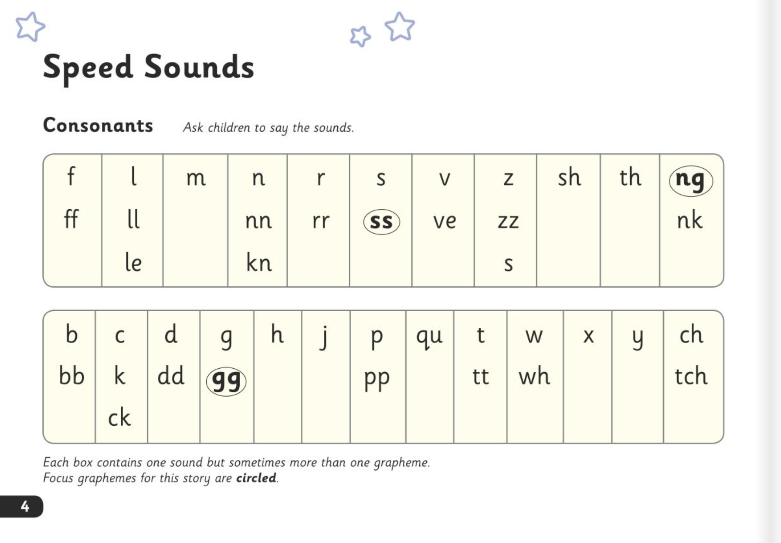
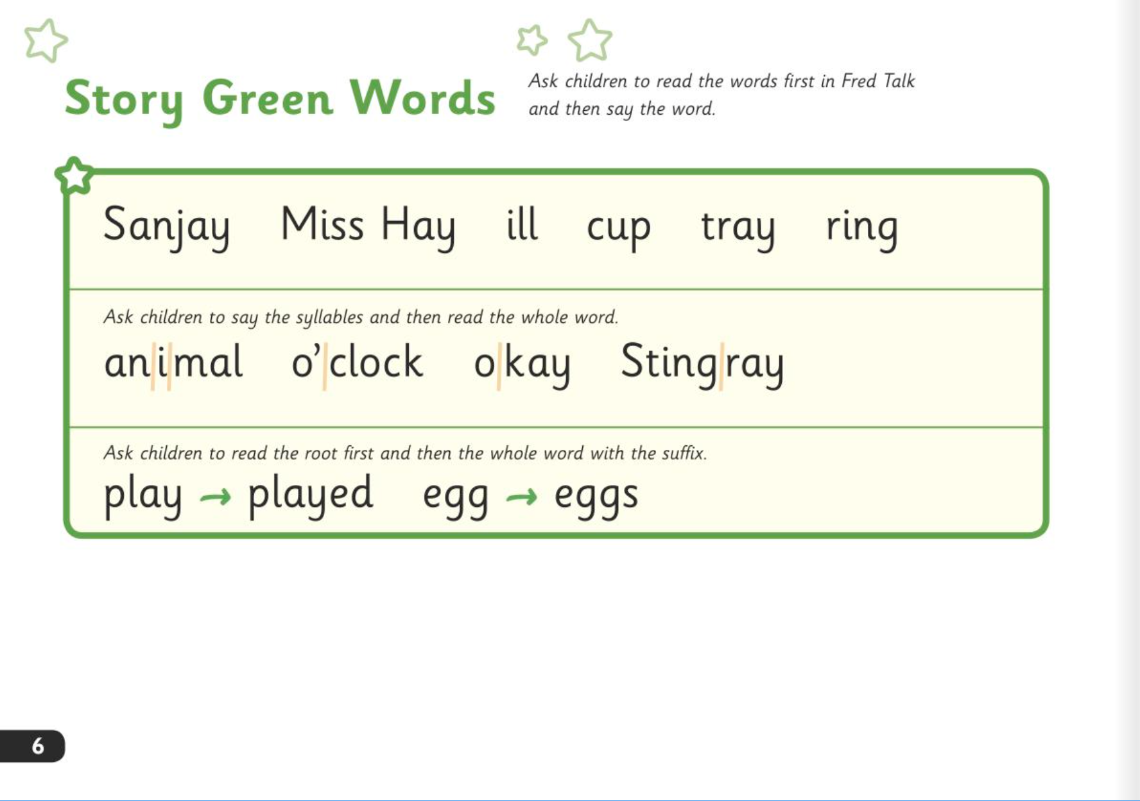
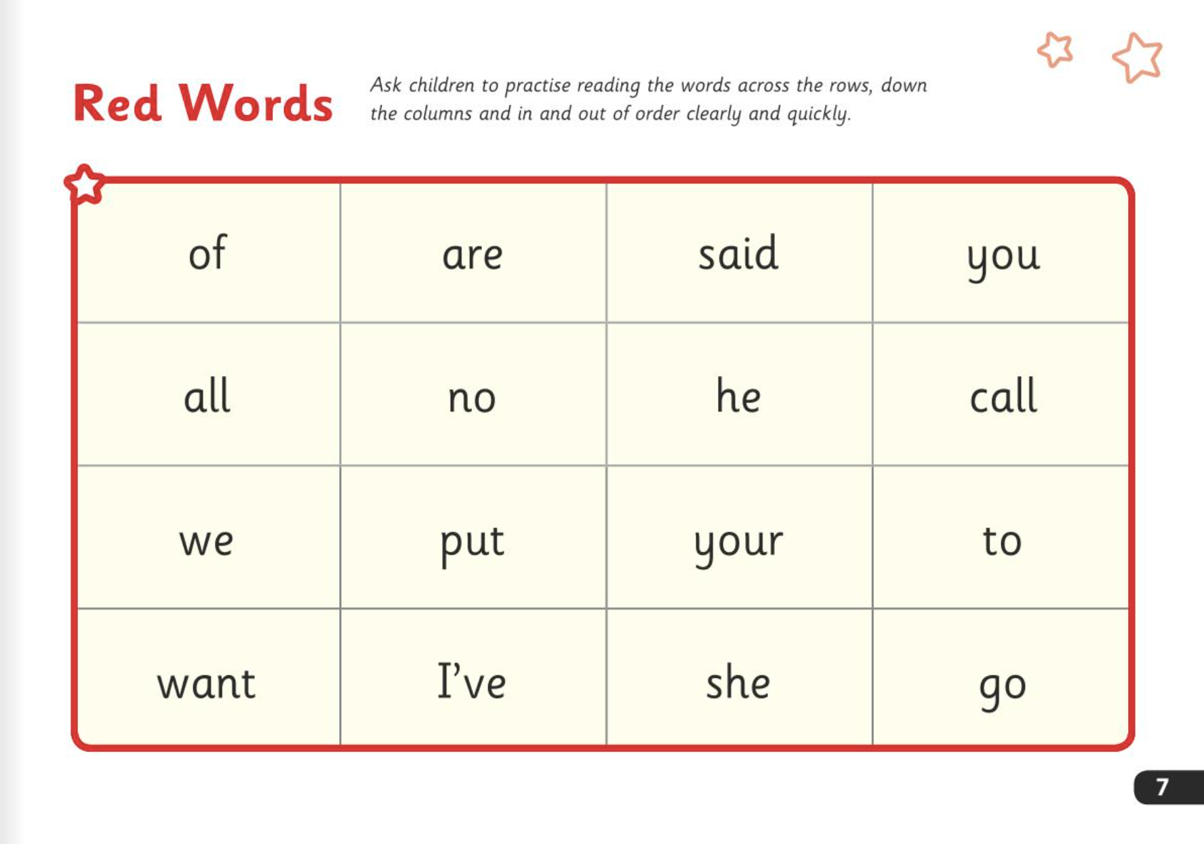
What can I do?
Ask your child to read the sounds and words before they read the story.
They will enjoy teaching you to read these words too.
Notes:
Ask your child to read the sounds and words before they read the story. These are at the front of the book.
They will enjoy teaching you to read these words too.
Make it a game – who is quicker?

Slide 13
What can I do?
Encourage them to read the word in Fred Talk if they hesitate or read it incorrectly.
Praise them when they succeed.
Notes:
When your child reads the story, encourage them to read the word in Fred Talk if they hesitate or read it incorrectly. Praise them when they succeed.

Slide 14
What can I do?
Read back each sentence or page to keep the plot moving.
Your child’s energy is going into reading the words not the story.
Notes:
Read back each sentence or page to keep the plot moving - your child’s energy is going into reading the words not the story.

Slide 15
What can I do?
Let them show you what they can do - avoid reading the story to them first.
Ask your child to use Fred Talk - avoid asking your child to guess a word by looking the pictures.
Encourage your child to keep going.
Keep smiling!

Slide 16

Online resources available
Ruth Miskin Families Page:
https://www.ruthmiskin.com/parentsandcarers/
Ruth Miskin Facebook:
https://www.facebook.com/miskin.education
Free e-books for home reading:
http://www.oxfordowl.co.uk/Reading/

Slide 17
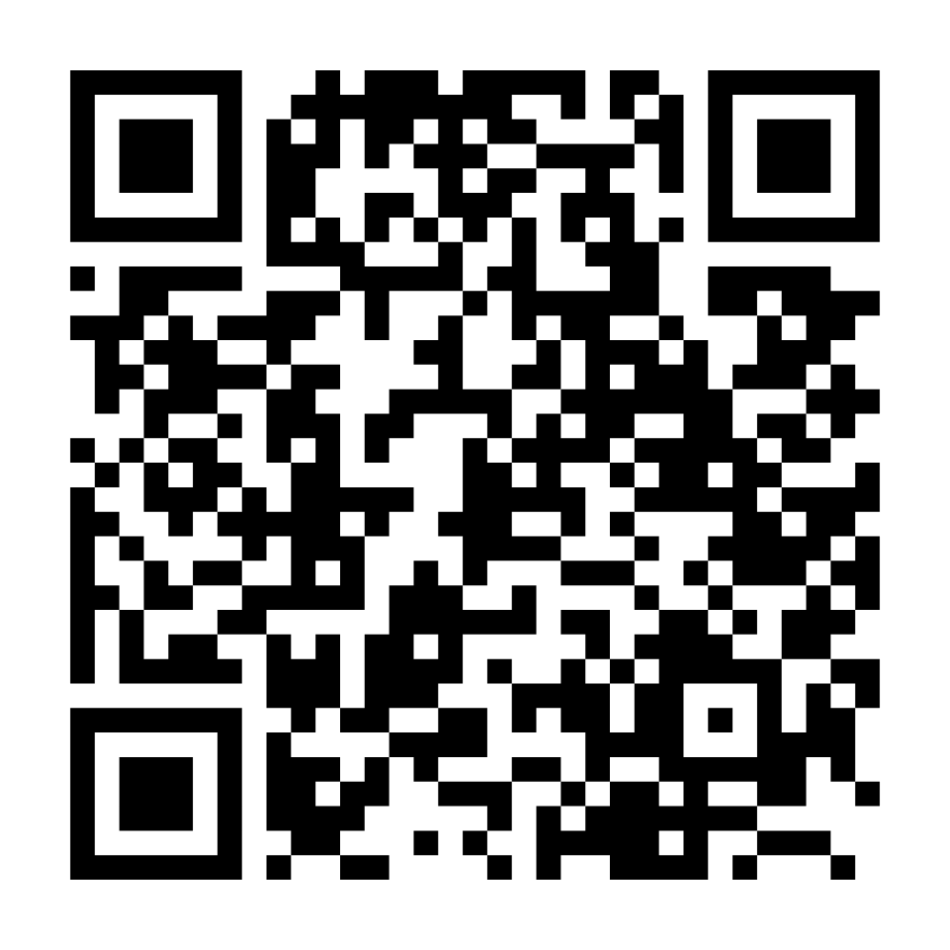

Parents carers and families webpage

Slide 18

Any questions?

Slide 19
Reading feeds the imagination. It expands horizons and offers new and exciting ways of seeing and making sense of our lives and of the world around us.
Michael Morpurgo
Notes:
Remember…you all have the power to change outcomes for your children.

