Slide 1


I can help.. RWI
Parent Meeting
Notes:
Approximately 20 minutes is needed for this session.
Notes are provided to help you lead the presentation.
Notes in italics are for your attention only.
This bitesize parent session is designed as an introduction to Read Write Inc. when you first implement the programme in your school or for your new Reception/ P1 intake.
Use the other bitesize parent PPTs throughout the year to discuss and practise how parents can help their child at home based on the child’s group.
Provide copies of ‘Reading at Home Booklet 1 or 2’ from Oxford Owl.
Booklet 1 is for Set 1 sound groups and Ditty/ Red Groups and Booklet 2 for Green – Grey Storybooks.

Slide 2
Introduction
This power point will be put on the school website
If you have any questions
  Please ask
  If you want to ask afterwards that’s fine
  If you would like to email, please email : office@stjamesacademy.co.uk
  If you’d like a chat at another time, please ring the school office and we can sort a time out : 01924 251048

Slide 3
Teach a child to read and keep that child reading and we will change everything.
And I mean everything.
Jeanette Winterson
Notes:
Read quote.
This is what we do in our school.
Research shows that children who learn to read early go on to succeed both in school and in life.
Today I will explain how your child will learn to read using the Read Write Inc. Phonics programme.

Slide 4



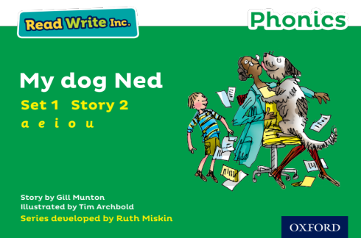
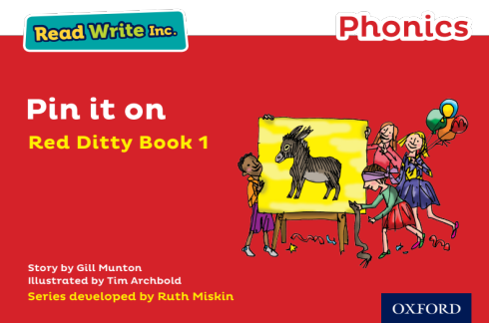
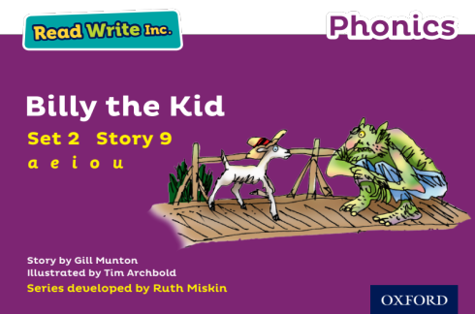
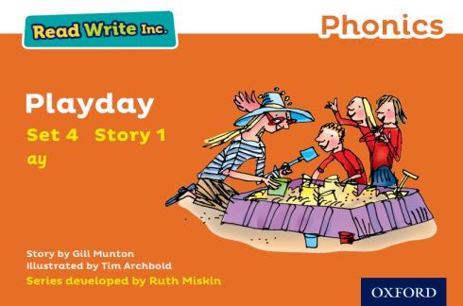

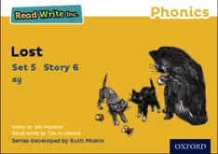
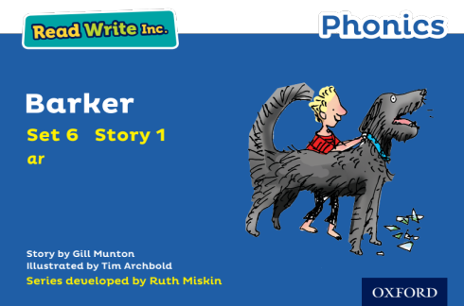
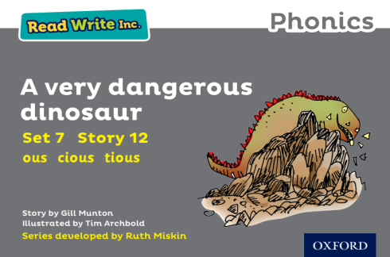




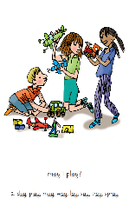
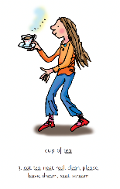
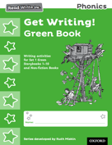
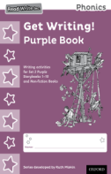
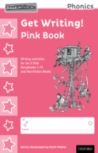
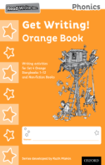
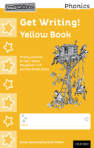
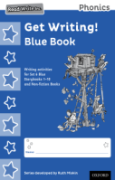
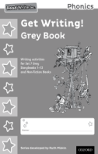
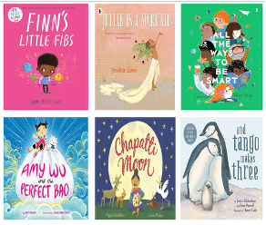
Read Write Inc. Phonics daily lessons
Notes:
What Read Write Inc. does is simple - we teach children to read and write sounds (click), children practise reading and spelling words containing these sounds (click), then we give children decodable books (click) containing sounds and words they can read.
They read each Storybook four times at school and again with you at home.
On each reading, children’s fluency increases and the more they can focus on what the story is about.
Children also learn to spell the words they have been reading and develop their ideas into sentences so that they can write about the Storybooks they read.
Alongside this we read stories to children: (click) stories they cannot yet read for themselves

Slide 5
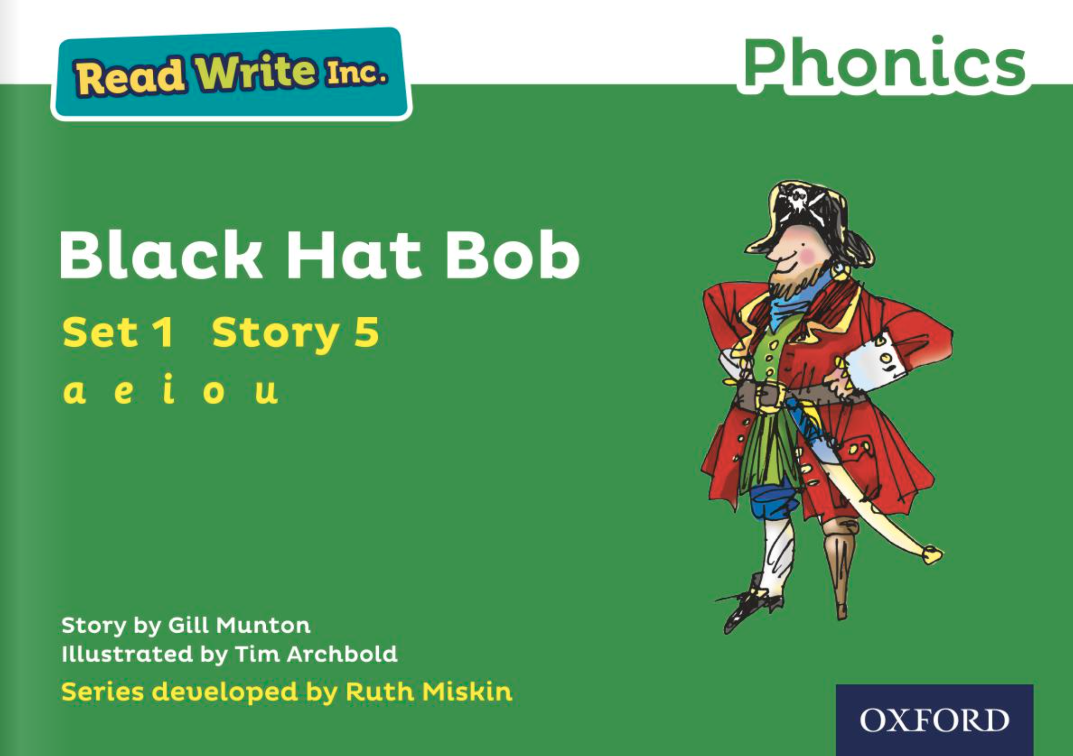
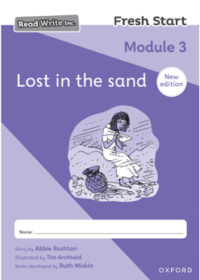
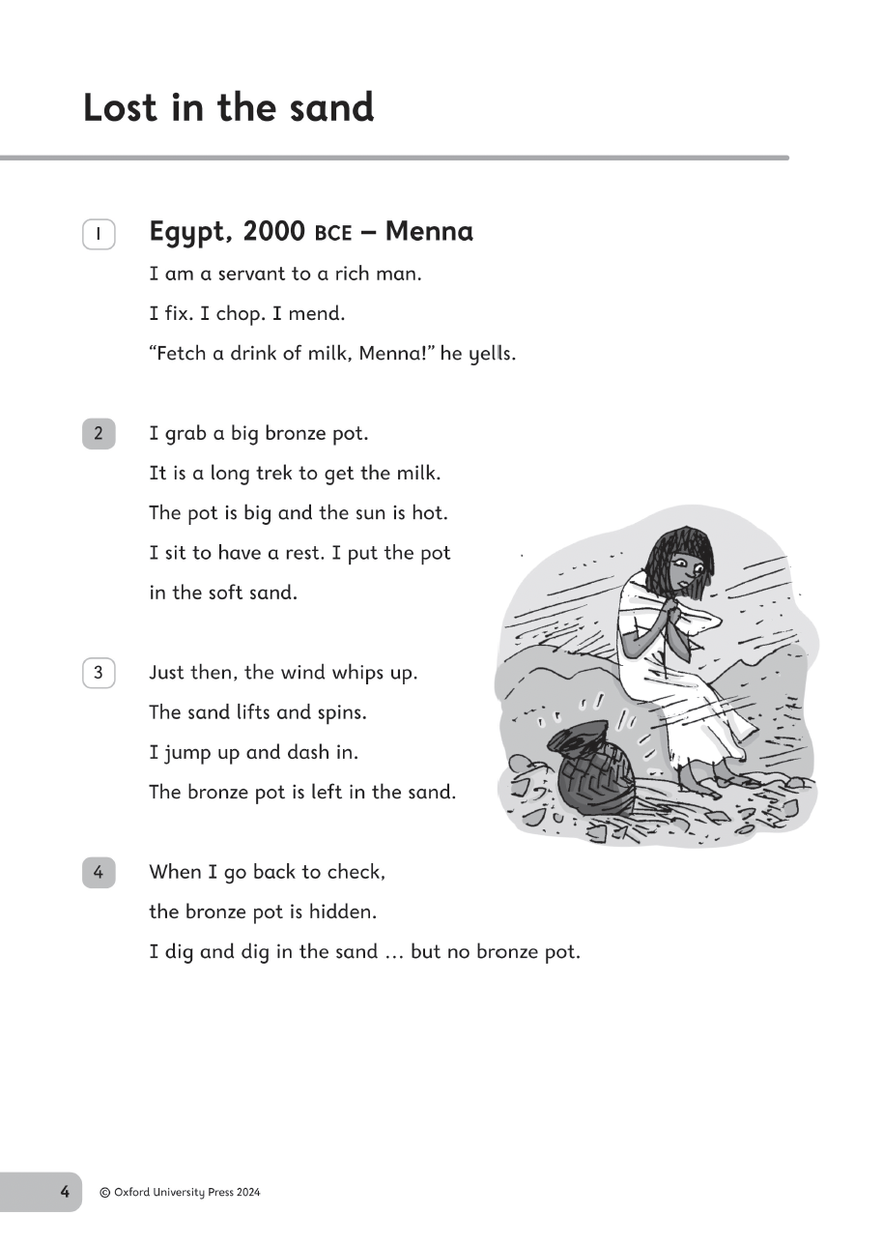
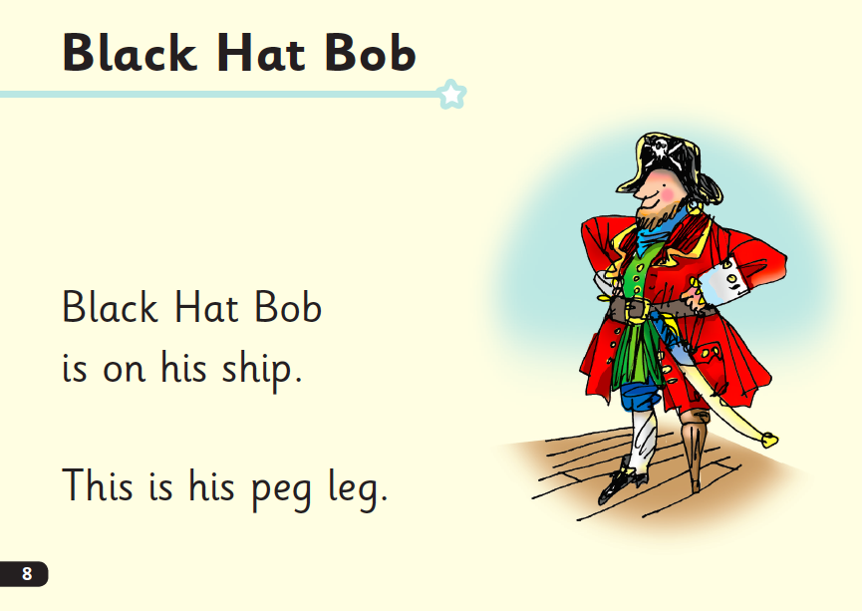
Who is Read Write Inc. for?
Notes:
Phonics is for children in Reception, Y1 and Y2 who are learning to read.
Phonics is also for children in Y3 and Y4 who haven’t met the KS1 reading expectations.
Fresh Start is for children in Years 5 and 6, who are need extra practice to learn to read.
We want to to make sure they catch up quickly and leave our school a reader.
Fresh Start is structured in the same way as the Phonics programme, but uses age-appropriate texts.

Slide 6

Progress groups
Group children by phonic stages.
Teach to the group’s challenge level.
Re-assess all children every half term.
Group children by their progress in word reading and fluency.
Notes:
In the same way as children learning to swim, play the violin or learn tai kwondo, while your children are learning to read, they work in progress groups to master each level of phonics and reading.
Children work in these progress group for one hour each day. This means they are learning at their ‘challenge’ level for five hours a week. (Reception children build up to this throughout the year).
As the reading leader, I assess and re-group the children every half-term.
This allows us to whisk children through the phonic stages as quickly as possible.

Slide 7
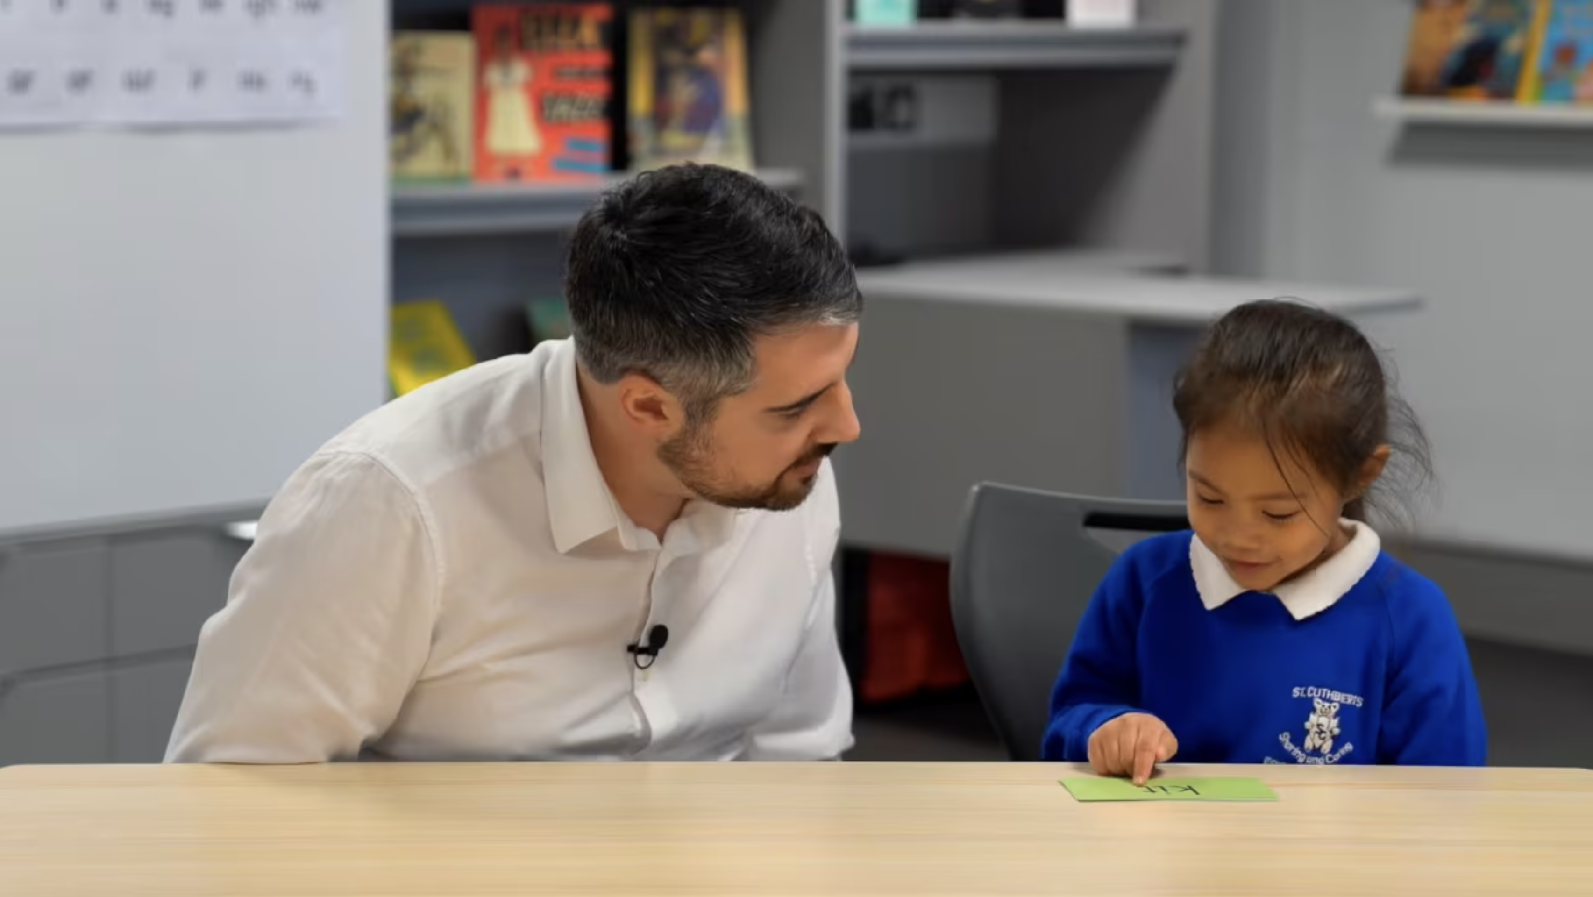
One-to-one tutoring –
‘keep up, not catch up!
Notes:
We want to make sure every child learns to read in our school.
Some children need extra practice when learning to read so we teach these children one-to-one for ten minutes every day – on top of their group lesson.
We make sure they ‘keep up’ from the beginning and don’t need ‘catch up’ later on.

Slide 8









What is phonics?
Sounds (graphemes)
demonstrate, containing, roamed, trivial, injured, whimper
Notes:
All words are made up of individual sounds. These sounds are blended together to form words.
e.g. in ‘mat’ we have the sounds ‘m’, ‘a’, ‘t’, ship – ‘sh’, ‘i’, ‘p’.
A grapheme is another name for the letters we use to write the sound. It’s spelling of a sound on the page.
Using phonics, children learn to read by saying each sound and blending them to read a word.
Children learn to spell by segmenting a word into sounds and writing the matching graphemes.
The National Curriculum ensures that all children are taught Phonics systematically.
This gives your children the tools to read any word, for example demonstrate, containing, roamed, trivial, injured, whimper.

Slide 9

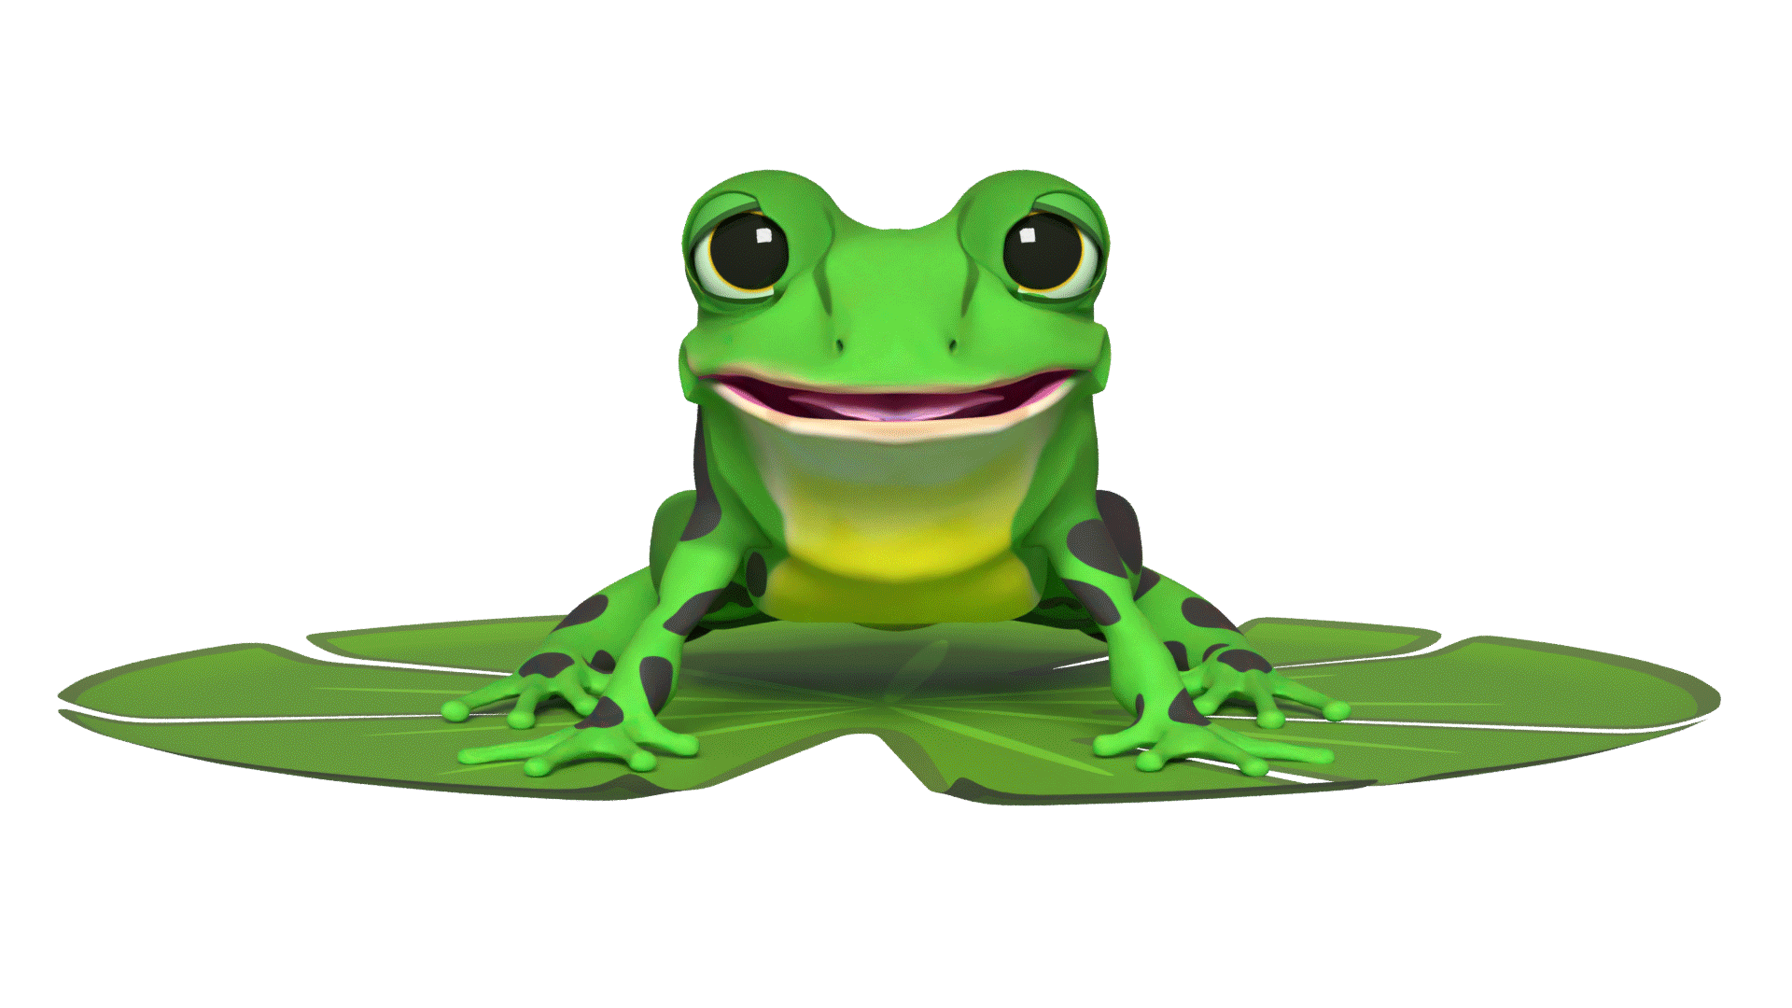

Speedy sounds + Fred = decoding
Notes:
Alongside teaching children sounds, we teach them to blend sounds to read words e.g. s-a-t, sat.
Once children can read sounds speedily, like this, (show how speedily this needs to be) and understand Fred (m-a-t...mat) (click), they can decode words.

Slide 10
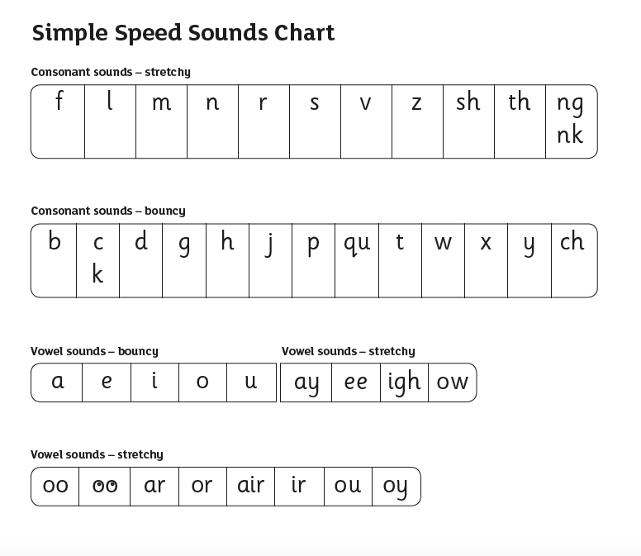
Speed Sounds Set 1
Notes:
Read Write Inc, Phonics makes learning to read easy for children because we start by teaching them just one way of reading and writing every sound. Here they are on the Simple Speed Sounds chart.
We teach Set 1 sounds first - (sounds as far as a e i o u).

Slide 11
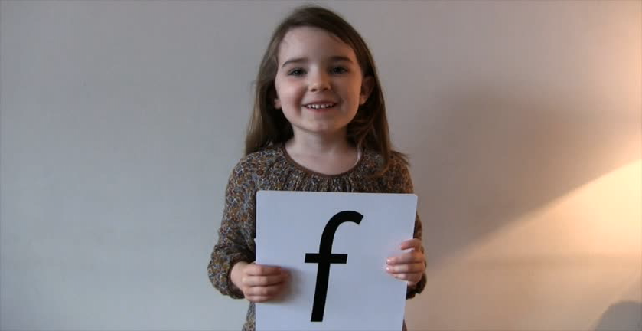
Pure Sounds (ruthmiskin.com)
Notes:
Children need to know sounds – not letter names – to read words.
We say the sounds in a way to make them easy to blend into a word.
We aim to eliminate the ‘uh’ at the end of the sound. This is called a ‘schwa’ sound.
We say ‘c’ ‘a’ ‘t’ rather than cuh a tuh.
Use MTYT to teach each of the Set 1 sounds to parents.
You can watch this film of little Sylvie on the Ruth Miskin website to practise using pure sounds. Play a little bit of the video.

Slide 12
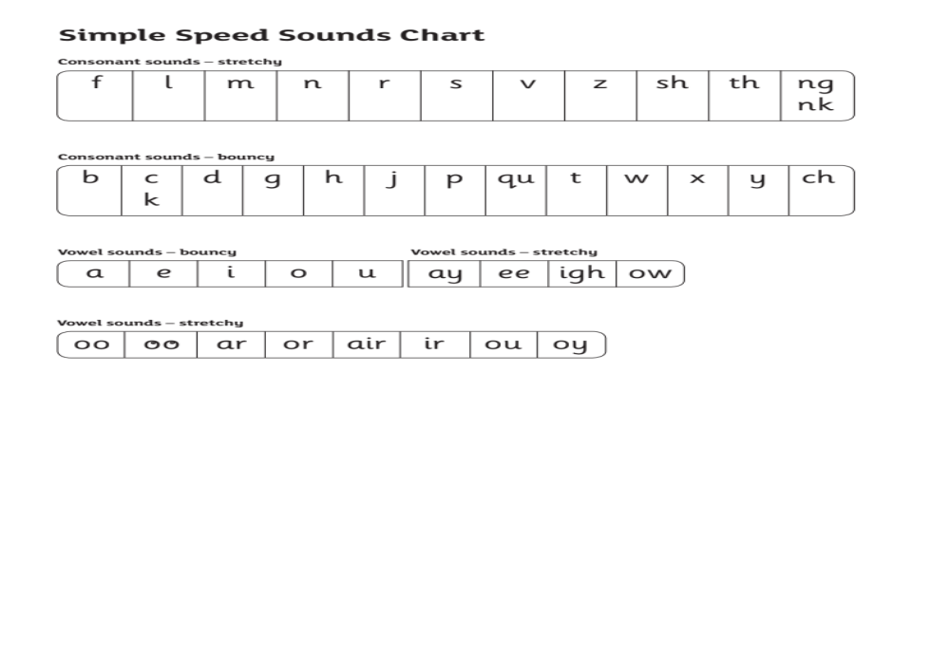
Speed Sounds Set 2
Notes:
Then Set 2 – one way to read and write each of the long vowel sounds.

Slide 13
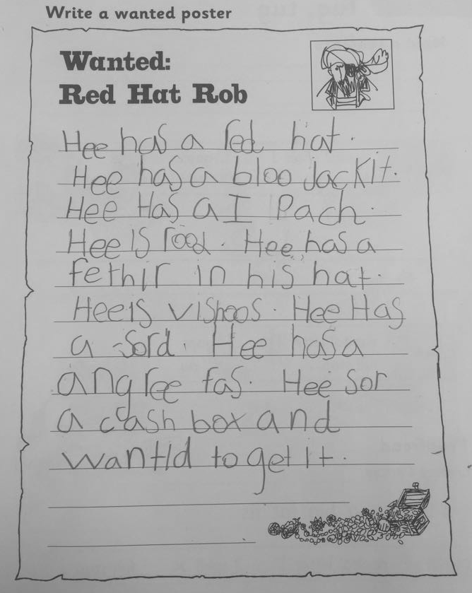



Writing with the simple code
Notes:
Once children know the simple code, they can write down their ideas - albeit not always spelled correctly.
This Reception child has written… read child’s writing aloud.
To write like this, children need to be able to write Set 1 and Set 2 sounds

Slide 14
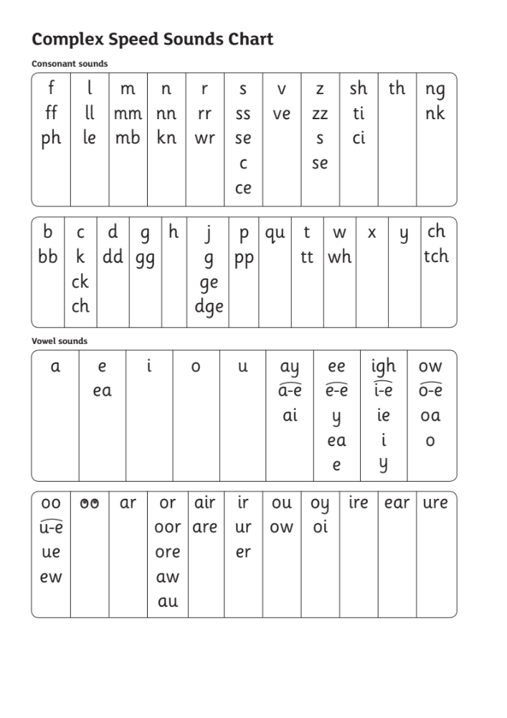
Speed Sounds Set 3
Notes:
Once children know how to read Set 2 sounds, they start to learn Set 3 sounds.
These are different ways to read and spell Set 2 sounds.
We call these Set 3 sounds, but actually they are the same sounds as in Set 2 but with a different spelling.
We say "same sound, different spelling".
Point to the chart to show. For example, they know ‘ay’ and now learn a-e and ai as other spellings for the same sound.
Once they know all of these sounds, they will be able to read any unfamiliar word.

Slide 15
Speedy sounds + Fred = decoding
Notes:
Alongside teaching children sounds, we teach them to blend sounds to read words e.g. s-a-t, sat.
Once children can read sounds speedily, like this, (show how speedily this needs to be) and understand Fred (m-a-t...mat) (click), they can decode words.

Slide 16
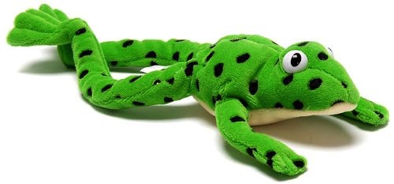
Make friends with Fred!
Notes:
Let me introduce you to Fred.
Fred helps children learn to blend sounds into a word.
Fred can only speak in sounds. He says d-o-g, h-a-t etc.
He says the sounds c-a-t, and then children help him to say the word.
This is how we quickly teach all of our children to blend orally.
We practise blending orally so children will find word-reading easier.

Slide 17
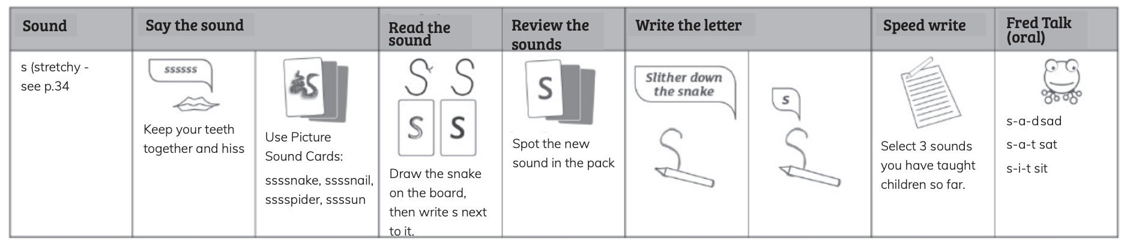
Set 1 Speed Sounds
Notes:
Each day, we teach children a new Set 1 sound. We know that children learn more rapidly at this age than at any other time in their lives so you can teach a new sound every day.

Slide 18
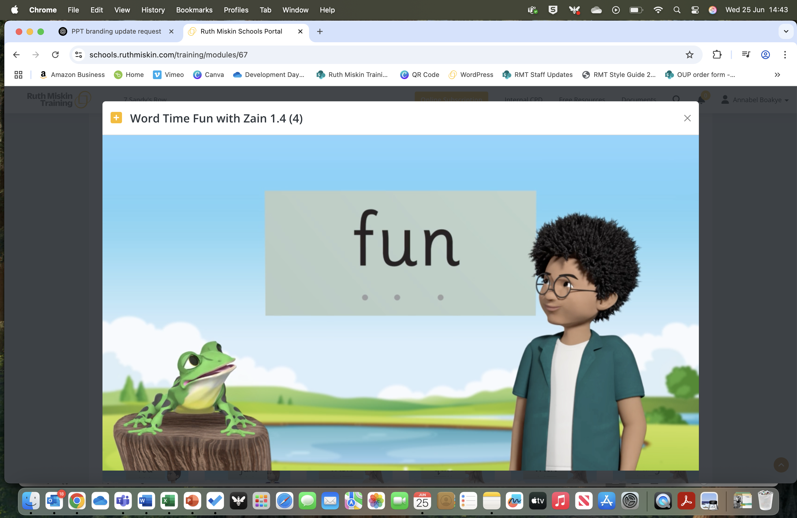
Virtual Classroom films
Notes:
Each week, we will send home film links or QR codes to lessons that match the sounds and words your child has been learning in school.
There are lessons to support children at every stage of the Read Write Inc. Phonics programme.
Your child uses the Virtual Classroom in school.
Children are familiar with the VC teachers – and interact with them as they would their own teacher.
Watch these films with your child to help them to practise reading the sounds and words until they can read them speedily.
Simply click the link or QR code and watch on a tablet or other device.
Let’s have a look at one of these films on the Virtual Classroom. Play a Set 2 or 3 at home film from the virtual classroom.

Slide 19

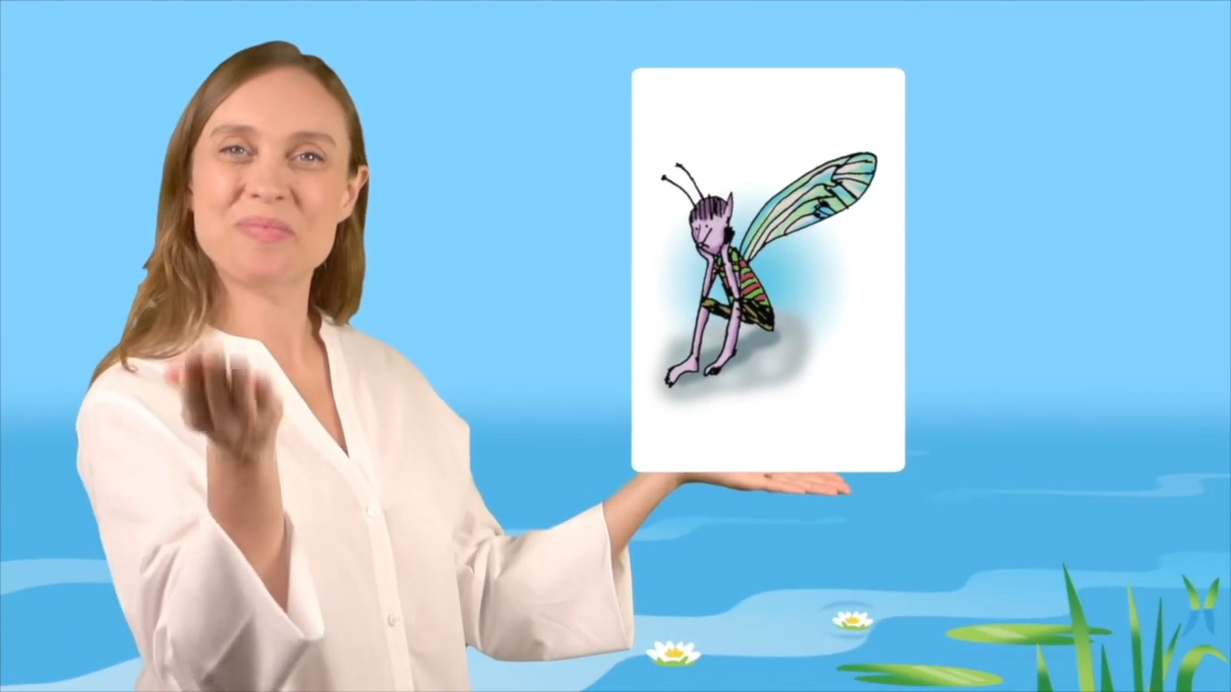
Virtual Classroom
Notes:
Let's watch a short taster of the range of animated films in our virtual classroom.

Slide 20

How do I use the Virtual Classroom?
Set aside 10 minutes to watch a film with your child each day.
Find a quiet space for your child to watch the film on a laptop or tablet.
Praise your child as they join in with the lesson – make it fun!
The more they practise using these films, the quicker they’ll learn to read.
Notes:
We will send you links to the films via email/ upload links to Google classroom/ Class Dojo etc.
When you receive the link, simply click on it . . . and press play.
Set aside 10 minutes to watch a film with your child each day.
Find a quiet space for your child to watch the film on a laptop or tablet.
Praise your child as they join in with the lesson – make it fun!
The more they practise using these films, the quicker they’ll learn to read.

Slide 21
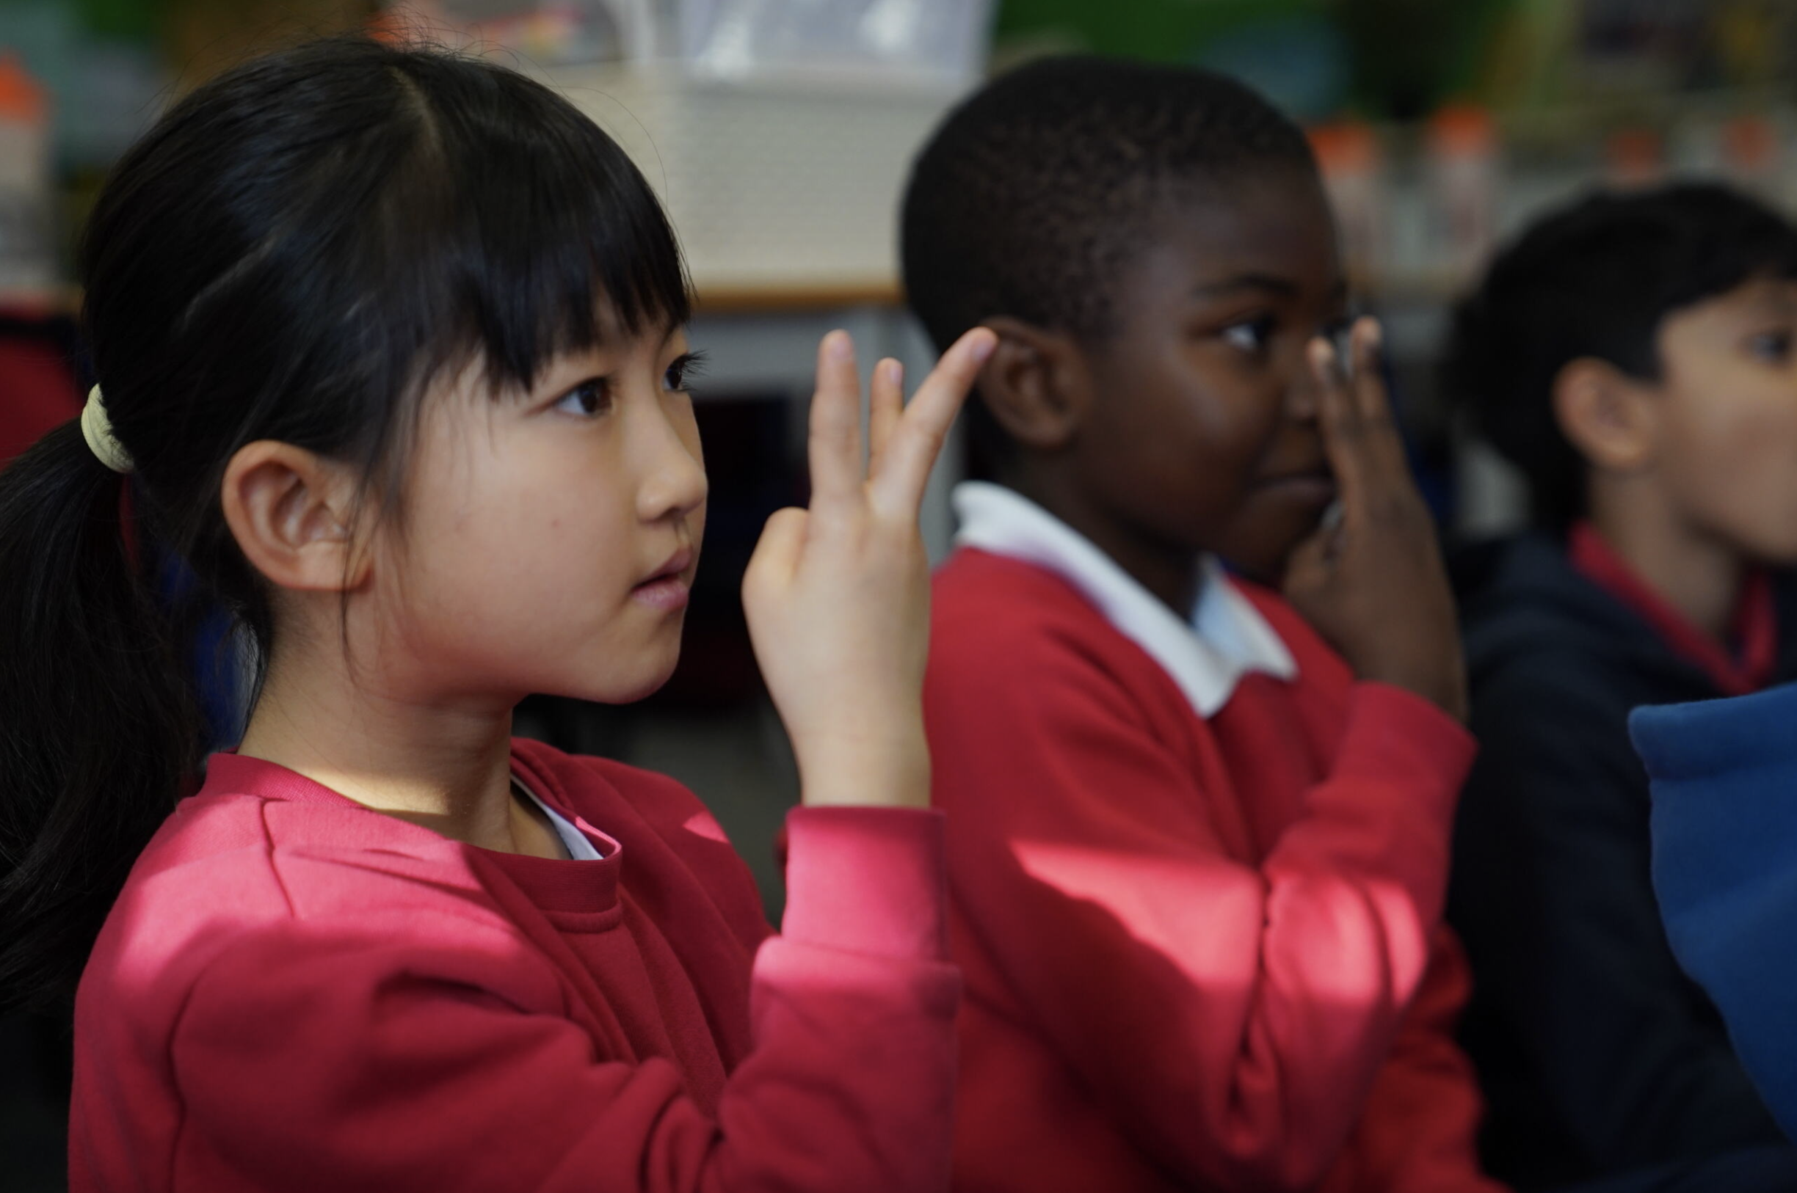
Teach spelling using Fred Fingers
Notes:
We use Fred Fingers to help children sound out words to spell easily.
It means they do not have to memorise lists of spelling words.
It is a tool so they will be able to spell any word.

Slide 22

Five reads
Read every word accurately.
Read more words ‘at a glance’.
Read the whole story accurately, fluently and with a storyteller’s voice.
Notes:
Children read the Storybook three times. Each read builds on the last.
On each reading, the number of words they read 'at a glance' increases – and along with it their ability to focus on the story.
1. On the first read, we help children read every word accurately.
2. On the second read, we help children read more words ‘at a glance’.
3. On the third read, we help children read the whole story accurately, fluently and with a storyteller’s voice.
Children then take this same book to enjoy at home.
Right from the start, children enjoy re-reading simple texts.

Slide 23
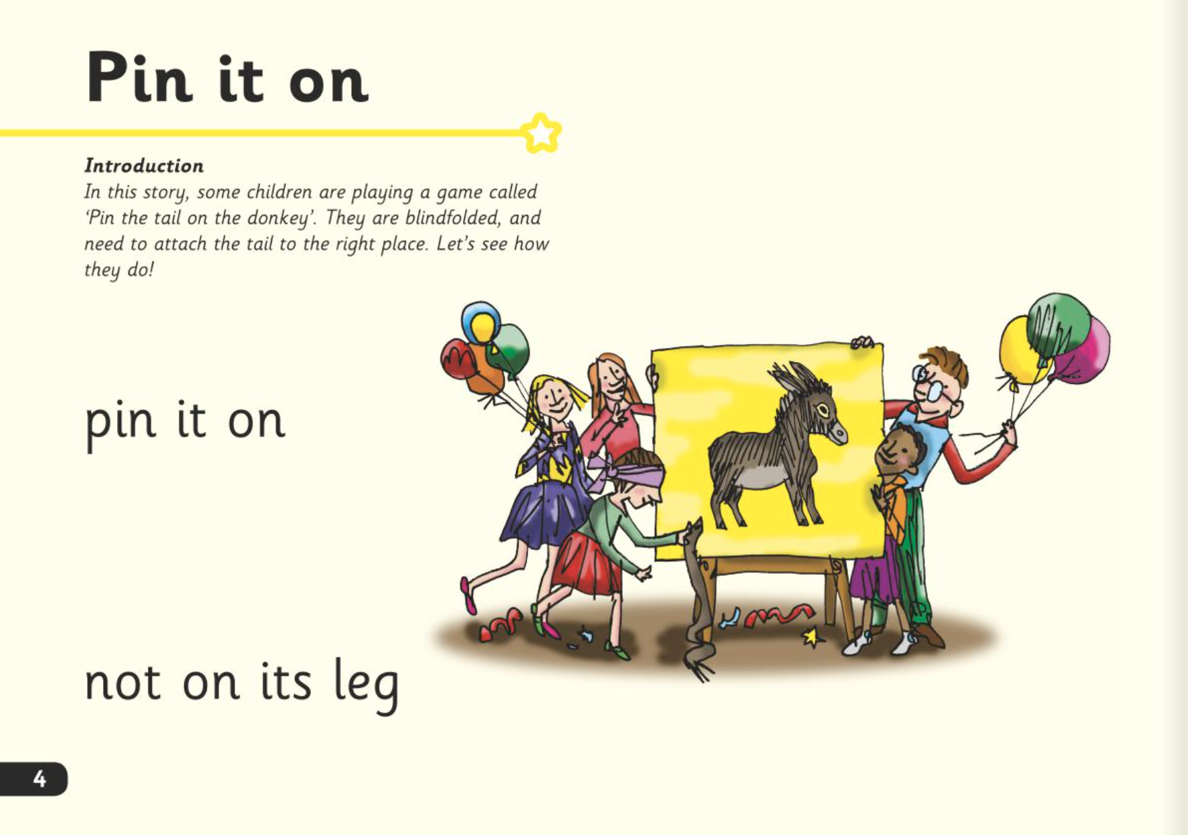
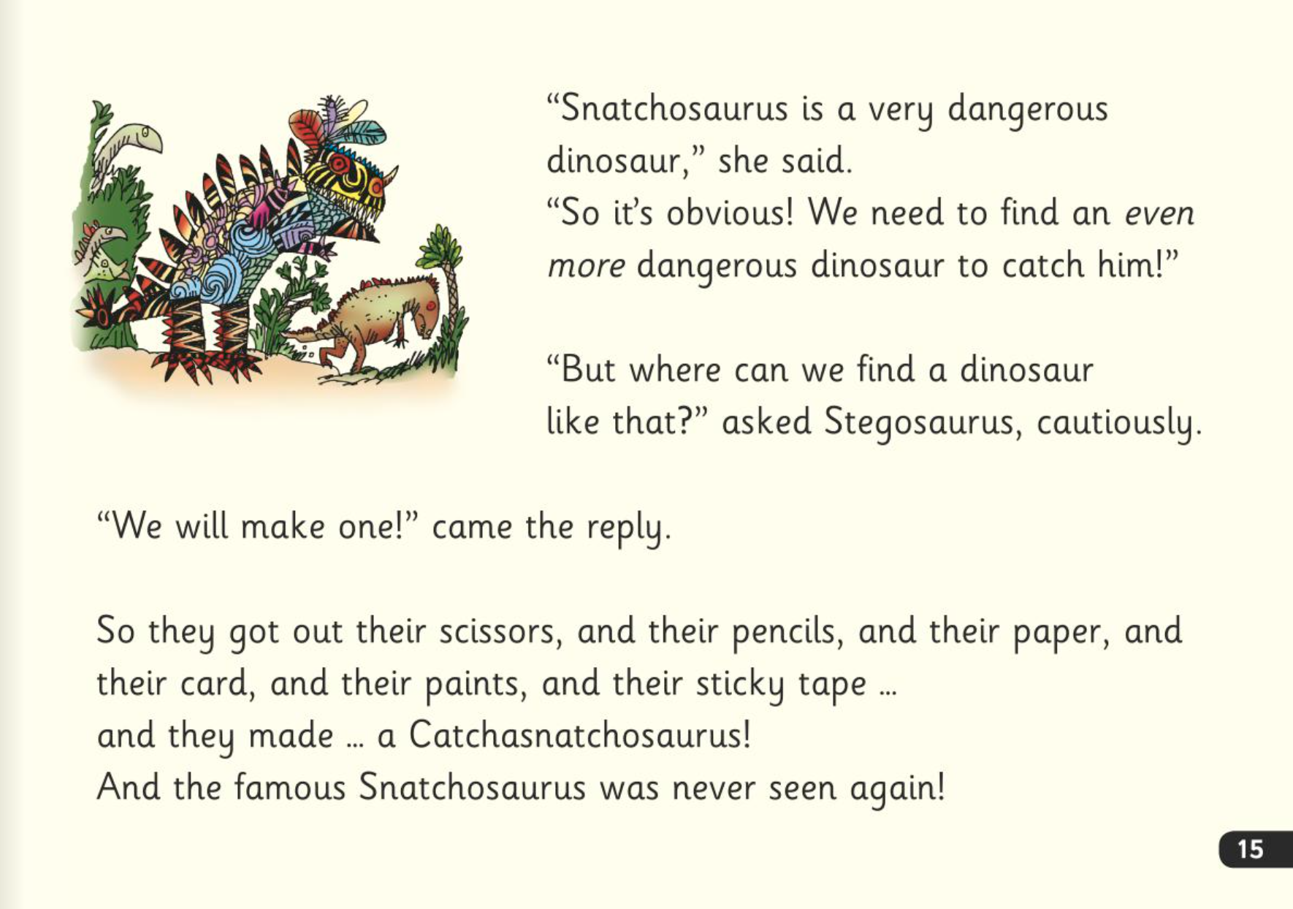
Five reads
Notes:
In our school, children read Read Write Inc. Storybooks that match the sounds they can read.
They read each Read Write Inc. Storybook three times in class with their partner.
Re-reading the same book helps children to become confident readers. Each time they re-read, they build their fluency/speed and comprehension.
They love reading and want to read because they can read all of the words in the Storybook.

Slide 24
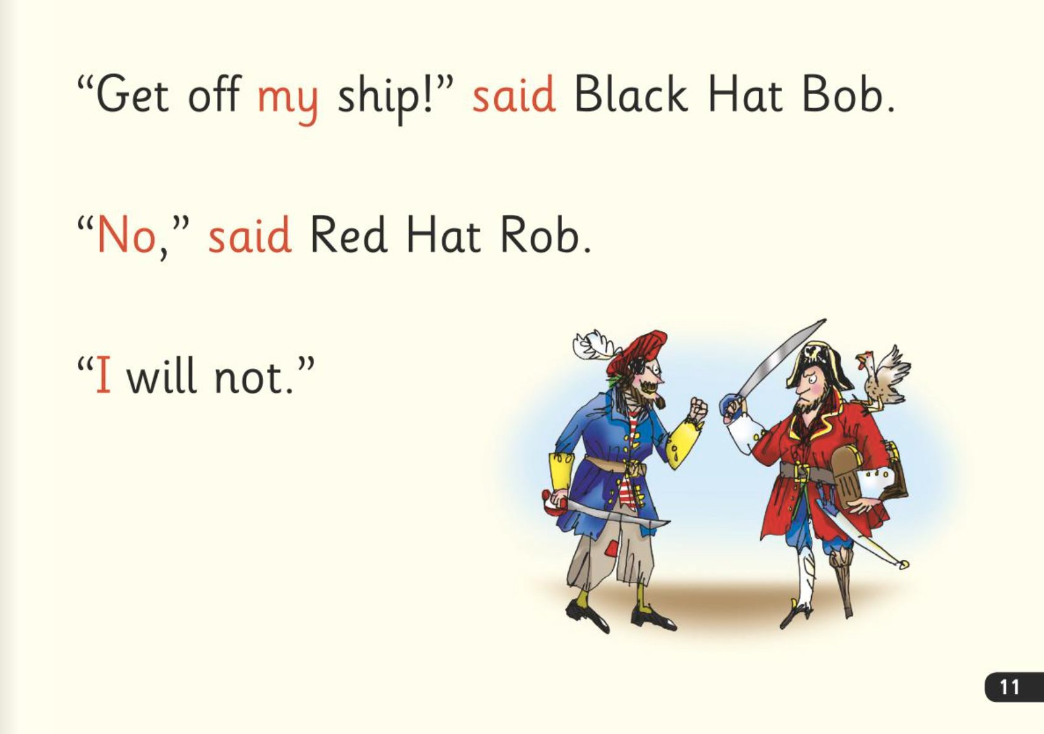

’Special Friends’, ‘Fred Talk’
Notes:
Children will be able to read all of the words in the Storybook.
If they hesitate, remind them to read the word using ‘Special Friends, Fred Talk,’.
For example, this means they spot the ‘sh’, then Fred Talk and blend to read the word e.g. sh, sh-i-p, ship.

Slide 25

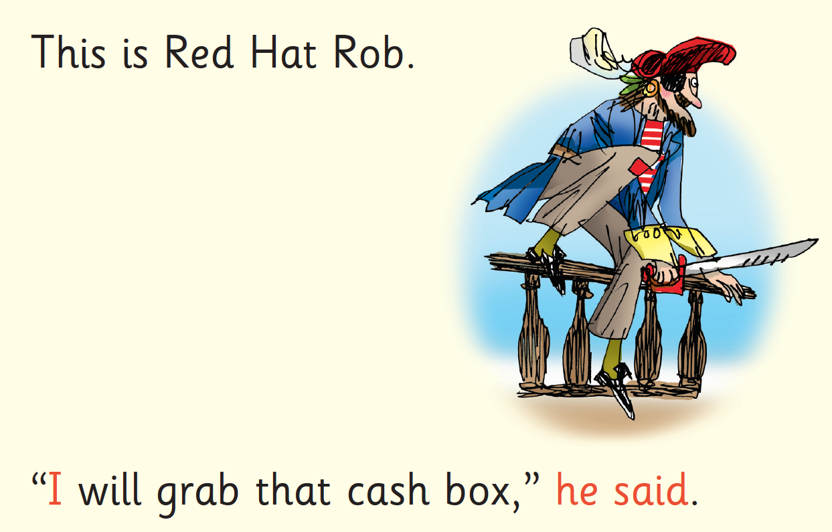

Red Words
Notes:
Some words are ‘tricky’ because they contain letters that don’t match the sounds the child has been taught.
For example, ‘said’ has ‘ai’ making an ‘e’ sound.
We teach these common exception words as Red words.
In the early Storybooks, these words are printed in red text.
Remind your child not to use Fred Talk to read Red words but instead to stop and think if they know the word. Tell them the word if needed.

Slide 26
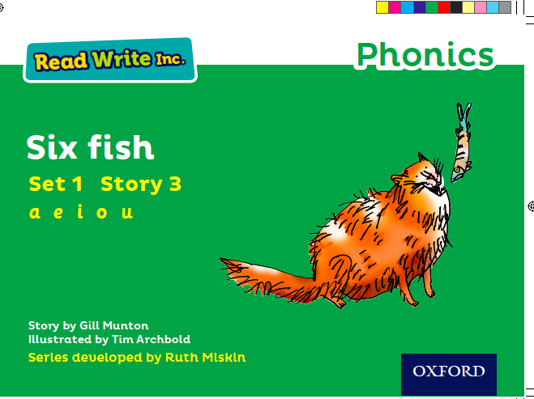
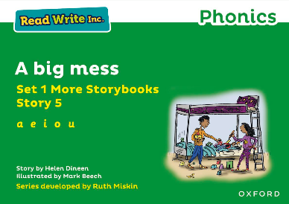
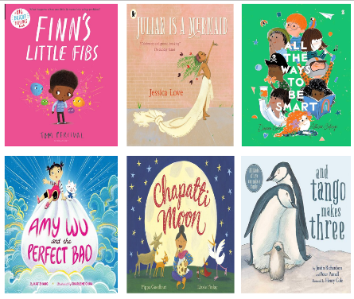
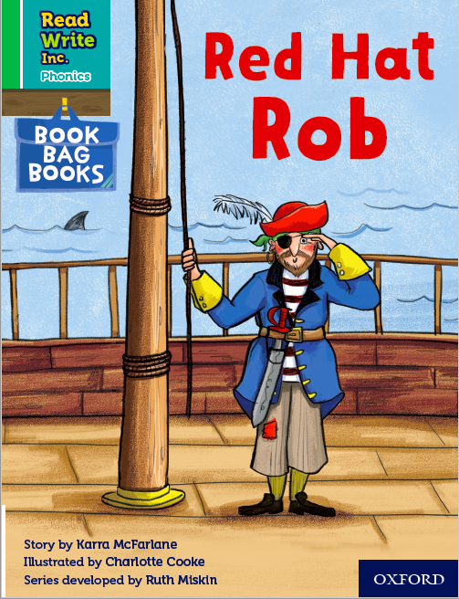
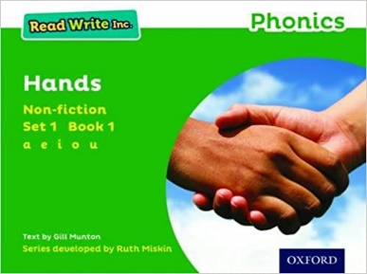
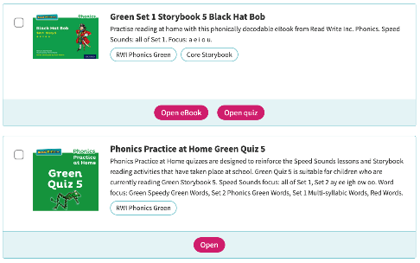
What books will children bring home?
Notes:
In your child’s book bag, they will bring home:
- the Storybook they have just read in class to practise reading what they can already read (they love this book and enjoy reading it in their storyteller voice).
- if applicable a past Storybook – a previously read RWI Storybooks for extra practice. The children enjoy re-reading stories they know well. Their fluency improves on every reading.
- if applicable a Book Bag Book that links to the story they have read in class or a non-fiction or ‘More’ Storybook.
A picture book to share with you which has already been read to them so they care about it. You can read the story to them or they can retell the story by looking at the pictures. They are not expected to read the story themselves.
We make sure that every book that goes into your child’s book bag is a well-loved book – one they know already and want to read again and again.
The more they read, the faster progress they will make.
Please avoid saying, “This book is too easy for you!” but instead say “I love how well you can read this book!”
If appliable:
We also use the Read Write Inc. Phonics eBook Library Subscription.
Each week, we will assign your child the book they have read during the week to read on a tablet or other device.
There are also phonics practice games to match each book.

Slide 27
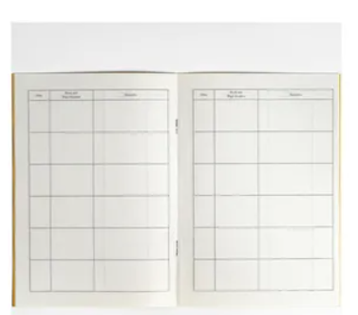
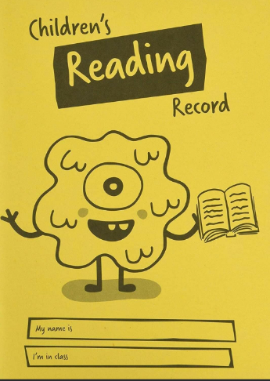
Reading records

Slide 28
At five years old:
Never read to - 4,622 words
1-2 times a week - 63,570 words
3-5 times a week - 169,520 words
Daily - 296,600 words
Five books a day - 1,483,300 words
Science Daily (2019)
https://www.sciencedaily.com/releases/2019/04/190404074947.htm
Notes:
In 2019, researchers in the United States looked at the impact of parents reading with their children.
Here’s how many words children would have heard by the time they were 5 years old.

Slide 29
The number and quality of the conversations they have with adults and peers throughout the day in a language-rich environment is crucial.
The reading framework
Teaching the foundations of literacy
DfE, July 2023
Notes:
Children need plenty of back-and-forth interactions with adults from an early age.
Read quote on slide:
‘The number and quality of the conversations they have with adults and peers throughout the day in a language-rich environment is crucial.’
Do not limit your language. With plenty of repetition, children will start to use the language themselves.

Slide 30

Talk with children
Cooking:
ingredients, heavy, light, knead, yeast, dough, temperature, moisture, creamy, whisk…
Walks:
narrow, wide, curved, symmetrical, mottled, speckled, spiky, sharp, thorn…
Notes:
Plan the words you’ll use when you’re cooking: ingredients, heavy, light, knead, yeast, dough, temperature, moisture, creamy, whisk…
Plan the words you’ll use when you go on walks: narrow, wide, curved, symmetrical, mottled, speckled, spiky, sharp, thorn…

Slide 31

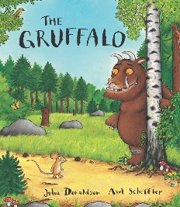
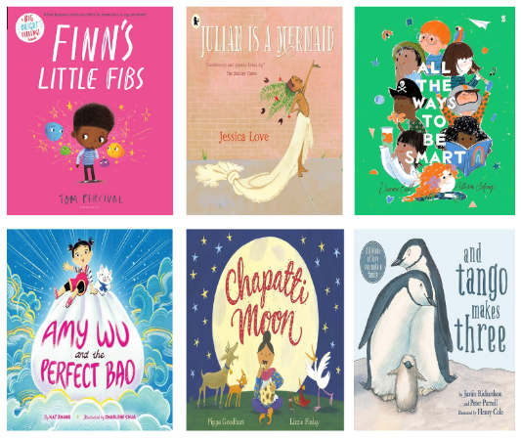
Choose the best stories for your storytime
Old and gold
New and bold
Notes:
Think about choosing ‘old and gold’ stories, but also the (click) ‘new and bold’.

Slide 32
Engagement: love each story
Share your love and enthusiasm for the story.
Notes:
share your love and enthusiasm for the story.
If you don’t truly love the story, the children won’t either.
Introduce it as a treasure!

Slide 33

Reading aloud is transformational
Being read to is the most powerful predictor of a child’s future reading comprehension.
Notes:
Being read to is the most powerful predictor of a child’s future reading comprehension.
Every child has a right to a story every day.
Reading stories to children isn’t an optional extra to fit in if there’s time; it is transformational.
Let’s read aloud books to children with love, confidence and enjoyment - every day.
Let’s do everything we can to ensure all children get the reading habit early.

Slide 34

What can I do?
Use pure sounds rather than letter names.
Use Fred Talk to help your child to read and spell words.
Listen to your child read their Storybook every day.
Watch the Virtual Classroom films together.
Read stories to your child every day.
Notes:
We will run regular bitesize meetings to look at each of these in more detail.

Slide 35
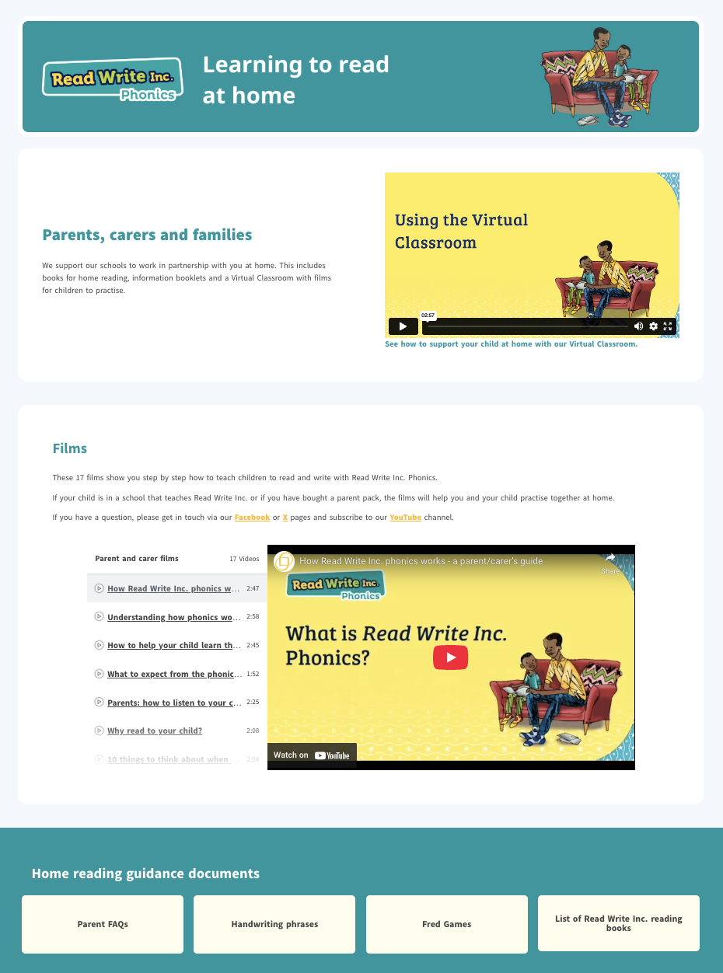
ruthmiskin.com
Notes:
Watch video tutorials on the Ruth Miskin website to help you to understand more about Phonics, Read Write Inc. and how to practise reading and writing with your child at home.
There is also a handy ‘Using the Virtual Classroom’ film.

Slide 36
Online resources available
Ruth Miskin Families Page:
https://www.ruthmiskin.com/parentsandcarers/
Ruth Miskin Facebook:
https://www.facebook.com/miskin.education
Free e-books for home reading:
http://www.oxfordowl.co.uk/Reading/

Slide 37
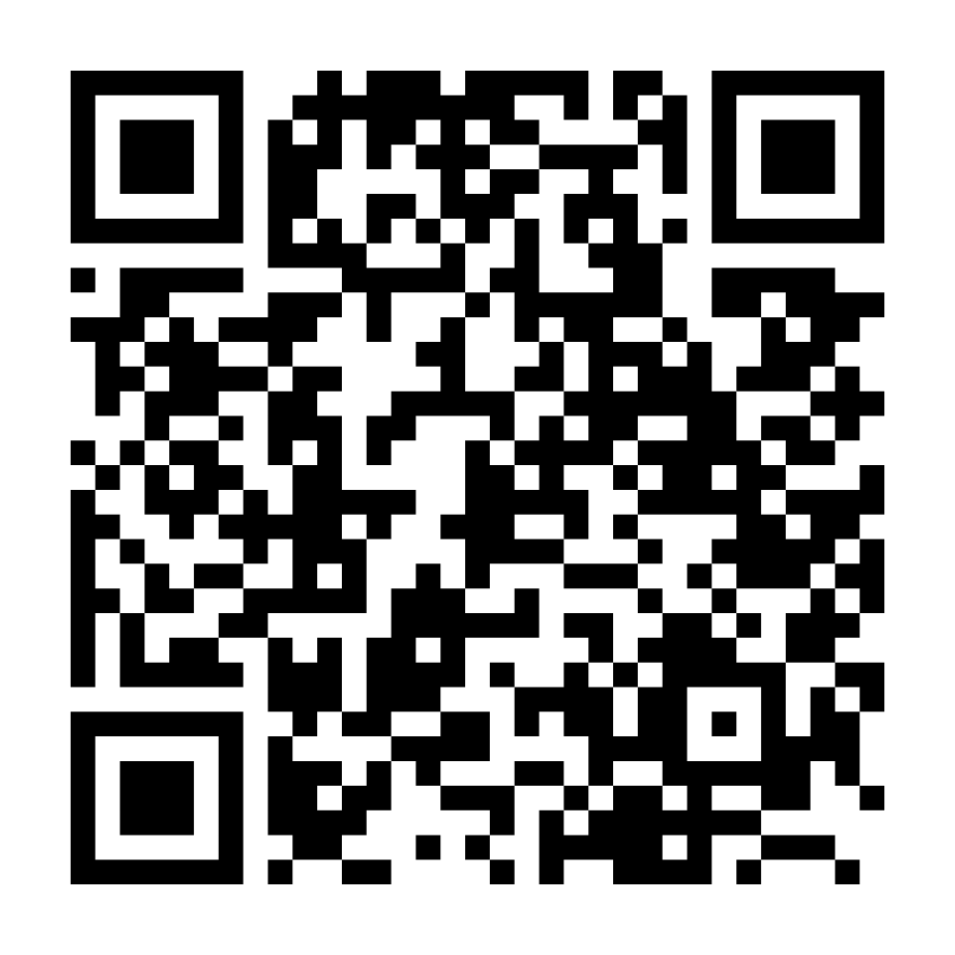

Parents carers and families webpage

Slide 38

Any questions?

Slide 39
Reading feeds the imagination. It expands horizons and offers new and exciting ways of seeing and making sense of our lives and of the world around us.
Michael Morpurgo
Notes:
Remember…you all have the power to change outcomes for your children.

