Slide 1

Transition Reception to Year 1

Slide 2
Key Dates
Transition Day Meet the Teacher
Thursday 2rd July
End of the school year
Friday 17th July
Start of new academic year
Thursday 3rd September

Slide 3
Staff
Class 1 – Mr Hall
Class 1 /2 – Mrs Armitage

Slide 4
Classes
There are approximately 45 children in each year group which means that there is one class of 30 children and another class with half of one year group and half of another.
Next year your child will be in Class 1 or Class ½, this has been done through their age – the oldest children in class 1 / 2 the younger children in class 1.

Slide 5
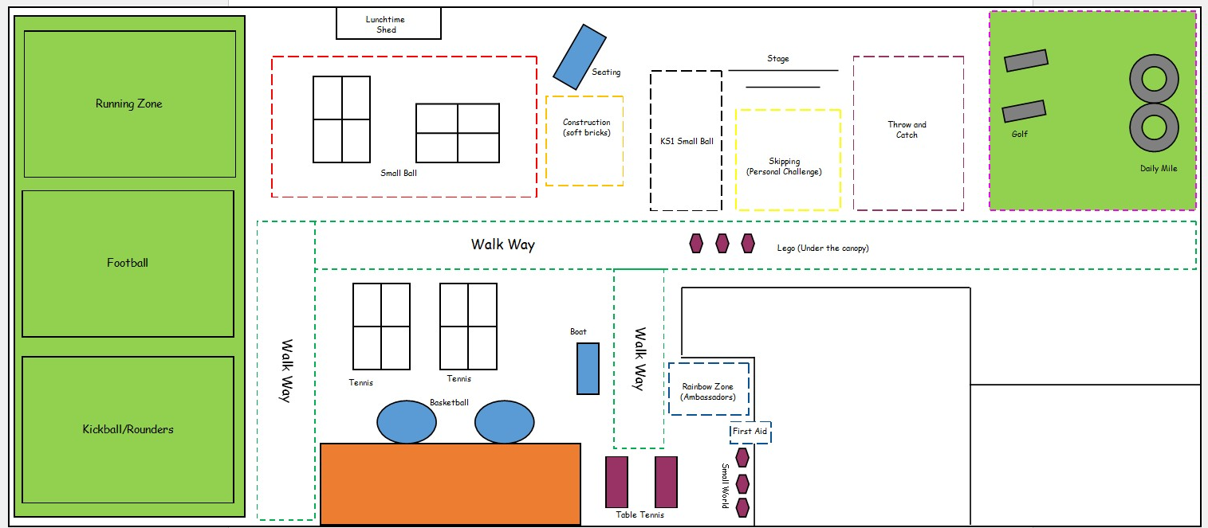
Coming into school
Please can you drop your children off at the middle gate
Children will walk into school independently
  There will be welcomes at the gate from members of SLT and Well Being Champions to support children coming into school
Class 1/2
Class 1
Entrance to Class 1/2
Entrance to Class 1

Slide 6
Going home
Children in class 1, will be collected from outside their classroom door near the ramp. See the green star.
Children in class ½ will be collected from outside on of their classroom doors, through the wet bay. See the blue star.
Class 1/2
Class 1
Entrance to Class 1/2
Entrance to Class 1

Slide 7


Curriculum Changes
EYFS curriculum
Year 1 curriculum
Our Key Stage One staff understand the importance of the learning experiences your child has had throughout their time in Early Years. These are the foundations that staff will now build upon.

Slide 8


2 year cycle
The curriculum is planned over two years so that children are not repeating topics and there is progression
Year A (2026-2027)
Science – Everyday materials Y1, Plants Y1, How animals are different, Growth
History – War and remembrance, Travel and transport, Explorers
Geography – Our school, Our local area, Our country
Year B (2027-2028)
Science – Uses of everyday materials Y2, Habitats around the world, Plants Y2, Lifecycles Y2
History – The Great Fire of London, Nurturing Nurses, Toys
Geography – Wonderful Safari, Wonderful weather, Beside the seaside

Slide 9
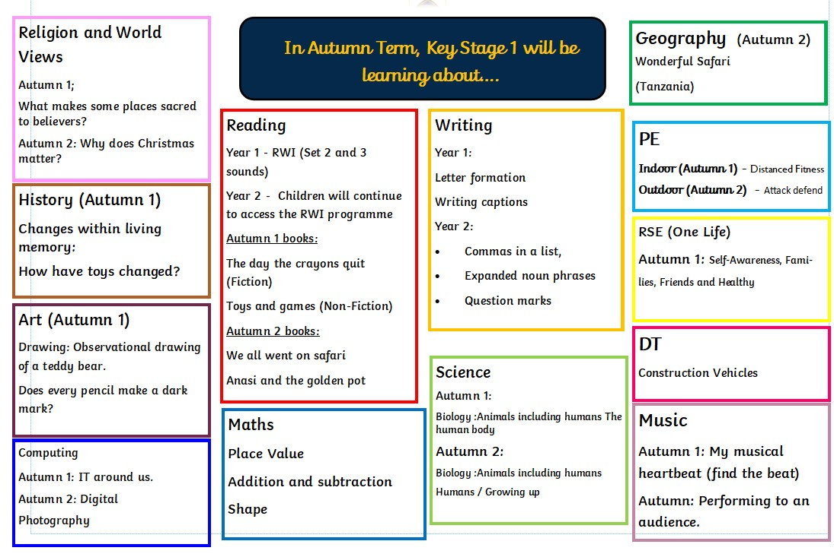

Slide 10
Our carefully planned transition …
Children will still have access to ‘areas’ but resources will be more limited and each area will have a planned subject focused activity, with a clear outcome in mind.
Learning will still be carried out as a whole class for core subjects and small groups for wider curriculum subjects, as it has been towards the end of Reception. The children will access planned activities with the ‘areas’ around the classroom.
Learning will be planned in line with the National Curriculum, where appropriate. Your child’s needs, abilities and starting points will always be taken into account.

Slide 11

One Life
One Life explicitly teaches all children how to live their ‘one life’ well.
The clear end goal of the programme is to ensure that all pupils know how to live a healthy, safe and happy life and know to manage their academic, personal and social lives in a positive way.
These lessons will be explicitly taught each week and every morning between 8:40 – 9:00 children come into school and complete activities which are linked to the current theme each week.

Slide 12

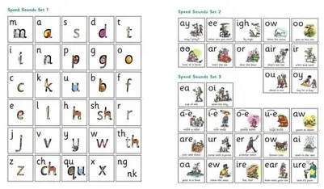
Phonics
Parent guide to Read Write Inc. Phonics - Oxford Owl

Slide 13




Supporting Phonics & Reading at Home
Children will bring home two ‘decodable’ books that are matched to the sounds they know. One of these they will have practised reading during the week in class.
The children read these to you and then you can ask them some questions about what they have read and comment in their reading diary.
Children will also bring home a library book each week that can be shared.

Slide 14
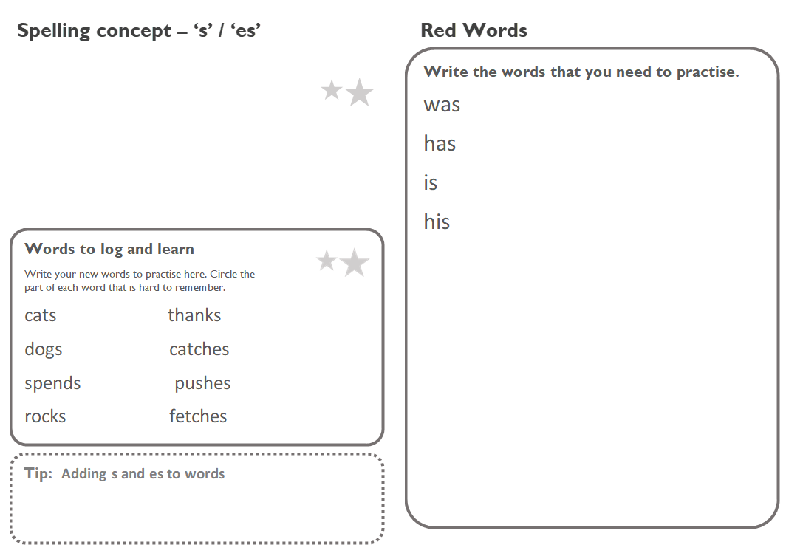
Spellings
We follow the National Curriculum spellings for year 1 and use a similar process to teach these as the rest of the school.
At the beginning of the week children will put their new spellings in their book to practise at home, these will include some tricky words that the children cannot sound out e.g. was
Children’s spelling books need to be brought into school EVERYDAY

Slide 15



Handwriting

Slide 16

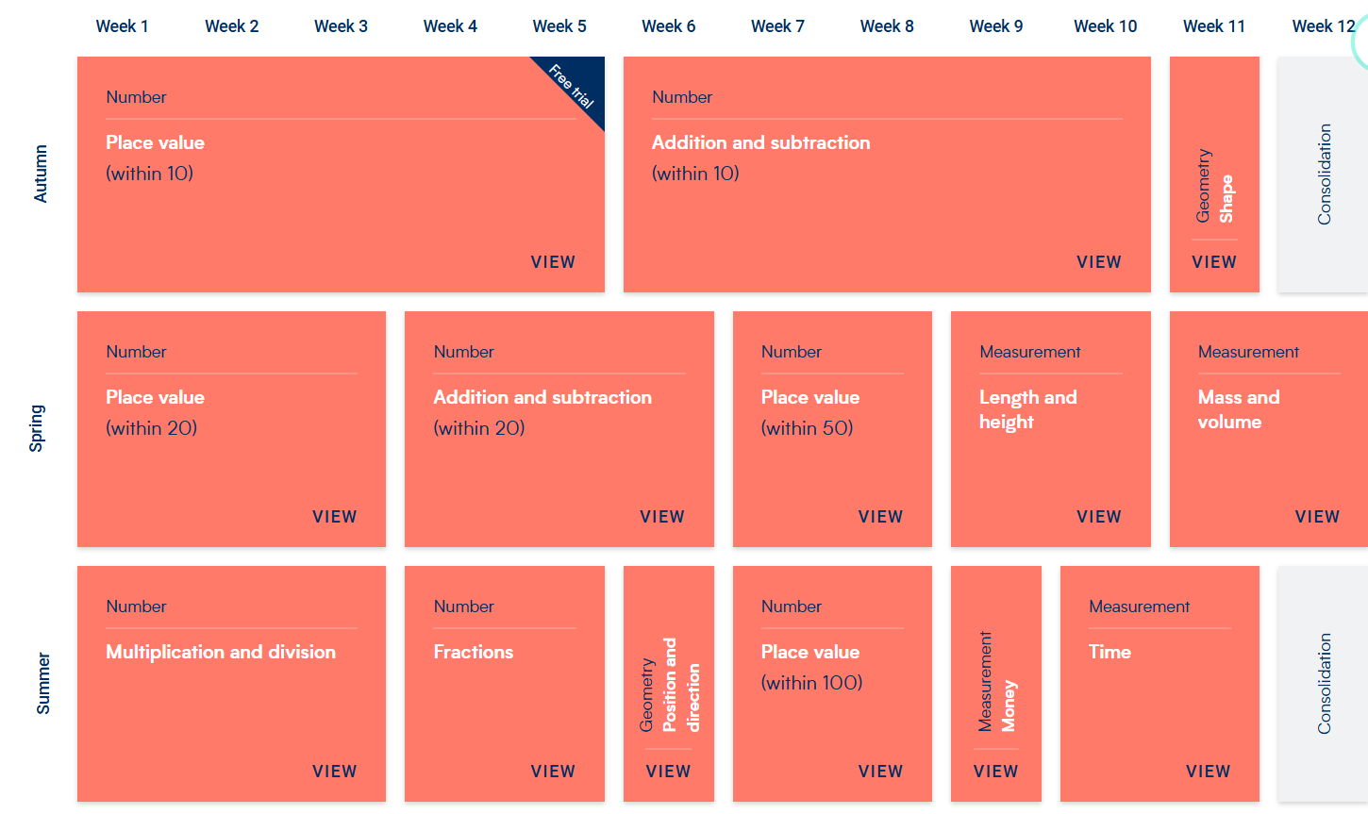
Maths

Slide 17

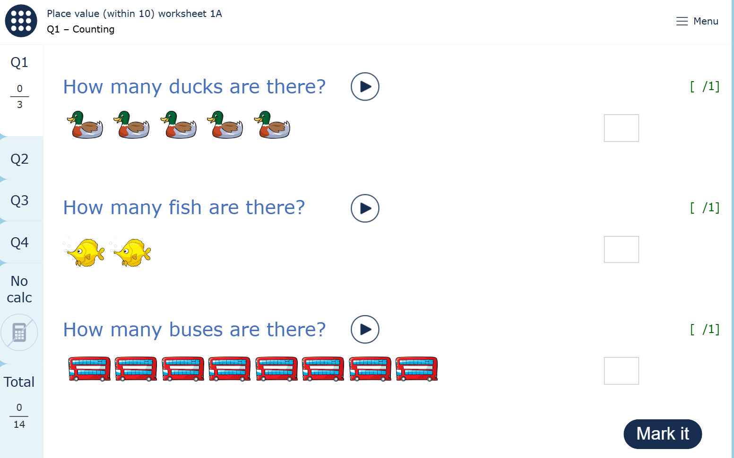
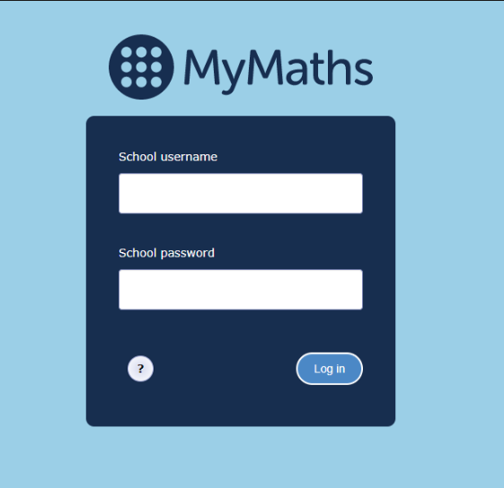
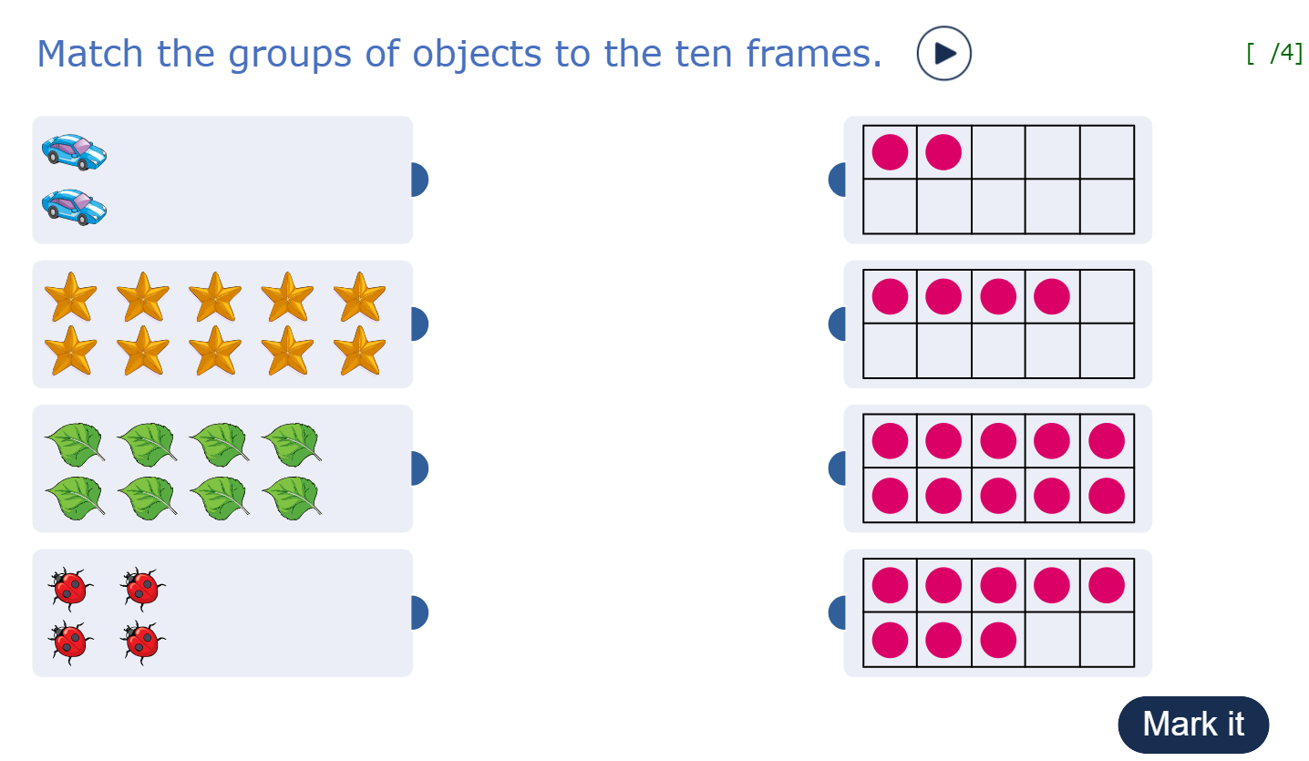
My maths
Here for you – wherever you learn - MyMaths

Slide 18


Numbots

Slide 19

Numbots

Slide 20

Where children will be assessed throughout the year
All children will be assessed against the Year 1 objectives, whether they are in class 1 or class 1 /2.

Slide 21
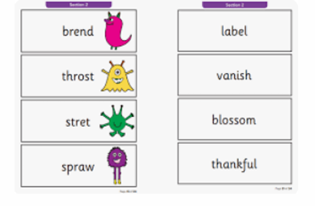
Phonics Screening Check
In June, the children take part in a Phonics Screening Check. It is essential that your child is in school for this test!
The children must use their phonic-knowledge to read 40 words (some real and some ‘alien’). All words are based on the sounds that your child has learnt in phonics.
The data is submitted to the DfE and you will receive a report in the Summer informing you of your child’s score.
There will be a meeting to explain this in the Spring / Summer term.

Slide 22
Morning lessons
9:00 – 12:15 (break 10:50 – 11:05)
Core lessons
Writing
Reading
Maths
Collective Worship
Afternoon lessons
13:15 – 15:00
Wider curriculum lessons
Geography
History
Science
Religion and World Views
Art
DT
Music
Computing
PE
Story time – 15:00 – 15:15

Slide 23
Play / Lunch Times
Playtime – 10:50 – 11:05 – Children are offered a piece of fruit from school or they can bring in a healthy snack to eat during this time.
Lunchtime – 12:15 children will go for lunch and then play out until 13:15
We will have a playtime in the afternoon until the 11th September

Slide 24

Behaviour
Pegs – Pot of Gold certificates daily
House points – house teams
Visions
Roll of honour

Slide 25
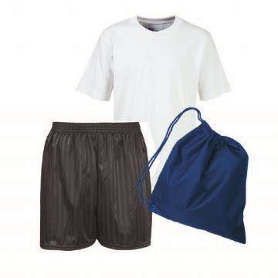
PE Kit
PE (1 full afternoon per week, this will be both indoor and outdoor which changes each half term) - Indoor (white t-shirt, black/navy shorts) Outdoor - White tee shirt & shorts
Black/navy shorts – to be knee length, knee length cycling shorts – not hot pants
Navy/black plain leggings/leisure trousers
Navy/black tracksuit top/sweater
Navy/black/white trainers (No plimsoles or pumps)
Hair tied back for PE
Trainers must not contain any other prominent colours, designs or logos.
Football shirts / football kits are not part of the school PE kit and should not be worn.
PLEASE CAN ALL CLOTHING BE NAMED

Slide 26

Jewellery and make up should not be worn - including nail varnish.
Children will be unable to actively participate in PE if they have their ears pierced. Children will participate in other ways, which may mean that they have different roles assigned to them in physical PE lessons.
Similarly, children will not be able to take part in physical activities at lunchtime, unless earrings are removed. If children wear earrings for religious purposes, please contact school to discuss how we can support you and your child.
PLEASE CHOOSE TO HAVE ANY EAR PIERCINGS AT THE START OF THE SUMMER HOLIDAYS AS THIS WILL GIVE SUFFICIENT TIME FOR EARRINGS TO THEN BE REMOVED AFTER THE PROCEDURE AND BEFORE TERM STARTS. THIS IS SOMETHING WE WILL BE MONITORING CLOSELY.
** Children may use two school bags - a book bag and a PE bag.
** Hair bands or clips must be small and discrete. They should not be 'oversized or overtly colourful'

Slide 27
How we will help you
Parents Maths Event
  This is new (date/time TBC)
  Opportunity for us to share how we teach maths in Year 1
  Videos of the methods to be shared on the website
  Advice on resources which you could use to support at home
Parents RWI Event
  How you can help your child with their phonics and reading
  Advise on resources which you could use to support at home
Parents Evening
  We will also contact you between parents evening if there is anything which we need to discuss

Slide 28
How you can help your child
Please attend events that are in school
  As mentioned before
  Parents evening
  Any events which we hold in school and you’re able to attend
Share your child’s achievements
  Tapestry isn’t used through school after Reception
  If your child receives any certificates, awards or other achievements
    Send to admin@stjamesacademy.co.uk so we can celebrate these with your child
Homework
  Please complete homework with your child
  Read the school books, additional story books, read at bedtime
  Instant Recall Facts for maths
  Support children to write their name and form recognisable letters and numbers.

Slide 29
Questions
Does anyone have any questions about the transition to Year 1?
If you would like to speak to one of the team afterwards please do
If you would like to email any general questions about transition to Year 1 please email admin@stjamesacademy.co.uk and this will be passed on for someone to respond to

