Slide 1


Conscious Discipline
Enabling your child to succeed
Parents’ Course
Session 1

Slide 2
Week 1
Composure – being the person you want others to become
Encouragement – contributing brings self worth

Slide 3
Teaching our children to respond not react

Slide 4
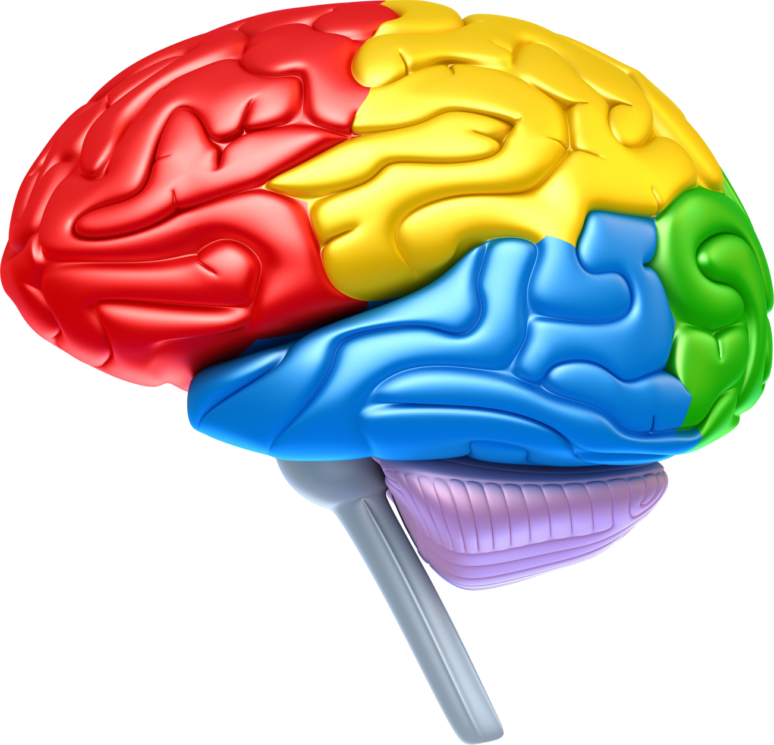
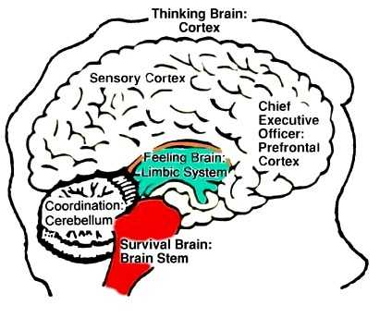
Know your brain!
Prefrontal lobe
Conscious: Problem solving
Executive State
Limbic system
Unconscious: Reactive
(emotional states)
Emotional State
Brain stem
Unconscious: fight, flight or freeze
Survival State

Slide 5
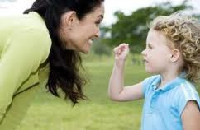
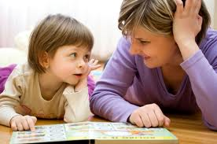
Being present with our child and connecting with them helps to build neural connections in their brain.

Slide 6
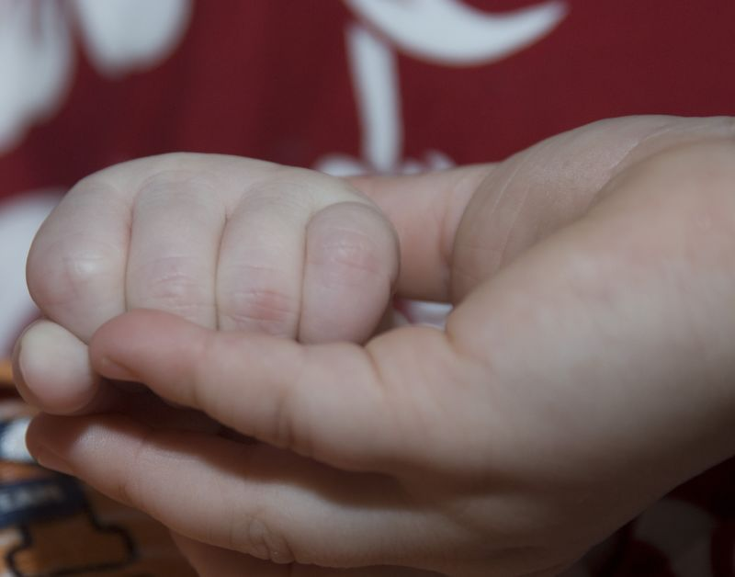
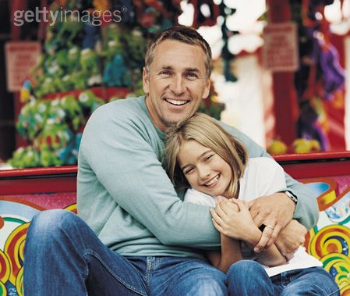
The brain functions optimally when a child feels safe.

Slide 7

How were we taught to behave?
How were we disciplined as children?

Slide 8
How were we taught to behave?
How were we disciplined as children?
Most of us will have been disciplined by FEAR!

Slide 9
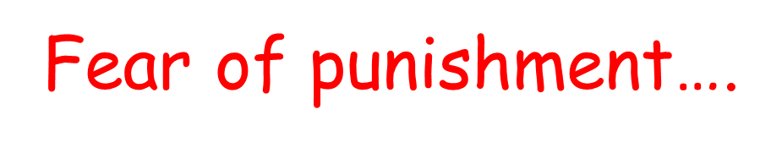
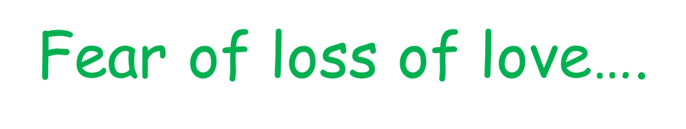
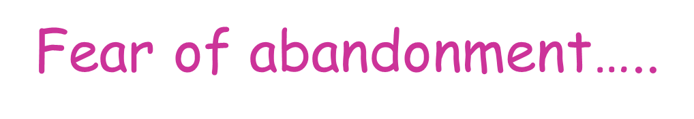
Fear of failure…..

Slide 10
So why not rely on fear to discipline our children?

Slide 11
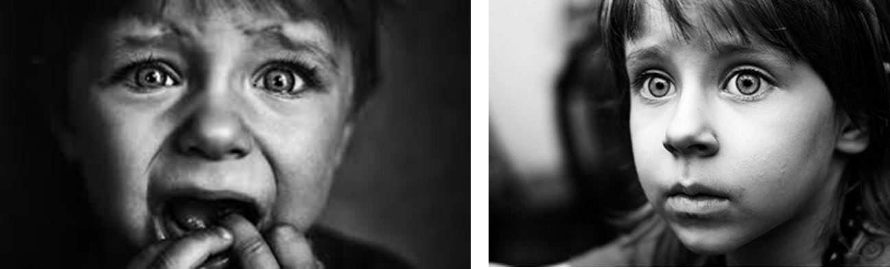
Fear puts children in a state of stress.

Slide 12

Fear tends to focus on what you don’t want.

Slide 13
So what can we use instead?!!

Slide 14
Don’t take behaviours personally…..

Slide 15
When things go wrong for a child….
Prefrontal lobe
Conscious: Problem solving
Limbic system
Unconscious: Reactive
(emotional states)
Brain stem
Unconscious: fight, flight or freeze

Slide 16
Recognise:
Where the child is at
Where you are at
Respond:
Help them to reason, to problem solve
OR
Help them to calm until they reach a state where they can reason/ problem solve

Slide 17
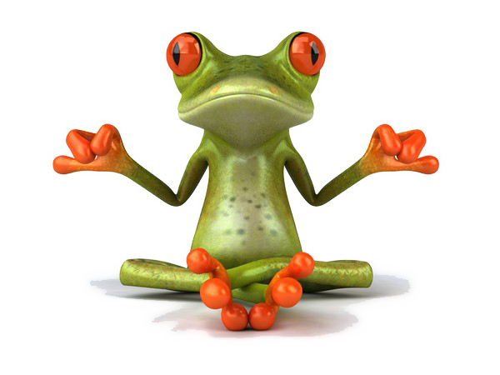
Power of perception
COMPOSURE

Slide 18
Can a child solve a problem while they’re in survival mode in their brain stem?

Slide 19

Purpose:
Remain calm and teach children how to behave
My job is to make you behave

Slide 20
Purpose:
Remain calm and teach children how to behave
My job is to keep you safe,
your job is to help me to keep you safe.
Anger management is essential for social competence.

Slide 21
The children continue to be taught self calming techniques:
Be a
S - stop
T - take a deep breath
A - and
R - relax
The Tap
Tense yourself up and then put your hands out in front of you like taps and let the tension gush out as you release your hands
The pretzel
Twist hands and legs. Tongue to roof of mouth. Tense and then relax.
The Balloon
Inhale and pretend to blow yourself up like a balloon. Hold for a few seconds and then let the air out like a balloon deflating.

Slide 22
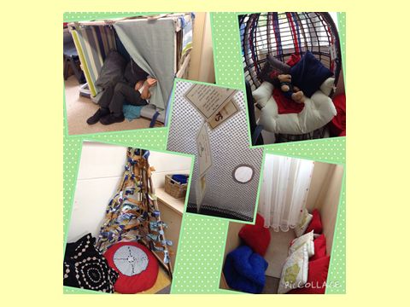
Safe Place

Slide 23
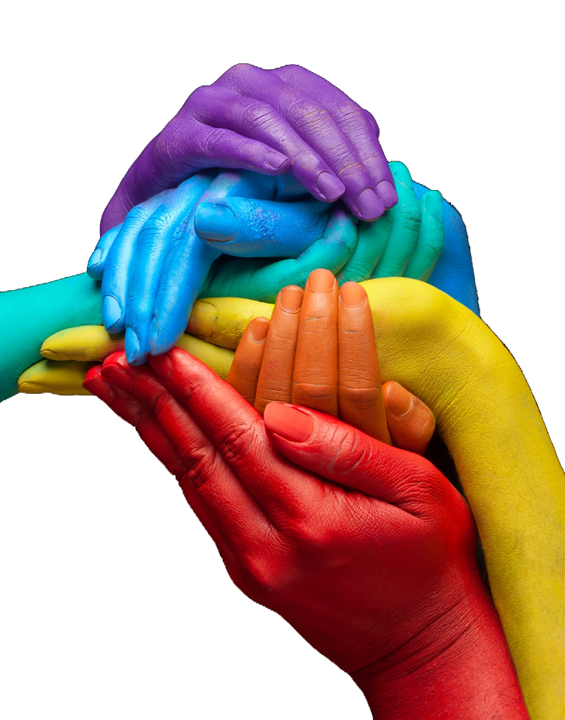
Encouragement

Slide 24
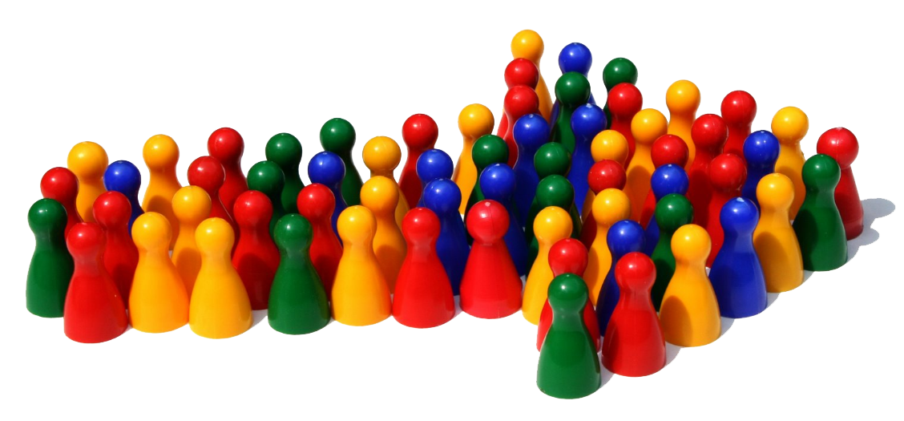
We’re all in this together

Slide 25


Slide 26
Will you get me a drink?

Slide 27
If a relationship is severed, the willingness to be helpful is reduced.

Slide 28


Discouraged children are disconnected children…
https://www.youtube.com/watch?v=apzXGEbZht0

Slide 29
So how do we help them to be connected so that they want to be helpful?

Slide 30

Noticing is helpful
It lets children know when they are getting it right.
When you see appropriate/ helpful behaviours
from children, let them know!

Slide 31
You did it! Good for you!
You ______ so _______.
That was helpful.

Slide 32
Describe what you notice

Slide 33
You did it!
Good for you!

Slide 34
Be specific

Slide 35
The behaviours we give the most attention to are the ones we are attaching the most value to.

Slide 36
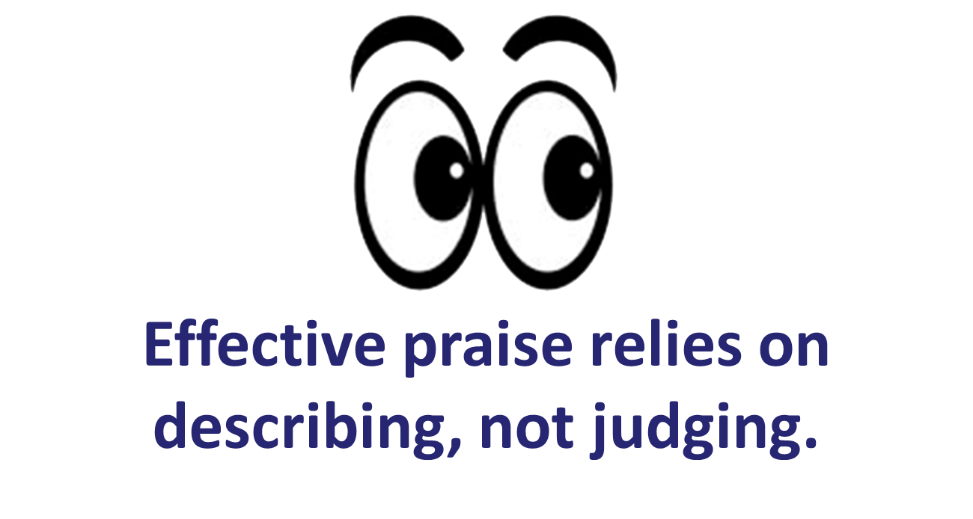

Slide 37

Mastery = seratonin hit

Slide 38
You did it!
Good for you!

Slide 39
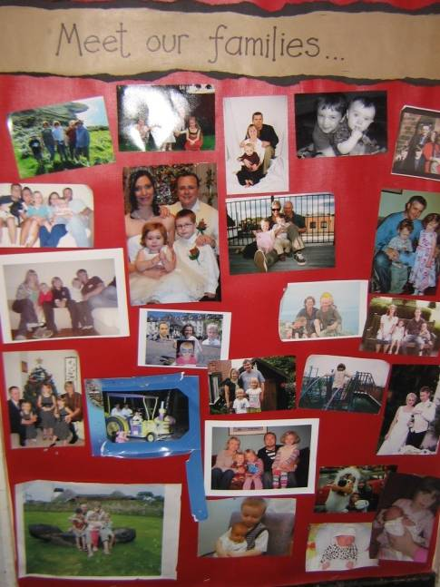
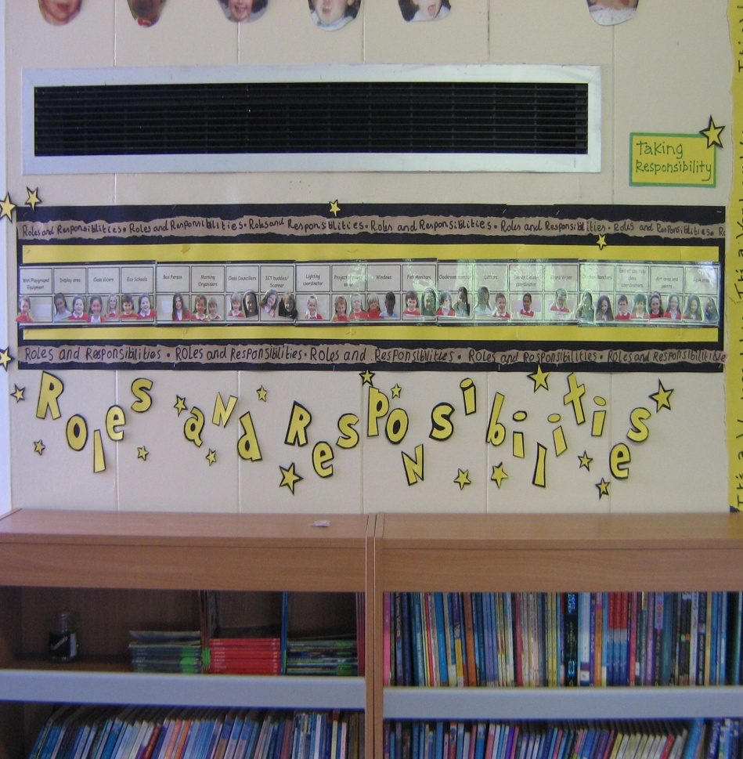
How do children know that they belong?

Slide 40

For next time…
Take moments out to step back recognise what brain state you and others are in during different situations this week.

Slide 41

Still to come…
Assertiveness
Choices
Positive Intent
Empathy
Consequences

Slide 42
Conscious Discipline
Enabling your child to succeed
Parents’ Course
Session 2

Slide 43

What did you take away from last week?
Did you do anything differently?
How did your child respond?
Did you see anything in a new way?

Slide 44

Assertiveness

Slide 45

Setting limits and expectations
Healthy boundaries are essential for all relationships.
Purpose:
Set limits and
expectations

Slide 46
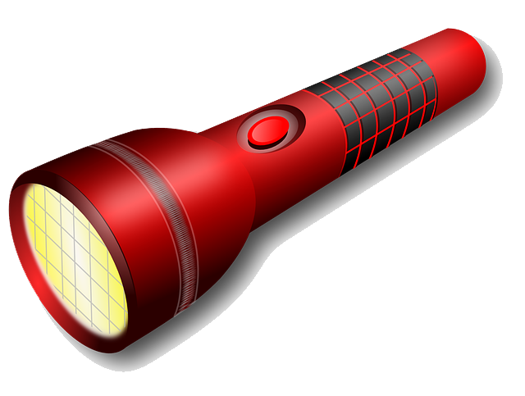
What you focus on, you get more of...

Slide 47
How many of you have tried to change a behaviour?

Slide 48
You can’t change behaviour by focussing on what you don’t want.

Slide 49
Tell and show children what TO do rather than what NOT to do.
https://www.youtube.com/watch?v=5JrtpCM4yMM

Slide 50
Assertiveness does three things:
Tells children what to do
Gives clear and direct instructions
Is said in a tone of voice that says ‘just do it’.

Slide 51
What you focus on, you get more of...
When you are upset, you are always focussed on what you don’t want.

Slide 52

composure

Slide 53
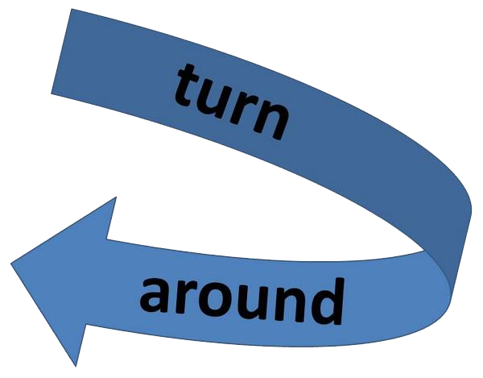
composure
pivot

Slide 54
Use an assertive voice

Slide 55
Command
V
Request
Please
Thank you

Slide 56
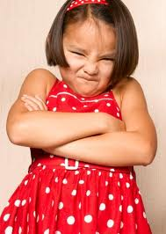
When a child doesn’t do what we ask, we feel powerless and head towards our limbic system

Slide 57
When a child doesn’t do what we ask, we feel powerless and head towards our limbic system
Tell and show

Slide 58
Once we are assertive, we can teach our children to be assertive.

Slide 59

Assertiveness is the medium through which we teach respect.

Slide 60
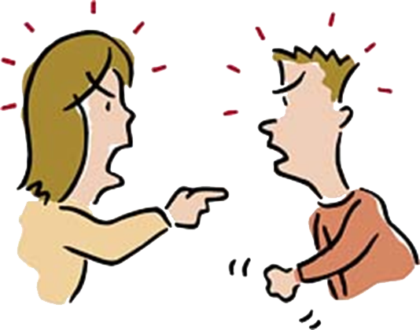
Dealing with conflict

Slide 61
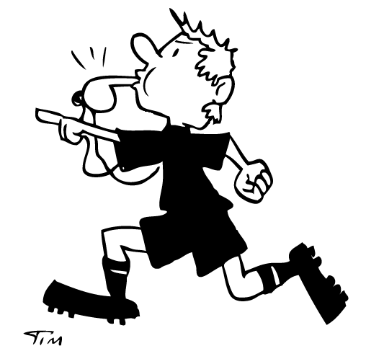

Slide 62

Go to the victim first
Did you like it?
Go and tell ___ “I don’t like it when you_____”
Then give them the words for what they DO want

Slide 63
Give children an assertive voice

Slide 64
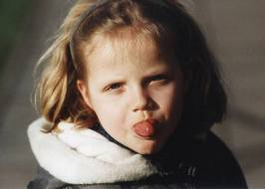
This is not the same as them being rude!

Slide 65
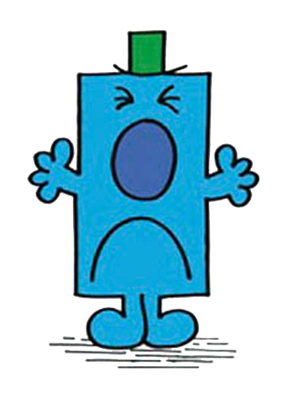
Dealing with tale telling

Slide 66
‘He ______.’
‘Are you telling me that to be helpful or hurtful?’
‘Hurtful’ / ’helpful’
‘What could you do that would be helpful?’
‘I don’t know’
‘You could say would you like some help____’.

Slide 67
What you focus on, you get more of...

Slide 68

Making choices

Slide 69
Can you MAKE a person change?
Can you MAKE a child change?
The only person you can MAKE change is yourself…..

Slide 70
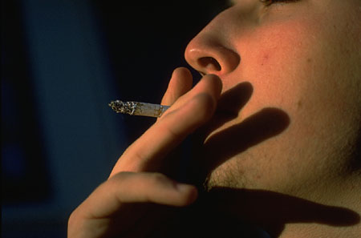
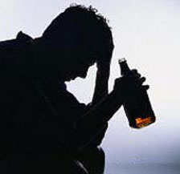

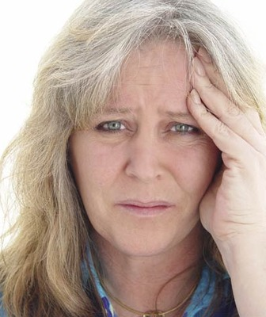
The power of FREE WILL…

Slide 71
Should
Could

Slide 72
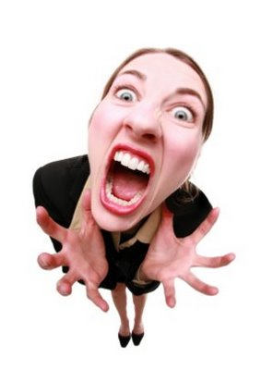
If I try to change YOU and it doesn’t work I feel frustrated and powerless….

Slide 73
If I try to change YOU and it doesn’t work I feel frustrated by you which puts you in charge of me and makes me feel powerless and start to blame and lash out….
Which part of my brain am I likely to be functioning in then?
I will BLAME and ATTACK….

Slide 74

Guilt makes us cave in on our boundaries – this trains children to be obnoxious…

Slide 75

He made me do it!
BLAME!
Is revenge a good problem solving tool?

Slide 76
So he’s the boss of you?
Huh?

Slide 77
No
So what could you do if you were the boss of you?

Slide 78
Yes
How sad. It must be tough having someone else running your life.

Slide 79
How can I get my child to eat their carrots?
How can I get my child to get ready for school on time?
How can I get my child to do their homework?
How can I get my child to do what I say?
How can I get my child to do their chores?
How can I get my child to tidy their room?

Slide 80

How do I get my child to…?
By offering two positive choices, we help children to:
Focus their attention on the task we deem important
Comply with our wishes
Learn decision-making skills
Feel empowered, thereby reducing power struggles
Redirect their behaviour and learn impulse control
Establish and maintain self-control

Slide 82
CHOICES
Usually we give a positive and a negative.
Eat your tea or starve!
Do what I say or you’ll go to bed!

Slide 83
What you focus on, you get more of...

Slide 84
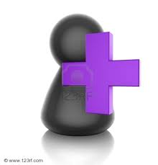
Offer 2 positive choices to accomplish the goal!
You can _____ or______.
What’s best for you?

Slide 85
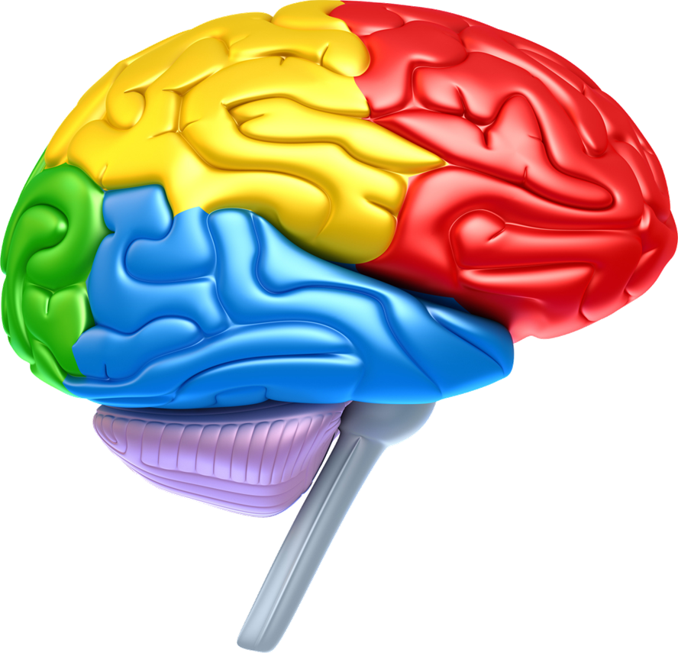
Executive state
= Open-ended question
Emotional state
= Two positive choices
Survival state
= Assertive commands

Slide 86
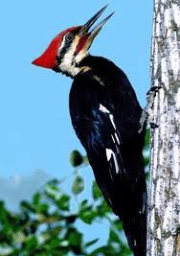
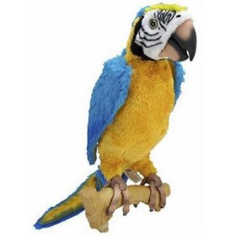
Offer 2 positive choices to accomplish the goal!

Slide 87

Scenarios
Think of 2 positive choices to offer in the scenario to help the child make a good decision.

Slide 88
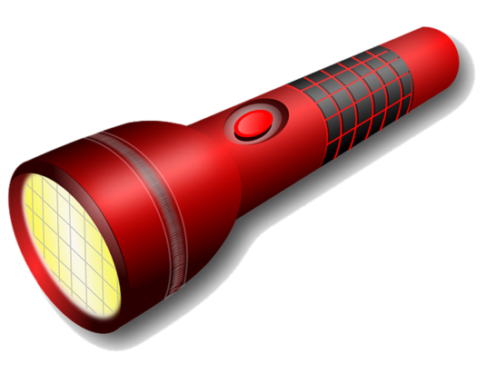
For next time…
Consider what structures for encouragement you have/ could create.
Remember that what you focus on you get more of.
Use your assertive voice and empower others to use theirs

Slide 89
Conscious Discipline
Enabling your child to succeed
Parents’ Course
Session 3

Slide 90

Empathy
Handling the fussing and tantrums…

Slide 91
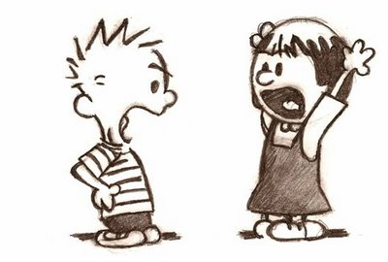
We have been taught that resistance causes change…..

Slide 92
You should be dressed by now
We should have left half an hour ago!
You shouldn’t have hit him
There shouldn’t be traffic at this time
We don’t run in this classroom

Slide 93
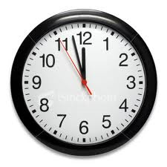
We negate the moment – what’s happening in my life isn’t good enough
We negate the thoughts...
We negate the feelings...

Slide 94
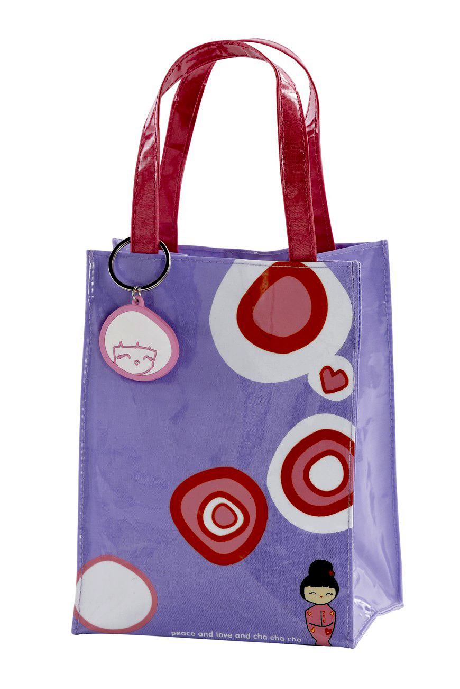
Accept the moment is as it is!

Slide 95
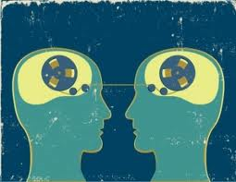
Empathy – seeing things from someone else’s point of view.
– I understand why...

Slide 96
I hate maths!
No you don’t!
I don’t want to go to school.
You’ve always loved school!

Slide 97
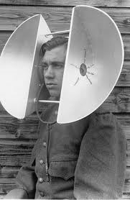
Listen without the need to change

Slide 98
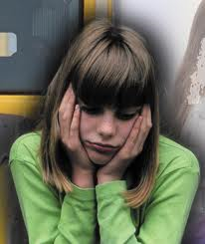
It’s not about happying up children.
We need to leave the upset with the child.

Slide 99

Help children accept and
process feelings
Your feet are going like this
Your face is doing this
Mirror what you see
Your body is telling me...

Slide 100
Help children accept and
process feelings
You seem ________.
Something must have happened.
Mirror what you see

Slide 101

Seeing the best

Slide 102
There is always another way to look at things…
Our perception of how others are looking at us effects how we feel…

Slide 103
Sometimes we read a child’s behaviour incorrectly…
We often assume the worst…

Slide 104
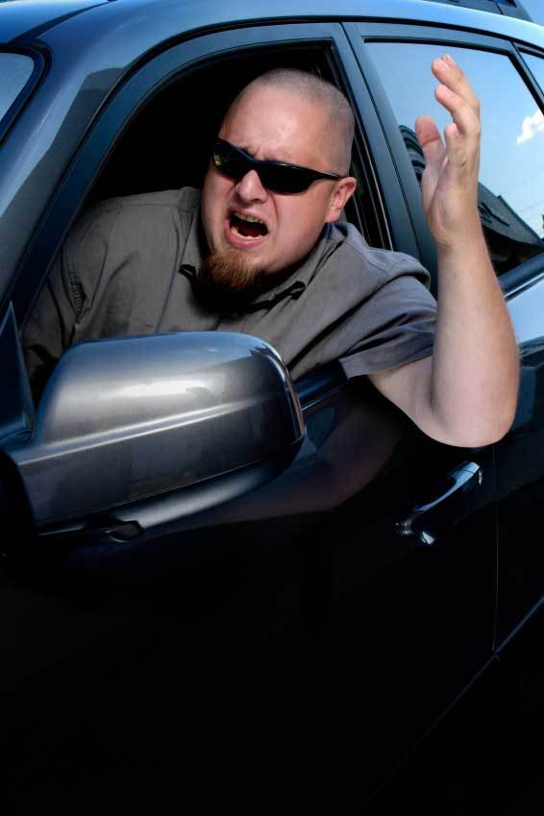
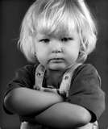
But why look at things positively?

Slide 105
What we offer to others we strengthen in ourselves.

Slide 106

Which part of our brain do we access when we choose to see the worst in others?
Prefrontal lobe
Conscious: Problem solving
Limbic system
Unconscious: Reactive
(emotional states)
Brain stem
Unconscious: fight or flight

Slide 107

Which part of our brain do we access when we choose to see the best in others?
Prefrontal lobe
Conscious: Problem solving
Limbic system
Unconscious: Reactive
(emotional states)
Brain stem
Unconscious: fight or flight

Slide 108
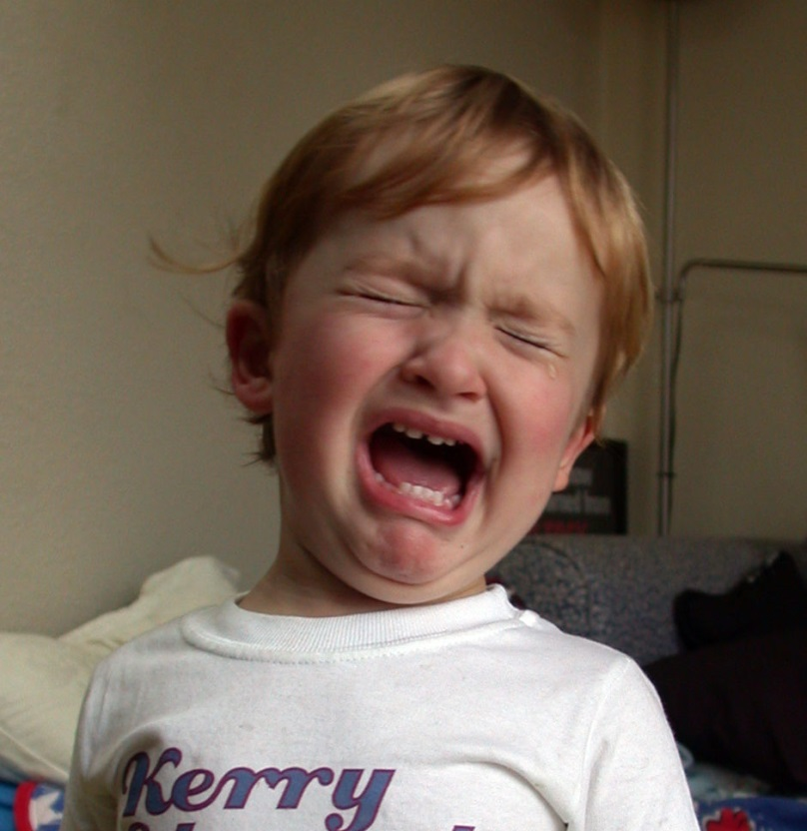

When we rant and rave we teach children that if the world doesn’t go our way we should throw a tantrum!

Slide 109
We also teach that when people get things wrong they deserve to be treated badly and called names…
****
Stupid head!

Slide 110
You ______ because you wanted_____.
You didn’t know the words to say.
You may not______.
When you want _______, say _______.

Slide 111
In conflict situation model this for child – give them the words to say.

Slide 112
You ______ because you wanted_____.
You didn’t know the words to say.
You may not______.
When you want _______, say _______.

Slide 113
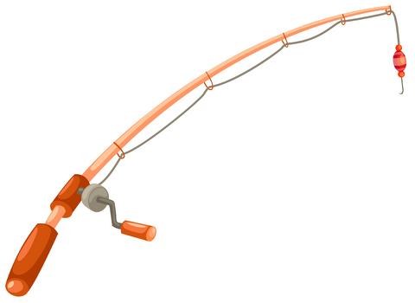
We are not letting children off the hook.

Slide 114
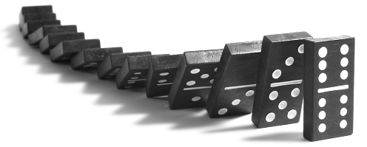
Consequences

Slide 115
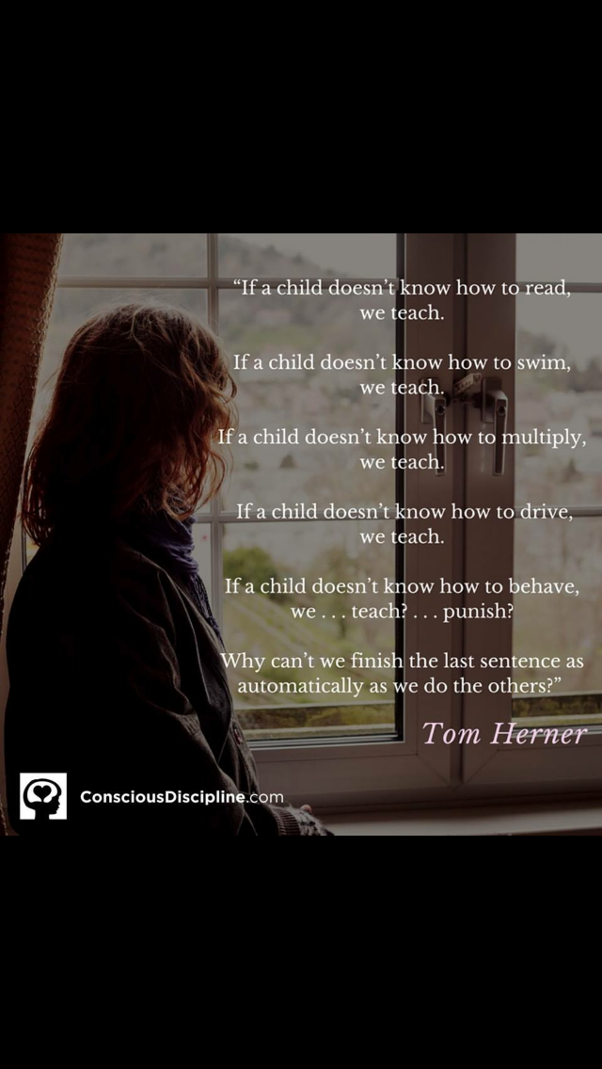

Slide 116
What I do when my child makes a mistake reveals my intention.

Slide 117
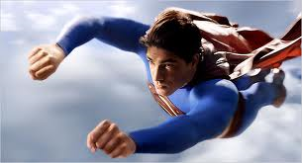
Intent to rescue

Slide 118
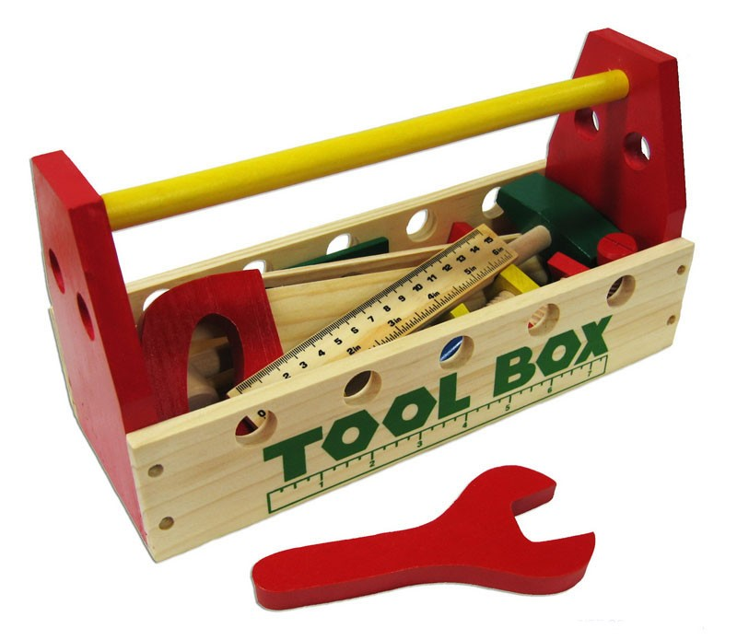
Intent to fix

Slide 119
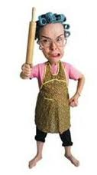
Intent to lecture

Slide 120
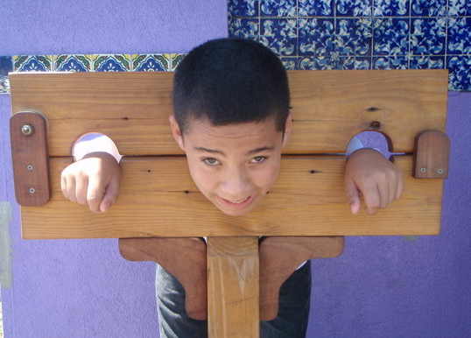
Intent to punish

Slide 121
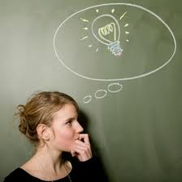
Intent to teach

Slide 122

Consequence = the discomfort resulting from their choice

Slide 123
Consequence
+
Empathy
=
Responsibility and change

Slide 124


Natural consequences
I don’t like it when...
Motivate you to use skills you already have

Slide 125
Imposed logical consequences
You have a choice....
I’m going to help you, so that...
Need to use skills your child already has

Slide 126
Problem solving consequences
Chronic problems won’t respond to imposed consequences
I’ve noticed..
How will we solve this?
How will we know it’s working?

Slide 127

The meeting

Slide 128

Help children reflect on their
choices and change.
effect
effect
effect
cause

Slide 129

Mistakes are opportunities to learn

Slide 130



Intention determines effectiveness.
Deliver consequences with empathy.

Slide 131
Help is at hand!

Slide 132


Slide 133

With acknowledgement to Dr Becky Bailey
www.ConsciousDiscipline.com

