Slide 1
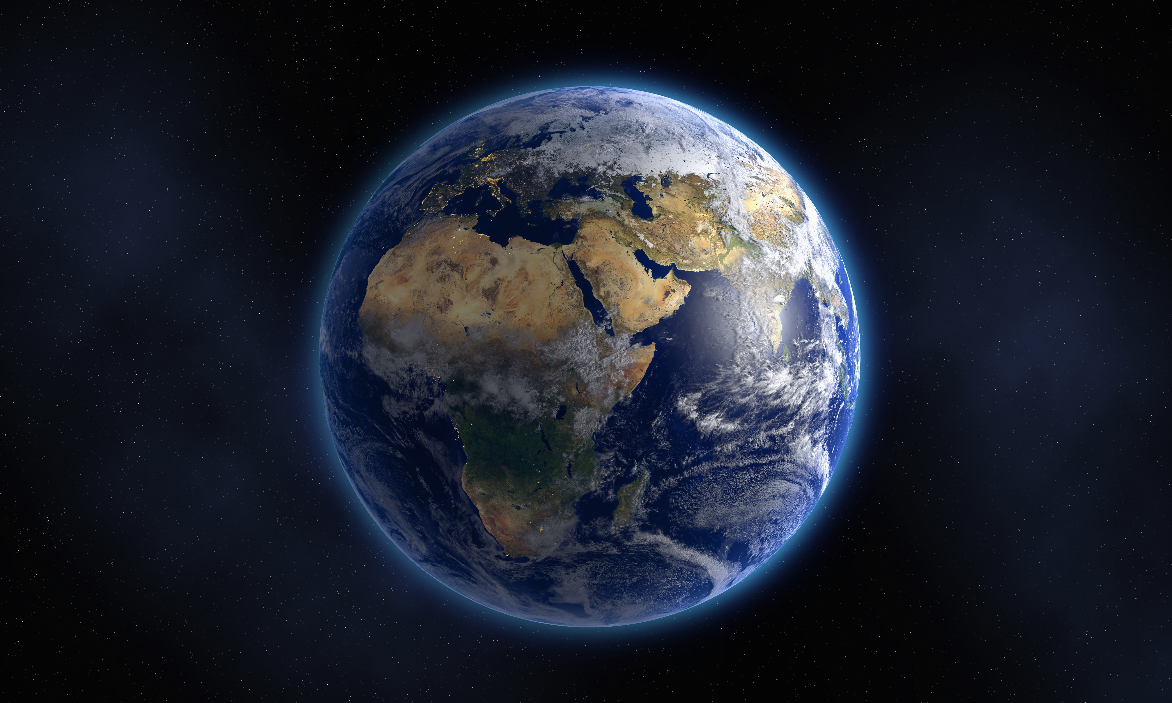
Science week
Oooo yeah!

Slide 2
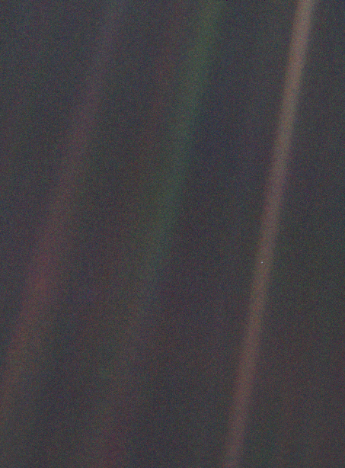
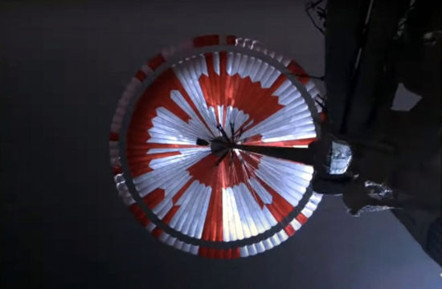
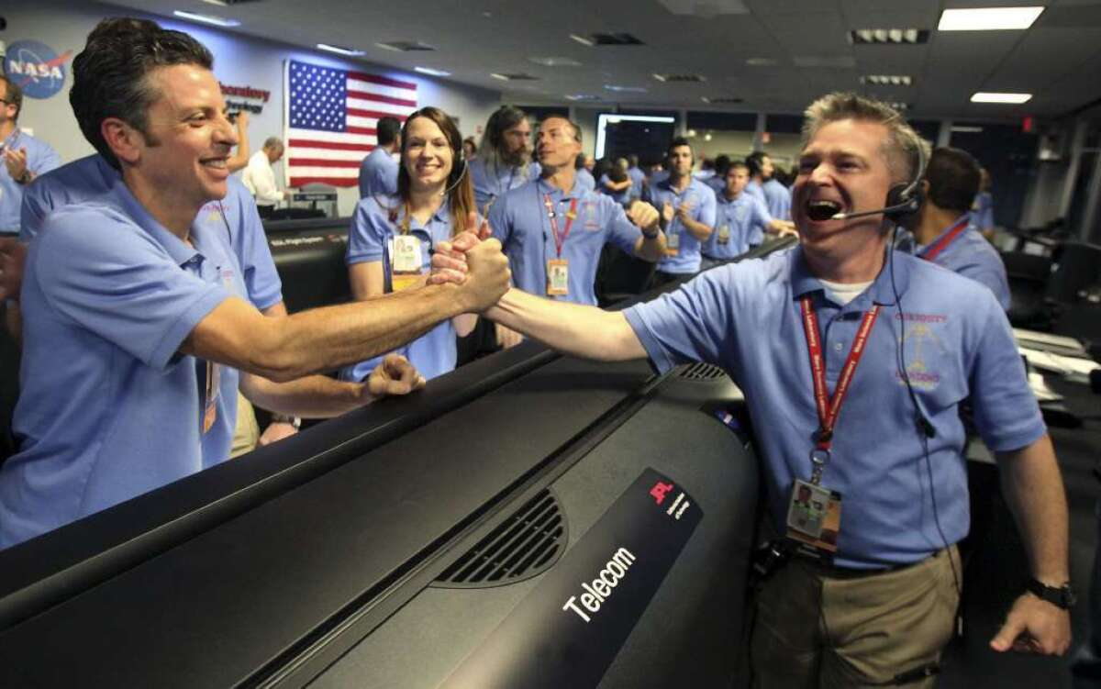
The Theme
This Photo by Unknown Author is licensed under CC BY-NC
This Photo by Unknown Author is licensed under CC BY-SA

Slide 3
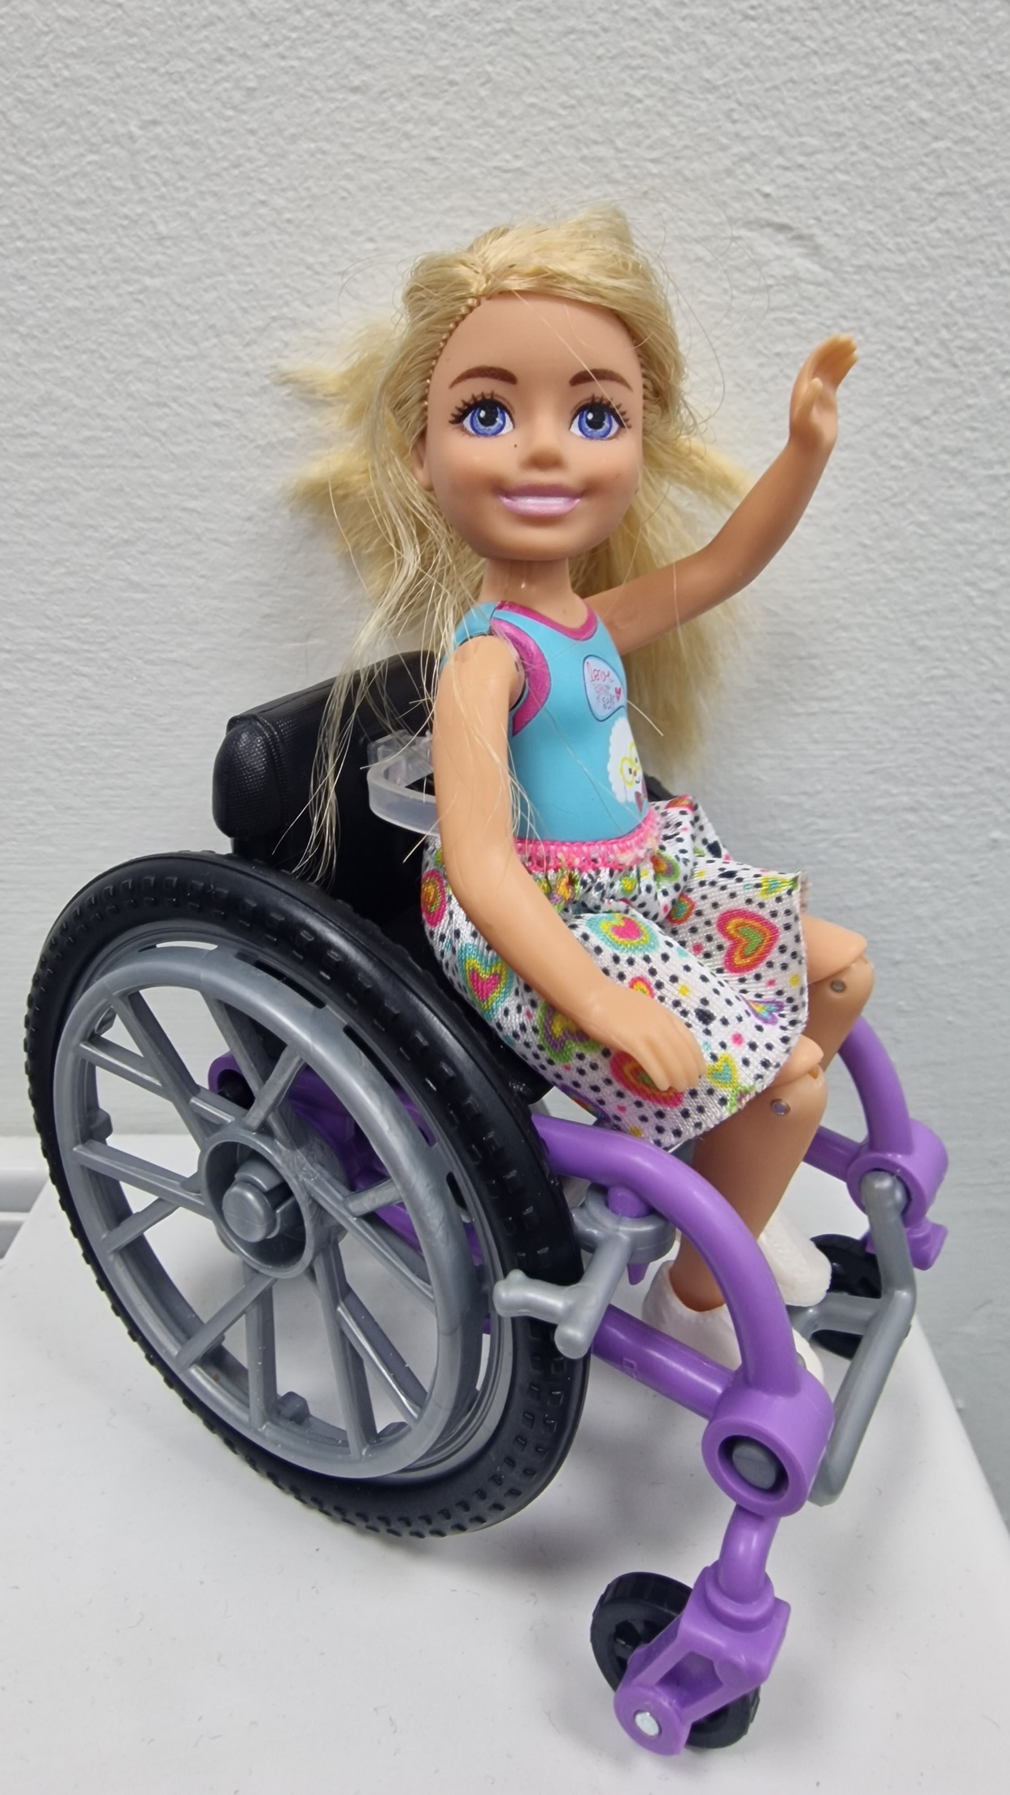
The Mission
Send a Heaton representative into space!!
All activities build towards making and protecting the astronaut and communicating with it.
Example:
https://www.youtube.com/watch?v=NpPuESSbhAc
This Photo by Unknown Author is licensed under CC BY-SA

Slide 4
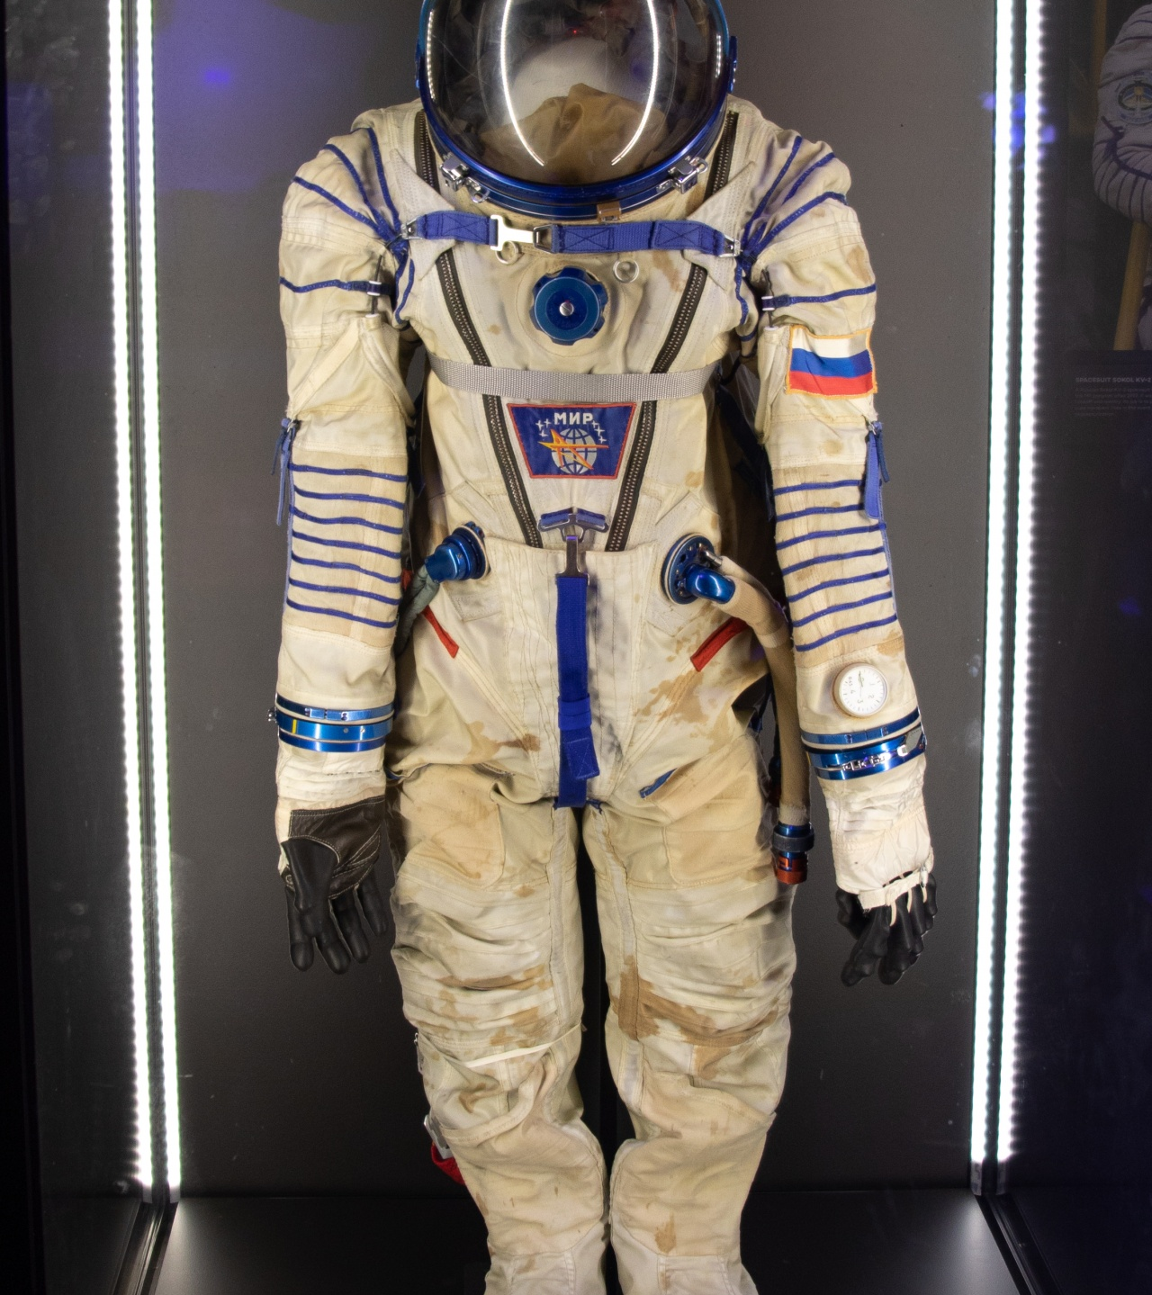
Space suite creation
Activity ideas:
Using a variety of materials students explore them, feel them and then test them. Test them by wrapping a teddy or toy. Squirt water, turn fans on use a hair drier. Did it stop it? How heavy?
NOTES
Develop and Apply
Make predictions, discuss results, choose best material
Explore and experiment
Group and classify, test
Encounter and experience
Wrap teddies or students in material (if safe)
Squirt water at them, use a hairdryer (switch controlled), fan. Can they feel it through the materials. Sensory play

Slide 5
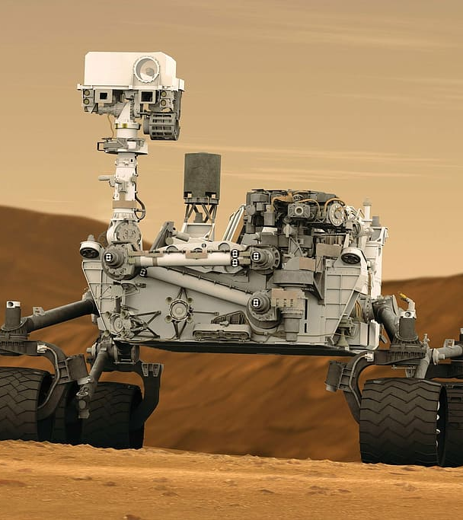
Rovers
Activity ideas:
Attention autism robot toy theme
Bee bots, add to the giant rover (art trolley)
NOTES
Develop and Apply
Program/code to complete mission
Explore and experiment
Interact with robots/bee bots and get them moving
Encounter and experience
Experience the different parts of a large robot

Slide 6
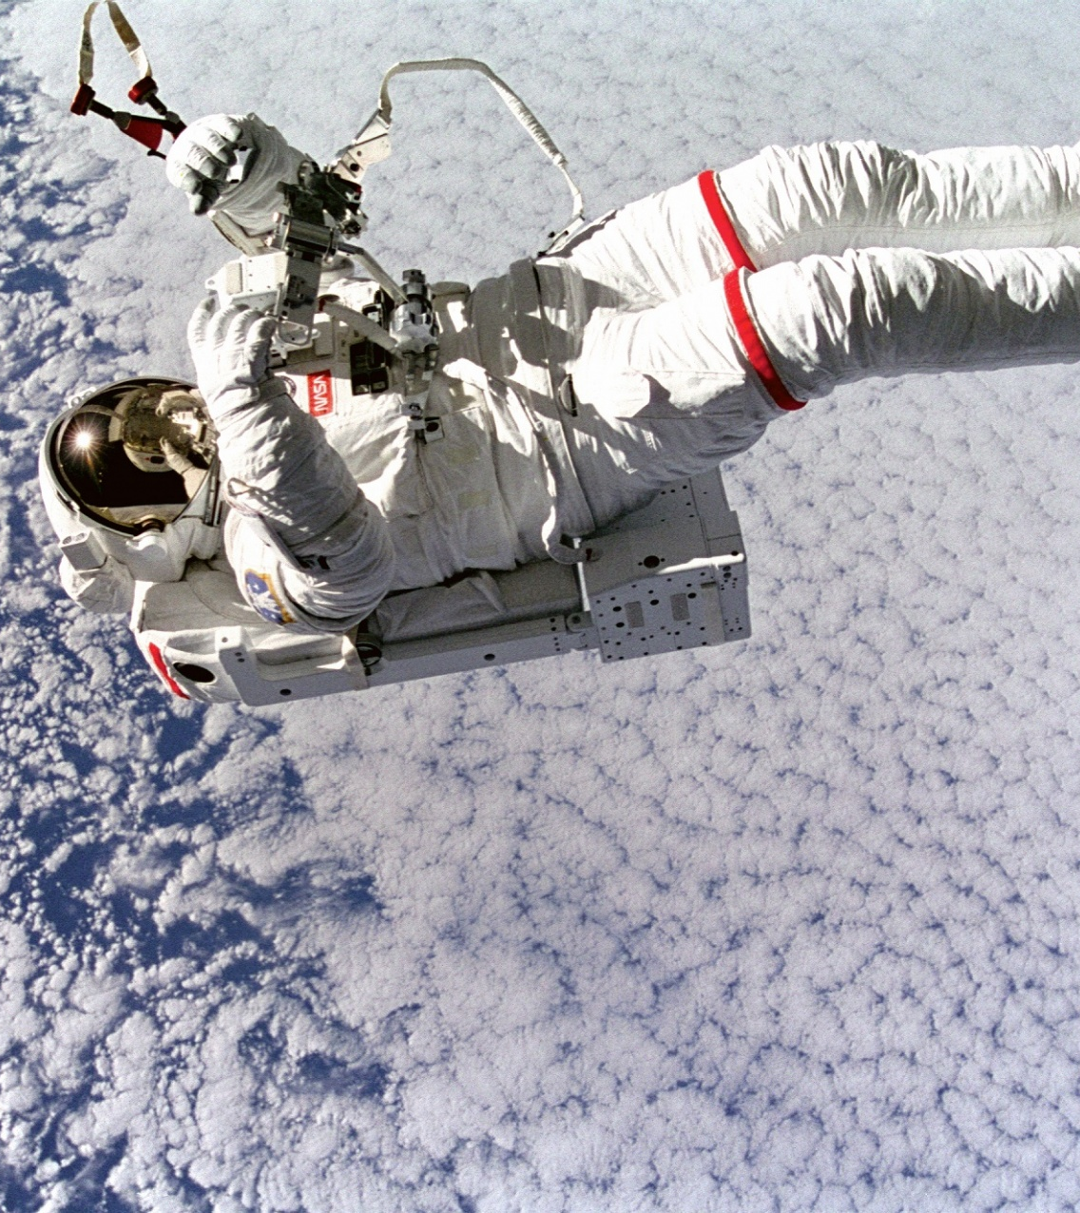
Space walk
Activity ideas:
Experience “weightlessness” in hydro (fairy lights on ceiling and space projector and floating lights. Use toy nuts and bolts to join together as mission.
NOTES
Develop and Apply
Complete tasks floating on back
Explore and experiment
Attempt challenges floating on back
Encounter and experience
Experience weightlessness and the sensory experience of “space”

Slide 7
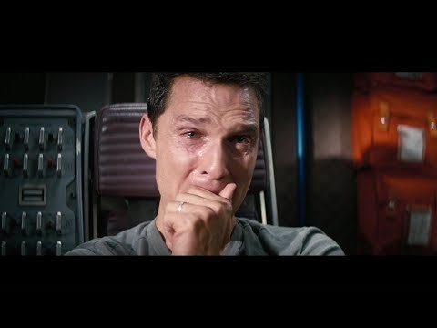
Messages from home
Activity ideas:
Watch the video. Use ZofR and ask students how they are feeling in the video.
How do the students feel?
Make their own message using video, colorful semantics to send home to their adults at home
NOTES
Develop and Apply
Complete tasks floating on back
Explore and experiment
Attempt challenges floating on back
Encounter and experience
Experience weightlessness and the sensory experience of “space”
https://www.youtube.com/watch?v=1sJZGWs5aJo

Slide 8
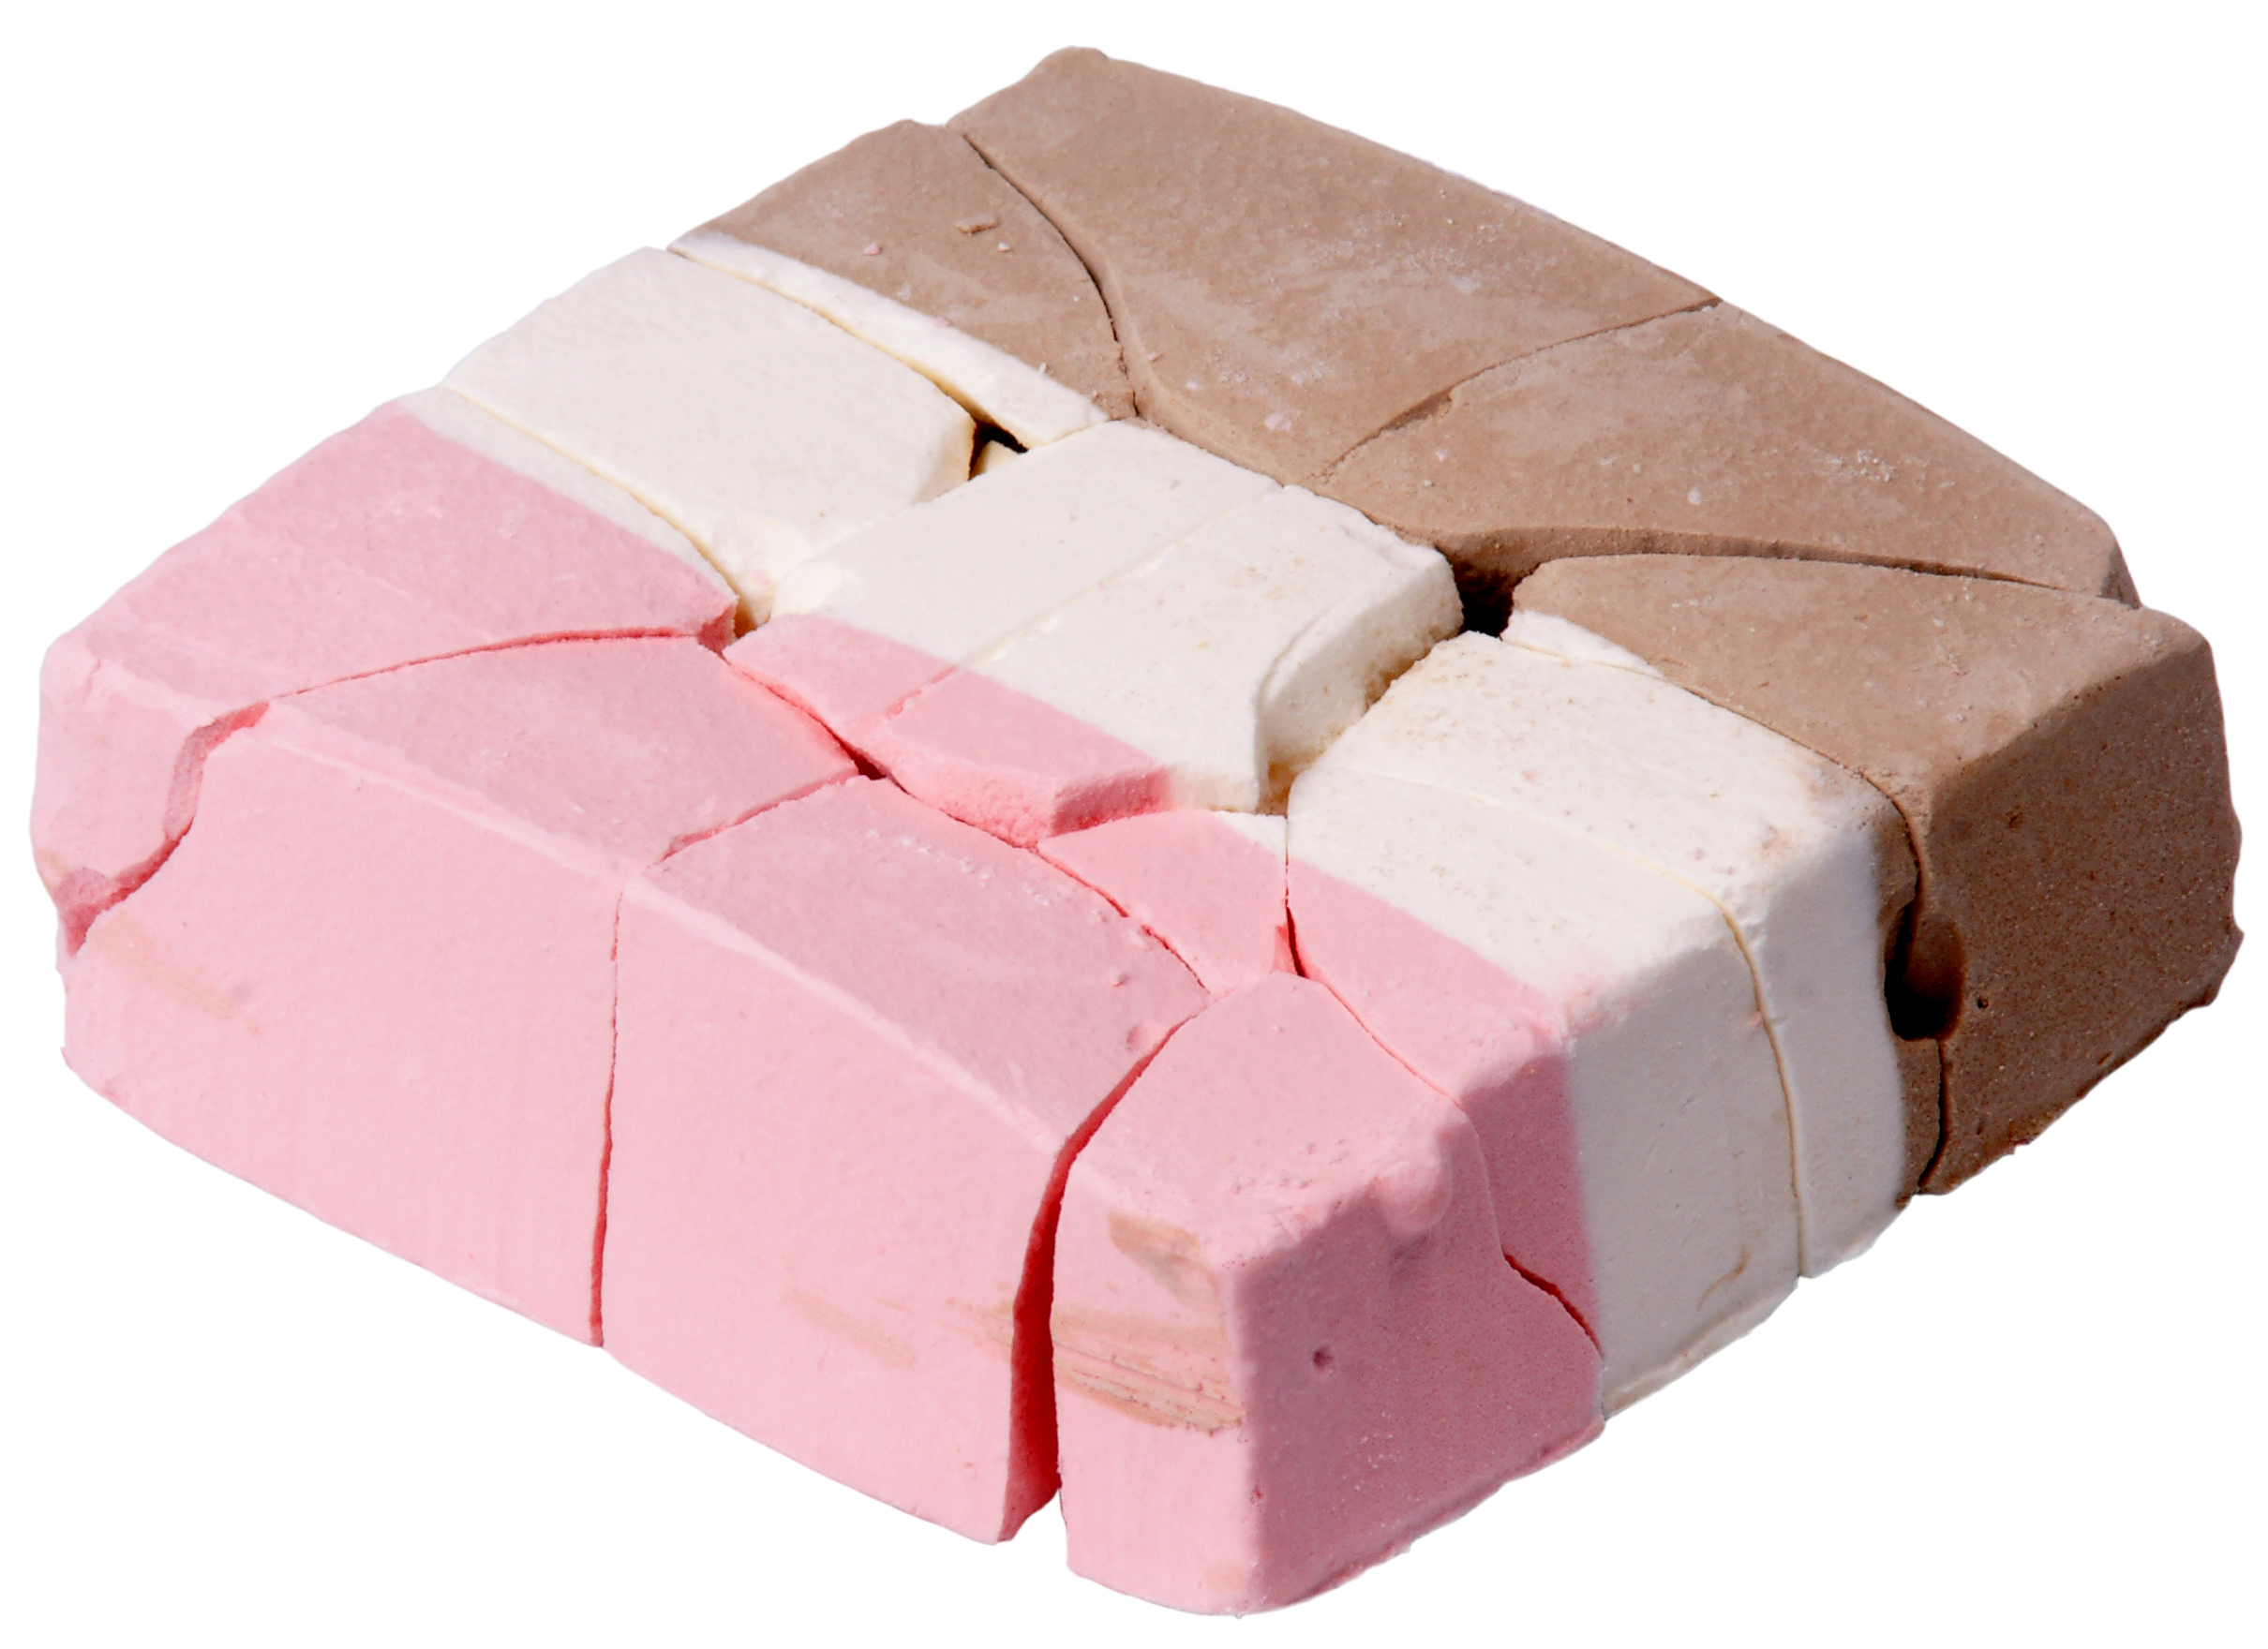
Space food
Making and trying space food in food tech and eating it in a way that astronauts do
Make angel delight. Put into sandwich bags. Squash it. Eat it using a straw
NOTES
Develop and Apply
What’s different to normal food?
Explore and experiment
Practice cooking skills
Encounter and experience
Encounter the ingredients and sensory experiences of the results
Eating in space
https://www.youtube.com/watch?v=bxhKUJE5-w0
This Photo by Unknown Author is licensed under CC BY-SA

Slide 9
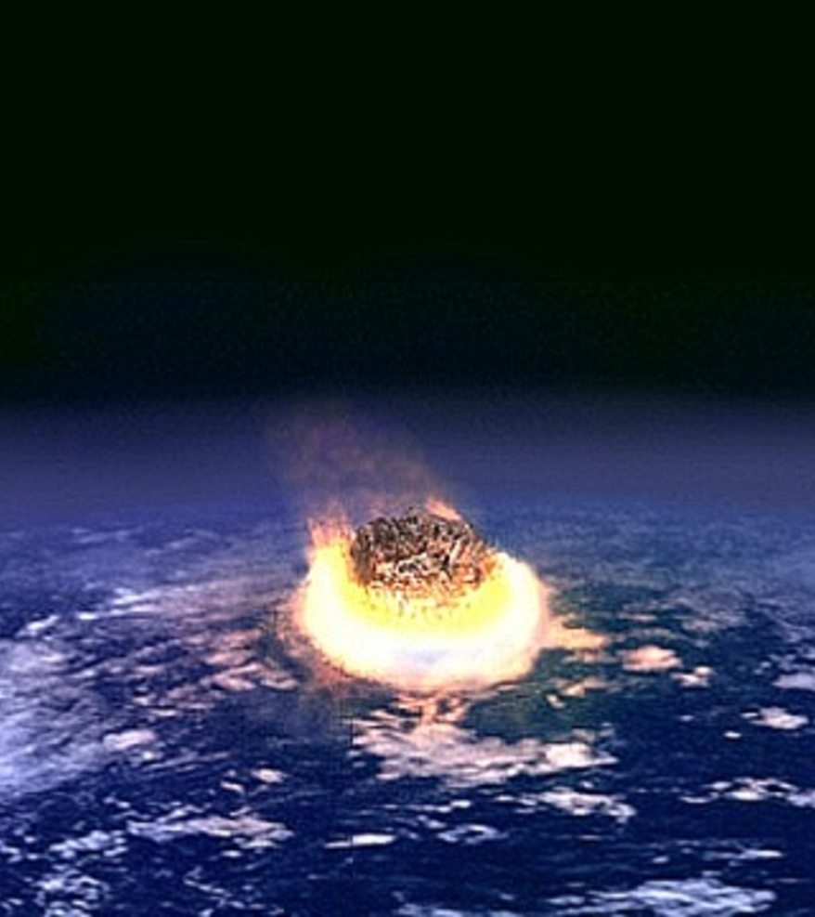
Crash landing!
Meteor strike
Drop different size and weight objects into a tray of flour covered with cocoa powder. Film in slow mo.
NOTES
Develop and Apply
Which makes the biggest crater? Why?
Explore and experiment
Test out different weights and velocities
Encounter and experience
Encounter the sensory experience and cause and effect of actions
This Photo by Unknown Author is licensed under CC BY-ND

Slide 10
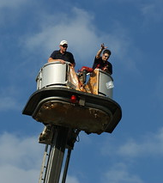
Landers
Egg drop
Make something that will protect an egg being dropped in Forest School session
NOTES
Develop and Apply
What materials are needed and why?
Explore and experiment
Try out different materials
Encounter and experience
Encounter the components of the egg drop. Hard, soft etc.
Use VOCA to initiate the drop
This Photo by Unknown Author is licensed under CC BY-ND

Slide 11
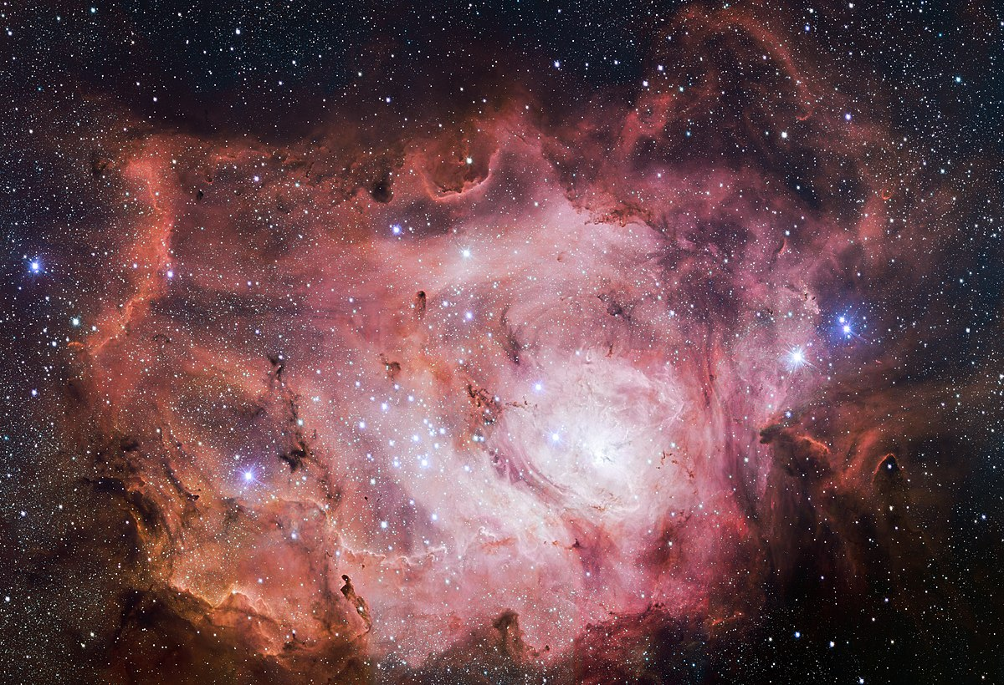
Sounds of space
Listen to NASA’s sonification of nebulas and other astronomical bodies.
Close eyes. Can you reproduce?
NOTES
Develop and Apply
How does it make you feel? Can you choose a suitable instrument to make the noise?
Explore and experiment
Try out different instruments to make the noise.
Encounter and experience
Listen to the sounds and experience the sounds of space. Use keyboards to recreate sounds
https://www.youtube.com/watch?v=H-Ci_YwfH04
https://www.youtube.com/watch?v=yv4DbU1CWAY
https://www.youtube.com/watch?v=DtymxN67eEE
More – Search for “nasa sonification” in youtube
This Photo by Unknown Author is licensed under CC BY-SA

Slide 12
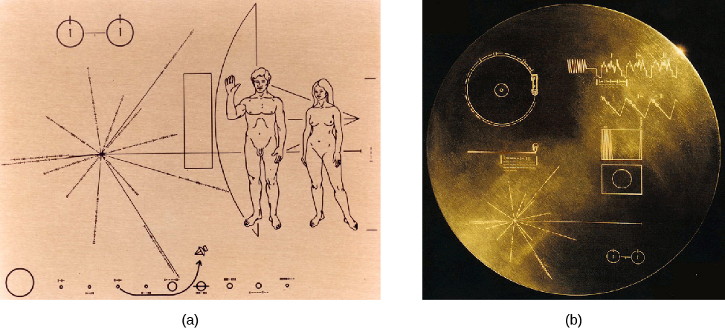
Message to other intelligent life
Contribute to the plaque incase aliens find it
Heaton School’s favorite things ANYTHING. Have time to explore all of the classes favorite music and objects.
Email Kyle the results
This can be adults opinion and then offered. Class culture?
NOTES
Develop and Apply
What would you want an alien to know about us?
Explore and experiment
Listen to different music and pick a favorite.
Encounter and experience
Encounter all of their favourite things and have a lovely time
This Photo by Unknown Author is licensed under CC BY-SA-NC

Slide 13
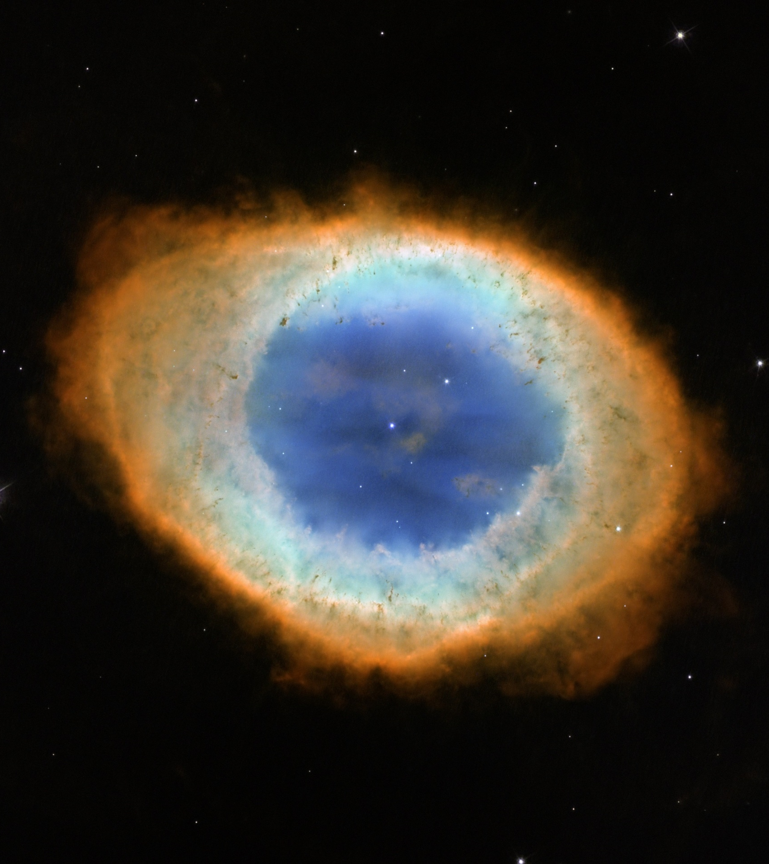
Space craft
(haha)
Making individual pictures of nebulas.
All work to be collected and brought to Kyle
Work to be put up next to each other to create huge collaborative art work similar to Hubble’s deeps space field photo.
Use art spinner (please book slot)
Blue bubbles with food colouring added to mix onto paper

Slide 14
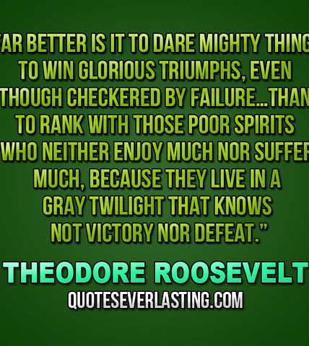
Mission name
Using adjective word mats choose words that we like for the mission name or ethos.
NOTES
NOTES
Develop and Apply
Choose a word. Why do they like it?
Explore and experiment
Act out the meaning of words and choose
This Photo by Unknown Author is licensed under CC BY

Slide 15
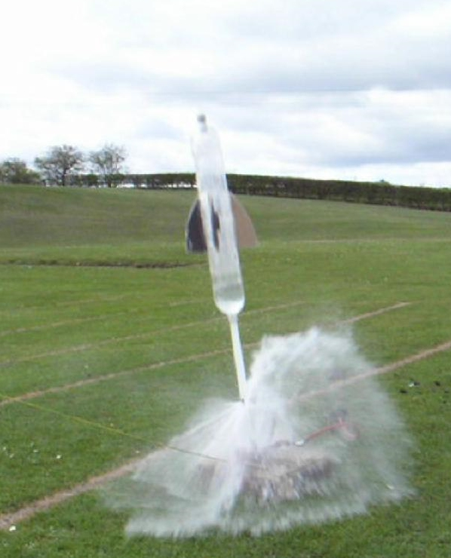
Rocket launch
Stomp rockets. Bottle rockets, balloon and straw along a piece of string
Mentos and diet coke?
(angle, how much energy, weight etc)
NOTES
Develop and Apply
Launch angle – Distance
Amount of force – distance (Stomp)
Explore and experiment
Try out different launch angles and launch energy
Encounter and experience
Launch rockets with VOCA and experience the sounds and cause and effect
This Photo by Unknown Author is licensed under CC BY-SA

Slide 16
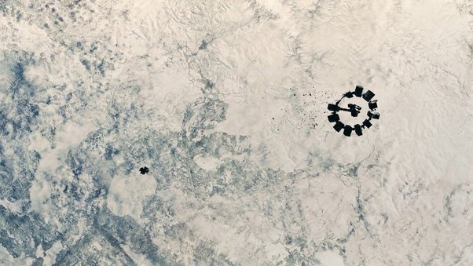
G force experience
(It’s not possible
No, It’s necessary)
Spinning, launching and flying in drama related to:
https://www.youtube.com/watch?v=a3lcGnMhvsA
Scooter boards to spin on. Hold onto hoops. Catch students who are “out of control” Stop and Go
Develop and Apply
Feel heavier and lighter and relate it to spinning and stopping
Explore and experiment
Experiment making themselves heavier and lighter
Encounter and experience
Encounter G forces on vestibular system

