Slide 1

New Parents – Information Afternoon
July 2024

Slide 2
Parents Meeting -10th July:
General Introduction – Who’s who??
Outline of the ethos and values of Heaton school
General information for parents
Introduction to Family Liaison Worker
Therapist introduction
Transport
Outline of useful information on the school website
Meet the teachers
Opportunity to purchase uniform and to ask any questions

Slide 3


Slide 4
Our School Ethos…
ENJOY
CHALLENGE
CELEBRATE
ACHEIVE

Slide 5
The curriculum offer…
 | Pre-Formal | Informal | Semi-Formal | Formal | Post 16
 | PMLD – Engagement level | SLD and CLD – Pre-key stage lower levels/ Autism | SLD – higher pre-key stage levels/ Autism | SLD/MLD – KS1/Autism
Curriculum | Thematic curriculum Sensory / Therapy focus | Individualised Interest led learning/ play – some classes TEACH focussed activities | Some subject specific learning Intervention/ Therapy where required | Subject specific learning | Work based learning Lifeskills focussed
Teaching | One teacher – some specialist input | One teacher – some specialist input | Half teacher/ half subject specific | Subject led – some specialist input | Community learning Work experience Well being programme
Assessment | Routes for Learning IEP focussed | SCERTS/ Autism progress TBC IEP Focussed | Subject assessment IEP | Subject assessment IEP | RARPA Potential Steps for Life?

Slide 6
The wider offer…
Therapy team – SALT, OT, Physiotherapy
School nurse
After school clubs
Holiday club – Summer
Music Therapy

Slide 7
How we ‘keep in touch’?
Class dojo – text contact – sharing of pictures/ short videos
EFL App – access to termly learner journey documents
Text alerts via Teachers 2 Parents
School website – weekly Blog (sent out on Friday’s)
Named teacher is always contactable via either email or phone

Slide 8
Progress and updates
Parents consultation meetings x2 – face to face conversation with class teacher
EHCP review meeting (annual)

Slide 9

Family Liaison Officer – Mel
I am here to support your family the best I can!
Support maybe available in the following areas:
  Benefits.
  Form Filling.
  Charity Applications.
  Support Letters.
  Housing.
  Family difficulties.
  Transport.
  Attendance.
  Food vouchers.
  Support families during TAC meetings.
  Liaise with teachers, social workers & other professionals on your behalf.

Slide 10

Transport

Slide 11
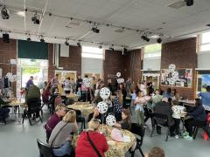
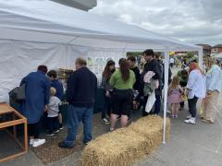
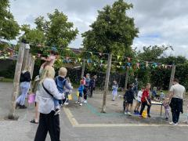
PTA

Slide 12
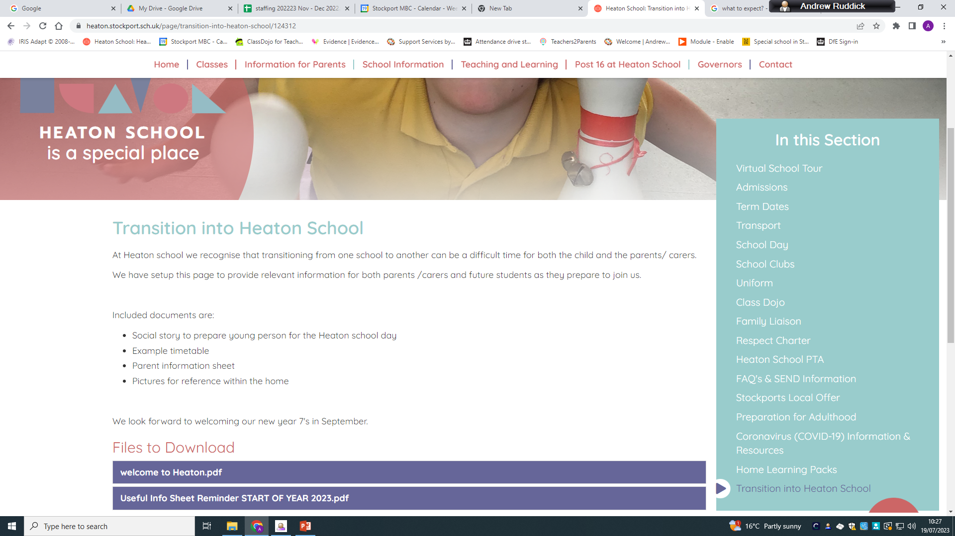
Website information
https://www.heaton.stockport.sch.uk/page/transition-into-heaton-school/124312

Slide 13
