Slide 1
Hapton’s Learning Adventures
OurJourney

Slide 2

Hapton C of E/Methodist Primary School
Small C of E/Methodist Primary School
Currently 117 pupils, 18% SEND - 4 EHCPs
4 classes - EYFS & Y1, Y1/2, Y3/4 and Y5/6
4 Teachers (plus HT – non-teaching)
6 Teaching Assistants
Family Learning Mentor

Slide 3

Our Journey

Slide 4
Intent
We asked ourselves, “What are our strengths? What are our barriers? What do we want for our learners?” and together discussed this fully, keeping in mind our vision of…
“I will lift up my eyes to the hills, where does my help come from? My help comes from the Lord, the maker of heaven and earth.”
Psalm 121 v 1-2

Slide 5
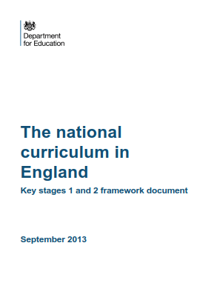
Subject Area Intent
We went back to the NC doc for each subject and then SLs devised their own intent for each subject.
Statement of Intent - ‘The curriculum is the means by which we ensure that all our children get their fair share of the rich cultural inheritance our world affords. A good curriculum empowers children with the knowledge they are entitled to: knowledge that will nourish both them and the society of which they are members’ – Clare Sealy
At Hapton School we will ensure that our curriculum in History meets the needs of our children and gives them the gift of historical knowledge, skills, attitudes and aspirations that they can take with them through life.
We provide our children with irresistible learning experiences that allows them to see the awe and wonder in the world and to appreciate life in all its fullness. Our school values will permeate our teaching and learning in History. This will equip our children to achieve, be confident and successful, allowing them to grow into the best young person he or she is capable of becoming.
It is through the teaching and learning, opportunities and experiences in History, that we will fulfil our mission statement to provide a vibrant, caring, Christian environment with a happy, friendly and calm atmosphere in which children and staff can live and work together. We will always aim for standards of excellence in teaching, learning and caring for each other. When learning about different historical periods, cultures and individuals, we want our school to be an extension of good family life and within our 'school family', each unique individual to be respected and valued.

Slide 6
Beginning the Work
We had been using the Lancashire topics and, to some extent, they worked for us. So we started with these and built on them. We removed parts that didn't suit our learners and added topics more pertinent to our children. As we built the curriculum we kept referring back to the National Curriculum constantly checking that we had the correct progression and coverage.

Slide 7
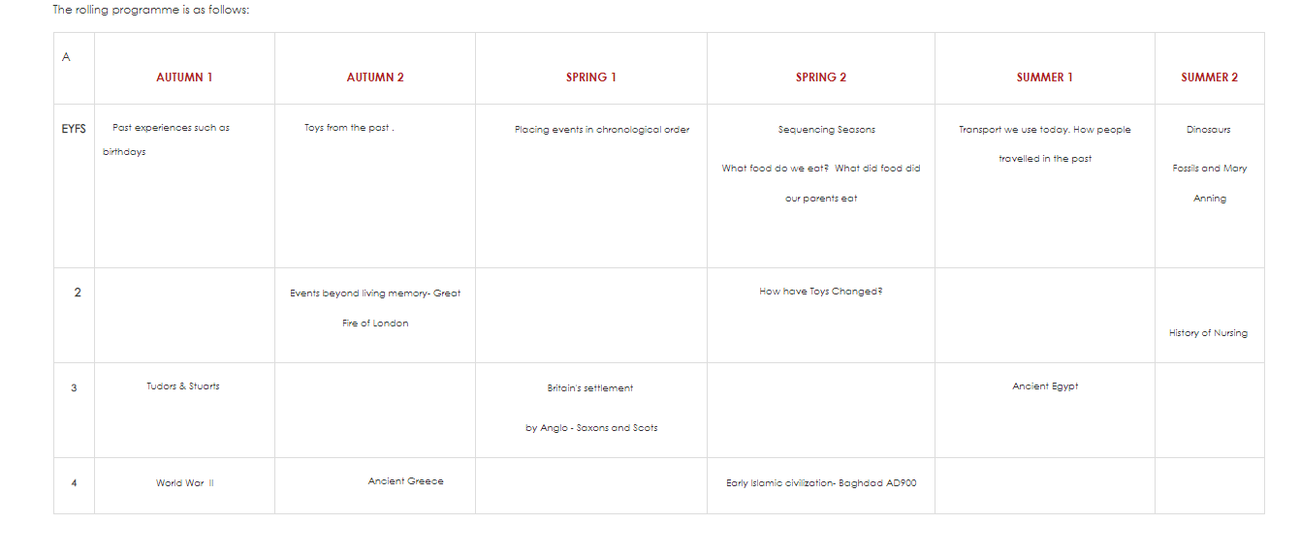
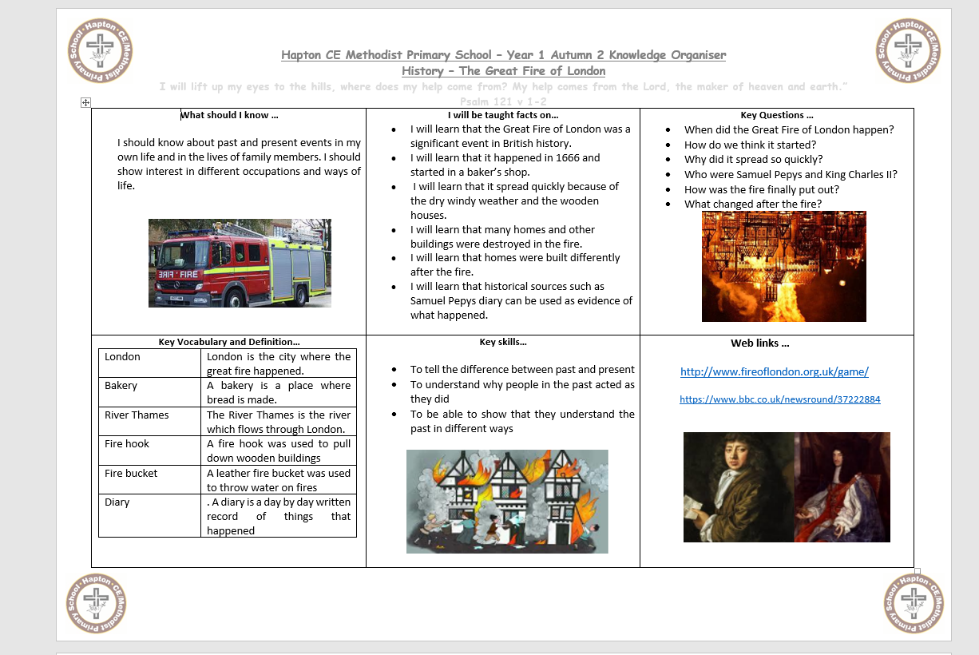
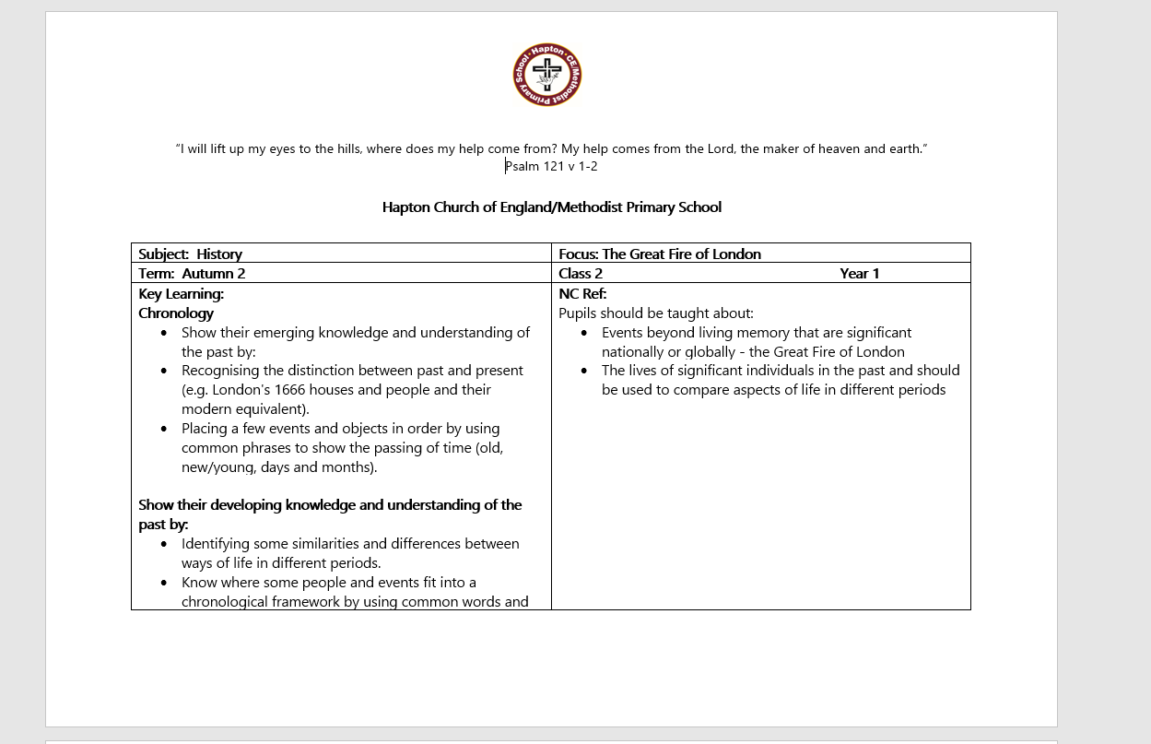
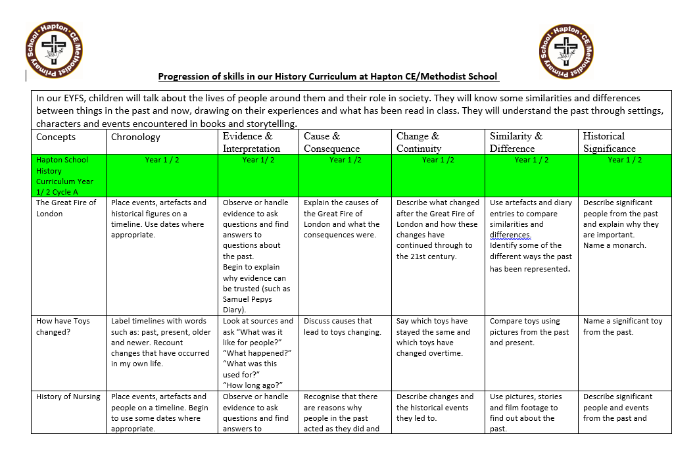
A Suite of Documents
We built the documents to showcase our curriculum and to support teachers to plan well.

Slide 8
Skills Progression Documents

Slide 9

Curriculum Maps

Slide 10

Units of Work

Slide 11
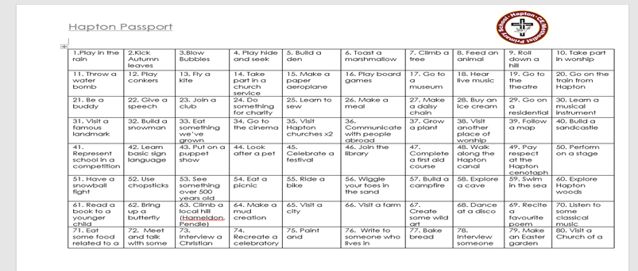

Slide 12

Knowledge Organisers

Slide 13
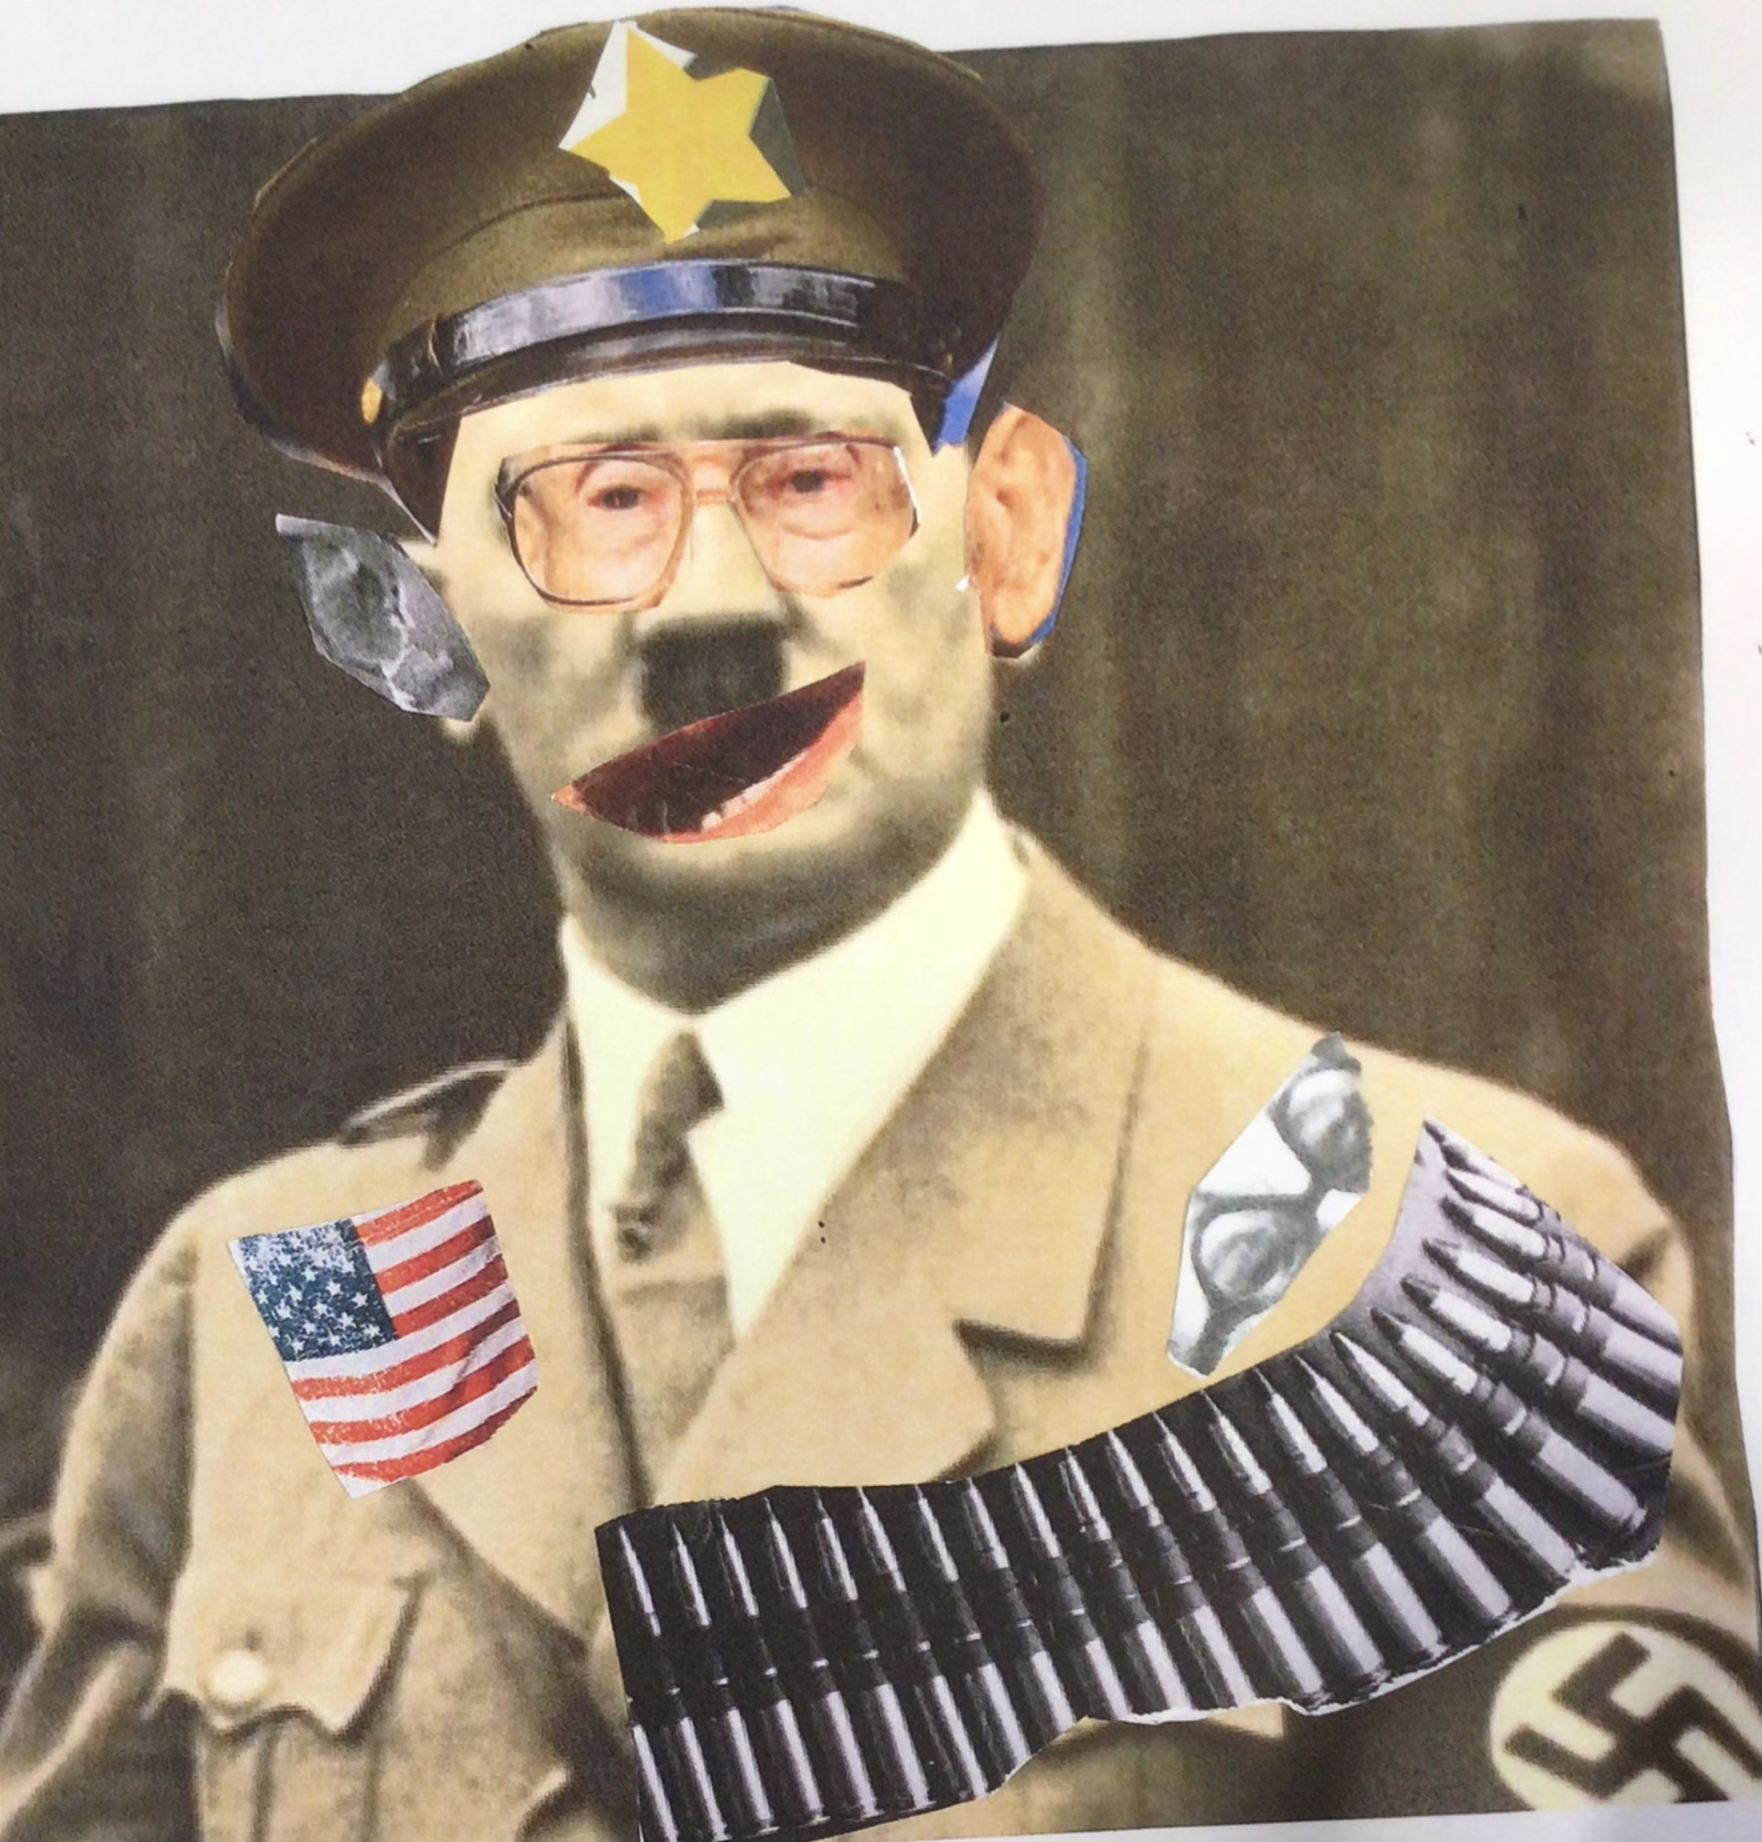
Key Learning for Us
Always Evolving
Our Curriculum will never be 'finished'. Our children are always changing and so we are prepared that our curriculum will need to adapt in order to support the different cohorts over time.
Exciting to All
We want our curriculum to entice and excite the children and the adults teaching it. This keeps it ‘alive’, nothing worse than teaching the ‘same old, same old’, over and over again.

Slide 14
Work Collaboratively
We don’t work in isolation, we use our ‘Cluster Schools’ and other schools in our support network. Collectively we draw on the knowledge and skills of different groups and individuals of like minded Teachers, Heads, Advisers and Consultants and this is the perfect opportunity to look at best practice, ask questions, voice concerns etc. There is strength in numbers. Between us all - there will always be a solution.
Suck It and See Strategy
We are confident and flexible enough to try things and adapt them. We are always evaluating and moving on. If we plan something, try it and if it isn't right for our pupils we look for something else.
Magpies
There is so much good practice across schools that we are always ready to snoop around and glean ideas. Published Schemes don't cater for our 'uniqueness' so we are always prepared to keep adapting everything and are brave enough to make our own adaptations ensuring we can justify our choices.

Slide 15

Stronger Together
We always work as a team. We have had a team approach for all our subjects, we have also worked with Subjects Leaders from other schools - again sharing good practice and expertise.

Slide 16
Our strengths
Our children are happy and enjoy attending school.
All staff have high expectations for all children
We are inclusive and ambitious
We have a well-thought-out curriculum and learning environment
Staff have carefully considered the challenges of mixed-age classes
We give high priority to pupils’ personal development and cultural awareness
Our children enjoy going on a variety of trips to different cultural, adventure and historical venues.
Next we need to...
Evaluate Cycle A.
Embed the curriculum on Cycle B of the rolling programme.

Slide 17
In Summary
Just because we are small doesn't mean we can't do all the things that bigger schools do, we simply have to make adaptations. We need to be flexible, brave, confident and always ready to find a solution, because there always is one.
Staff in small schools have to network and share the wealth of excellent practice that we have between us, we really are stronger together. Hapton is blessed to have a team of such knowledgeable, skilled and dedicated staff.
Building and then owning your own curriculum is a pleasurable experience and brings you together as a staff. Knowing that you have created something unique and personal to your pupils is a rewarding experience and well worth the work.

