Slide 1
Read Write Inc. Phonics
Parents’ Meeting
Listening to your child read
Notes:
Approximately 20 minutes is needed for this session.
Notes are provided to help you lead the presentation.
Notes in italics are for your attention only.
Provide copies of ‘Reading at Home Booklet 1 or 2’ from Oxford Owl.
Booklet 1 is sound groups and Ditty/ Red Groups and Booklet 2 for Green – Grey Storybooks.
Children will make the best possible progress if they read as often as possible.
Today we are going to discuss how to listen to your child read their Read Write Inc. Phonics decodable storybook when they bring it home.

Slide 2
‘Three with me, four at home’
Accuracy
Fluency
Comprehension
Read and enjoy at home
Notes:
In our school, children read each Read Write Inc. Storybook three times in class with their partner.
Re-reading the same book helps children to become confident readers. Each time they re-read, they build their fluency/speed and comprehension.
They love reading and want to read because they can read all of the words in the Storybook.
We set a focus for each re-read in school.
(Click) The first read focuses on reading every word accurately.
(Click) The second on reading the story more quickly.
(Click) The third read on comprehension - understanding what they read.
Then your child brings the same book home to read and enjoy with you again and again at home.
It’s ‘three with me, four at home.’
We do not send stories home the children cannot read because we always want them to be set up to succeed in their reading.
We want to make sure they enjoy reading so that they want to read.
The more they read, the faster progress they will make.

Slide 3
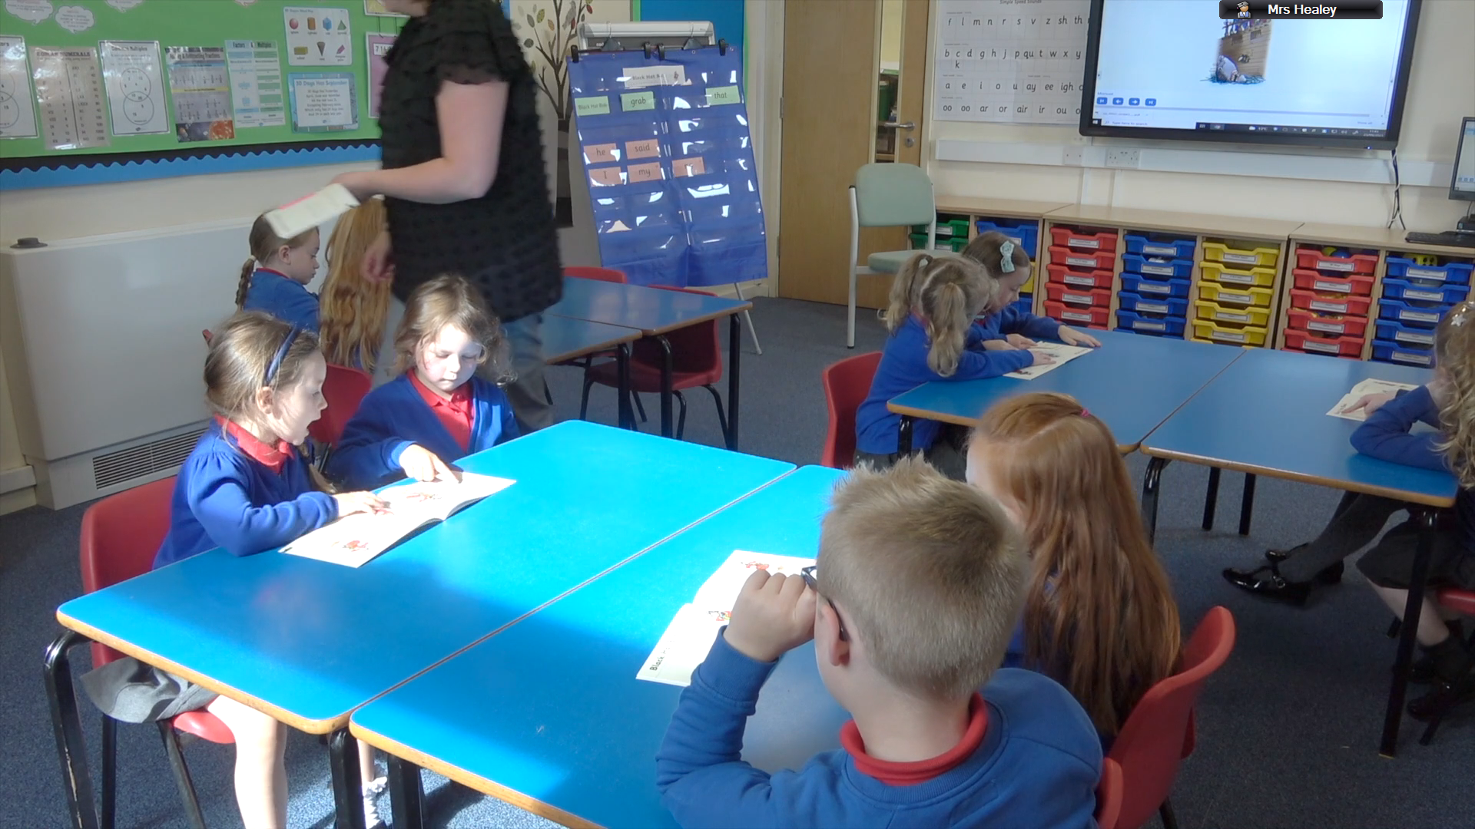
‘Three with me, four at home’
https://schools.ruthmiskin.com/training/modules/74
Notes:
Let’s watch this child enjoying reading their Storybook again and again.

Slide 4
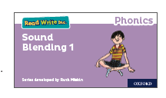

After the third read…
Notes:
So after the third read in class, children bring the same Storybook home in their book bag.
They love this book!
They can read it like a storyteller and can’t wait to read it to you, their grandparents or even their teddy bear.
Please avoid saying, “This book is too easy for you!” but instead say “I love how well you can read this book!”
They are meant to be able to read all of the words as the book is at the correct level.
Encourage them to share their enjoyment of the story with you and read it in their storyteller voice – again and again.

Slide 5

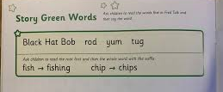
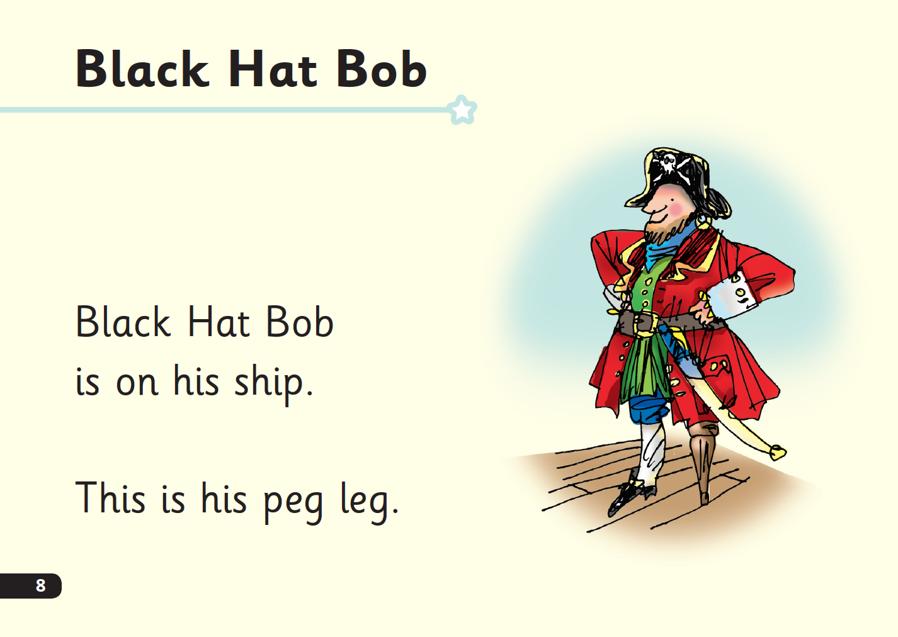
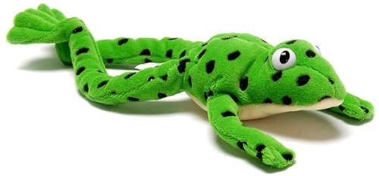
‘Special Friends’, ‘Fred Talk’, read the word
Notes:
E Children will be able to read all of the words in the Storybook.
If they hesitate, remind them to read the word using ‘Special Friends, Fred Talk, read the word’.
For example, this means they spot the ‘sh’, then Fred Talk and blend to read the word e.g. sh, sh-i-p, ship.

Slide 6


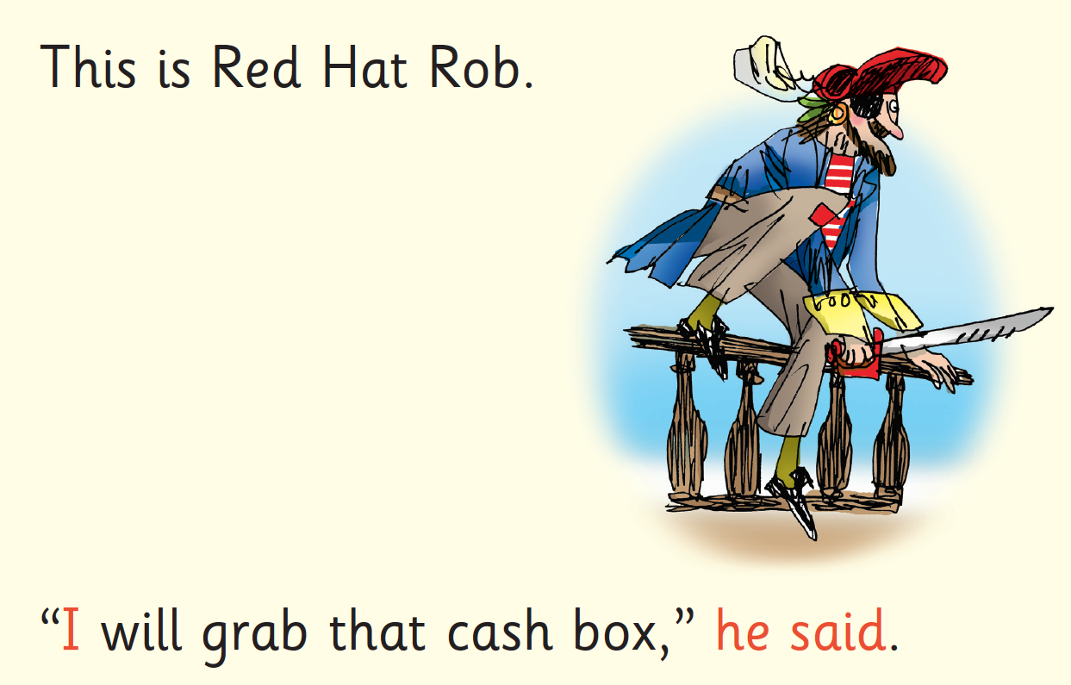
Red Words
Notes:
Some words are ‘tricky’ because they contain letters that don’t match the sounds the child has been taught.
For example, ‘said’ has ‘ai’ making an ‘e’ sound.
We teach these common exception words as Red words.
In the early Storybooks, these words are printed in red text.
Remind your child not to use Fred Talk to read Red words but instead to stop and think. Tell them the word if needed.

Slide 7
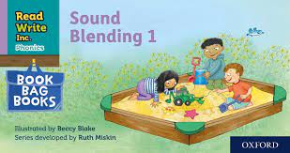
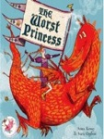
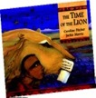



Which books will children bring home?
+
+
Notes:
In your child’s book bag, they will bring home:
- the Storybook they have read in class to practise reading what they can already read.
- if applicable a ‘Last and past’ Storybook – a previously read RWI Storybooks for extra practice. The children enjoy re-reading stories they know well. Their fluency improves on every reading.
- if applicable a Book Bag Book. I’ll explain more about these in one moment.
A picture book to share with you which has already been read to them so they care about it. You can read the story to them or they can retell the story by looking at the pictures. They are not expected to read the story themselves.
We make sure that every book that goes into your child’s book bag is a well-loved book – one they know already and want to read again and again.

Slide 8

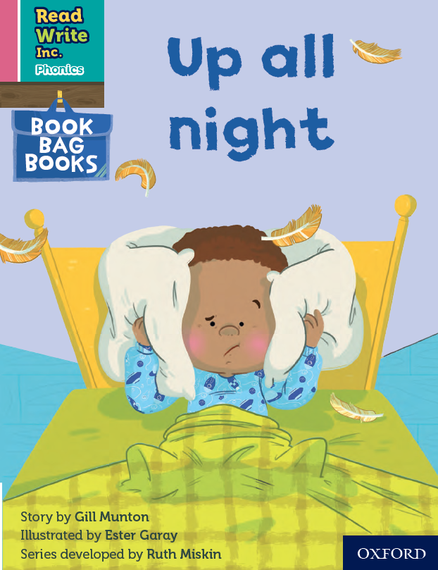
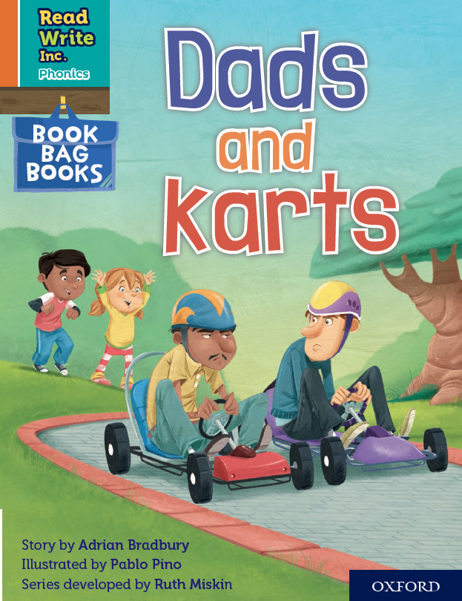

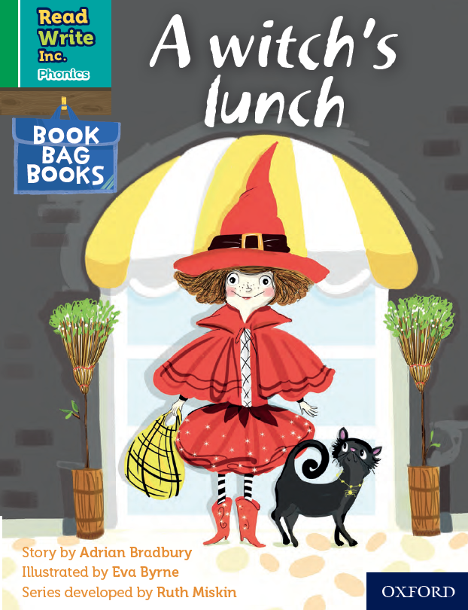
Book Bag Books
Extra reading practice at home
Uniquely matched to the Read Write Inc. Phonics Storybooks.
Reinforce children's learning of phonics at the appropriate level.
Helps to make even faster progress in reading.
Notes:
Only use this slide if you use Book Bag Books in your school.
We use Book Bag Books especially for home reading. They have guidance inside just for you as parents.
They are matched to the books children read in school so provide practice of the same sounds – extra practice at the right level for your child.
They include many of the same reading activities that we use in class.

Slide 9
What can you do?
Listen to your child read the same Storybook again and again
Encourage them to use ’Special Friends’, ‘Fred Talk’, ‘read the word’
Discuss the story and encourage their storyteller voice.
Notes:
Provide copies of ‘Reading at Home Booklet 1 or 2’ from Oxford Owl.
Booklet 1 is sound groups and Ditty/ Red Groups and Booklet 2 for Green – Grey Storybooks.

Slide 10
Online resources available
Ruth Miskin Parents’ Page:
http://www.ruthmiskin.com/en/parents/
Ruth Miskin Facebook:
https://www.facebook.com/miskin.education
Free e-books for home reading:
http://www.oxfordowl.co.uk/Reading/

Slide 11
The more that you read, the more things you will know. The more that you learn, the more places you’ll go!
Dr. Seuss
Notes:
In the words of Dr Seuss…read quote.
Good readers do well in school – and in life.
By listening to your child read, you are making sure they have the opportunity to practise and become a good reader quickly.
Remember that all parents have the power to change outcomes for their children.

Slide 12
Any other questions
Q&A

