Slide 1

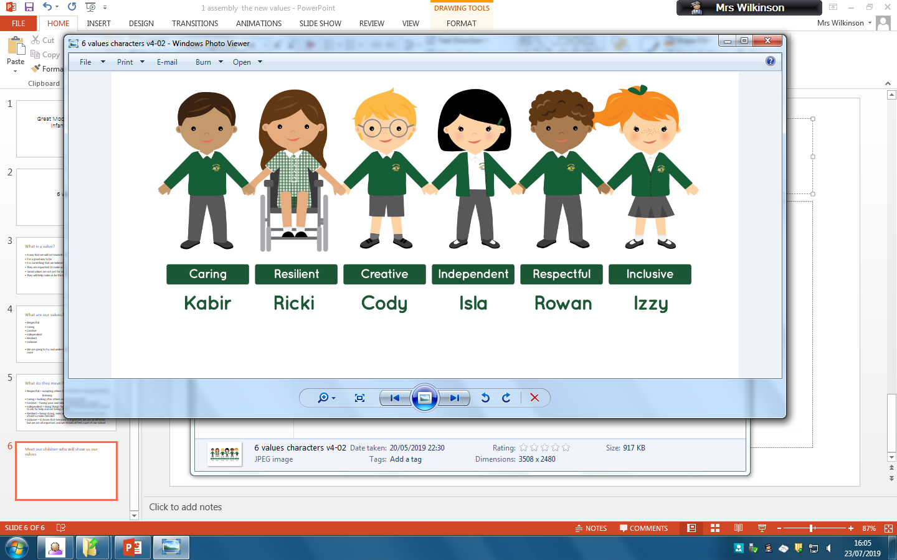
Welcome to Year 1

Slide 2
Meet the Year 1 team …
Class 4 ~ Miss Mangan
Class 5 ~ Mrs Ash (MTW)
& Mrs Wilson(WTF)
Class 6 ~ Miss Barrie
TA Support: Mrs Gilby, Mrs Humphries, Mrs Plant, Mrs Caffrey, Mrs Stark

Slide 3
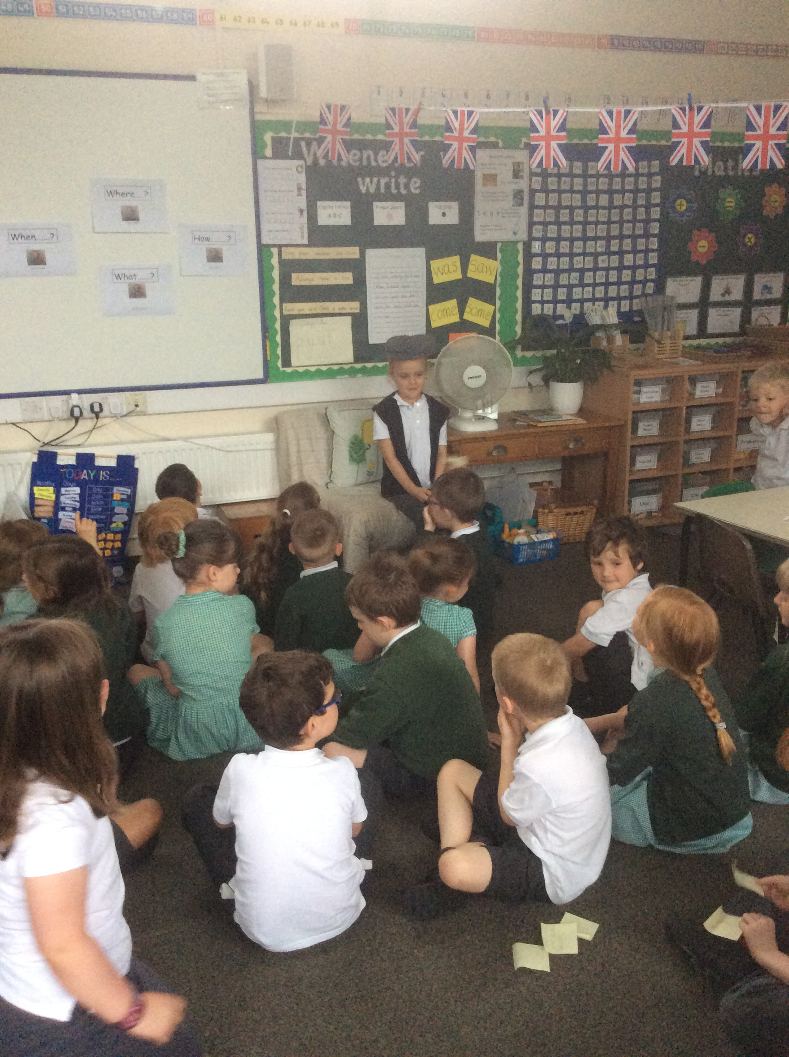
The School Day
8.50am ~ School opens
9am ~ Registration
9.10am ~ Session 1
9.45am ~ Phonics
10am ~ Playtime
10.15am ~ Assembly
10.30am ~ Session 2
12.00am ~ Lunchtime
1.00pm ~ Session 3
2.00 pm ~ Playtime
2.15 pm ~ Session 4 / Story
3.20pm ~ Home

Slide 4

School Rules
Kind hands and kind feet
Kind words
Good manners ~ please and thank-you
Walk in school
Share and take turns
Good listening
Ready to learn
School Behaviour Policy ~ Class Dojos

Slide 5
What does your child need at school?
Book bag
Named uniform
Water bottle
Coat with hood
Sensible shoes
PE kit – indoor and outdoor (named!)

Slide 6
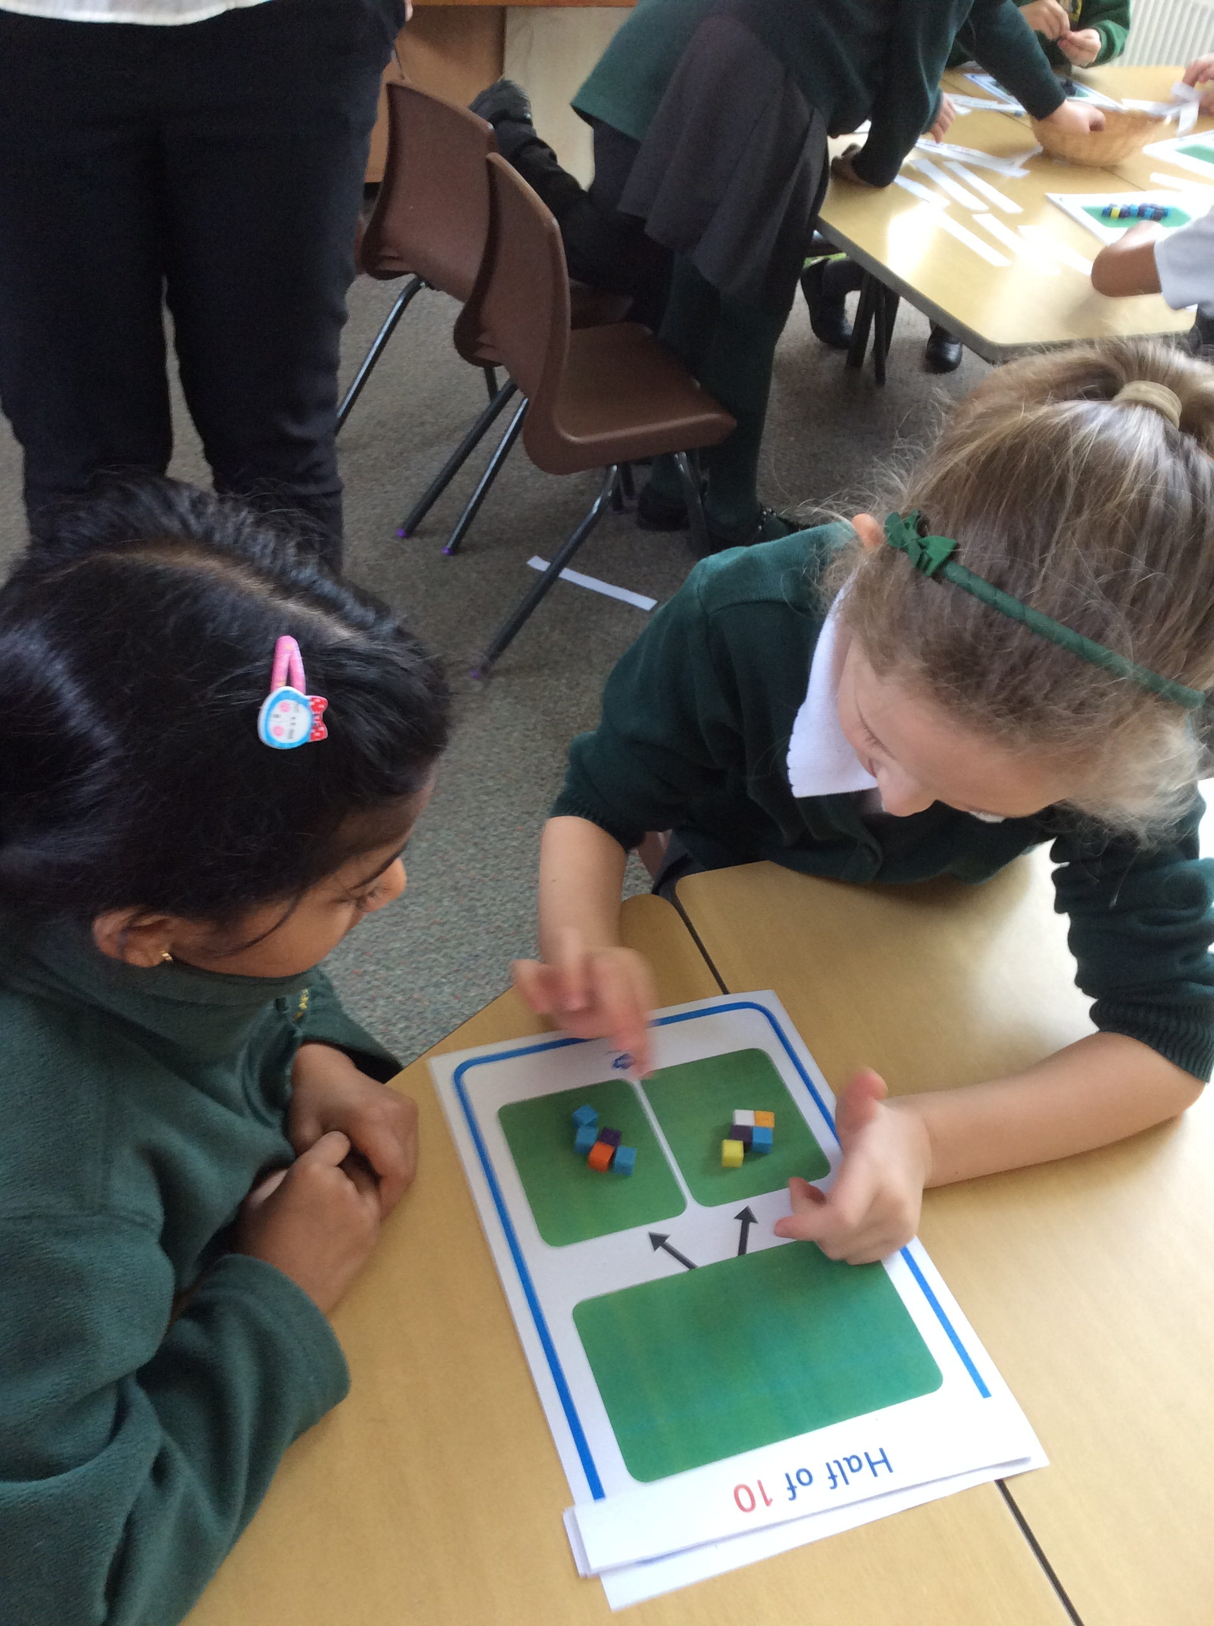
Areas of the KS1 Curriculum
English ~ reading, writing, handwriting & phonics
Maths
Science
Computing
Geography
History
Art & Design
Design Technology
Music
PSHE
PE ~ dance, games, gymnastics
RE

Slide 7
Year 1 Topics
Autumn
Great Explorers
Enrichment activities: Walk around the local area
TBC Explorer Day
Nativity play
Spring
Under the sea
Owl Babies
TBC Enrichment activities:
Sea Life Centre
Summer
The UK
(Barnaby Bear)
TBC Enrichment activities:
Teddy Bear’s Picnic
Staircase House

Slide 8
Phonics ~ Read Write Inc (RWI)
Taught daily – approximately 20 minutes sessions
Children taught in ability groups
Supports reading and writing
National phonics assessment takes place during the Summer Term

Slide 9
How can you help?
READ DAILY
Share library books
Pick & Choose homework
Weekly spellings
Purple Mash
Encourage independence
Label everything ☺ !!

Slide 10
Communication
Google Classroom
Morning - staff meet & greet at the entrance
End of the day – teacher’s available
Telephone the office

Slide 11
Please take a copy of the following handouts:
1. Topic leaflet
2. Pick and choose homework
3. Vocabulary list
4.Maths and English Curriculum (double sided)
Please sign by your child’s name.
The handouts are on the tables outside your child’s classroom.

