Slide 1
Parent Meeting
Phonics Screening Check

Slide 2
Reading changes everything
Teach a child to read and keep that child reading and we will change everything.
And I mean everything.
Jeanette Winterson

Slide 3
What is the Phonics Screening Check?
A word-reading test at the end of Year 1.
Children read 40 words.

Slide 4

‘Special Friends’, ‘Fred Talk’

Slide 5



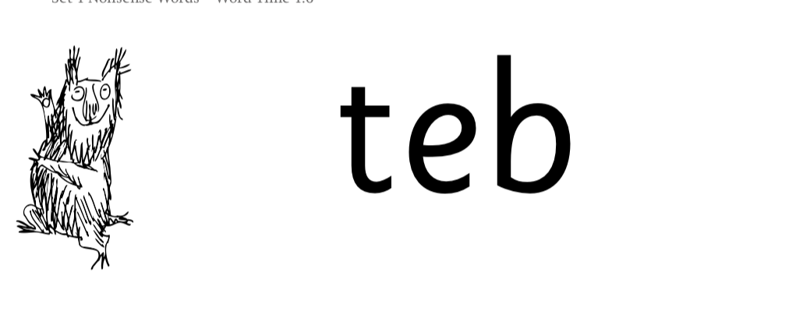
Nonsense words

Slide 6
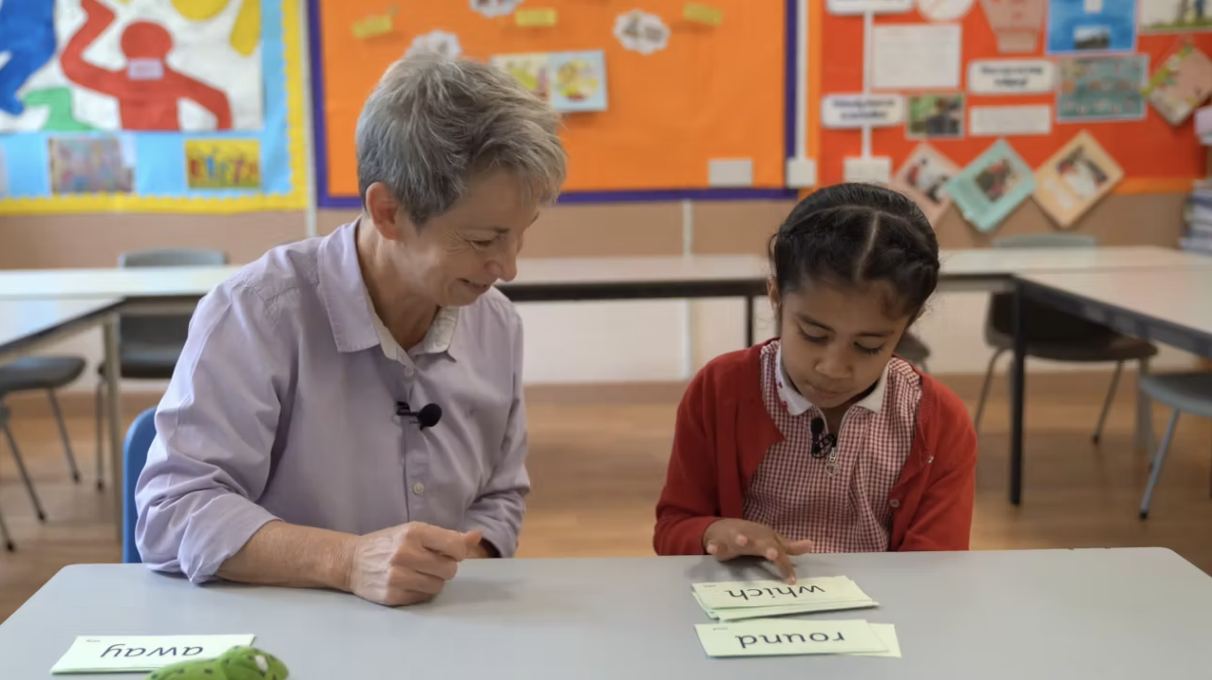
Teach every child to read

Slide 7
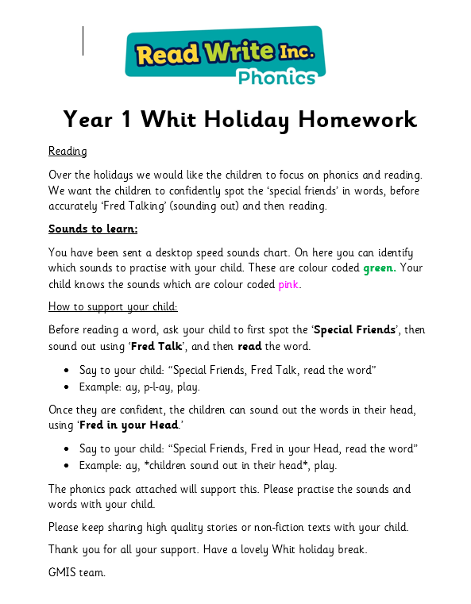
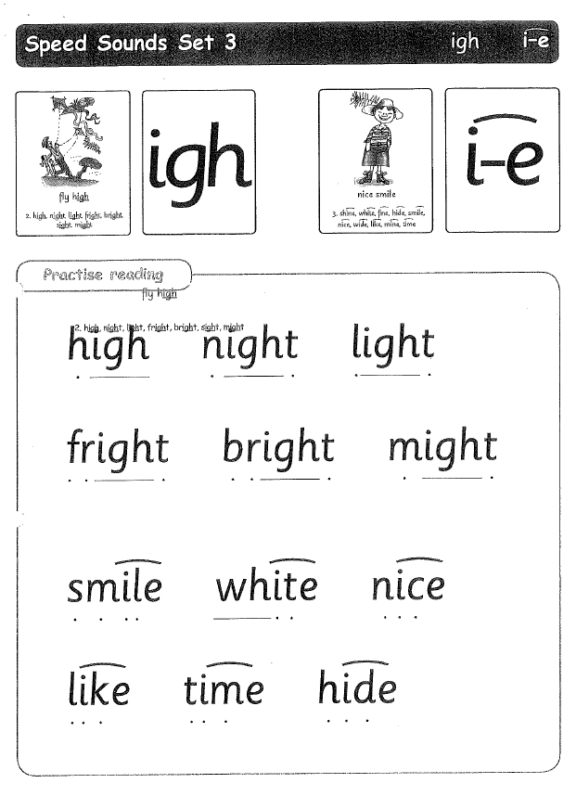
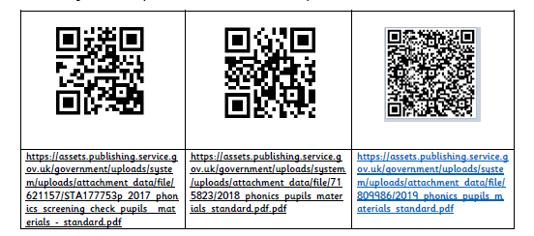
Practice at home

Slide 8
Online resources available
Ruth Miskin Parents’ Page:
https://www.ruthmiskin.com/parents/
Ruth Miskin Facebook:
https://www.facebook.com/miskin.education
Free e-books for home reading:
http://www.oxfordowl.co.uk/Reading/

Slide 9
Reading changes everything
Teach a child to read and keep that child reading and we will change everything.
And I mean everything.
Jeanette Winterson

Slide 10

Any questions?

