Slide 1

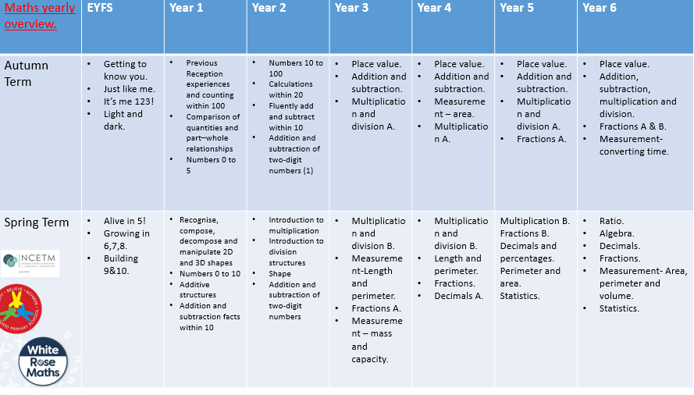
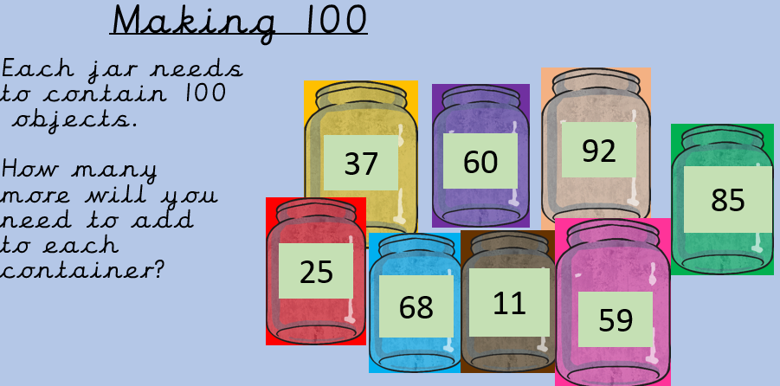
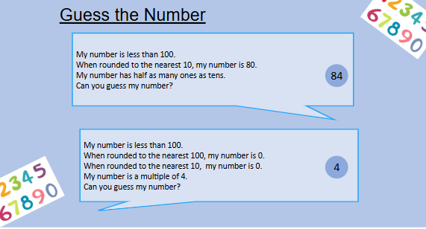
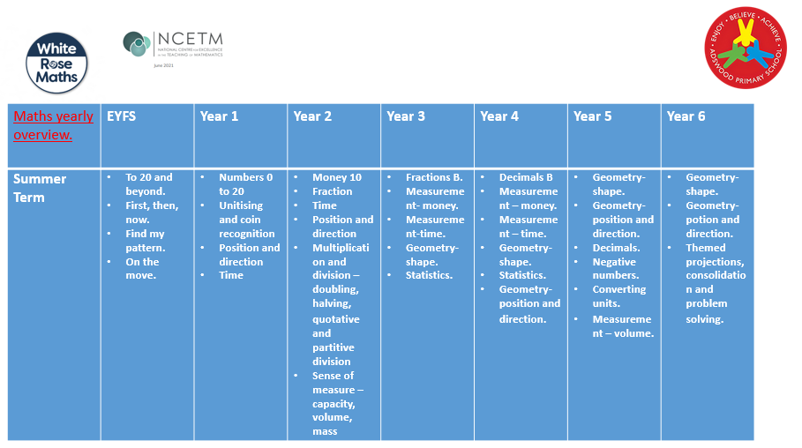
What does ‘Maths’ look like at
Adswood Primary?
1. Curriculum mapping
Our curriculum has been created for our learners. We use a Concrete, Pictorial and Abstract (CPA) approach in maths. Learning follows a clear sequence in each year group and throughout school. White Rose and the NCETM CP materials are used to support teaching and learning. We have ‘mapped out’ coverage across the school to ensure objectives are revisited often and learning is consolidated.
Quality First Teaching in all year groups, a range of questioning strategies , 5 mastery big ideas and the use of weekly SODA, enhance opportunities to develop maths
problem solving and reasoning
Our maths lessons are planned from our yearly overviews which allow us to build on each topic through small steps.
2. Learner voice
We discuss with learners what maths learning looks like in their classroom. We want all our learners to have a voice and to be heard. We use learner voice to impact on the way we teach maths in our school. For those learners who struggle with maths, we want to find out how they would like us to help them to make progress and enjoy their learning.
Leaners voice informs staff that learners are enjoying their maths lessons and are engaged.

Slide 2


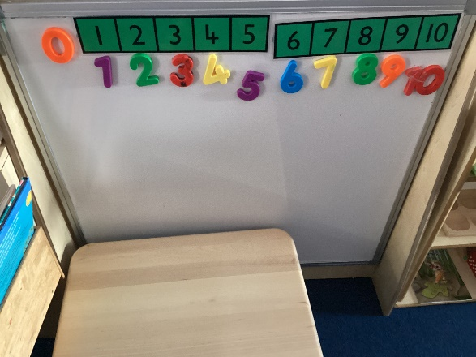
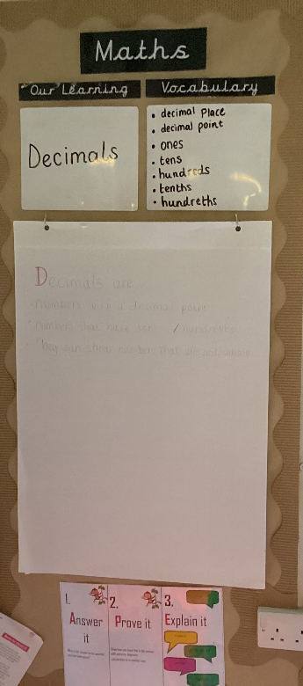
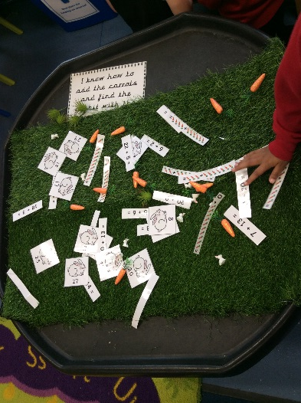
3. Adaptive Teaching
At Adswood Primary the teaching of Maths is inclusive through quality first teaching and adaptive teaching. We are following the mastery approach. Provision for learners is age appropriate and follows the CPA (concrete, pictorial, abstract) approach. We use the NASENCO handbook to assist learning while our SEN Support plans outline specific targets for our learners with additional needs.
All learners at Adswood complete a ‘One Page Profile’ to let their staff teams know how they learn best and what support they might need.
In addition we offer support through:
Multisensory approaches to learning
Use of iPads Magma Maths
Speech and language (SALT)
Maths support trays in all classrooms.
Concrete ‘Help yourself’ stations.
4. Learning environment
EYFS
KS1/KS2

Slide 3


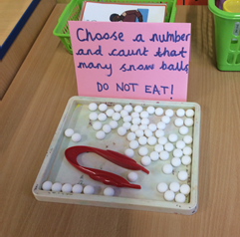
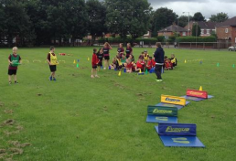

5. Opportunities to celebrate Maths.
The school is proactive in attending competitions to promote maths.
In February we take part in the NSPCC number day in which all classes
are asked to choose
one competition to enter online.
Throughout the year we take part in
Timestable Rockstar battles
between classes, year groups and within the Victorious trust.
Every year as a school we take part in National Number Day. This encourages learners to focus on Maths for a whole day exploring maths in all different lessons through various activities.
We are competing in the ‘Times Table Rock Stars’ competition against 2000 other schools. This means the learners need to answer as many as possible questions correctly within a week to score points!
6. Cross curricular Maths.
We have had exciting opportunities where maths learning out of school is enhanced. Examples include: Cook for life, Local Walks and theme weeks.
We also use maths throughout the curriculum we incorporate it into our Geography destinations, timelines, Science –statistics, P.E – measuring, counting. EFYS even display maths through snack time. We also aim to help with their use motor skills united within maths.

Slide 4
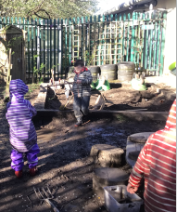
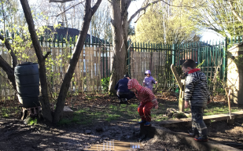
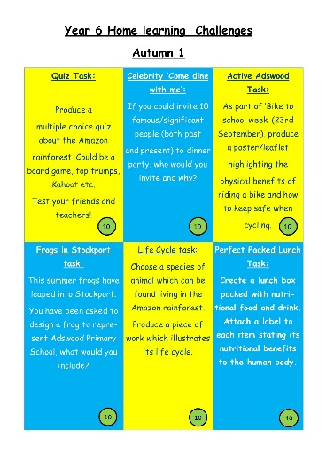
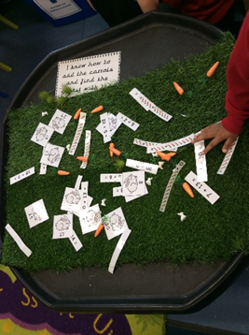
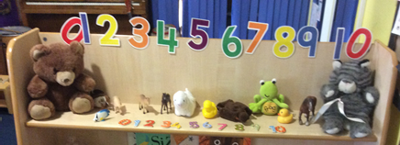
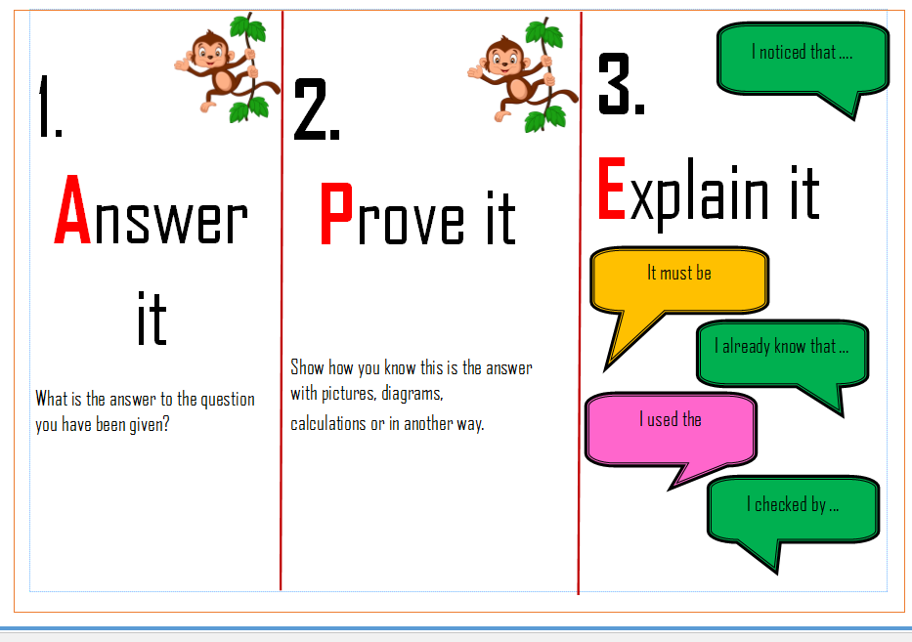
7. Learning beyond the classroom
Where possible, we aim to lift Maths off the page and bring it to life for our learners. This begins in EYFS with maths outdoor areas and in the willow garden.
Through to maths outdoors in KS1 and KS2.
We introduced the mastery CPA approach in order for learners to visually see maths.
All learners are provided with maths challenges in their home learning to take home. Parents/Carers are encouraged to communicate with the staff team about how the learners are attempting their maths challenges.
8. Challenges to deepen learning
Our school vision, ‘Enjoy. Believe. Achieve’ is evident through our additional challenges for learners. Some set verbally as a result of daily formative assessment, others available through ‘Challenge’ areas within the classroom, we enjoy seeing our learners challenge themselves to achieve more.
Each half term, learners are set ‘Home Learning Challenges’ aimed to deepen learning. These challenges may be completed independently or with support from someone outside of school.
Within the EYFS classrooms we have ‘Challenge areas’ We enjoy seeing our learners challenge themselves. Challenge areas often link to maths in everyday life.
We have introduced ‘APE’ KS1 and KS2 this is when children have to ‘Answer it, Prove it and Explain it’ to deepen their understanding of the question.

Slide 5
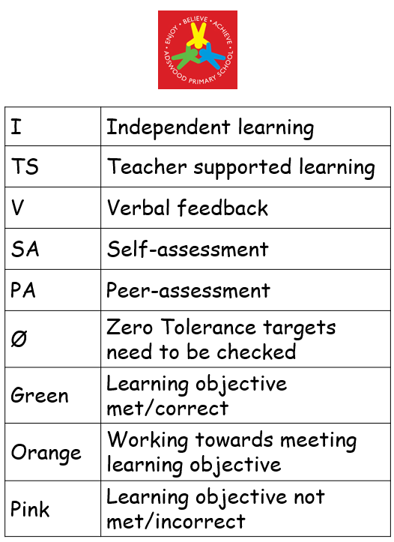
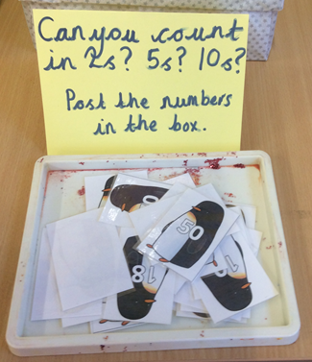
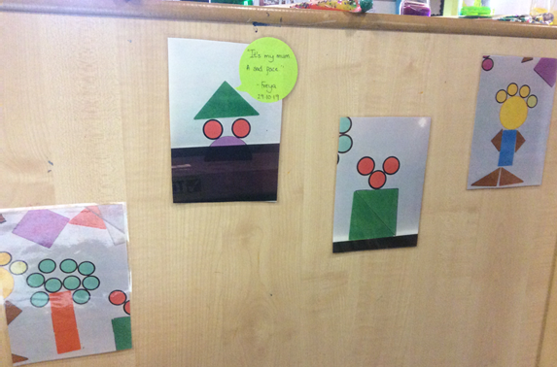
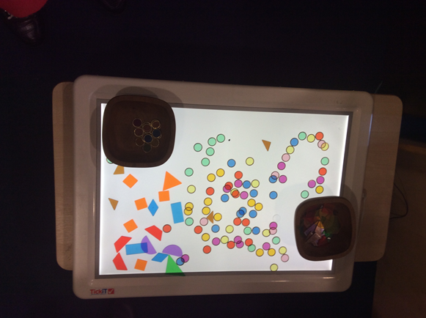
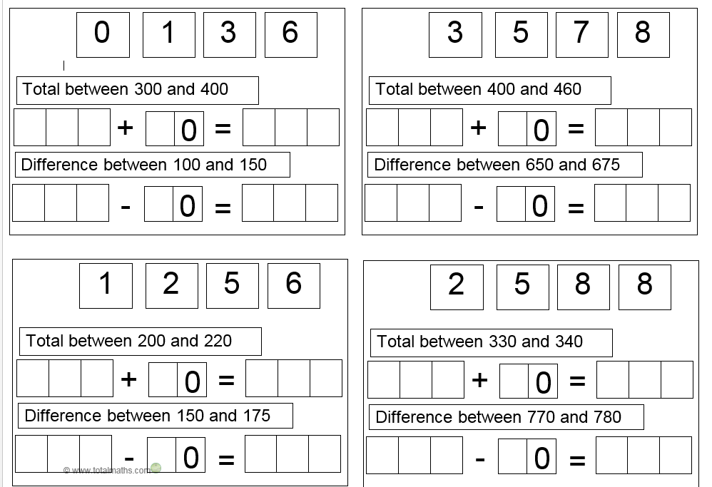

9. Self- Assessment
Where possible, we aim to allow learners to self-assess their own work in order for them to see where they have made errors and self correct them. This is displayed in our marking and feedback policy and will be labelled in learners books as SA.
Staff will monitor self-assessment in books.
In the Maths area we have ‘Help yourself’ baskets. These allow learners to take concrete resources to aid their learning. This teaches the children to understand what helps them learn.
.
10. Staff CPD
In order to provide staff with CPD we have joined the North West Maths Hub. This has given staff the opportunities to take part in CPD in different areas of Maths from Number work to pedagogy of Maths.
We invited a speech and language specialist to host a staff meeting to help us with learners vocab this is not only needed in English, but a necessity in maths. This is in its infancy.
Following the visit we received resources we can adapt to suit our learners to aid their problem solving and reasoning skills and increase their understanding of maths vocabulary.
As a subject lead I attend courses led by the trust and Maths Hub North West One. Feedback from courses is delivered to staff. An ongoing CPD programme for maths is in place.

