Slide 1

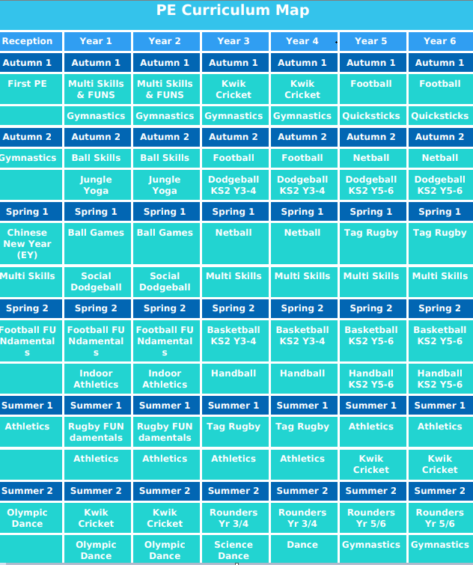
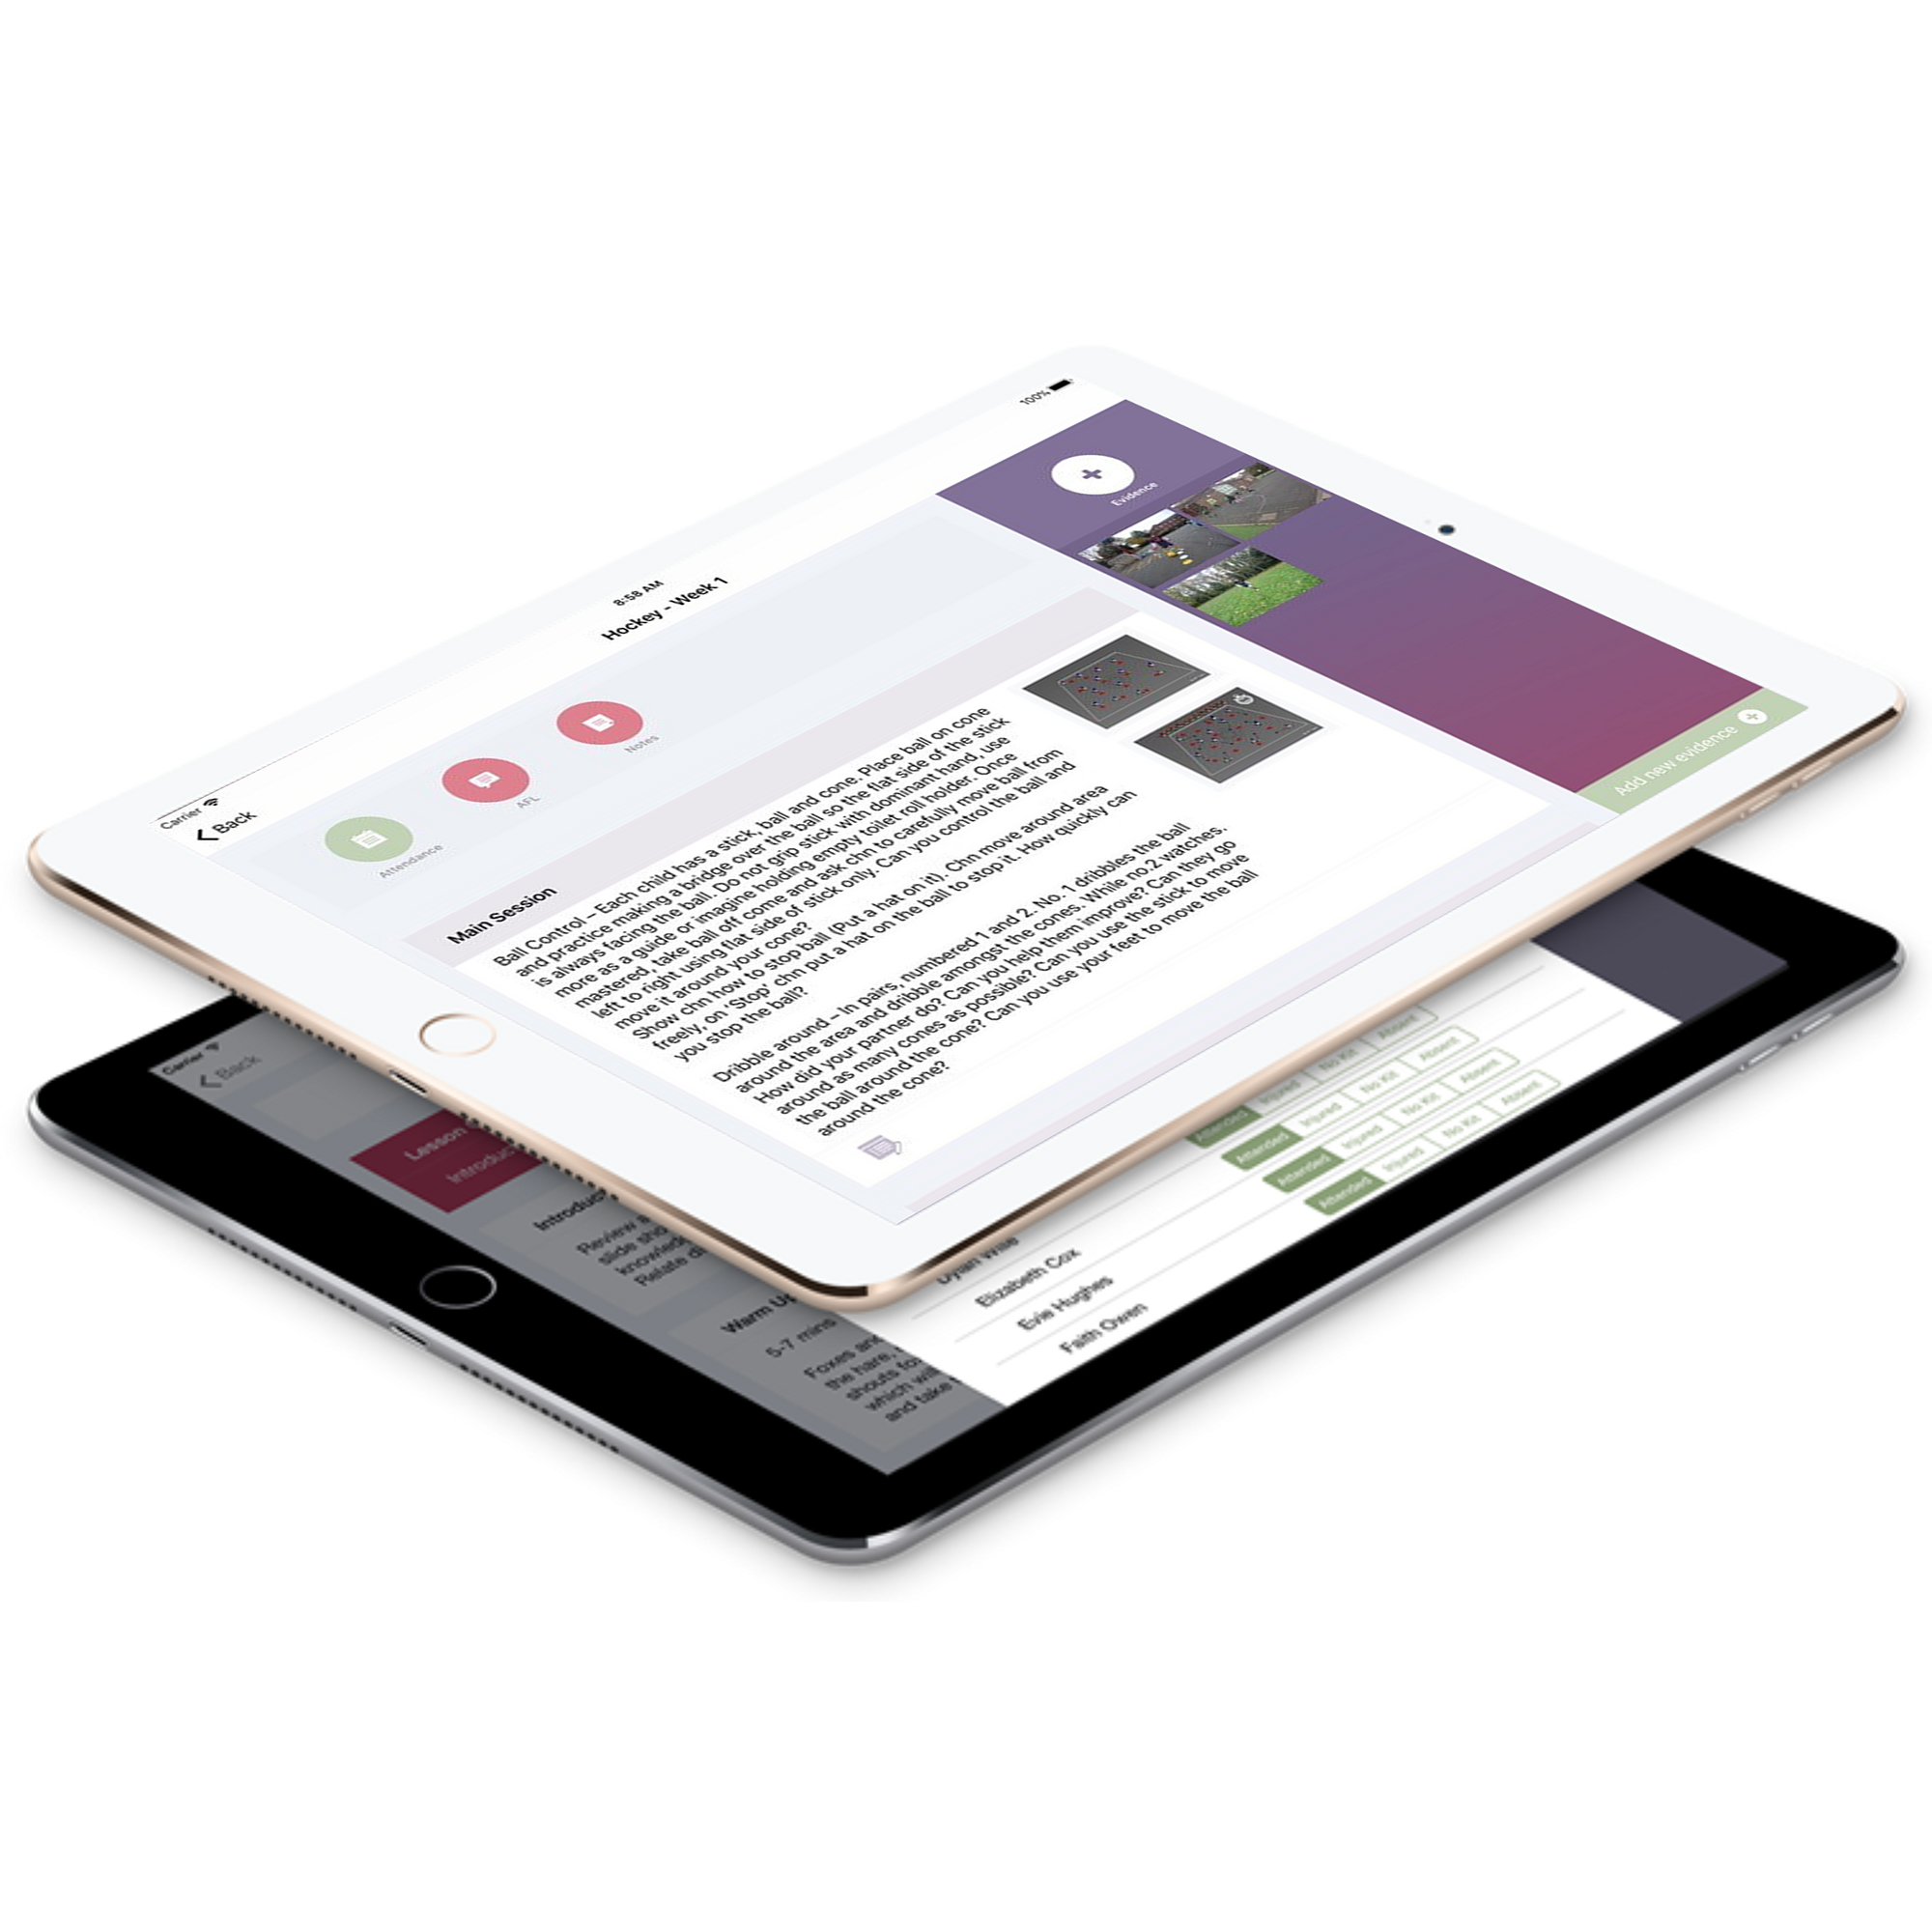
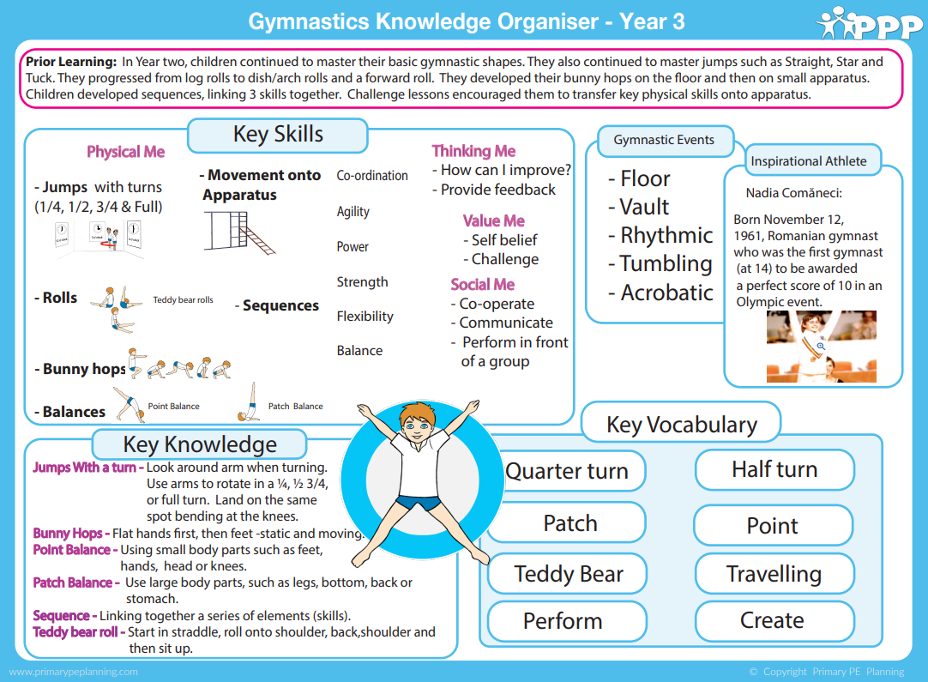
What does ‘PE’ look like at
Adswood Primary?
1. Curriculum mapping
For the past 2 years we have followed a whole school overview which informs staff of the teaching and learning that will take place in each half term.
The yearly overview ensures that learners have the best chance to progress within a sport. We combine sports of similar rules to encourage metacognition skills to develop. For example, benchball & netball and handball & basketball. Sports are revisited each year to ensure learners build on prior learning.
At Adswood we use PrimaryPEPlanning platform to support in the delivery of high quality PE lessons.
2. Progression of Learning
Knowledge organisers and progressions of skills and vocabulary documents are used throughout EYFS, KS1 and KS2 to ensure progression of learning and national curriculum coverage. Learning follows a clear sequence in each year group and throughout school.

Slide 2
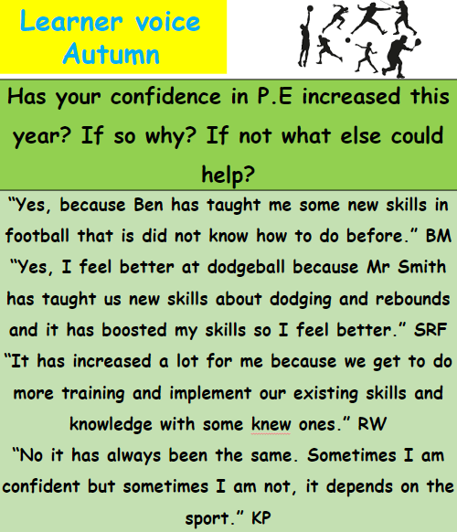
What does ‘PE’ look like at
Adswood Primary?
3. Learner voice
Learner voice informs staff that learners are enjoying their P.E lessons and are engaged. It also provides learners suggestions for future lesson planning.
4. Evidence of Learning
From 2024/2025, each year group will share an e-book to evidence the learning throughout the Year (UKS2 will share one e-book which evidences the learning during the Foundation 5 lessons). At the beginning of each half term, each class will assess the learners on their understanding of key vocabulary and understanding of the sports/activities they will be taking part in. Each week, the lessons will progress and introduce a new skill while reflecting on skills from previous sessions. Pictures and pupil voice will be recorded from the sessions to evidence the learning and progress made by the learners. At the end of a half term, teachers will assess the learners understanding of key vocabulary and skills learnt within that particular sport/activity to assess progress. The PE lead completes the impact form at the end of every academic year to evidence where the PE Premium budget is spent and how it is used to support learners learning.
5. Adaptive Teaching
Inclusion is vital in the success of our school. To ensure inclusion in PE we provide PE kits for ALL learners from Nursery through to Year 6. If a child is recognised as someone who can be reluctant to engage in learning during PE sessions, lessons can be adapted to encourage all. We use the PE budget to support FSM families in engaging with after school activities. Adaptive teaching allows all pupils to access learning and achieve age related expectations. We have adapted UKS2 lessons in the form of creating ability groups in the Foundation 5 sessions - ensuring all learners are able to participate and have the opportunity to enjoy PE. This Foundation 5 also ensures a smooth transition in to high school.

Slide 3

What does ‘PE’ look like at
Adswood Primary?
6. Theme Weeks
.
Each year we will conduct a PE and Sports theme week. They will be planned and organised close to sports day. If there is a key sporting event in that academic year, for example ‘The European Championships’ or ‘The Olympics’, the sports week will reflect this event. We will encourage all learners to participate in sporting opportunities that week and discuss and develop an understanding of a healthy balanced lifestyle. We approach external agencies to help inspire the next generation of sports stars.
7. Learning beyond the classroom education.
.
Learners have the opportunity to represent the school in intra and inter competitive activities. For example, football matches/tournaments and gymnastics. Sports coaches have been used at lunchtime to encourage participation outside of the classroom. Sports equipment is provided for the learners to use during break times and lunchtimes to encourage physical activity throughout the school day.

Slide 4




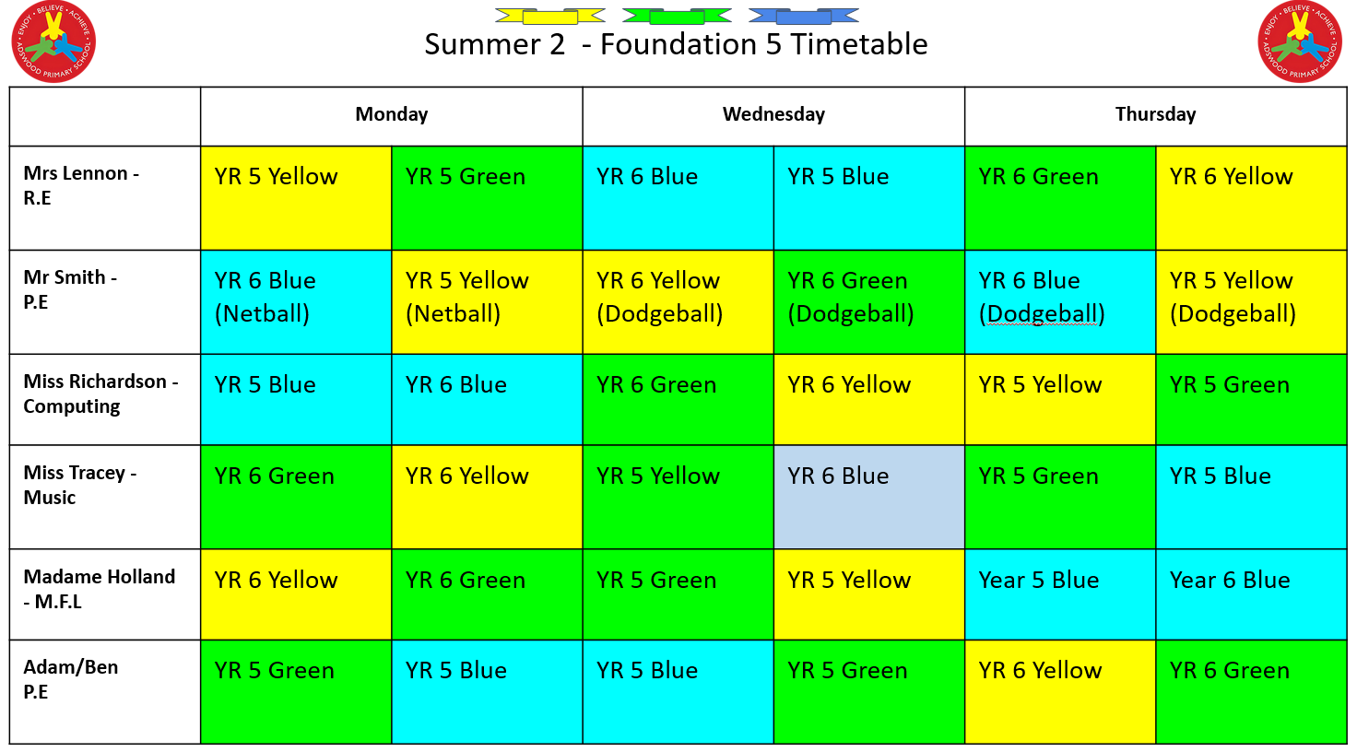

What does ‘PE’ look like at
Adswood Primary?
8. Self- Assessment
9. Staff CPD
Learners are encouraged to self assess and peer assess across all PE lessons. In addition, with our expert coaches for Invasion Games and Gymnastics, we encourage self and peer assessment while watching other learners's perform skills/routines.
PE lead monitors CPD by assessing teachers levels of confidence through conducting questionnaires. These are allowing targeted CPD to be planned for the teachers wanting some support in the delivery of PE lessons.
10. Foundation 5
Foundation 5 is unique to Adswood Primary School.
It is aimed at Year 5 and 6 learners in order to aid their transition between year groups and primary to secondary school. Beliefs and Values, P.E, Computing, Music and M.F.L are taught three afternoons a week by subject leads. This allows learners to move from class to class, develop relationships with numerous members of staff and enhance their knowledge and understanding of that subject. It is an excellent way to accelerate progress within these subjects. Furthermore, it is directly increasing the level of engagement in PE across the two year groups.

