Slide 1


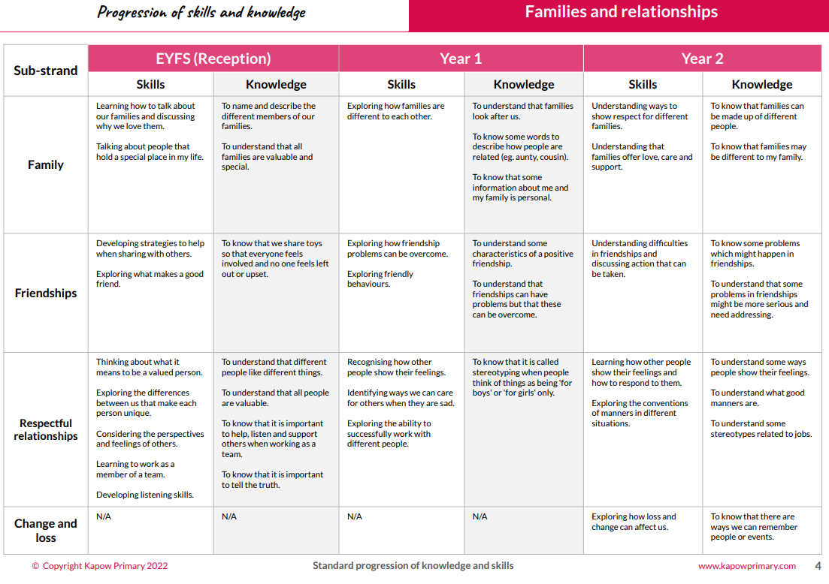
What does ‘PSHE’ look like at
Adswood Primary?
1. Curriculum mapping
Our school uses the KAPOW Primary scheme of learning for PSHE (Personal, Social, Health, and Economic education) and RSE (Relationships and Sex Education) because it provides a comprehensive, well-structured curriculum that supports the development of children’s social and emotional skills in a safe and inclusive way. KAPOW is designed to be age-appropriate and engaging, ensuring that students gain a clear understanding of important topics such as healthy relationships, personal wellbeing, and safety. The scheme aligns with statutory requirements and helps prepare pupils to navigate real-life challenges confidently and respectfully, fostering positive attitudes and promoting mental health and resilience.
Each teacher timetables a weekly explicit PSHE lesson
The KAPOW PSHE and RSE curriculum is carefully structured to provide a comprehensive, progressive, and engaging learning experience that supports children’s personal growth, safety, and wellbeing throughout their primary education.. Whilst the KAPOW, SEAL, RSE SPIRAL curriculum and DATE SPIRAL curriculum form the basis of PSHE, as well as the PSHE Association, teaching and learning within the classroom, a wide range of other strategies are in place, which contribute to the development of the learners’ social and emotional well-being. The school’s Inclusion Team work in conjunction with class teachers to address specific issues relating to PSHE. The school also receives support from the Local Authority advisor(Tanya Cross) and the associated PSHE network, other agencies such as primary Behaviour Support Service, Primary Jigsaw and Mosaic and the Abacus Learners’ Centre to support the work done within school and to meet the needs of our learners.
2. Learner voice
FD - We enjoyed learning about how to manage money. We talked about debt and how it can get you into financial trouble.’’
MW - ‘In PSHE we learnt about how the media can alter peoples images. We talked about the negative impact on mental health when people edit their pictures and use filters. It makes them feel like they aren’t good enough as they are.’

Slide 2
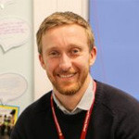
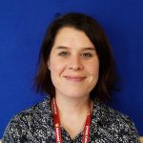
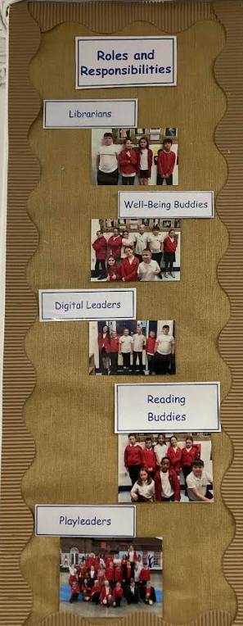
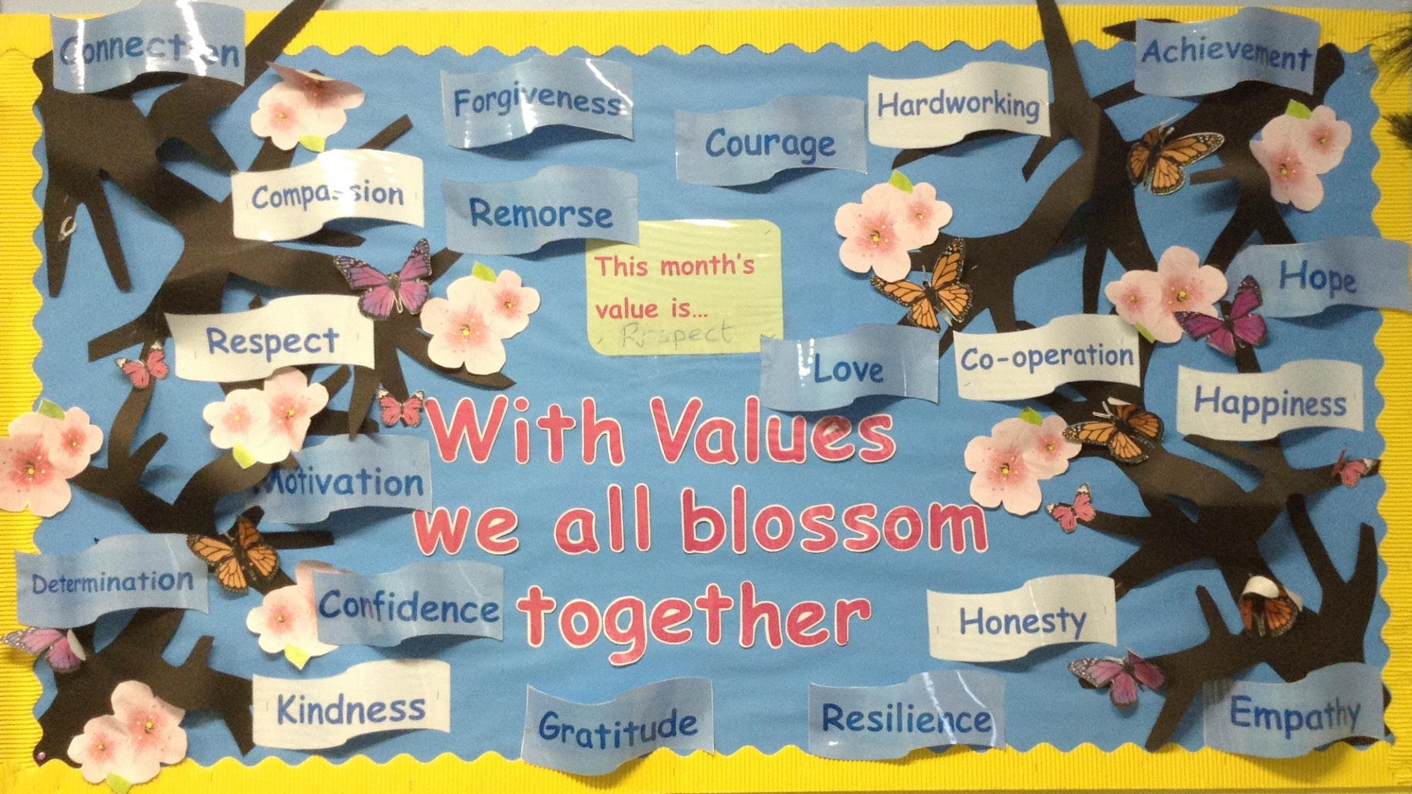
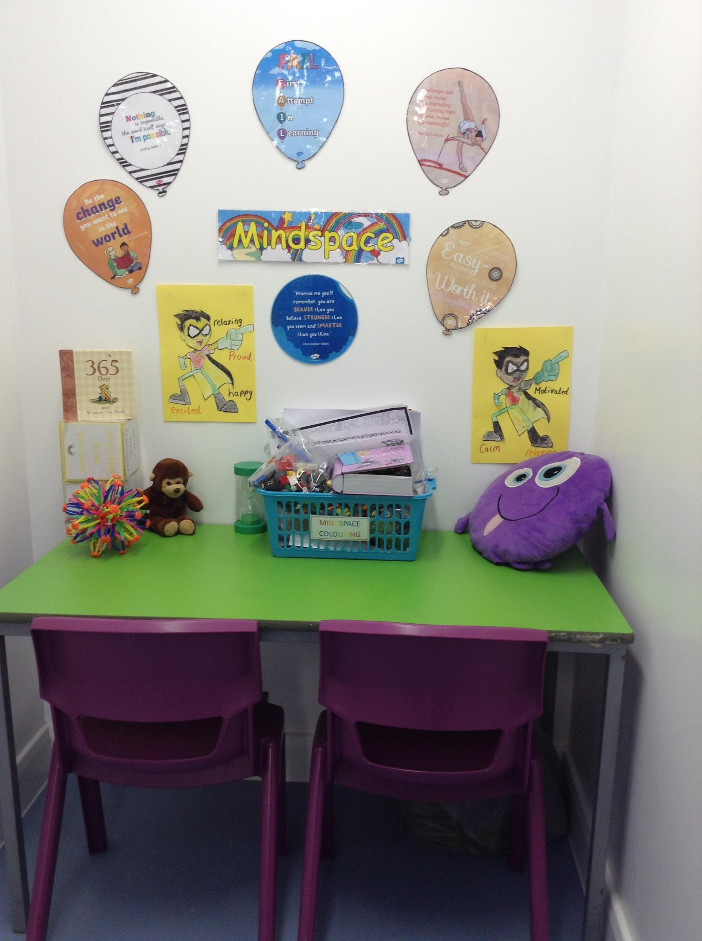
3. Inclusive pedagogy
All the learners at Adswood Primary School receive a broad and balanced PSHE curriculum,
regardless of their age, gender, ability or cultural origin. Teaching is differentiated to take into
account learners’ differing abilities and learning styles.
The school offers an ‘open door’ policy and parents and carers are welcome to come into school at any time to discuss the PSHE and RSE curriculum. The policy, scheme of work and resources are available for parents / carers. Our curriculum and universal provision aim to enable all learners to achieve. The school works collaboratively to equip all learners with the belief, knowledge and cultural capital they need to succeed in the next stage of life.
Support aims to develop independence; targets are ambitious and emotional well-being and enjoyment are paramount. The Inclusion Team operates consistently with a number of school policies to ensure that the social and emotional needs of the individual children are met. Through brief or prolonged interventions, further opportunities for learning through topics within PSHE and citizenship curriculum are achieved. The children are given opportunities at a personal and individual level to explore their experiences, relationships, emotions, values, beliefs and attitudes and gain insight into the lives of others.
4. Learning environment
At Adswood, we pride ourselves on promoting P.S.H.E not only in the classroom but throughout the school. There are several displays promoting our schools core values, restorative approaches, inclusion, mindfulness, environmental awareness and many more. These ever changing displays are adapted frequently to ensure they reflect the current focuses within school. Our interactive ‘Mindspace’ areas outside classrooms encourage children to interact with the displays, reflect on their behaviours and feelings. These areas also have activities for the children to complete to support them in their mindfulness.

Slide 3
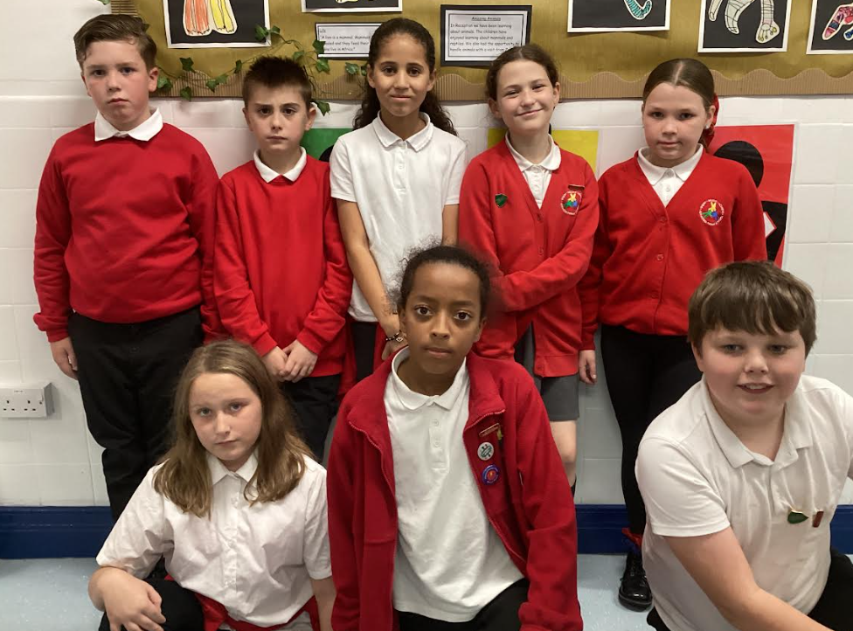
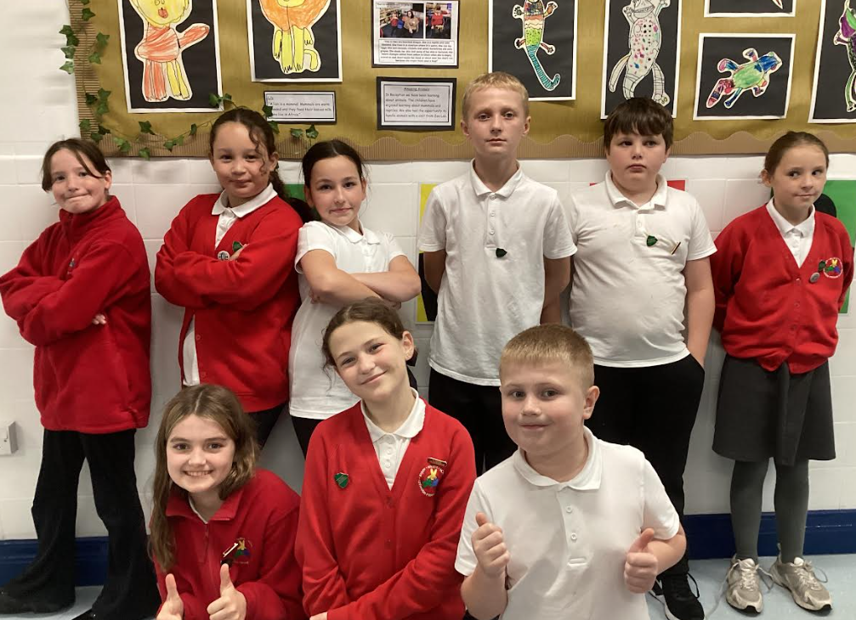
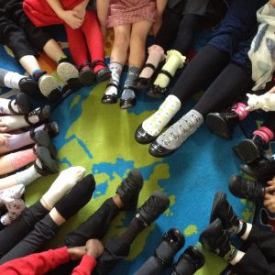
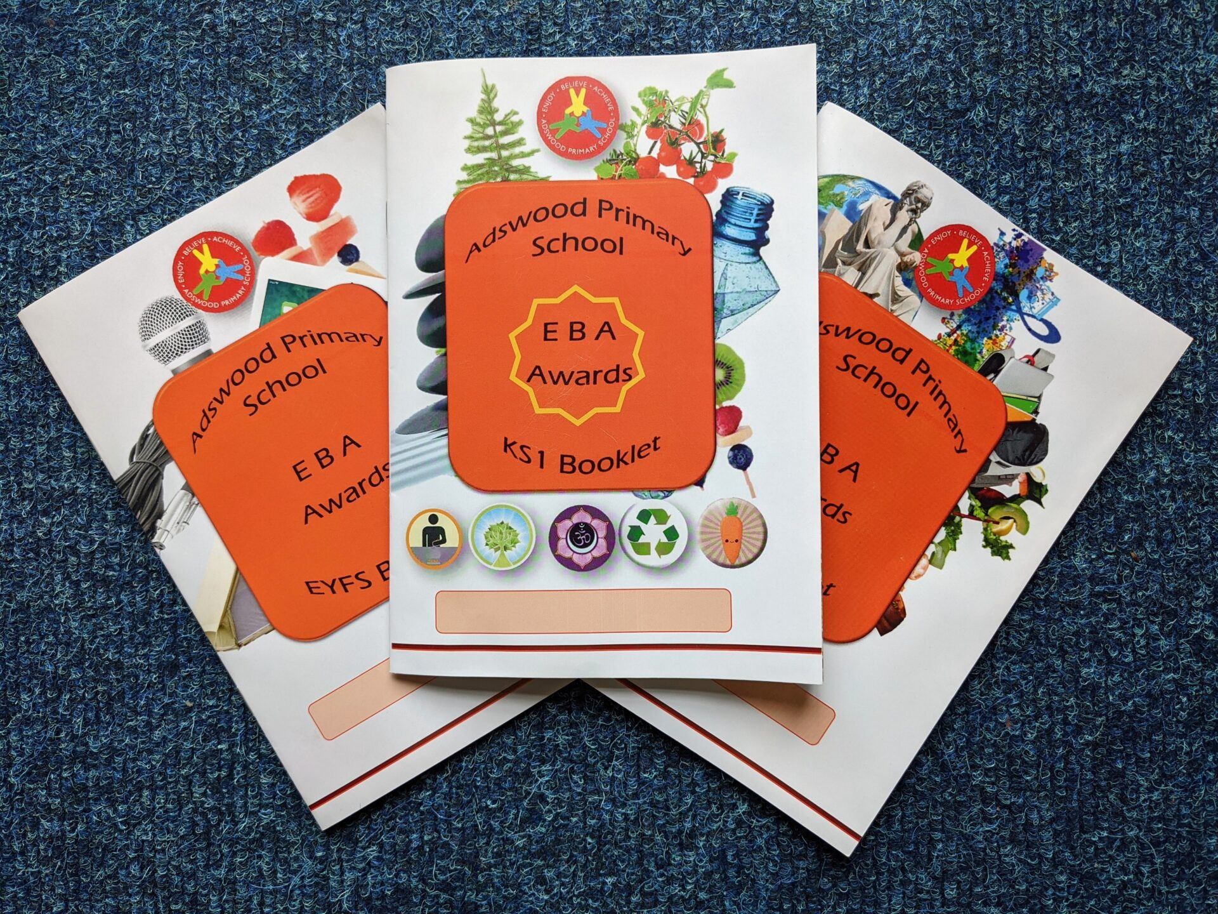
5. Opportunities to celebrate PSHE.
We have many roles and responsibilities that children may apply for within school. These roles are celebrated through assembly where children receive their badges. These badges are worn every day. In addition to this, Always Award badges are a prestigious award that may be awarded by Mrs Smart for children who always make the right choices. We also award daily ‘Star of the Day’ certificates and ‘Star of the Week’ certificates every Friday. We also are awarding a ‘Values
At Adswood Primary, PSHE (Personal, Social, Health and Economic education) is more than just a subject—it’s a part of everyday life. From assemblies and themed weeks to outdoor learning and community projects, pupils have regular opportunities to explore key values like respect, resilience, and responsibility in real-world contexts. Whether through peer mentoring, charity events, or teamwork on the playground, PSHE helps our children grow into confident, caring individuals ready to make a positive impact beyond school.
6. Learning beyond the classroom
One World Week - Our fascinatingly engaging, stimulating and exciting week begins with whole school assemblies of different faiths, cultures and beliefs. We focussed this year on the countries and beliefs within our own classes. We invited parents and family into school to share their cultures with us.
This year’s Anti-Bullying Week in our primary school was a powerful reminder of the importance of kindness, respect, and standing up for one another. With the theme "Make a Noise About Bullying," students took part in engaging activities, thoughtful discussions, and creative projects that encouraged empathy and inclusion. From odd sock day to storytelling sessions and class pledges, our pupils showed that even the smallest voices can make a big difference. Together, we’re building a safer, more supportive school for everyone.

Slide 4
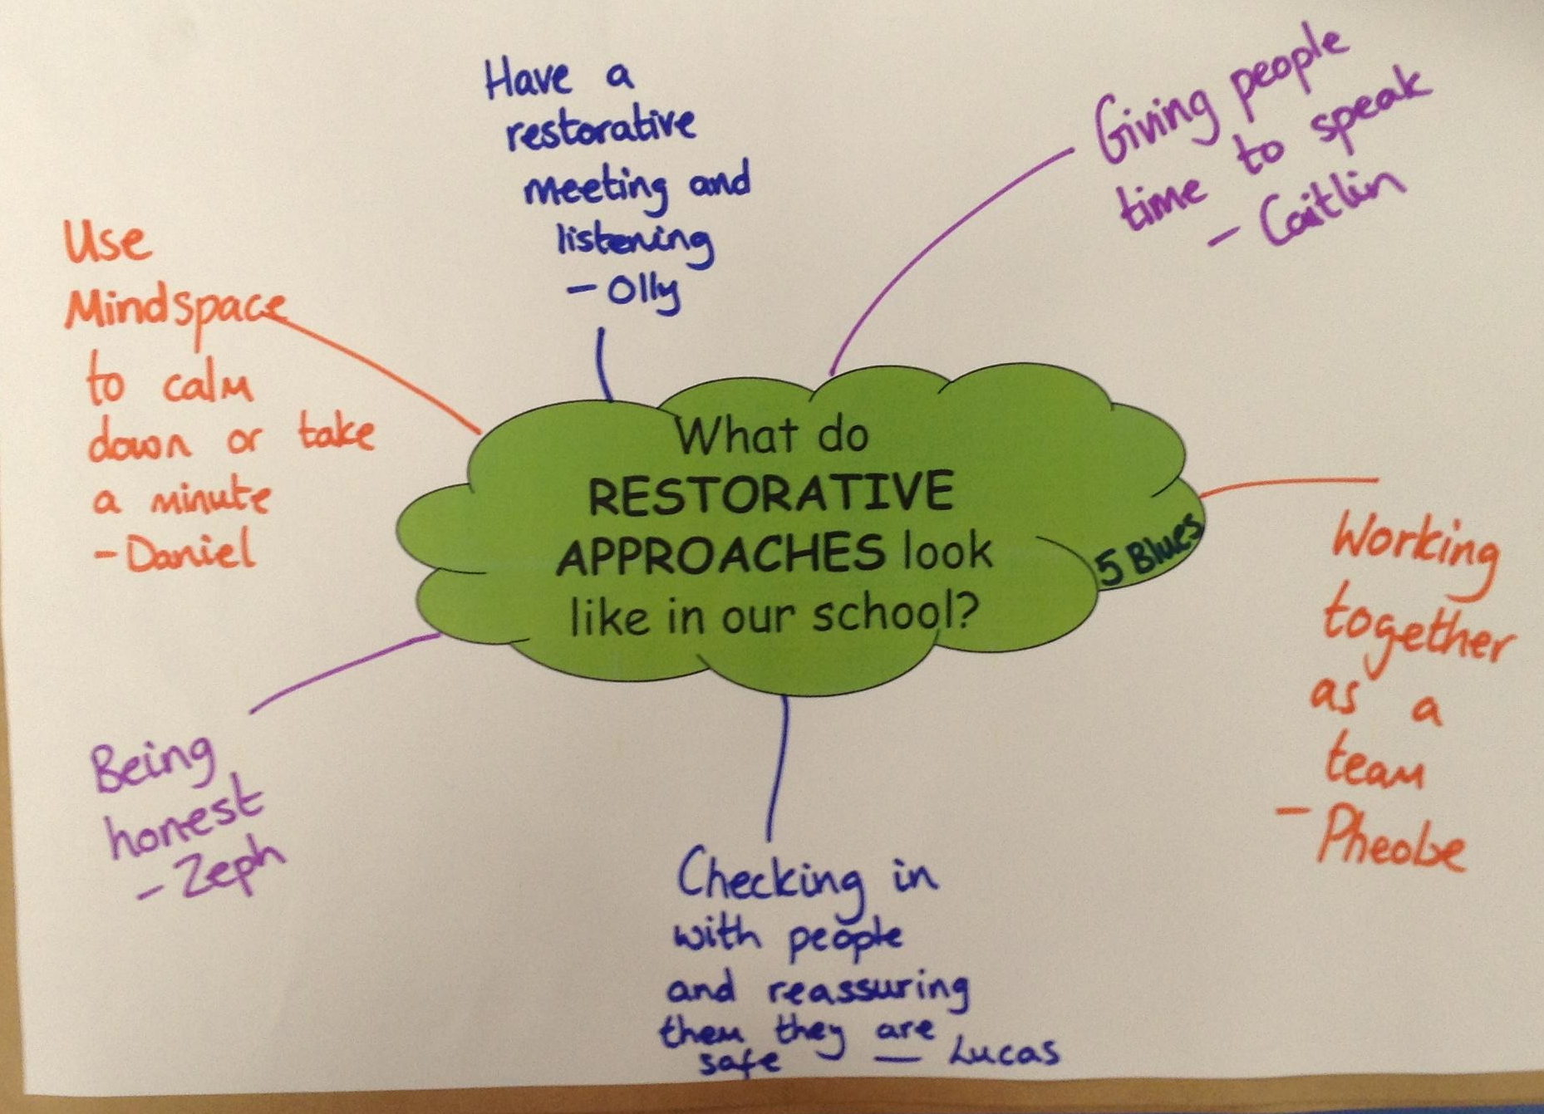
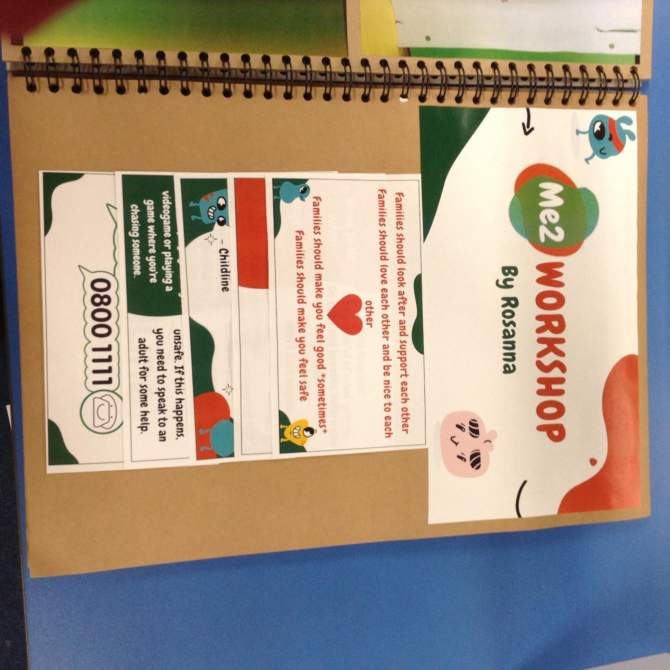
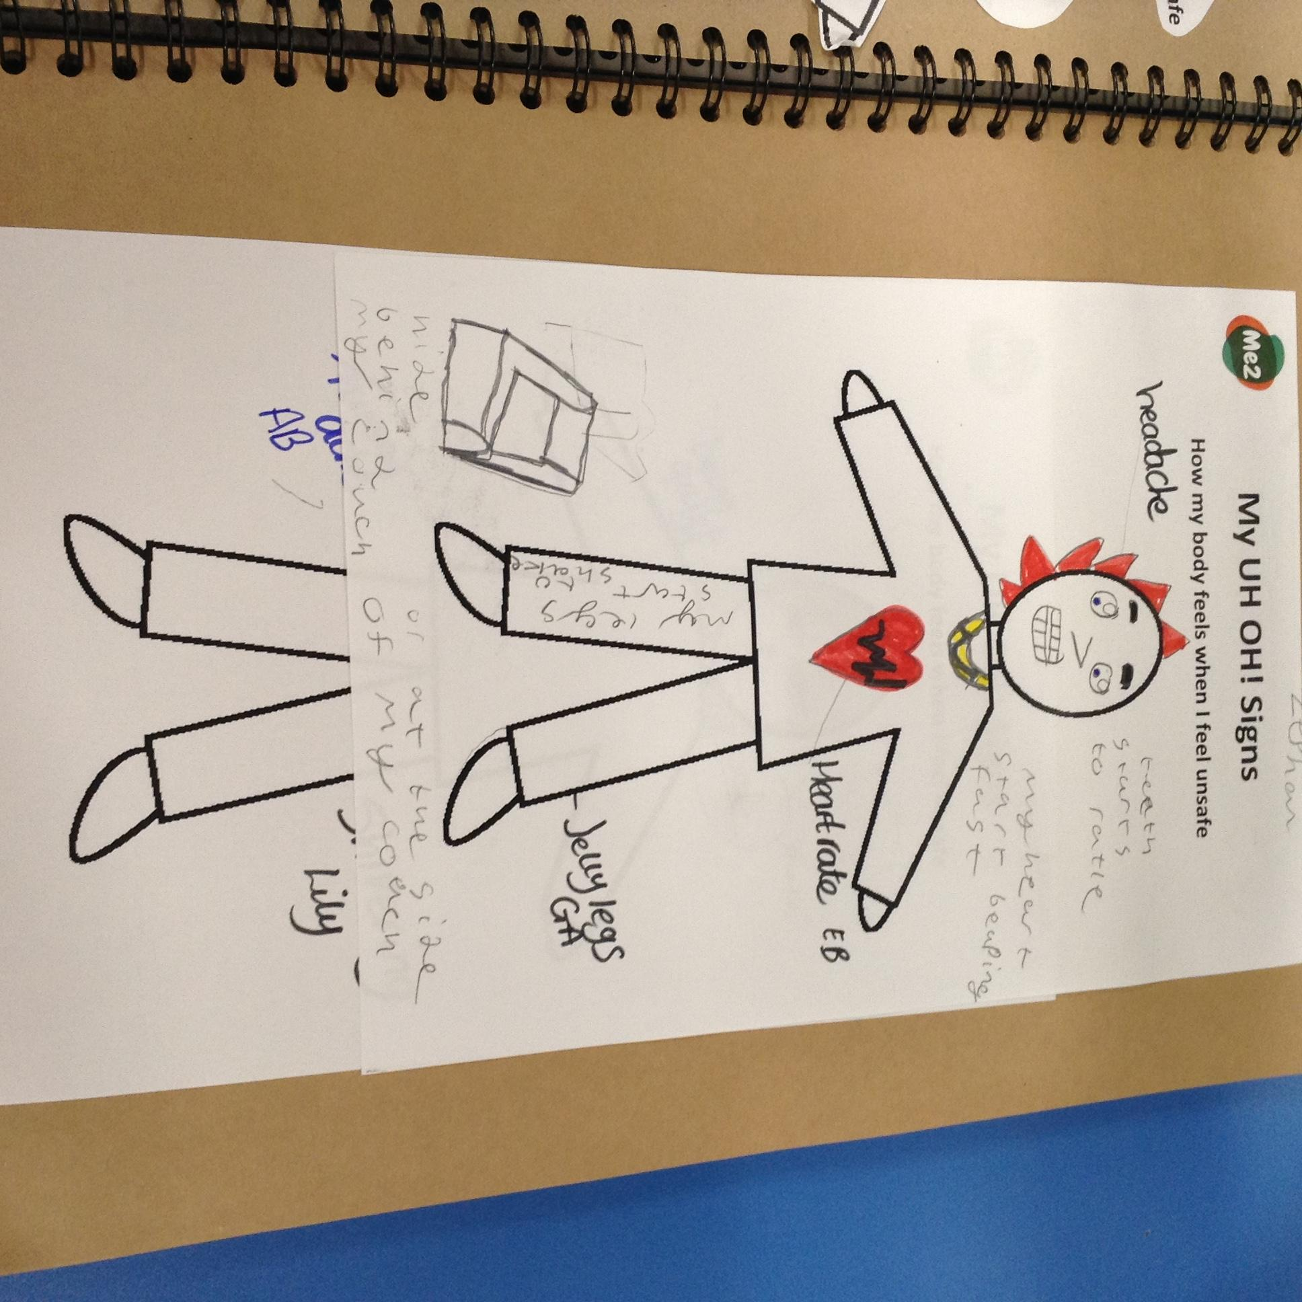
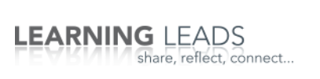

7. Evidence of Learning
One way learning is evidenced in PSHE is through the use of floorbooks. Floorbooks contain images of activities, pupil voice, mind maps of discussions and many other forms of evidence. PSHE can also be evidenced in the voices of the children. Pupil voice is one of the most important ways to evidence PSHE. Hearing children talk about restorative approaches and managing conflicts between themselves evidences for itself how PSHE is established within school.
Staff have access to Learning Leads to join the PSHE Network. The PSHE Network provides staff with resources, insightful journals and reading material and also offers opportunities for staff training. We also have regular staff Safeguarding training, wellbeing staff meetings, ACE’S training and much more to continuously develop their CPD.
8. Staff CPD

